Slide 1
Introduction
What is AI?
The foundations of AI
A brief history of AI
Applications of AI

Slide 2
What is AI?

Slide 3
What is AI?
Intelligence: “ability to learn, understand and think” (Oxford dictionary)

Slide 4
What is AI?
Thinking humanly | Thinking rationally
Acting humanly | Acting rationally

Slide 5



Acting Humanly: The Turing Test
Alan Turing (1912-1954)
“Computing Machinery and Intelligence” (1950)
Imitation Game
Human
Human Interrogator
AI System

Slide 6
Acting Humanly: The Turing Test
Predicted that by 2000, a machine might have a 30% chance of fooling a lay person for 5 minutes.
Anticipated all major arguments against AI in
following 50 years.
Suggested major components of AI: knowledge,
reasoning, language, understanding, learning.

Slide 7
Thinking Humanly: Cognitive Modelling
Not content to have a program correctly solving a problem.
More concerned with comparing its reasoning steps
to traces of human solving the same problem.
Requires testable theories of the workings of the
human mind: cognitive science.

Slide 8
Thinking Rationally: Laws of Thought
Aristotle was one of the first to attempt to codify “right thinking”, i.e., irrefutable reasoning processes.
Formal logic provides a precise notation and rules for representing and reasoning with all kinds of things in the world.
Obstacles:
− Informal knowledge representation.
− Computational complexity and resources.

Slide 9
Acting Rationally
Acting so as to achieve one’s goals, given one’s beliefs.
Does not necessarily involve thinking.
Advantages:
− More general than the “laws of thought” approach.
− More amenable to scientific development than human- based approaches.

Slide 10
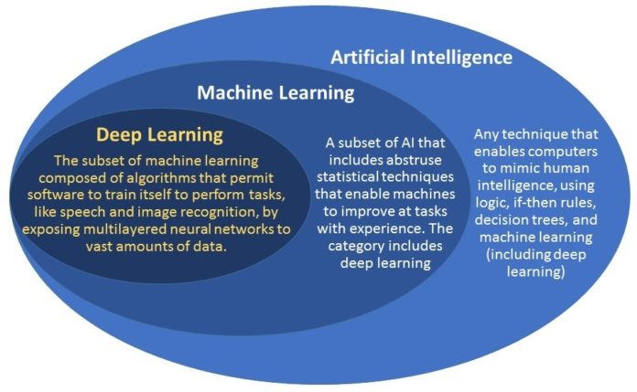
Artificial Intelligence vs Machine Learning

Slide 11
The Foundations of AI
Philosophy (423 BC − present):
− Logic, methods of reasoning.
− Mind as a physical system.
− Foundations of learning, language, and rationality.
Mathematics (800 − present):
− Formal representation and proof.
− Algorithms, computation, decidability, tractability.
− Probability.

Slide 12
The Foundations of AI
Economy (1776− present):
− Decision theory.
− Markov decision processes.
Neuroscience (335 BC− present):
− Nervous system, particularly the brain.
− Algorithms, computation, decidability, tractability.
− Probability.

Slide 13
The Foundations of AI
Psychology (1879 − present):
− Adaptation.
− Phenomena of perception and motor control.
− Experimental techniques.
Linguistics (1957 − present):
− Knowledge representation.
− Grammar.


Slide 14
The Foundations of AI
Computer engineering (1940− present):
− Adaptation.
− Phenomena of perception and motor control.
− Experimental techniques.
Control theory and cybernetics (250 BC − present):
− Knowledge representation.
− Grammar.


Slide 15
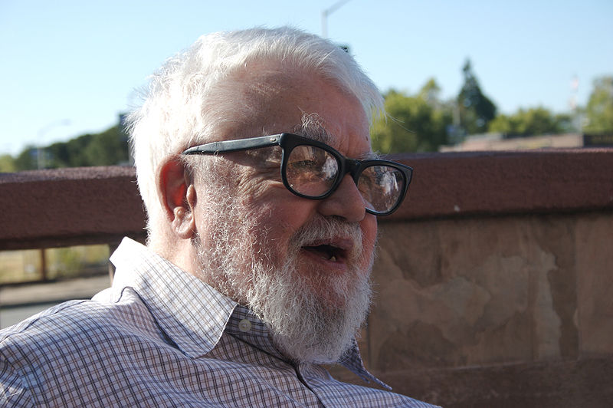
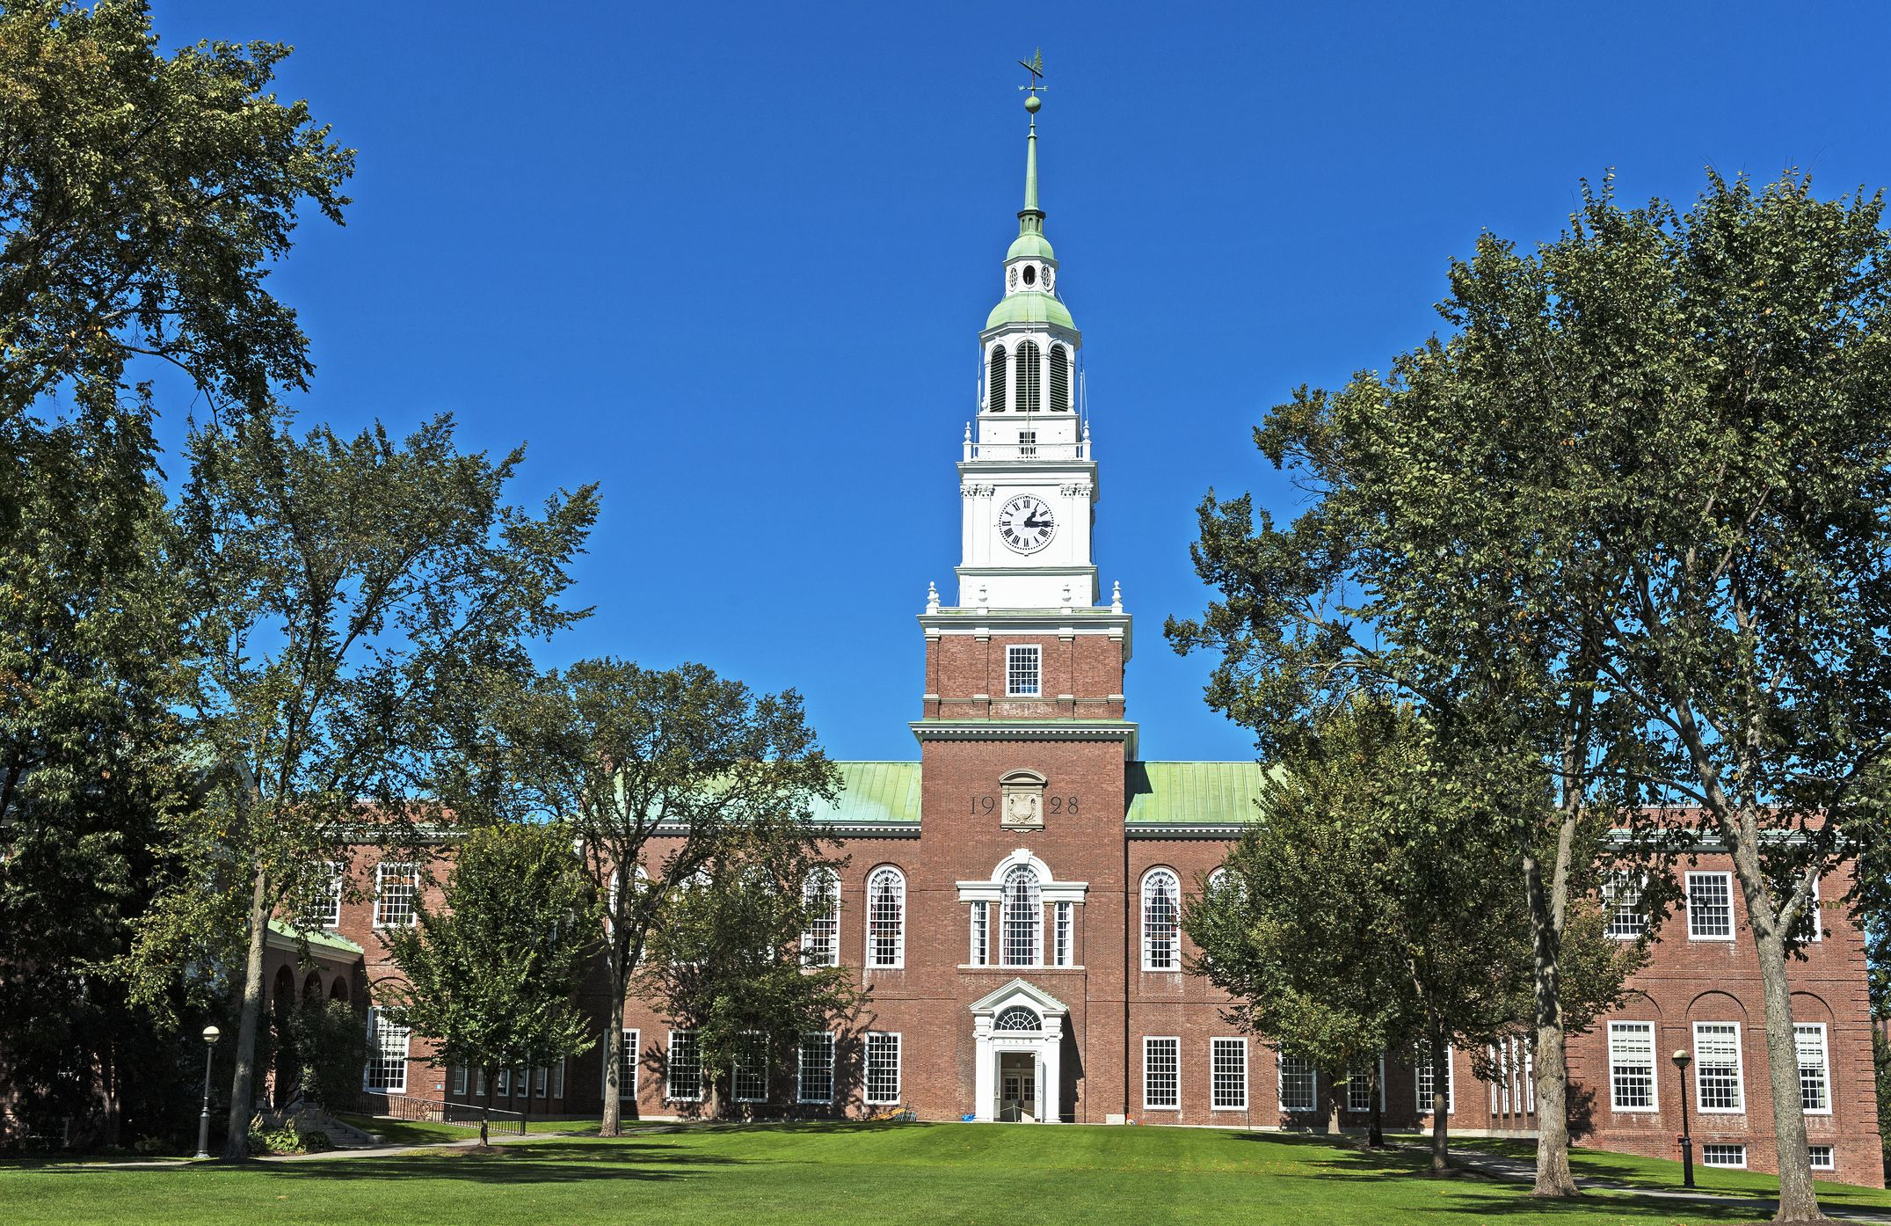
A Brief History of AI
Birth of AI (1956)
  Workshop at Dartmouth College; attendees: John McCarthy, Marvin Minsky, Claude Shannon, etc.
  Aim for general principles: “Every aspect of learning or any other feature of intelligence can be so precisely described that a machine can be made to simulate it.”
John McCarthy (1927 – 2011)
Computer scientist
Dartmouth College

Slide 16
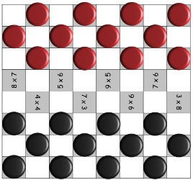
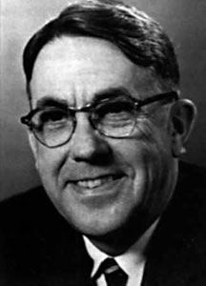
A Brief History of AI
1960: checkers playing program, Logical Theorist
  Alpha-beta pruning
  Minimax

Checkers board
Arthur Samuel (1901-1990)
Electrical Engineering – Computer Scientist
Notes:
ALPAC (Automatic Language Processing Advisory Committee) was a committee of seven scientists led by John R. Pierce, established in 1964 by the United States government in order to evaluate the progress in computational linguistics in general and machine translation in particular. Its report, issued in 1966, gained notoriety for being very skeptical of research done in machine translation so far, and emphasizing the need for basic research in computational linguistics; this eventually caused the U.S. government to reduce its funding of the topic dramatically.
Sir Michael James Lighthill, FRS^{[1]} (23 January 1924 – 17 July 1998) was a British applied mathematician, known for his pioneering work in the field of aeroacoustics
The Lighthill report is the name commonly used for the paper "Artificial Intelligence: A General Survey" by James Lighthill, published in Artificial Intelligence: a paper symposium in 1973.^{[1]}
Published in 1973, it was compiled by Lighthill for the British Science Research Council as an evaluation of the academic research in the field of artificial intelligence. The report gave a very pessimistic prognosis for many core aspects of research in this field, stating that "In no part of the field have the discoveries made so far produced the major impact that was then promised".

Slide 17
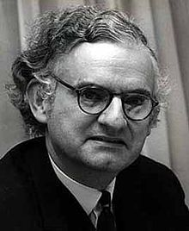
A Brief History of AI
1966: ALPAC report cuts off funding for translation
1974: Lighthill report cuts off funding in UK
  “In no part of the field have the discoveries made so far produced the major impact that was then promised"

Sir Michael James Lighthill (1924-1998)
Applied Mathematician
Notes:
ALPAC (Automatic Language Processing Advisory Committee) was a committee of seven scientists led by John R. Pierce, established in 1964 by the United States government in order to evaluate the progress in computational linguistics in general and machine translation in particular. Its report, issued in 1966, gained notoriety for being very skeptical of research done in machine translation so far, and emphasizing the need for basic research in computational linguistics; this eventually caused the U.S. government to reduce its funding of the topic dramatically.
Sir Michael James Lighthill, FRS^{[1]} (23 January 1924 – 17 July 1998) was a British applied mathematician, known for his pioneering work in the field of aeroacoustics
The Lighthill report is the name commonly used for the paper "Artificial Intelligence: A General Survey" by James Lighthill, published in Artificial Intelligence: a paper symposium in 1973.^{[1]}
Published in 1973, it was compiled by Lighthill for the British Science Research Council as an evaluation of the academic research in the field of artificial intelligence. The report gave a very pessimistic prognosis for many core aspects of research in this field, stating that "In no part of the field have the discoveries made so far produced the major impact that was then promised".

Slide 18
A Brief History of AI
1970-80s: expert system XCON in industry
  written in OPS5 by John P. McDermott of CMU in 1978
  used in DEC’s plant in 1980
1982: Fifth-Generation Computer System (Japan)
  aimed to create an "epoch-making computer"
Strategic Computing Initative (DARPA - US)
  spent a total of $1 billion on chip design and manufacture, computer architecture to artificial intelligence software (1983 – 1993)
Notes:
XCON first went into use in 1980 in DEC's plant in Salem, New Hampshire. It eventually had about 2500 rules. By 1986, it had processed 80,000 orders, and achieved 95-98% accuracy. It was estimated to be saving DEC $25M a year by reducing the need to give customers free components when technicians made errors, by speeding the assembly process, and by increasing customer satisfaction.
It aimed to create an "epoch-making computer" with supercomputer-like performance and to provide a platform for future developments in artificial intelligence. There was also an unrelated Russian project also named as a fifth-generation computer (see Kronos (computer)).

Slide 19
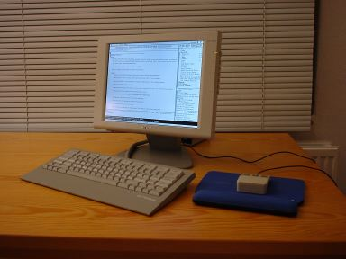
A Brief History of AI
1987: collapse of Lisp market, government funding cut

Lisp machine
Notes:
Corporations around the world began to develop and deploy expert systems and by 1985 they were spending over a billion dollars on AI, most of it to in-house AI departments. An industry grew up to support them, including software companies like Teknowledge and Intellicorp (KEE), and hardware companies like Symbolics and Lisp Machines Inc. who built specialized computers, called Lisp machines, that were optimized to process the programming language Lisp, the preferred language for AI.^{[27]}
In 1987, three years after Minsky and Schank's prediction, the market for specialized AI hardware collapsed. Workstations by companies like Sun Microsystems offered a powerful alternative to LISP machines and companies like Lucid offered a LISP environment for this new class of workstations. The performance of these general workstations became an increasingly difficult challenge for LISP Machines. Companies like Lucid and Franz Lisp offered increasingly more powerful versions of LISP. For example, benchmarks were published showing workstations maintaining a performance advantage over LISP machines.^{[28]}Later desktop computers built by Apple and IBM would also offer a simpler and more popular architecture to run LISP applications on. By 1987 they had become more powerful than the more expensive Lisp machines. The desktop computers had rule-based engines such as CLIPS available.^{[29]} These alternatives left consumers with no reason to buy an expensive machine specialized for running LISP. An entire industry worth half a billion dollars was replaced in a single year.^{[30]}

Slide 20
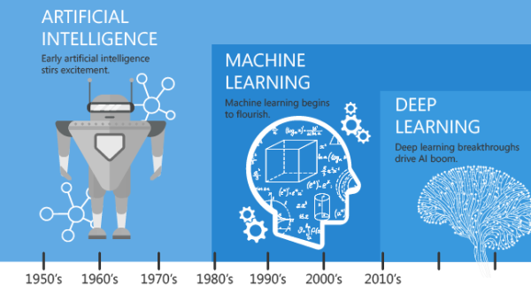
A Brief History of AI
1990: rise of machine learning
2010s: heavy industry investment in deep learning

Slide 21
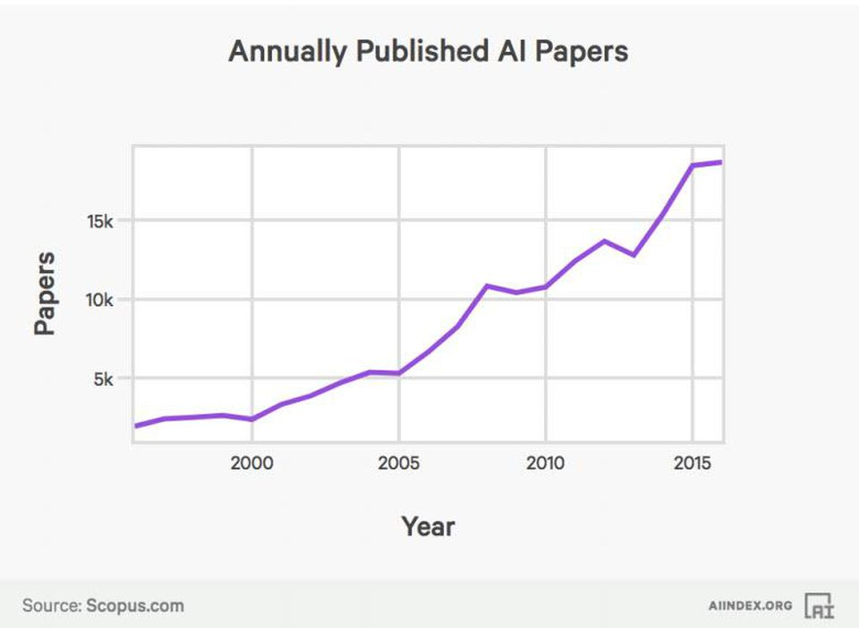
The growth of AI in Research

Slide 22
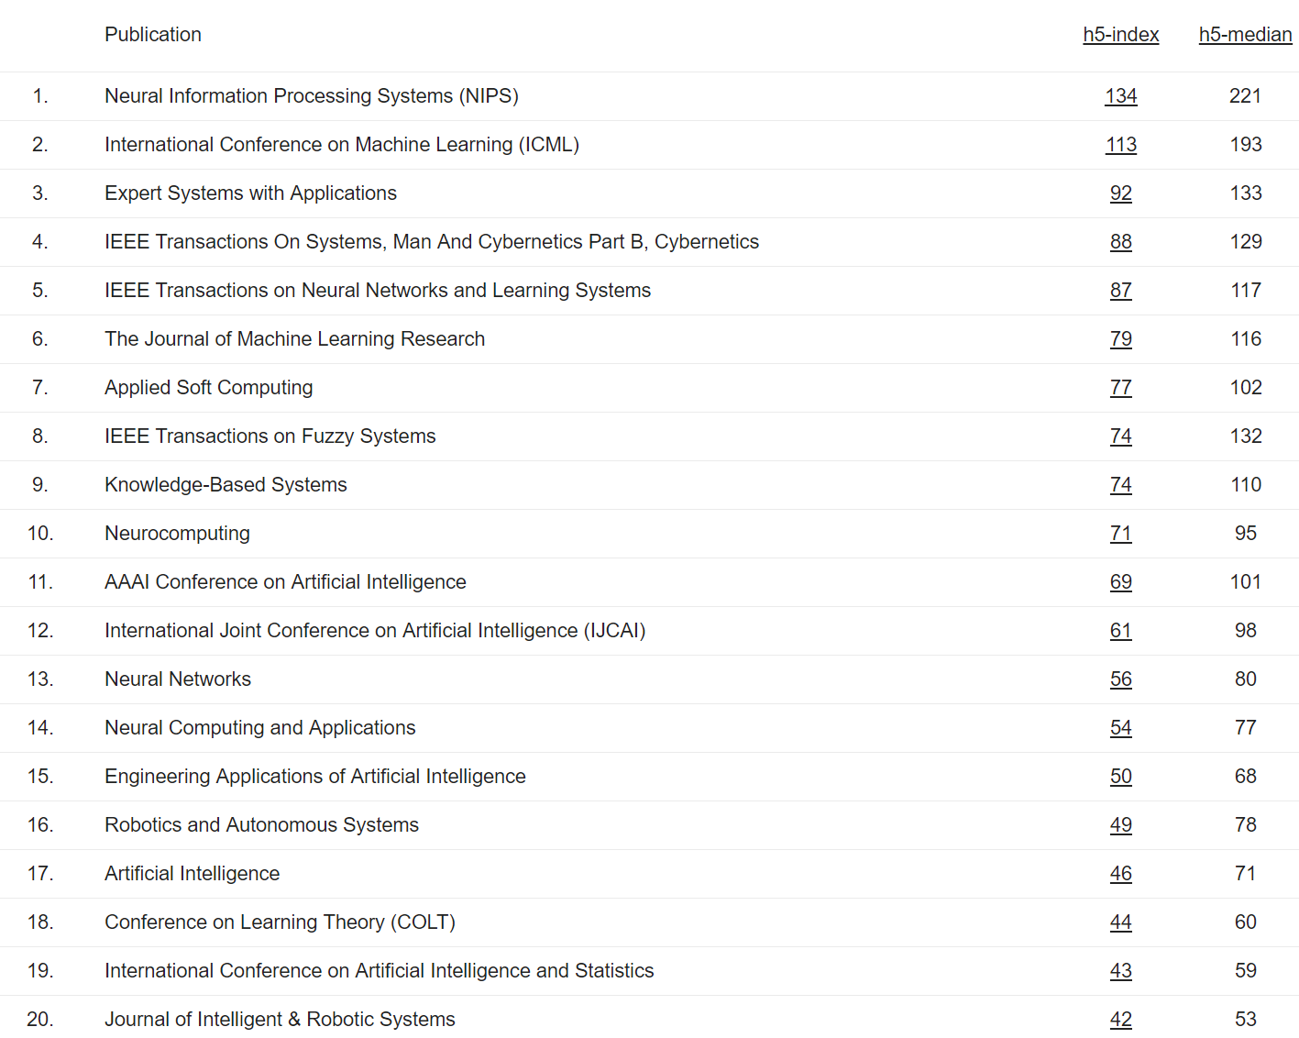

Slide 23
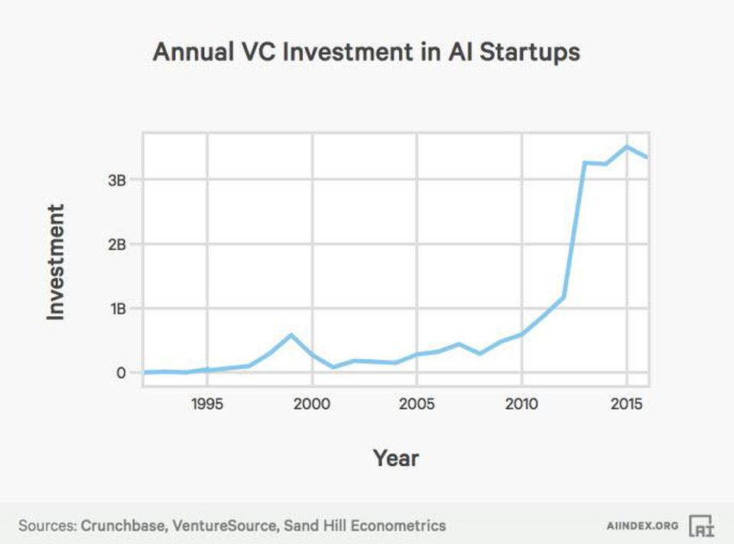
The growth of AI in Industry

Slide 24
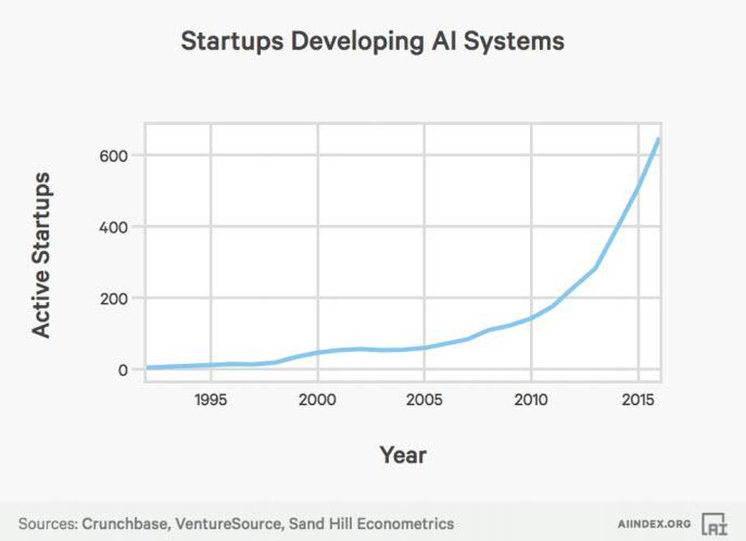
The growth of AI in Industry

Slide 25
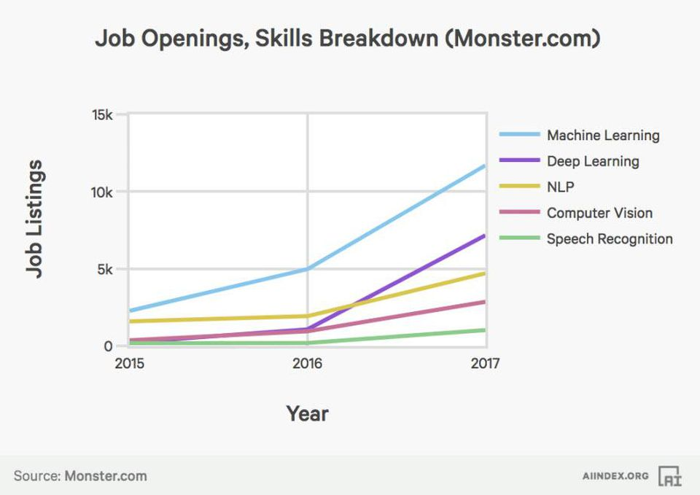
Job skill requirements

Slide 26



Companies
“An important shift from a mobile first world to an AI first world” [CEO Sundar Pichai @ Google I/O 2017]
Created AI and Research group as 4th engineering division, now 8K people [2016]
Created Facebook AI Research, Mark Zuckerberg very optimistic and invested
Others: IBM, Amazon, Apple, Uber, Salesforce, Baidu, Tencent, etc.

Slide 27
Application of AI
Speech recognition
Language translation
Game playing
Logistics and Supply Chain
Self-driving Car
AI in Medicine

Slide 28

Speech recognition

Slide 29

Machine Translation

Slide 30

Logistics and Supply Chain

Slide 31

Game playing

Slide 32
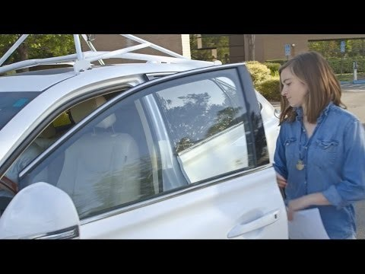
Self-driving Car

Slide 33
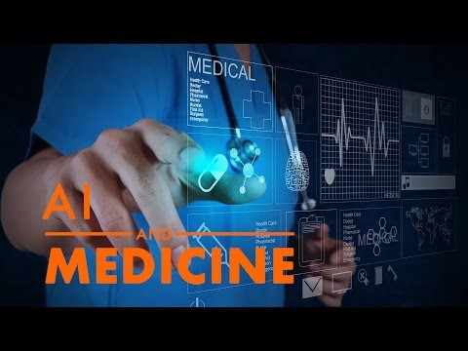
AI in Medicine

Slide 34
Content
Search
Markov decision processes
Game playing
Constraint satisfaction problems
Bayesian networks
Logic
Machine learning
Conclusion

Slide 35
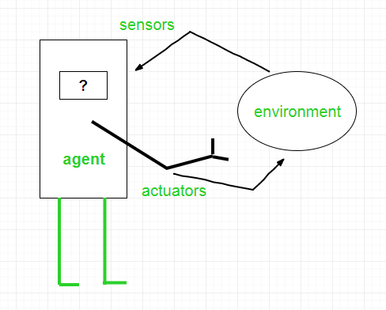
What is AI?
https://www.geeksforgeeks.org/agents-artificial-intelligence/

Slide 36
Basic Terminology
Fully vs Partial Observable
Deterministic vs Stochastic
Discrete vs Continuous
Benign vs Adversarial

Slide 37
Homework
Read chapter 1 “Artificial Intelligence - A Modern Approach”

