Slide 1
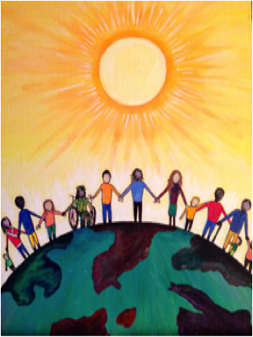
Trauma Resource Institute
Group Project Proposal Group 3: Daniel Robles, Jennyfer Aguirre, Lucynda Young & Matthew Melger

Slide 2

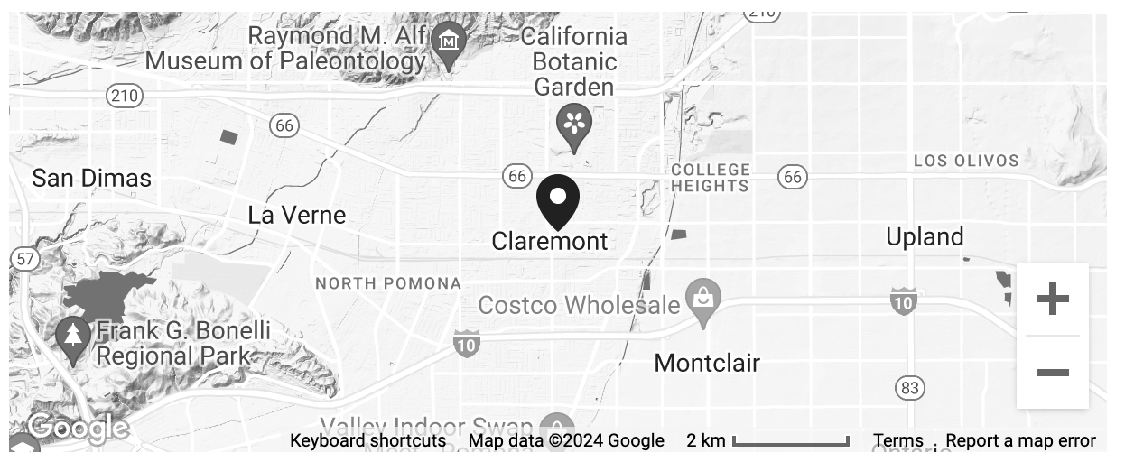
History & Mission
The Trauma Resource Institute (TRI) is a non-profit organization that empowers global communities by promoting healing and resiliency through trauma education. Their mission is rooted in neuroscience and body wisdom, fostering change by training individuals in accessible, affordable, and adaptable practices. They believe every person has natural resilience, and trauma recovery should be gentle, effective, and culturally sensitive. TRI emphasizes making trauma education and treatment available, building community strength by empowering local leaders, and reducing reliance on external experts.
Location
427 N. Yale Ave., #202 Claremont, CA 91711

Slide 3
Business Objectives
Project Objectives
Generate sign-ups for their certification classes
Educate people and communities about the two models and functionality
Destigmatize asking for help and teaching others how to become better and stronger individuals
Project Objective 1
Project Objective 2
Project Objective 3

Slide 4
Methods to be used to achieve project objectives

Slide 5
Methods to be used to achieve project objectives

Slide 6
A Mockup Deliverable

Slide 7
A Mockup Deliverable

Slide 8
Timeline and Deliverable

Slide 9
Thank You

