Slide 1
Publication Influence
An Exploratory Analysis by Ilya Getsin

Slide 2
Background
The goal of this project is to understand the penetration of publications and what drives scientific relevance.
The citation data was extracted from DBLP, ACM, MAG (Microsoft Academic Graph), and other sources. It is available on this website. The version used was the 13th version. It contains 5,354,309 papers and 48,227,950 citation relationships. Each paper is associated with abstract, authors, year, venue, and title.
Due to original JSON file being corrupted, the size of the file, and hardware limits on computer, the analysis was limited to the first 1.5 million publications.

Slide 3
Questions
General Data
Amount of journal releases over the number of years
Citation Distribution?
How much has no or negligible citations (i.e. low impact journals)?
This would assume either 0 citations and/or no author
What percentage is this of total?
Of the non-penetrating citations - who are the top publishers?
Look at Authors and Venues
Do they have a common area or tend to use a specific keyword?

Slide 4
Questions (cont)
Focused Data
Limit the citations to be something considered influential. 10 or more citations is considered to be solid.
Check the distribution of citations. It should be heavily focused to one-side
What are the top ten venues, authors and keywords?
Of the Top 10 everything - what is the distribution of citations for each?
Is there a difference between the #1 and #10 source? What about #5 and #10?
Repeat for each venue, authors, keywords
Is there a statistically significant difference between the #1 venue and #1 author?

Slide 5
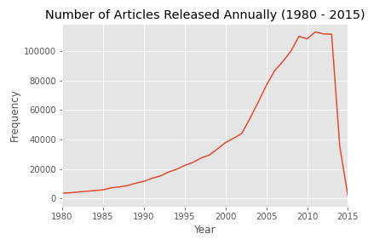
When were the publications released?
Purpose: identify when all publications were released.
Most concentrated timeframe:
1995 - 2013

Slide 6
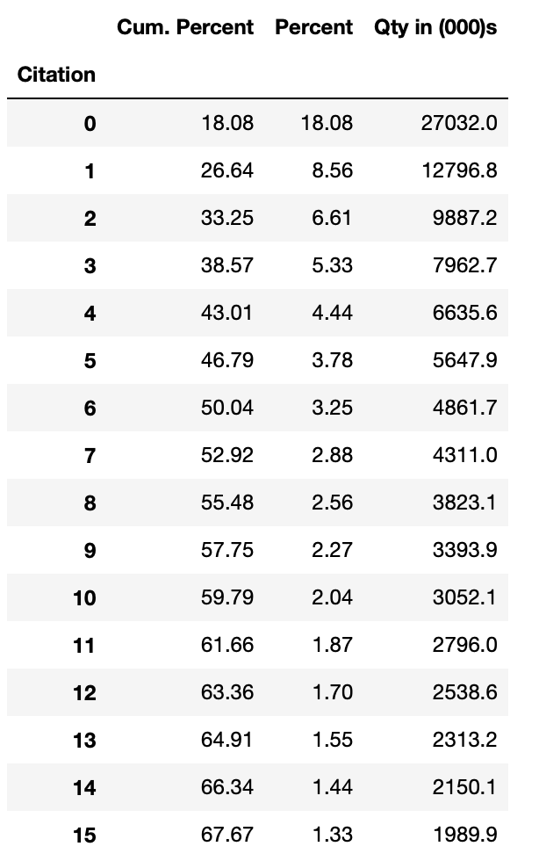
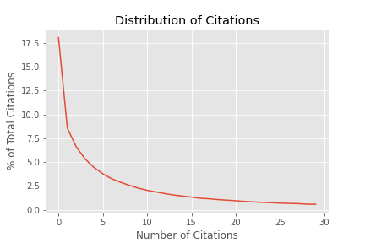
How Do Publications Differ by Number of Citations?
Around 60% of all publications have less than 10 citations

Slide 7
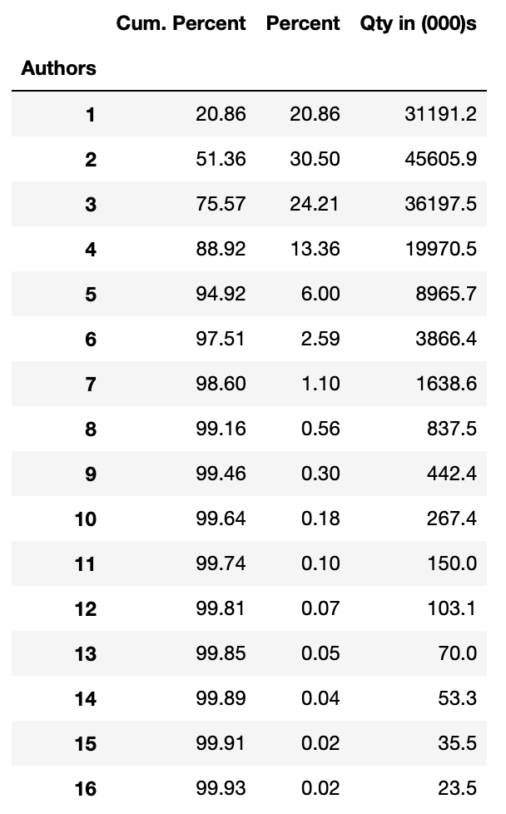
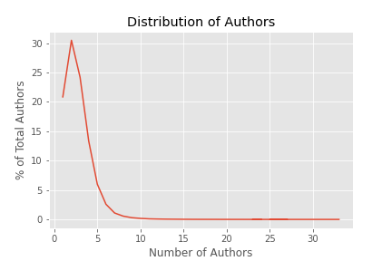
How Do Publications Differ by Number of Authors?
Around 75% of all publications have three authors or less

Slide 8
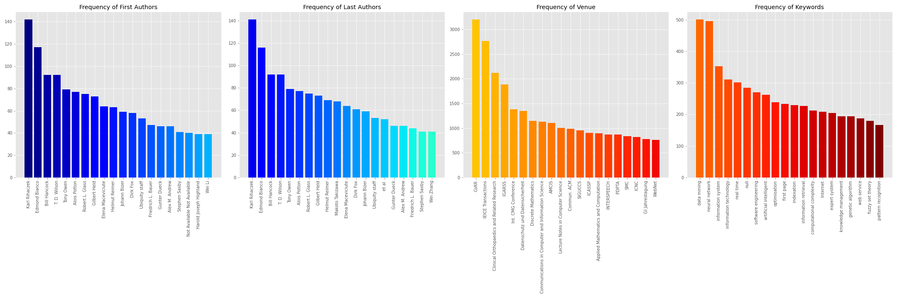
Non Influential Publications (0 Citations)
Most of the authors were both the first and last author signifying that they were the only author coupled with most of their publications were limited to one venue. >90%.
CoRR, IEICE and Clinical Orthopaedics and Related Research are top locations for submissions.
Top Keywords are data mining and neural networks

Slide 9
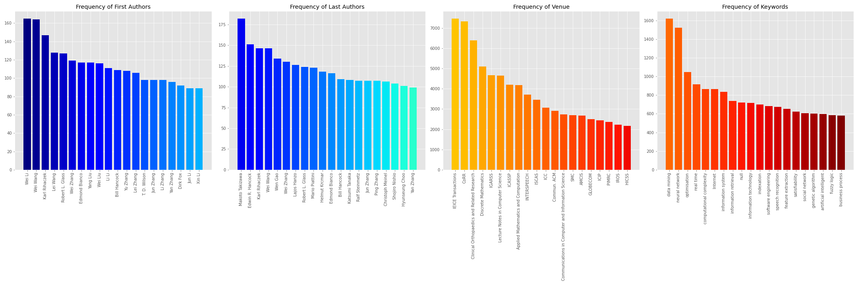
Non Influential Publications (<10 Citations)
No major changes from the 0 citations but there are more researchers that aren’t single authors.

Slide 10
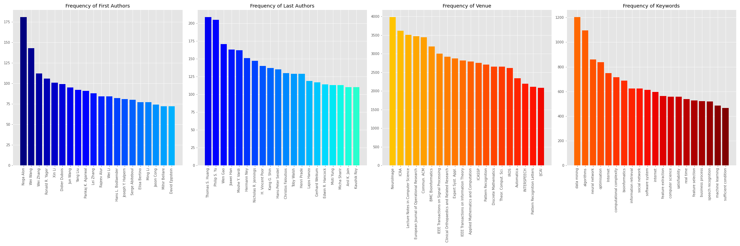
Influential Publications (>10 Citations)
Most non-influential candidates dropped off other than in a few cases such as Authors like Wei Wang and Wei Li.
First keyword still remained data mining and neural networks which highlights all the interest and research efforts centered in this area.
The most influential authors tended to submit to a multitude of journals and have more authors that would lend credence.

Slide 11
1st Hypothesis Tests
Null Hypothesis
There is no intergroup difference between all the most prolific Authors, Venues or Keywords
Alternate Hypothesis
There is an intergroup difference between the Authors, Venues or Keywords
Each Hypothesis is independent of one another and will run with an alpha of 0.005.
Since this is testing the same data several times, a bonferroni correction was applied
The test used is the Mann Whitney U in which in checks if the publication is significanticantly greater than the other.

Slide 12
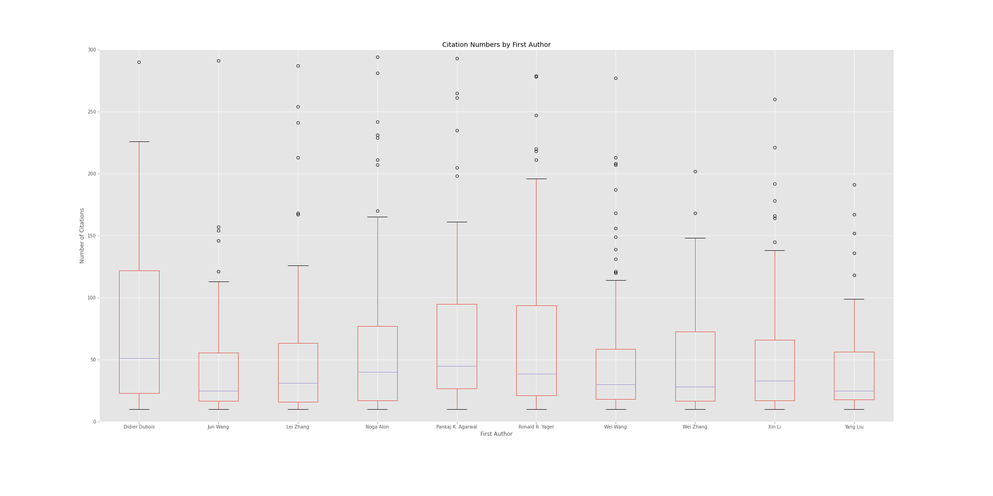
Intergroup Reference for Most Prolific Last Author

Slide 13
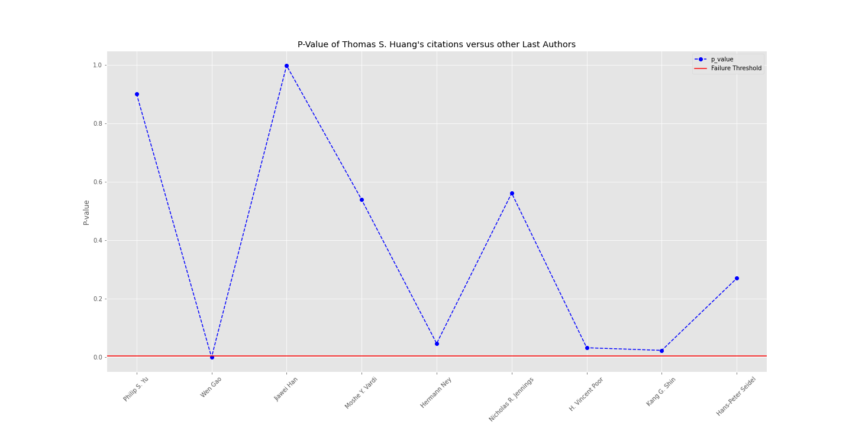
Intergroup Reference for Most Prolific Last Author

Slide 14
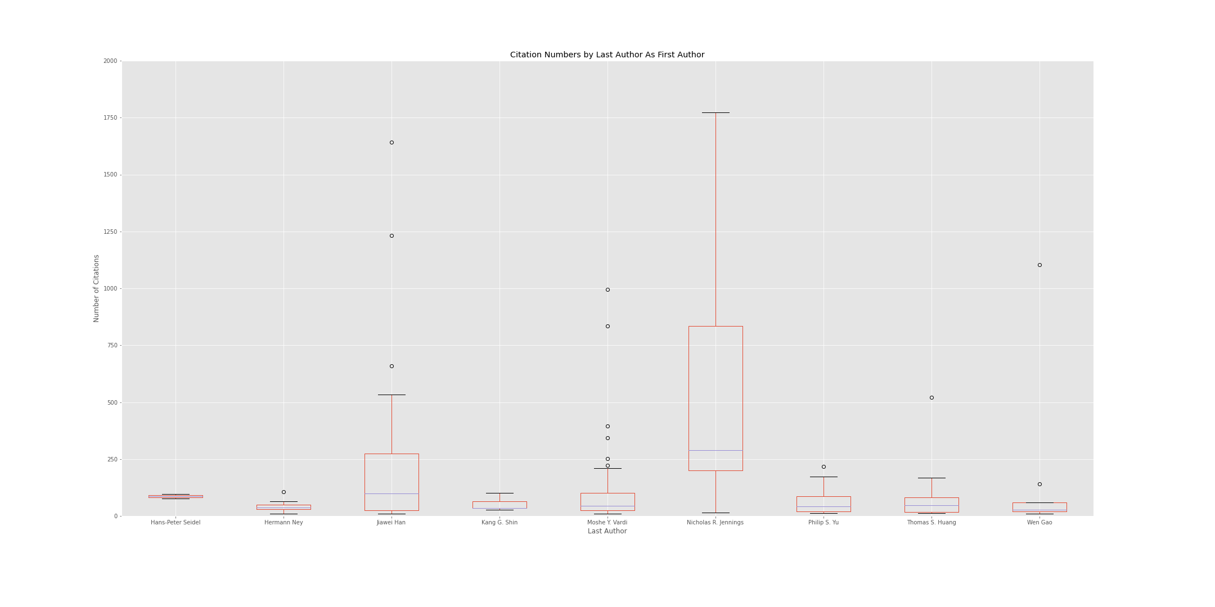
Intergroup Ref for Most Influential Author As First Author

Slide 15
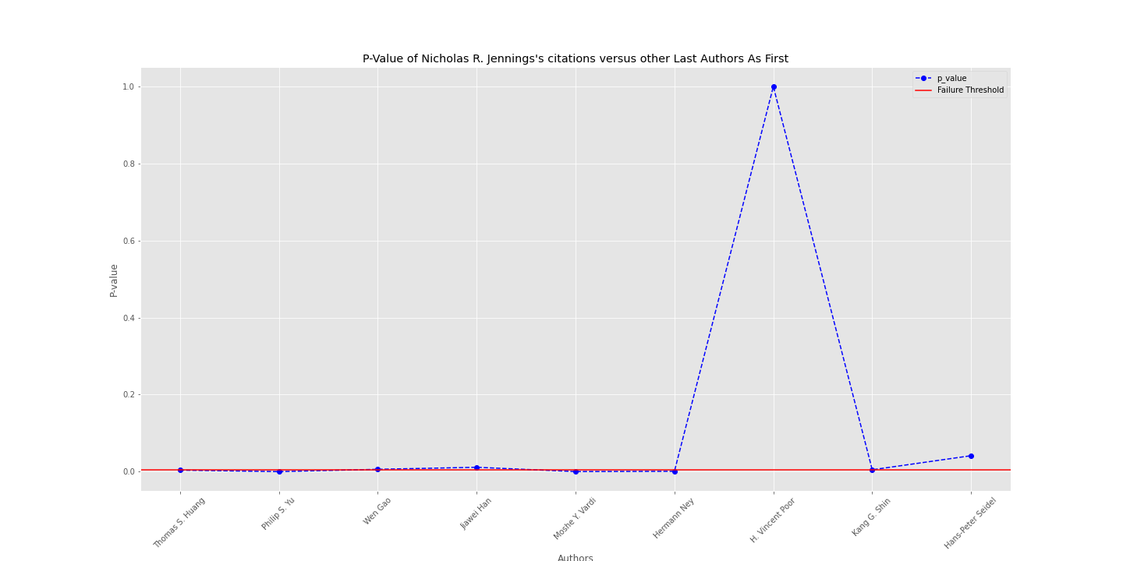
Intergroup Ref for Most Influential Author As First Author

Slide 16
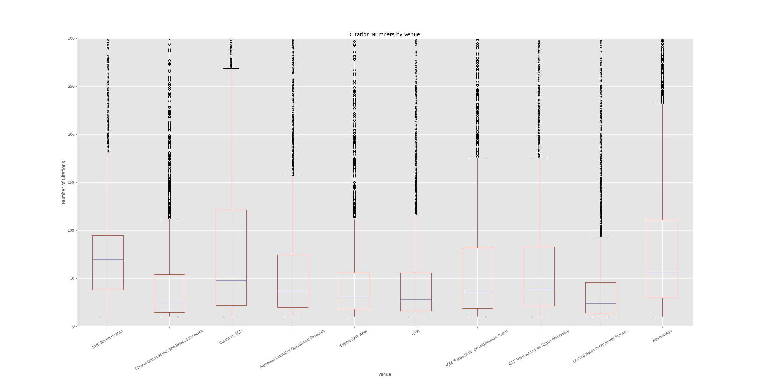
Intergroup Reference for Most Prolific Venue

Slide 17
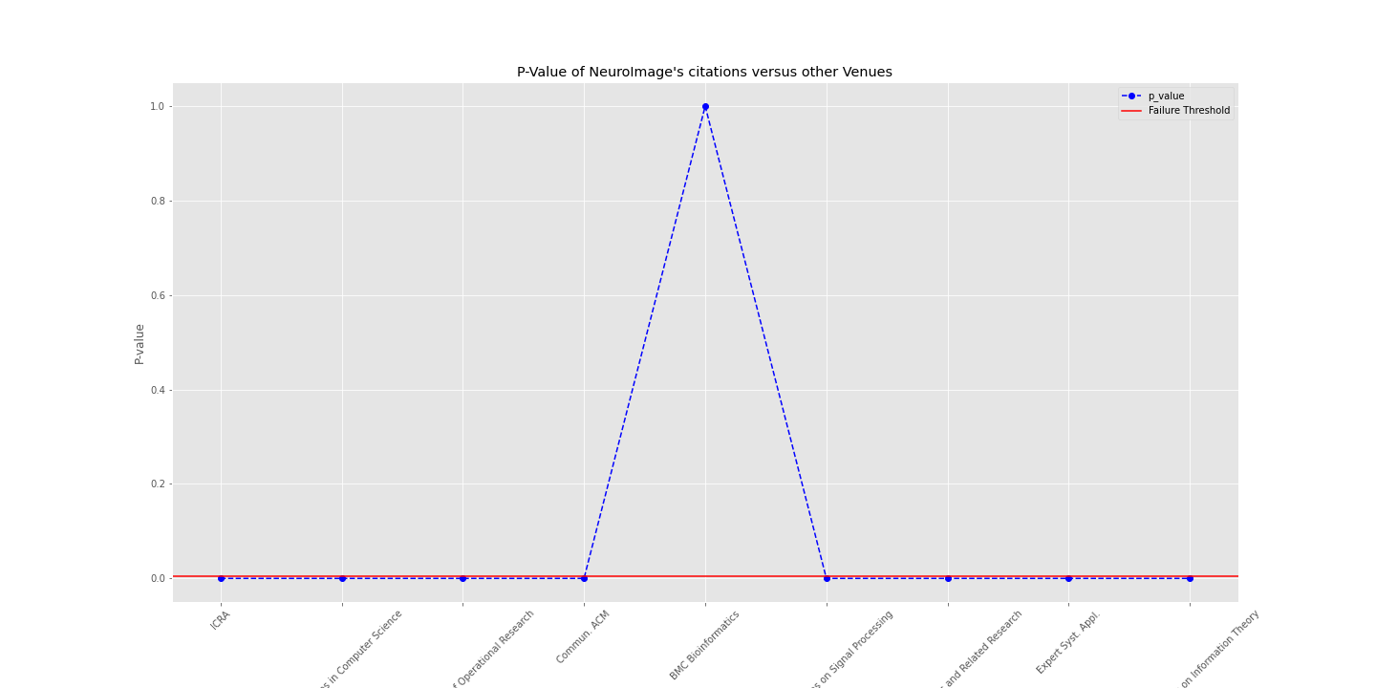
Intergroup Reference for Most Prolific Venue

Slide 18
1st Hypothesis Results
Majority of authors, keywords and venues did not have a statistically significant inference that they had greater influence or penetration
Last Authors tend to be Principal Investigators of Labs and ones that are prolific tend to have greater saturation and expediency than other versus the opposite.
The most prolific venue did have multiple significant difference where it is greater. Only BMC Informatics have similar penetration.
Authors who have more influence tend to publish in a wide variety of journals versus concentrating in one area

Slide 19
2nd Hypothesis Test
Null Hypothesis
There is no difference between all the most prolific Author and Venue
Alternate Hypothesis
There is an intragroup difference between the Author and Venue
Alpha used is 0.05.
The test used is the two-sided t-test with a Welsh Correction

Slide 20
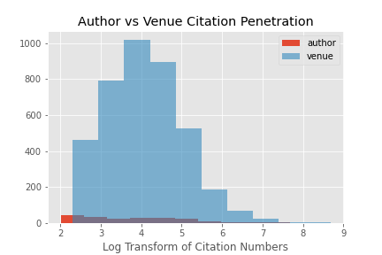
Most Prolific Author vs Prolific Venue
Reject with p-value of 0.043.
Means that the venue has more of an impact on relevancy than the author.

Slide 21
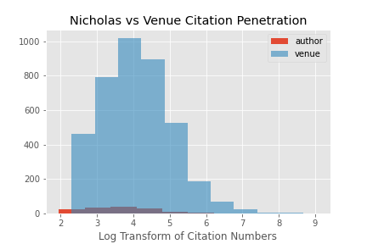
Most Influential Author vs Prolific Venue
Unable to reject with p-value of 0.248.
Means some authors can have an influence but bias is for venue.

Slide 22
Conclusion
Prolific Venues are statistically more important to ensure a publication is influential; however, there are specific cases in which the Author will have as much clout.
This data is limited to mid-2000s range and to heavy computer science publications.

Slide 23
Next Steps
Expand on the data currently done
Use all 5 Million rows
Group by specific keyword to see what kind of trends originated by keyword
Look deeper into the abstract and see if we can glean any insights
Remove duplicates of venues
See the full data on github!

