Slide 1
House Prices – Advanced Regression Techniques
Mentor: ThucHK, HoangBV4
Mentees: DatTPQ, ChungHB

Slide 2
Agenda
Overview
Dataset
Data processing
Exploratory Data Analysis (EDA)
Feature engineering
Model and Result
Demo

Slide 3
1. Overview

Slide 4

Overview
House Price Prediction
Predict house price based on 79 explanatory variables describing (almost) every aspect of residential homes in Ames.
Practice skills:
Creative feature engineering
Advanced regression techniques like gradient boosting

Slide 5
2. Dataset

Slide 6
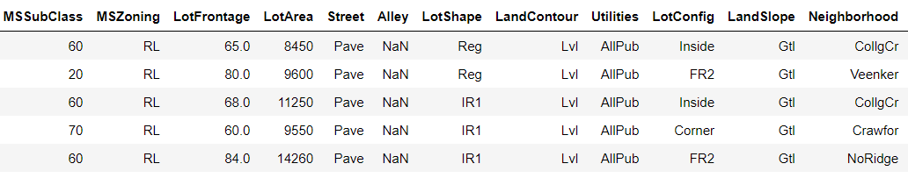

Dataset
Training set: 1460 samples
Testing set: 1459 samples (no SalePrice)
Features: YearBuilt, YearSold, KitchenQuality, GarageArea, 1stFlrSF, 2ndFlrSF, RoofStyle, MSZoning…
Features have two types: 36 quantitative and 43 categorical

Slide 7
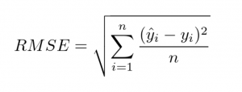
Dataset
Metric: Root-Mean-Squared-Error
RMSE[log(y), log(ŷ))]
Challenges:
Have many features
Some features have many missing value
Some features have high skewed distribution

Slide 8
3. Data processing

Slide 9
Data processing
Exploratory Data Analysis (EDA)
Features Engineering

Slide 10
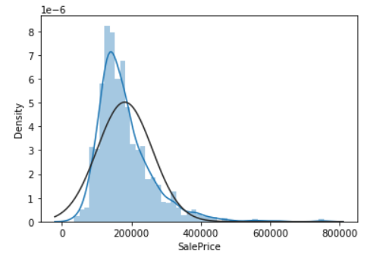
Data processing
EDA
SalePrice:
Mean: 180921, Standard Deviation: 79442
Skewness: 1.88
Kurtosis: 6.53

Slide 11
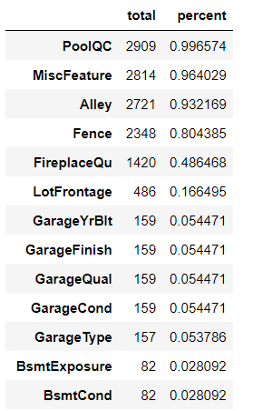
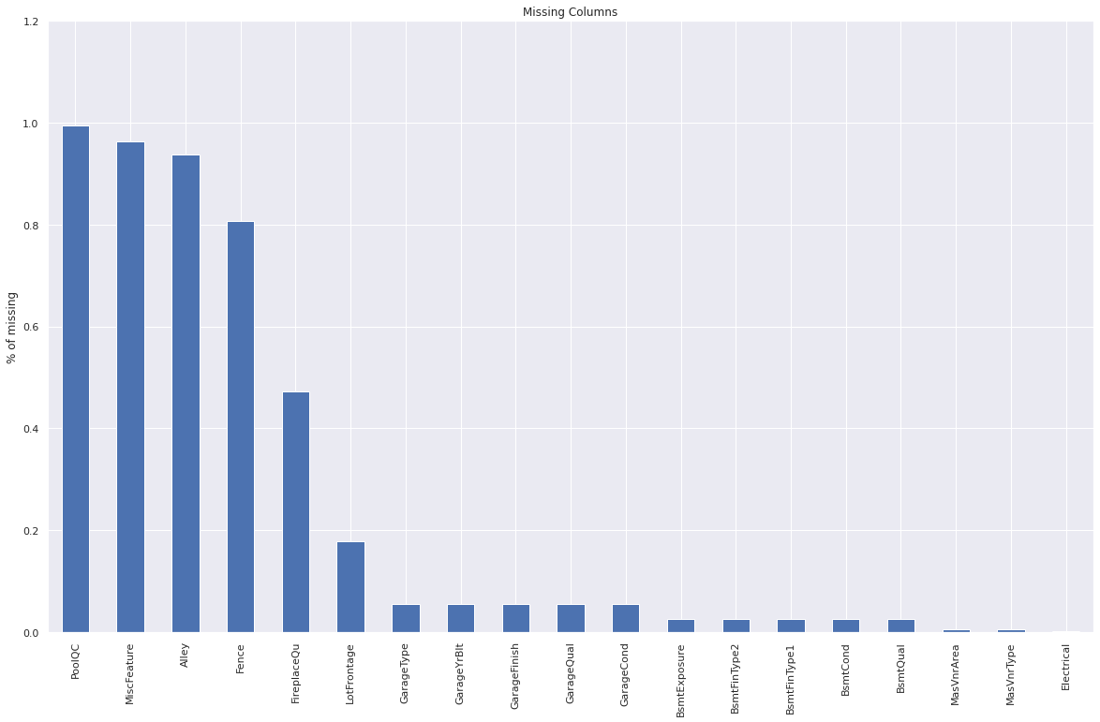
Data processing
EDA
Missing values (NaN)

Slide 12
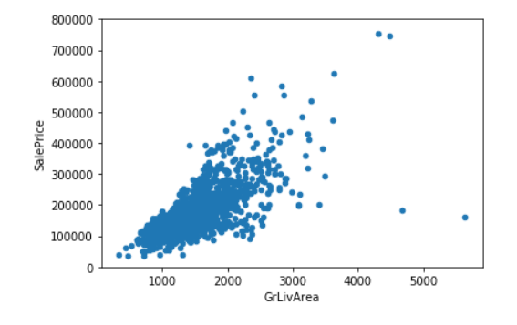
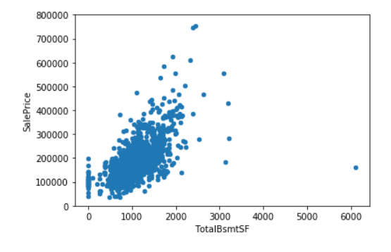
Data processing
EDA
Outlier

Slide 13
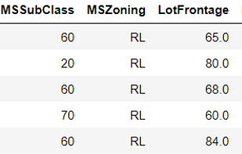
Data processing
EDA
Features:
Categories: MSZoning, LotShape, LotConfig, KitchenQual,…
Numeric: LotArea, YearBuilt, 1stFlrSF, 2ndFlrSF, TotalBsmtSF,…
Some numeric features have properties of categories features:
MSSubClass: “20”: 1-STORY 1946 & NEWER ALL STYLES
YrSold: “2008”
OverallQual : “8” : Very Good

Slide 14
Data processing
Feature engineering
Transform YrSold, MonthSold, MSSubClass to categories features
Deal with missing value
Remove outlier
Label encoder for categories features
Box-Cox power transformation
Dummy variable encoder for categories features

Slide 15
Data processing
Feature engineering
Deal with missing value
Remove features have a rate of missing value more than 80%
Imputing missing values:
Numeric | Categories
Median | NaN meant don’t have a feature | NaN meant don’t have data about a feature
 | ‘None’ | Mode

Slide 16
Methods
Feature engineering
Remove outlier
Detect outlier by Z-scores :
Keep all outlier: 0.1468
Remove all sample have |Z-scores| > 3: 0.1294
Remove all sample have |Z-scores| > 4: 0.1289
Replace outlier by Mean: 0.11899

Slide 17
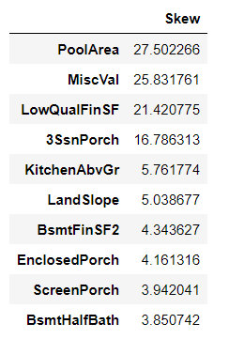
Data processing
Feature engineering
Box-Cox transformation
Transformation for features have skewness > 0.75

Slide 18
Data processing
3. Feature Engineering
Remove features have a high rate of missing value or almost have one value
Create new features
HouseAge = YearSold – YearBuilt
TotalHouseSF = 1stFlrSF + 2ndFlrSF
Try to remove features have low correlate with House Price

Slide 19
4. Model & Result

Slide 20
Model and Result
Processing | Lasso | Enet | KRR | Submission
+ Replace missing value by Median or Mode + Label encoder + MinMaxScaler | 0.1499 | 0.1502 | 0.1298 | 0.1468
+ Replace missing value by Median or Mode + Label encoder + MinMaxScaler + Drop feature has low correalate with Sale Price | 0.1529 | 0.1532 | 0.1336 | 0.15xx
+ Change some numeric feature to categories feature + Replace missing values by Mode, Median or None + Label encoder categories hierarchical feature + Transform distribution of some feature has high skew + One hot encoder | 0.1244 | 0.1249 | 0.1251 | 0.13xx
+ Remove outlier Z-scores > 4 | 0.1052 | 0.1057 | 0.1092 | 0.1289
+ Average of 6 model: Lasso, Enet, KRR, Gboost, XGBoost, LightGBM |  |  |  | 0.12386
+ Average of 6 model + Replace outlier by Mean |  |  |  | 0.11899

Slide 21
5. Demo

Slide 22

Thanks for watching

