Slide 1
Society and Civilization

Slide 2
Society and Civilization
Society is an organized group of people sharing a common culture, territory, and institutions that facilitate cooperation, such as family and government.
Civilization is an advanced, complex stage of human society characterized by urban settlements, specialized labor, social hierarchies, and technological development.

Slide 3
Ancient civilizations
Ancient civilizations (c. 4000 BCE – 500 CE) were the first settled, urbanized societies, primarily emerging in river valleys like Mesopotamia, Egypt, the Indus Valley, and China. These societies developed agriculture, complex social structures, writing systems, and monumental architecture. Key cradles of civilization included Mesopotamia, Egypt, Indus Valley, China, Peru, and Mexico.

Slide 4
Key ancient civilization
Mesopotamia (Sumer, Assyria, Babylon): Known as the oldest civilization, developing writing (cuneiform) and cities between the Tigris and Euphrates rivers.
Ancient Egypt: Famed for its complex kingdom, Nile-based agriculture, and monumental structures like pyramids.
Indus Valley Civilization: A large, highly organized urban society in modern-day Pakistan and India.
Ancient China: Emerging along the Yellow River, it was characterized by early dynasties (Xia, Shang) and agriculture.
Ancient Greek and Rome: The foundation of Western political thought, democracy, and empire, succeeding earlier Minoan and Mycenaean cultures.
Mesoamerica (Olmec, Maya, Aztec): The earliest civilizations in the Americas, noted for complex societies, astronomy, and architecture.

Slide 5
Key Differences Between Ancient Civilizations
Geography and Environment:
Mesopotamia: Had unstable, unpredictable flooding, leading to a more fearful, pessimistic worldview and heavily fortified city-states.
Egypt: Isolated by deserts and sustained by the predictable, gentle flooding of the Nile, fostering a more stable, confident, and centralized civilization.
Indus Valley: Focused on urban planning, featuring advanced sewage and drainage systems in cities like Mohenjo-Daro.

Slide 6
Cont.…
Political Structure:
. Egypt/China: Centralized kingdoms where kings or emperors held absolute power (e.g., Pharaohs).
Greece/Sumer: Often operated as fragmented, independent city-states rather than a unified empire
Religion:
Mesopotamians/Mayans: Polytheistic, often requiring intense rituals to appease unpredictable gods.
Egyptians: Focused heavily on the afterlife and divine kingship.

Slide 7
Key stages of Evolutions
Neolithic Revolution (~10,000–4000 BCE): Warmer climates allowed for plant domestication (rice, wheat, barley) and the establishment of permanent villages.
Early City-States (~4000–3000 BCE): In Sumer (Mesopotamia), the first cities (Uruk, Ur) grew with monumental architecture, irrigation systems, and early writing (cuneiform).
Complex Kingdoms (~3000–1000 BCE): Centralized states formed, such as Ancient Egypt, which built pyramids, and the Indus Valley, which built planned cities with sanitation (Harappa, Mohenjo-daro).
Classical Age (~800 BCE–500 AD): The rise of complex empires and ideological foundations, including Greek democracy, the Hellenistic empire of Alexander the Great, and the expansion of the Roman Empire, which solidified military and civic organization in Europe.

Slide 8
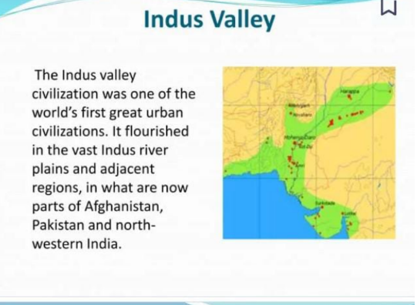

Slide 9
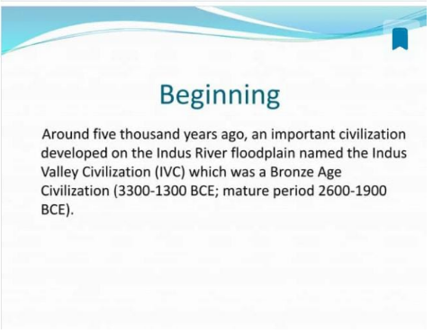

Slide 10
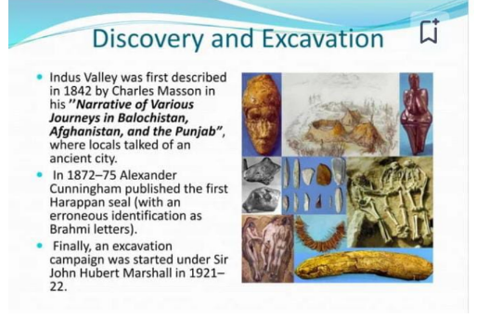

Slide 11
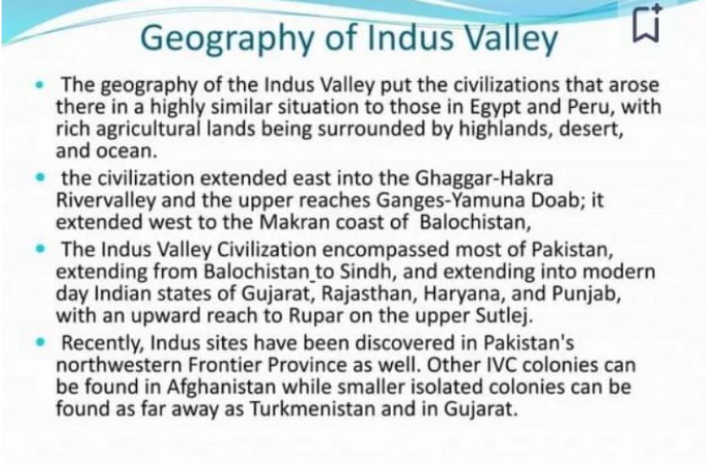
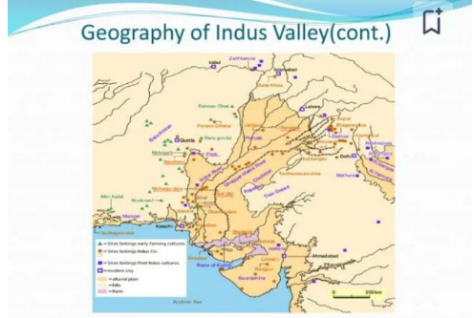

Slide 12
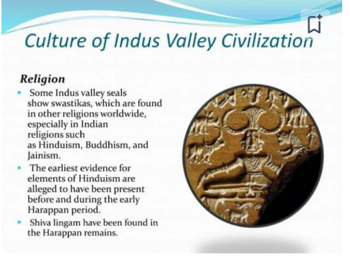

Slide 13
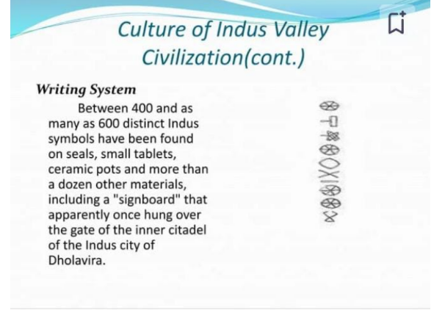

Slide 14
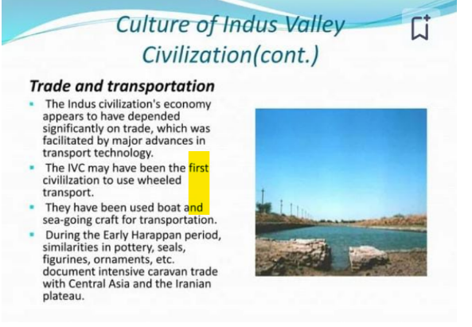

Slide 15
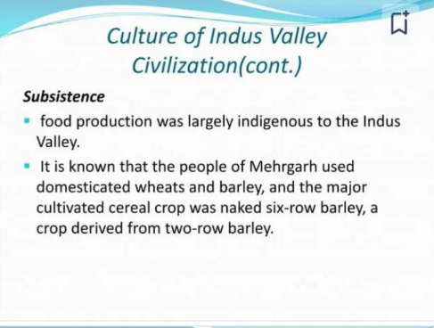

Slide 16
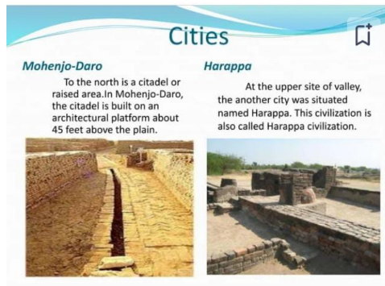

Slide 17
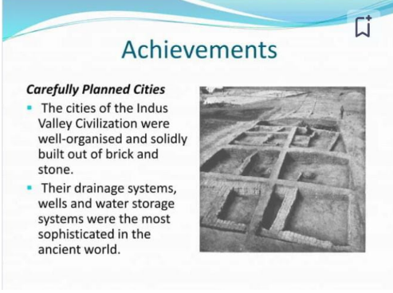

Slide 18
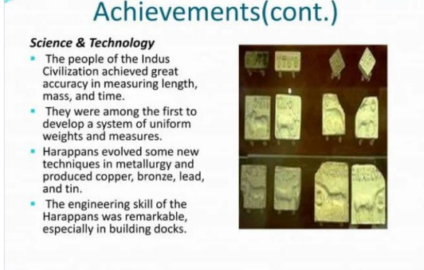

Slide 19
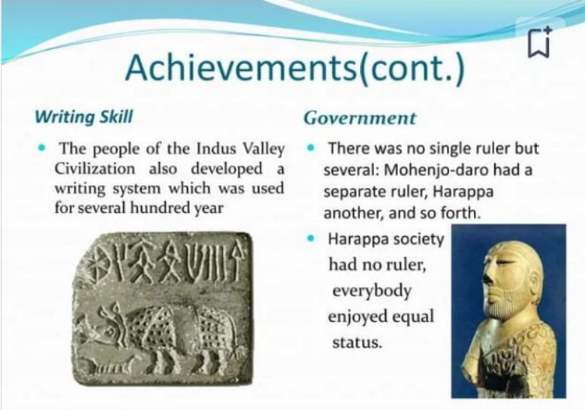

Slide 20
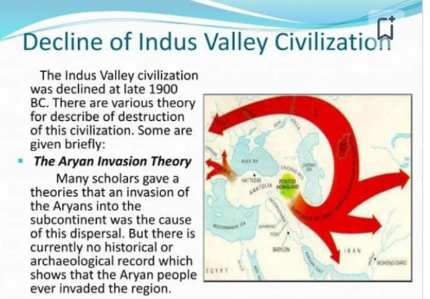

Slide 21
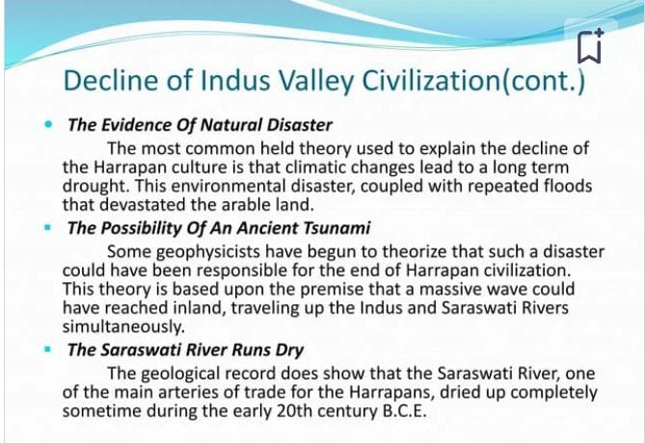

Slide 22
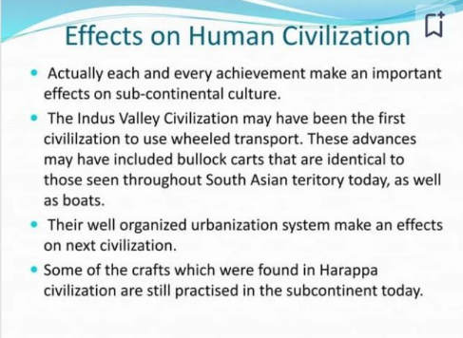

Slide 23


