Slide 1
SENSE-bot
Recommending music based on Expressions

Slide 2
Content
Motivation
Technology
Future
Problem
Problem
Solution
Glimpse

Slide 3


Problem
All the time we have to type sad, Happy, and Neutral to listen to the specific mood of the song

Slide 4
Motivation
From this, we think why shouldn't we do a project that will sense our mood through expression and recommend music according to it

Slide 5
Solution
We came up with this project that will sense the user's mood and it will recommend music according to it.

Slide 6
TECHNOLOGIES
openCV
Matplotlib
Pandas
Numpy
Python
Streamlit
OpenCV is a library of programming functions mainly aimed at real-time computer vision.
Matplotlib is a plotting library for the Python programming language and its numerical mathematics extension NumPy.
Pandas is a Python library used for working with data sets. It has functions for analyzing, cleaning, exploring, and manipulating data.
NumPy is the fundamental package for scientific computing in Python.
Python is an interpreted, object-oriented, high-level programming language with dynamic semantics.
Streamlit is an open-source app framework for Machine Learning and Data Science teams. Create beautiful web apps in minutes.

Slide 7
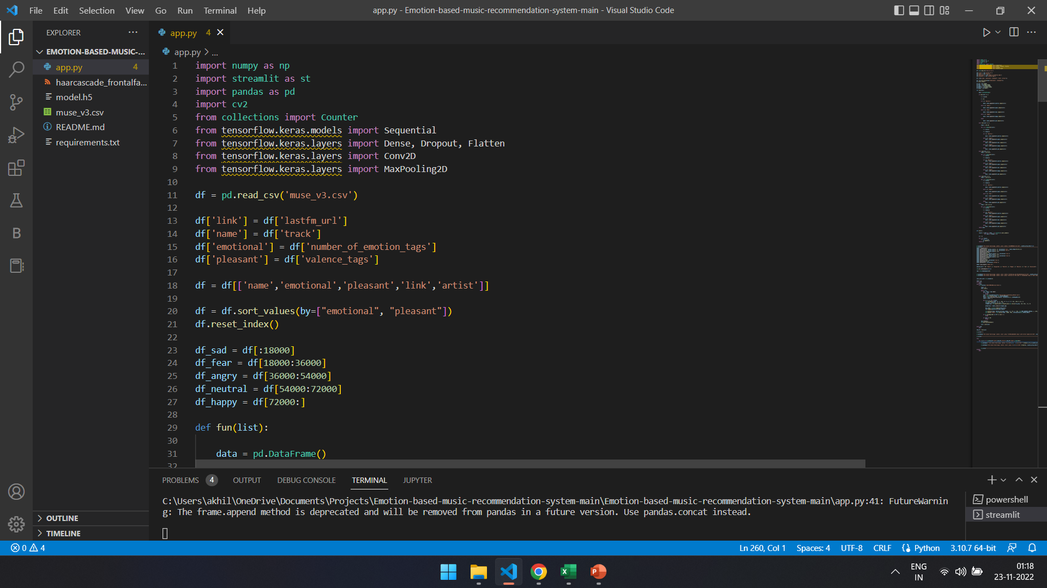
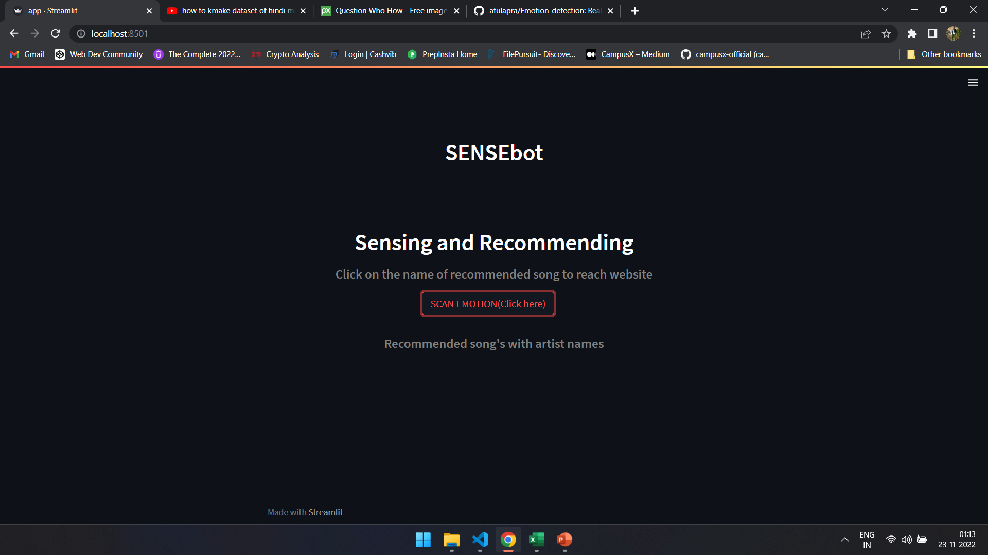
GLIMPSE

Slide 8
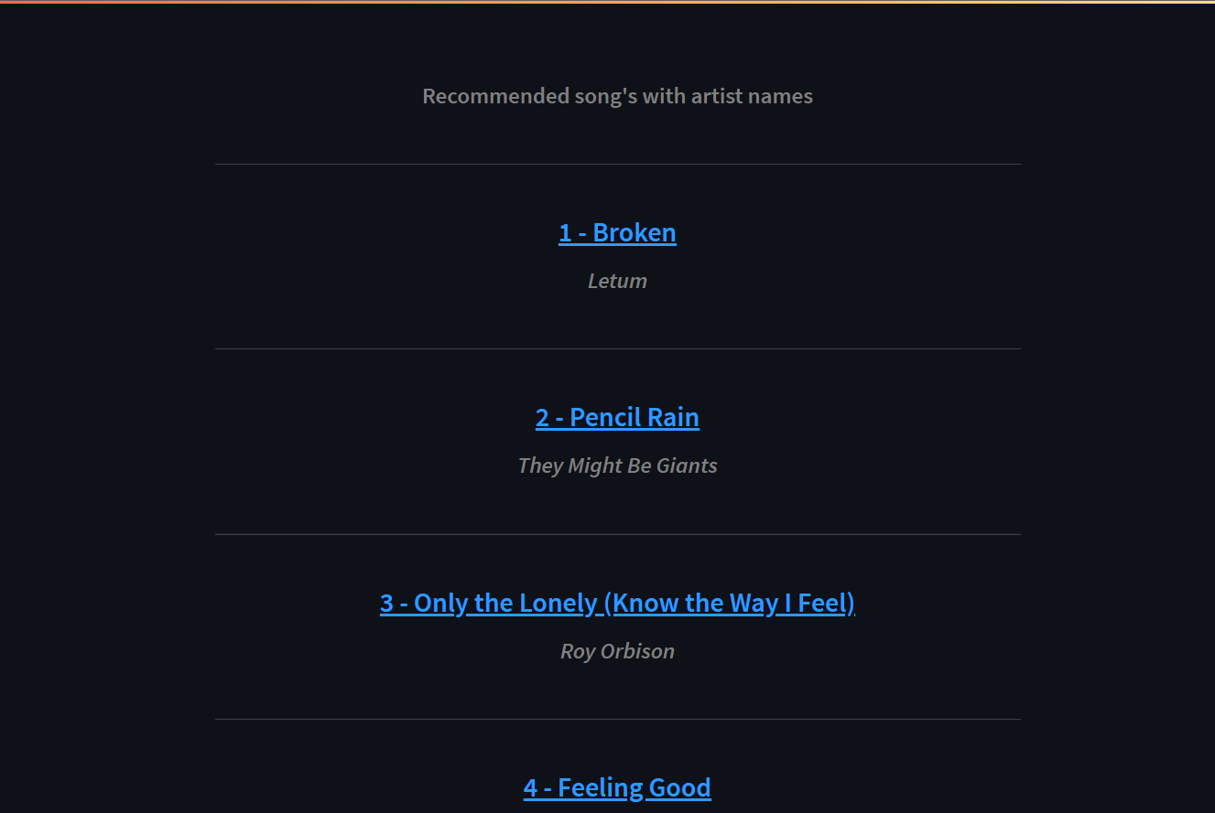
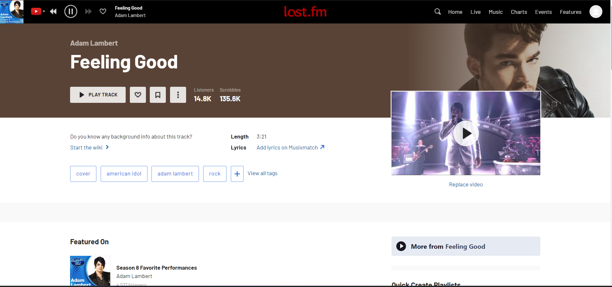
GLIMPSE

Slide 9
FUTURE
Accuracy
More IOT components
Online & Offline
Integrated and Automate
Web App
App
Availability
Accuracy

Slide 10
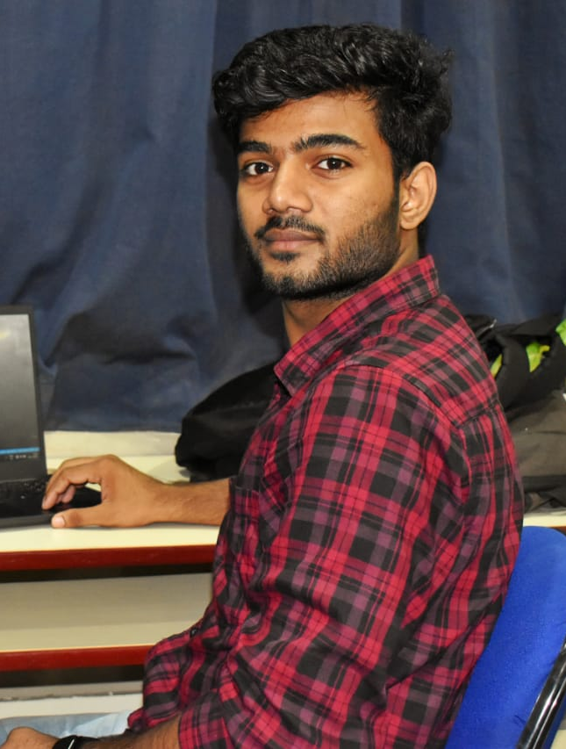

Team
Akhilesh Singh
Abhishek Kushwaha

Slide 11
THANK YOU

