Slide 1
Machine Learning
Abhishek Krishna TM
ENG19CS0011

Slide 2
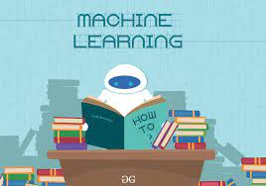
Introduction
Machine learning is the field of computer science that uses statistical technique to give computer systems the ability to learn with the data, without being explicitly programmed.
In other words, giving the input and desired data to the system(machine learning algorithm) for getting a model.

Slide 3
Types of ML
Supervised Learning
Unsupervised Learning
Learning from someone(teacher or supervisor)
Consists of features(input) and labels(Output)
Types are Regression and classification
Learning on your own(without any external guidance)
Consists of features(input) only
Clustering is a type of unsupervised learning

Slide 4


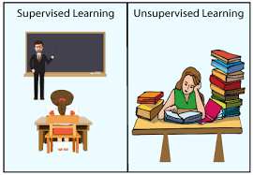
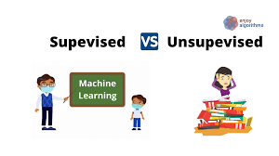

Types of ML

Slide 5
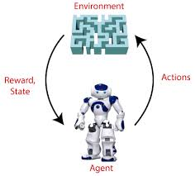
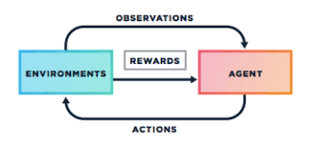
Types of ML
This is the kind of ML where reward is given when the task is completed else penalty is issued.
Reinforcement Learning

Slide 6

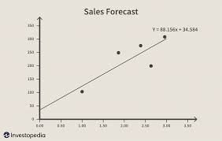
Types of supervised learning
Classification – Is the type through which the algorithm can classify between two options like yes or no , true or false etc. Different types of classification algorithms are Logistic Regression , Decision Tree , Random Forest , SVM, KNN etc..
Regression – is the type of algorithm through which the model can predict the outcomes with the present input and test datas. Different types of regression are linear regression etc.

Slide 7
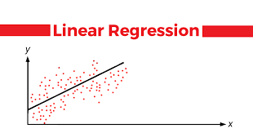
Linear regression
Is the algorithm used to predict the output when an input is given. Before that the sample in input and output should be fed into the system as features and labels.
Example 2 = 4, 3=6, 4=8 , 5=10 so that makes 9=18(that is y=2x)
It’s working program is here click -
https://colab.research.google.com/drive/1fLTJBD4ROy2SFWIWbqflIj2rjj_8wYMA#scrollTo=TN4Ve8-KjGT1

Slide 8
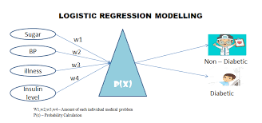
Logistic regression
Is the algorithm used to classify the given input to a specific output that is like yes or no, true or false etc.
Example 40 marks is passing marks then when a input is given the algorithm classifies it to be pass or fail.
It’s working program is here click -
https://colab.research.google.com/drive/1fLTJBD4ROy2SFWIWbqflIj2rjj_8wYMA#scrollTo=TN4Ve8-KjGT1

Slide 9
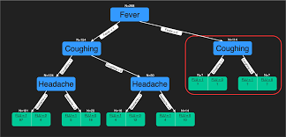
Decission tree
Is the algorithm in which the decision is made based on two options which will further decide the future input in the datasets. That is basically each node will have two options .
It’s working programs is here click –
https://colab.research.google.com/drive/1fLTJBD4ROy2SFWIWbqflIj2rjj_8wYMA#scrollTo=TN4Ve8-KjGT1

Slide 10
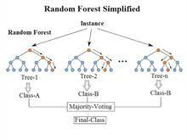
Random forest
Is the algorithm in which random inputs(trees in the forest) are taken and based on the highest common output the output is found.
It’s working program is here click –
https://colab.research.google.com/drive/1fLTJBD4ROy2SFWIWbqflIj2rjj_8wYMA#scrollTo=TN4Ve8-KjGT1

Slide 11
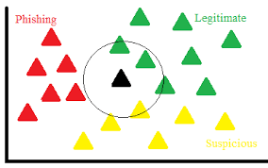
knn
In this algorithm the output is got with the help of the nearest neighbour. The value of K is the most crucial part in this algorithm.
Example we can classify between an apple and orange using this.
The working program of it is here, click –
https://colab.research.google.com/drive/1fLTJBD4ROy2SFWIWbqflIj2rjj_8wYMA#scrollTo=TN4Ve8-KjGT1

Slide 12
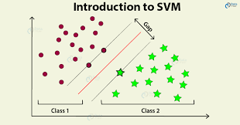
svm
Is the algorithm in which we plot each data as just a point in n – dimensional space. Where n is the number of features(input or dataset). Then we classify the output from the given space.
It’s working program is here , click –
https://colab.research.google.com/drive/1fLTJBD4ROy2SFWIWbqflIj2rjj_8wYMA#scrollTo=TN4Ve8-KjGT1

Slide 13
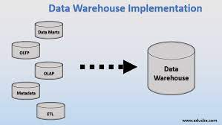
Data Warehouse
A data warehouse is the collection of all the data(database) and ELT(loader) and other applications

Slide 14
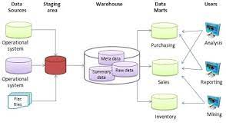
Data warehouse process

Slide 15
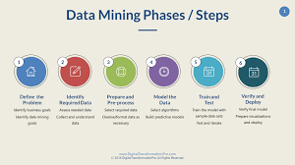
Data Mining
The process of taking data from the data warehouse.
In other words the process of retrieving data from Data Warehouse

Slide 16
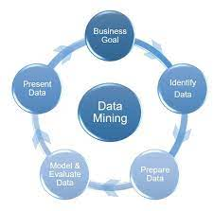
Data mining process
Data cleaning- Only required data is kept the unrequired data is eliminated
Data reduction- The duplicate data is eliminated
Data transformation- data is transformed into a suitable form
Data mining- data is represented in the forms of patterns
Data evaluation- the correct data is matched and selected

Slide 17
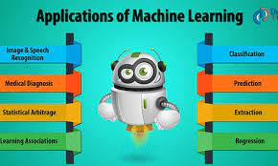
Application of Machine learning
It is widely used in Healthcare
Speech recognition
Traffic prediction
Self driving cars

Slide 18
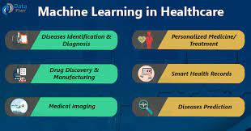
Healthcare
Identifying diseases and diagnosis
Drug Discovery and manufacturing
Medical imaging diagnosis
Personalized medicine
Smart health record
Clinical trial and research
Outbreak prediction

Slide 19
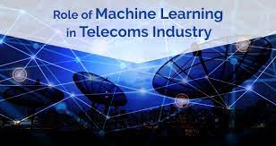
Telecom
Chatbots for operational support and automated self service
Network operation monitoring and management
Predictive mainteance using ML applications

Slide 20
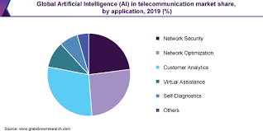
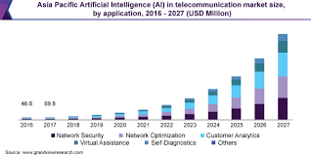
Telecom

Slide 21
Thank you
Please find my GitHub link below
https://github.com/CypherAk007/-Deep-Learning-Assignment_01
Please find my google colab link below
https://colab.research.google.com/drive/1fLTJBD4ROy2SFWIWbqflIj2rjj_8wYMA#scrollTo=TN4Ve8-KjGT1

