Slide 1

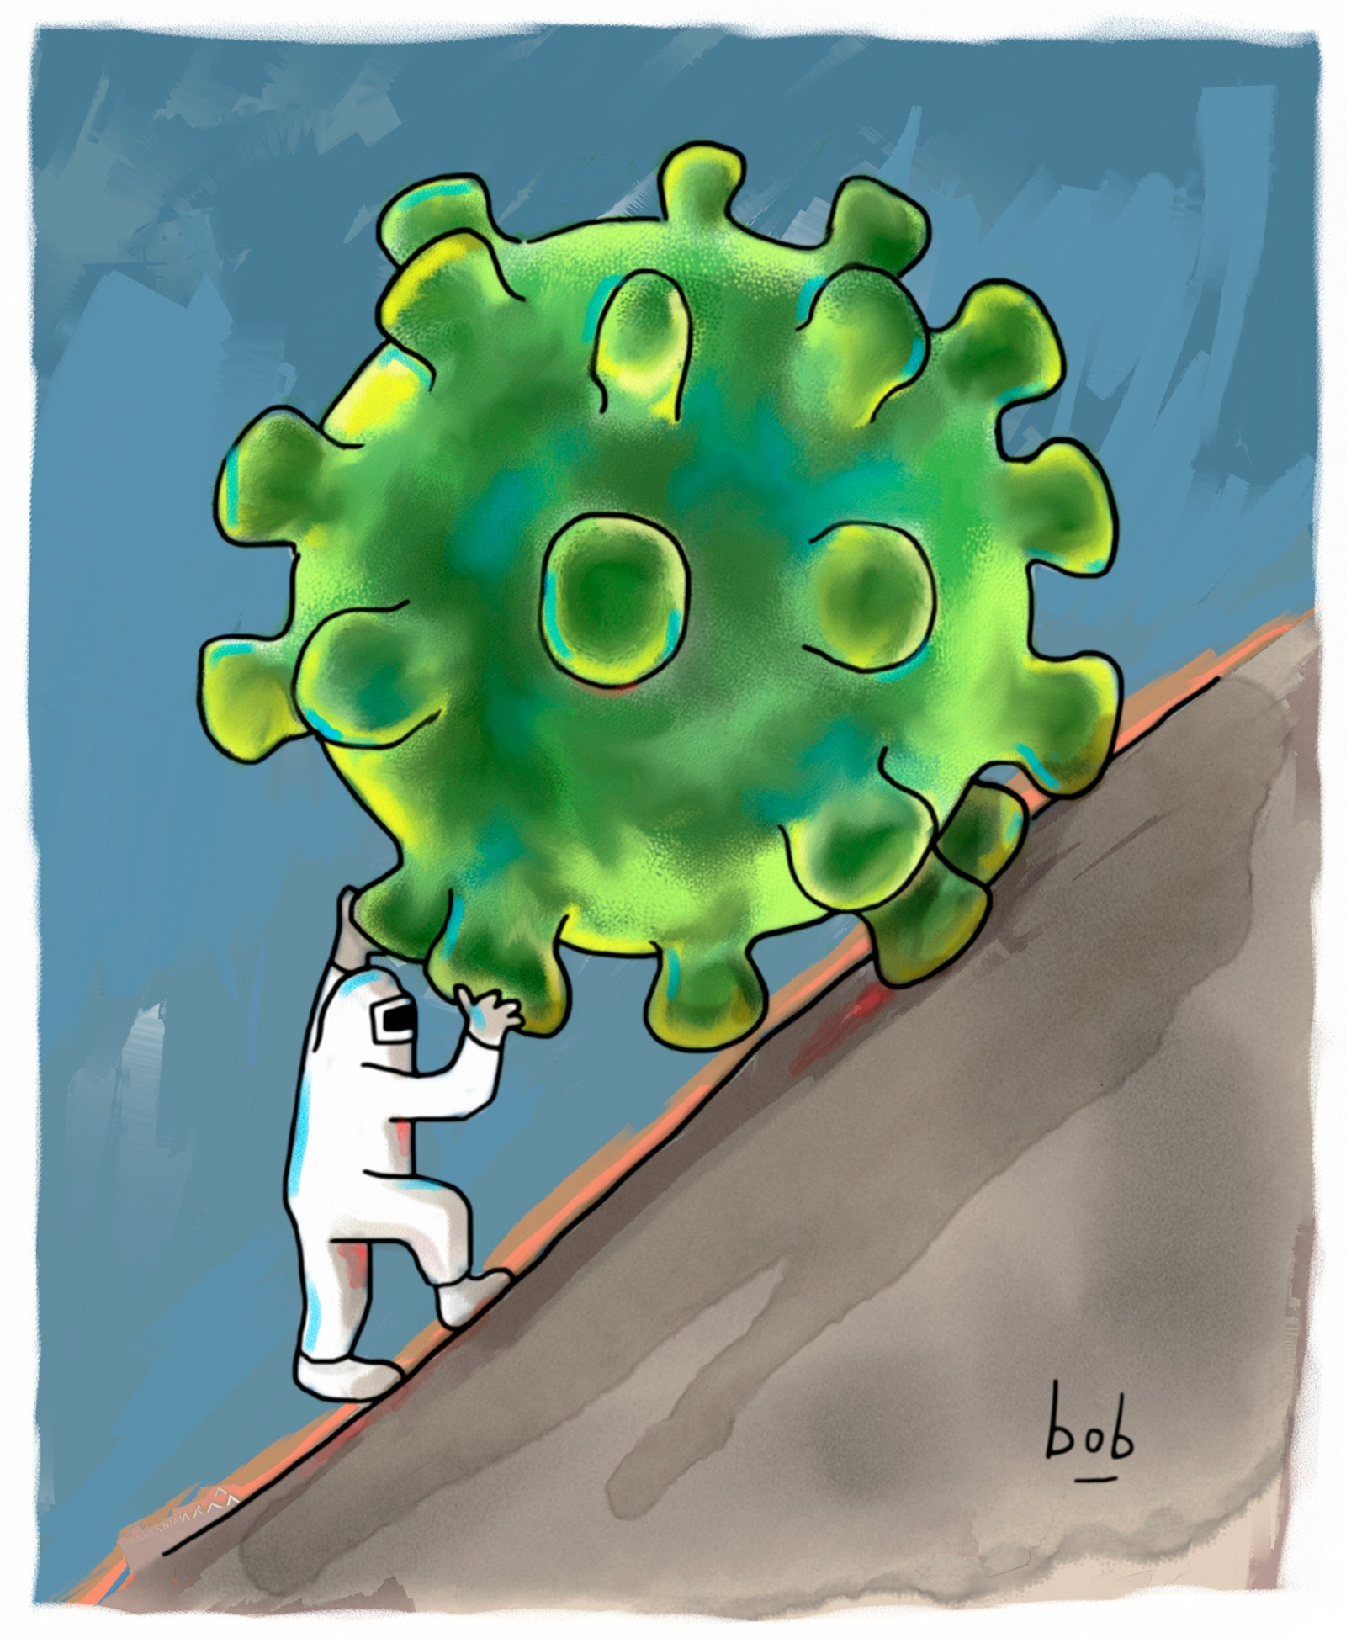

Panacea _{HELPING HANDS}
Under the supervision of
Dr Bondu Venkateshwaralu
AAROODH L– ENG19CS0002
ABHAY V R- ENG19CS0006
ABHISHEK KRISHNA T M- ENG19CS0011
AKSHAY V R - ENG19CS0023

Slide 2
Contents
Implementation of the project(code)
Demonstration of the project
Result analysis
Testing
Conclusion

Slide 3
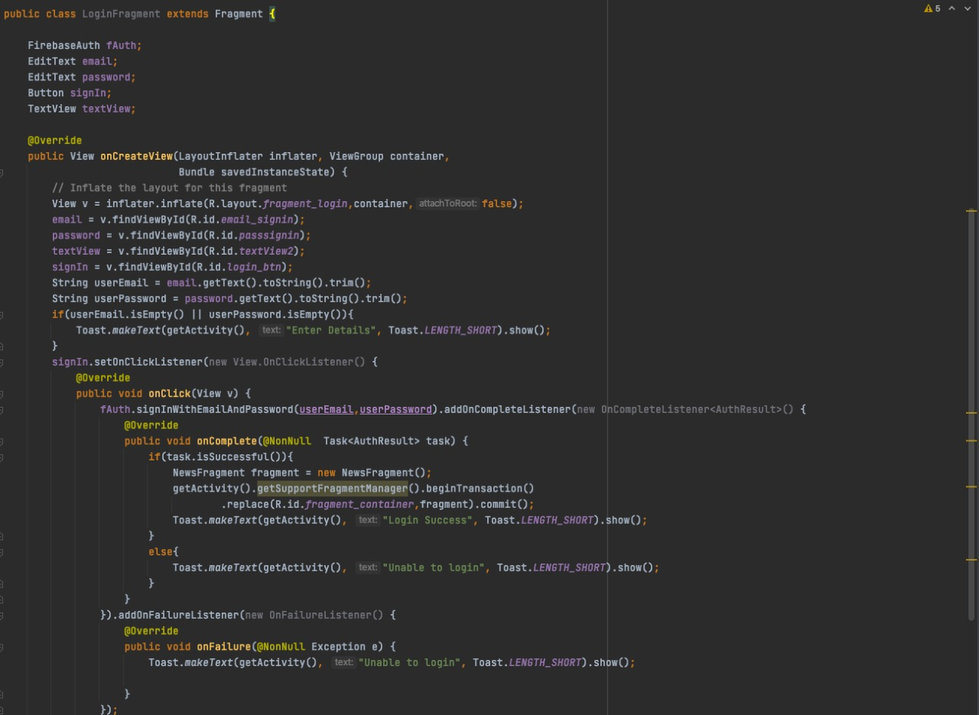
Implementation of the project(code) Login/signup

Slide 4
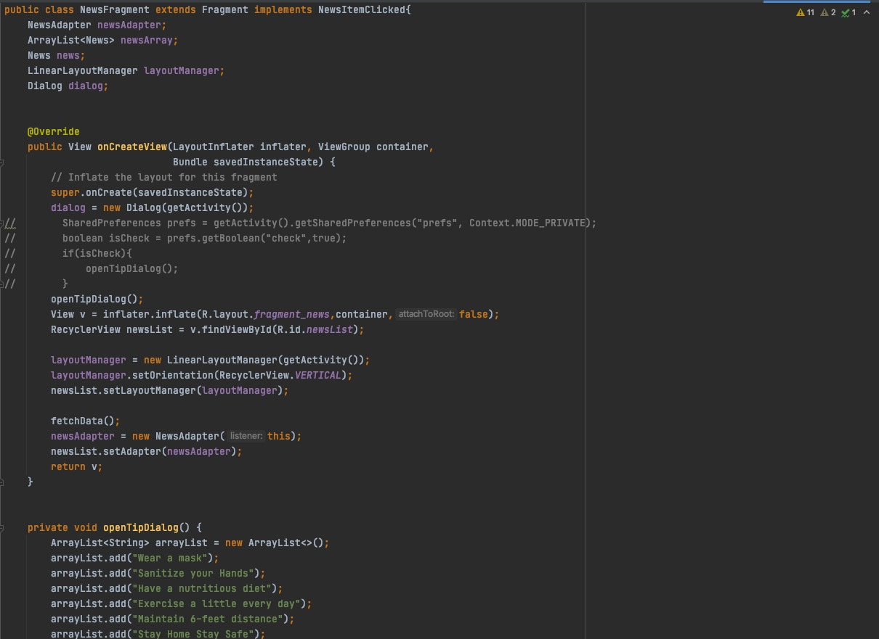
Implementation of the project(code) News fragment

Slide 5
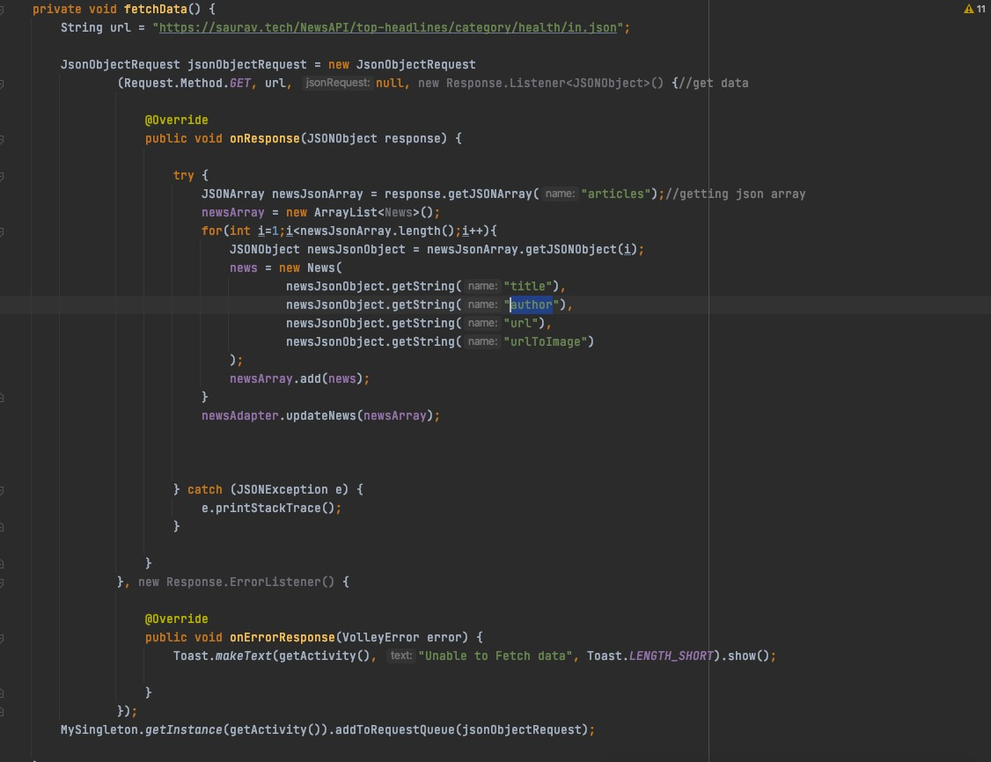
Implementation of the project(code)

Slide 6
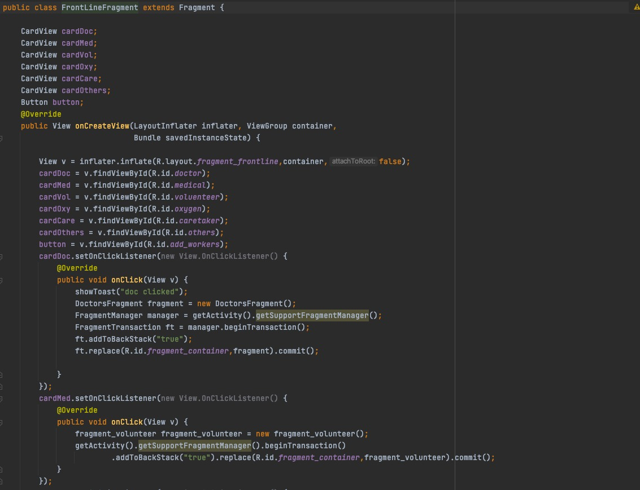
Implementation of the project(code) Front line

Slide 7
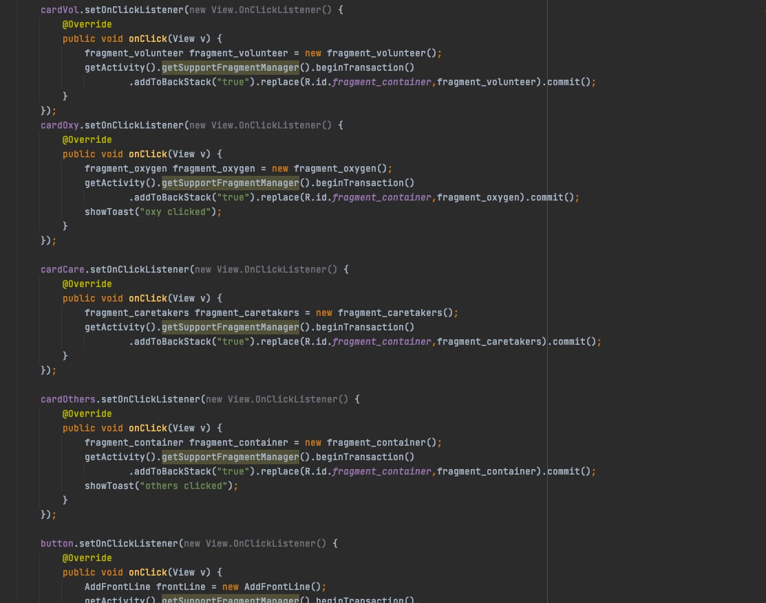
Implementation of the project(code)

Slide 8
Implementation of the project(code)
https://github.com/CypherAk007/CodeForCovid
Apk of the app
https://drive.google.com/file/d/11Ni4nDWmgs5SZf00DapCbrL5WB7YIyha/view?usp=drivesdk

Slide 9
Demonstration of the project
https://user-images.githubusercontent.com/57716055/124586963-b9389d80-de74-11eb-8a2e-0fad22611c31.mp4

Slide 10
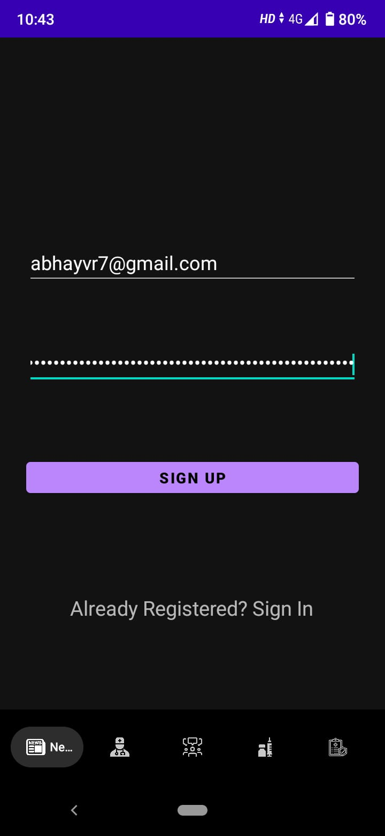
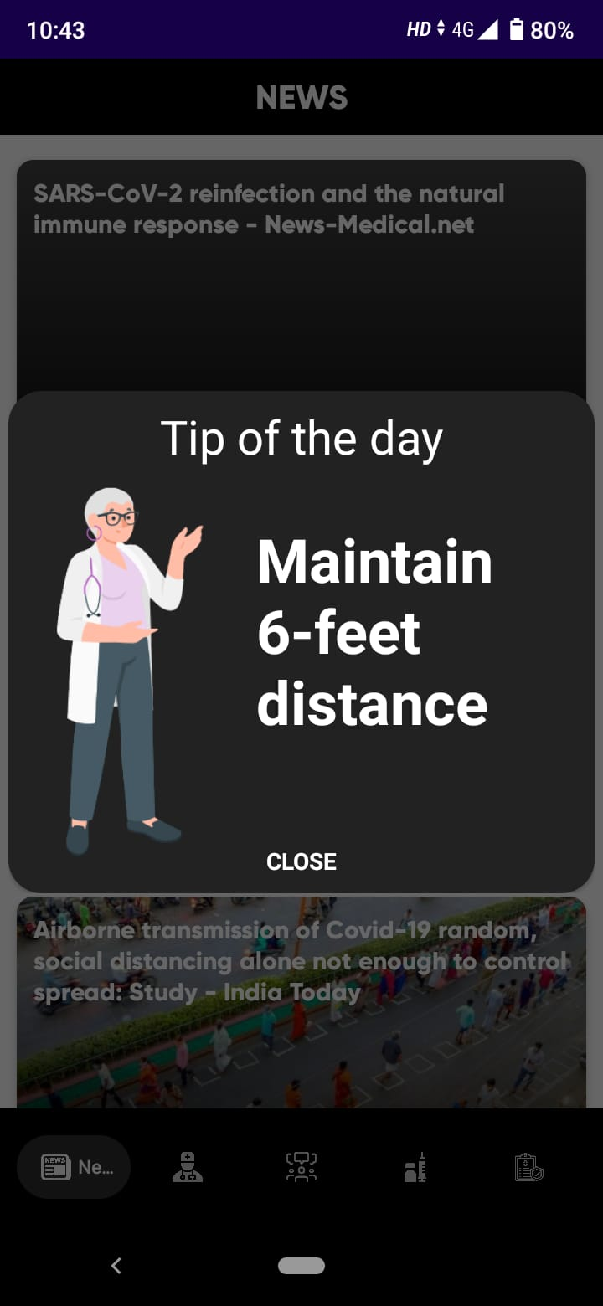
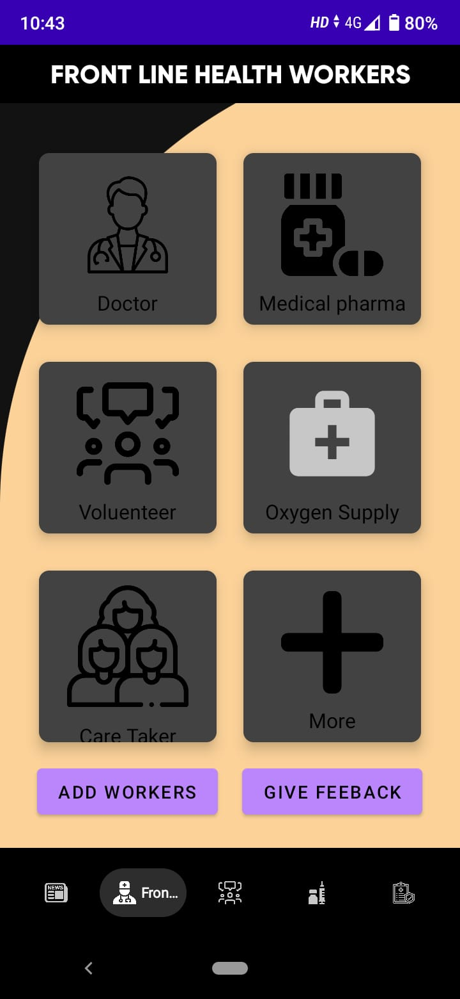
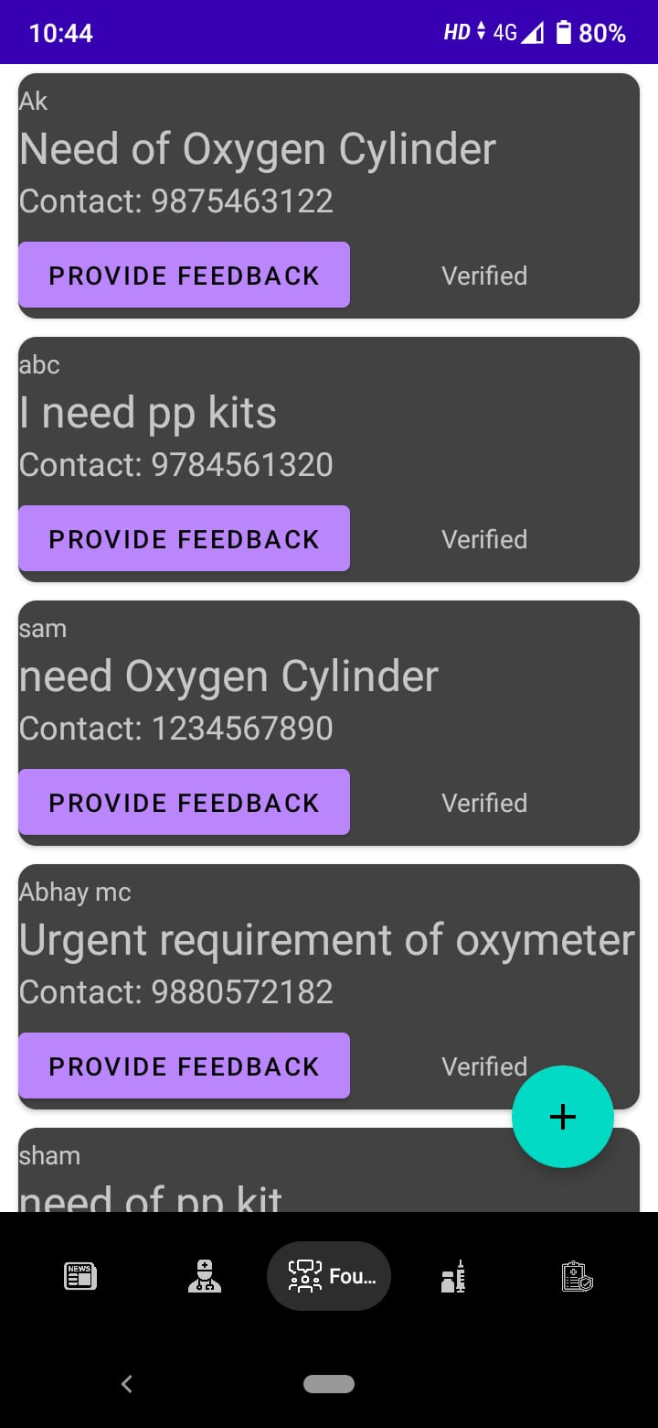
Demonstration of the project

Slide 11
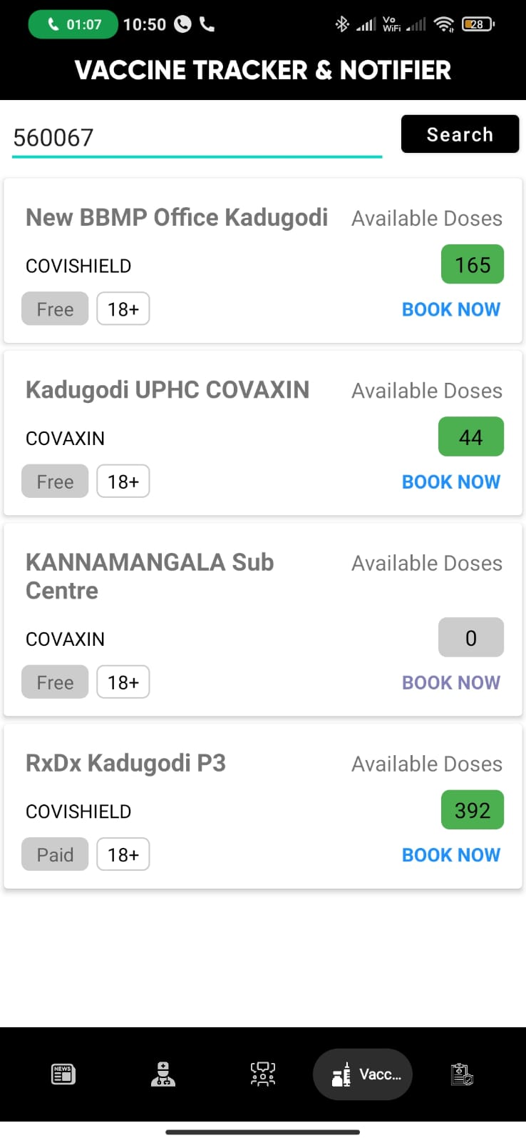
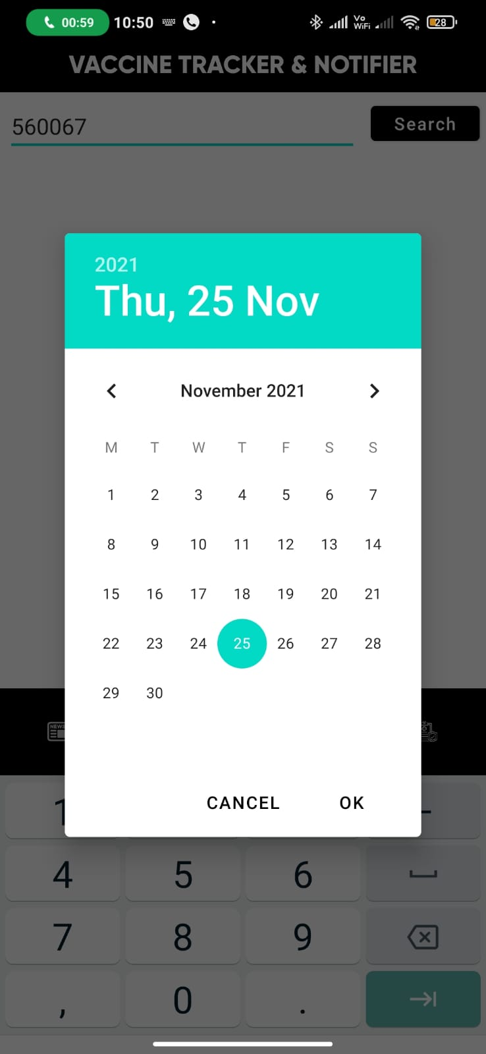
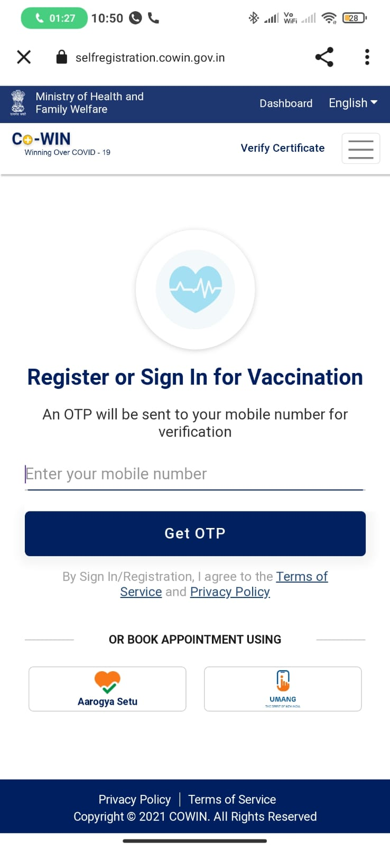
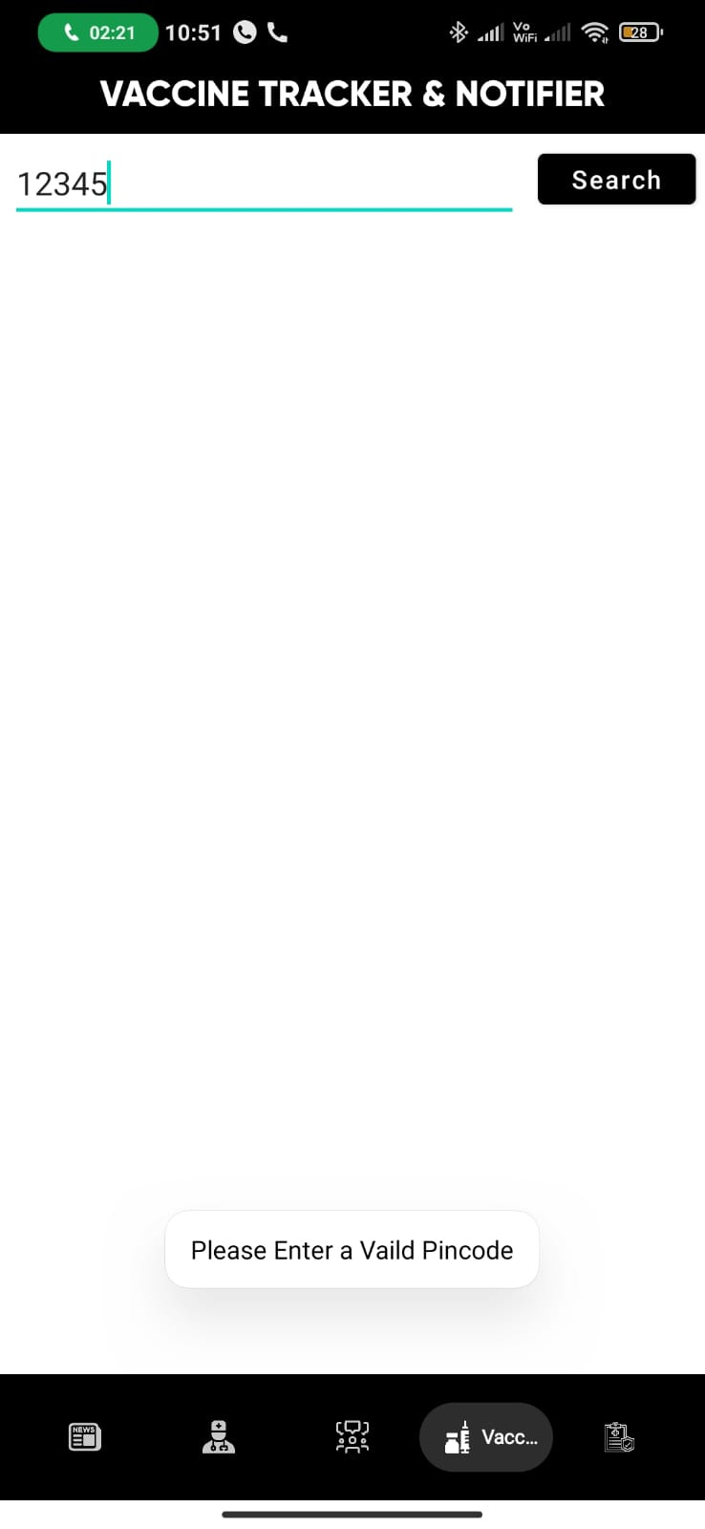
Demonstration

Slide 12
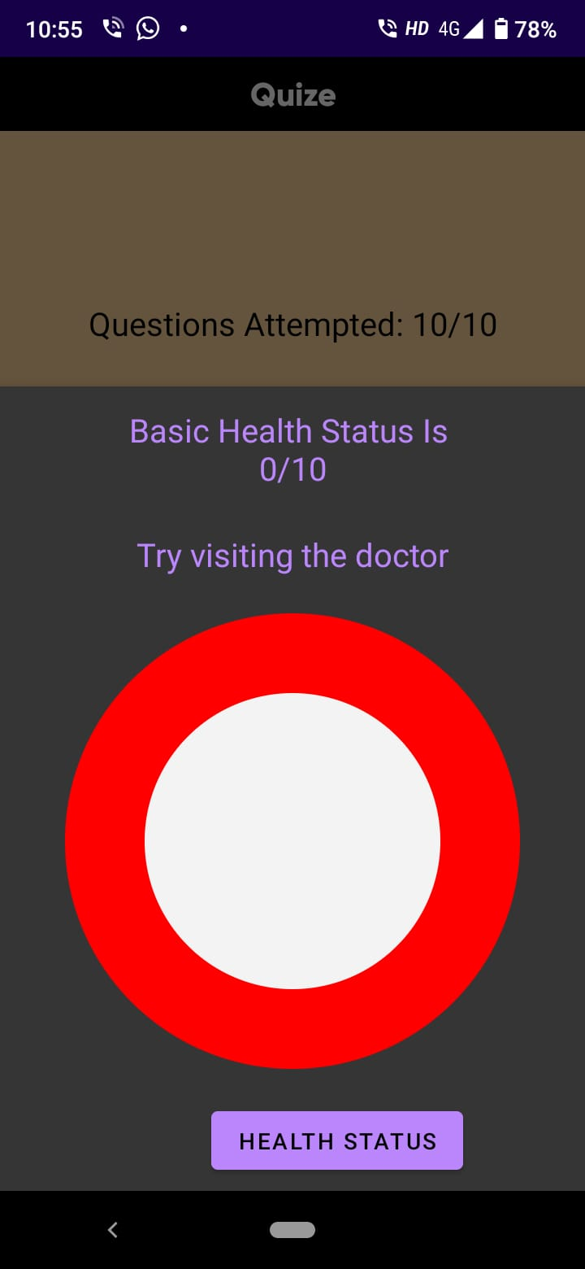
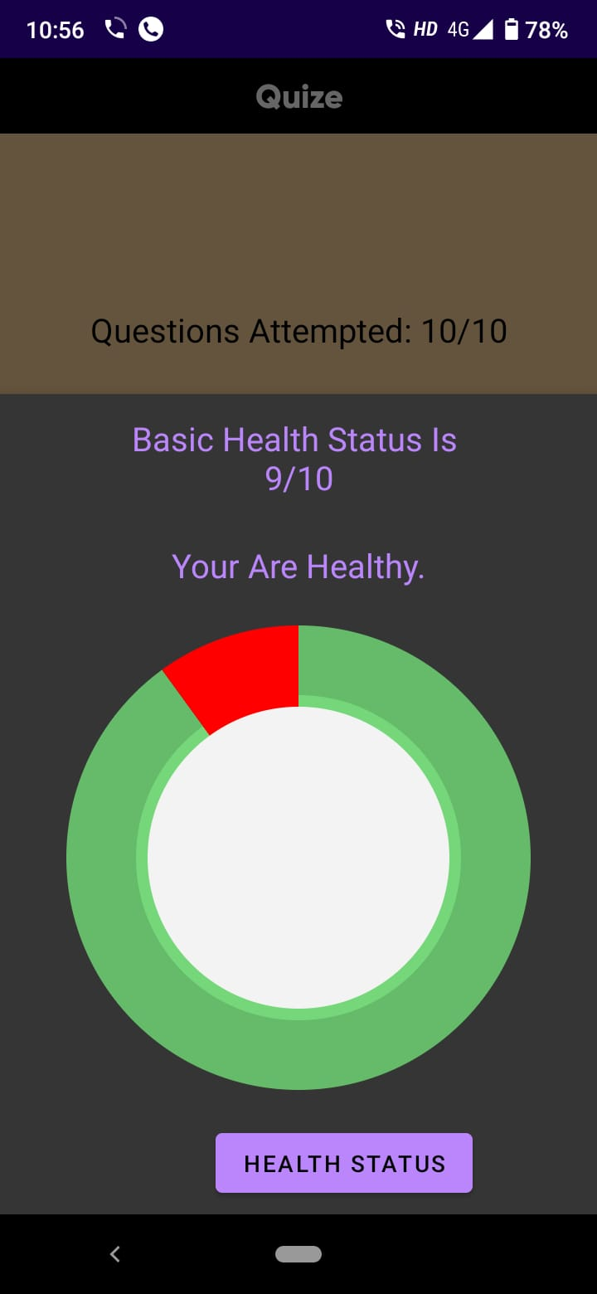
Demonstration

Slide 13
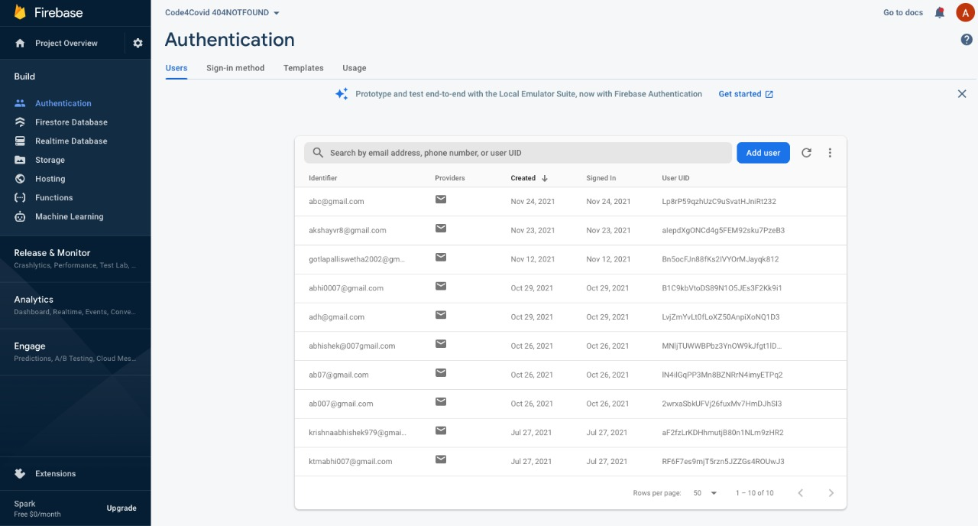
Result analysis Login/signup

Slide 14
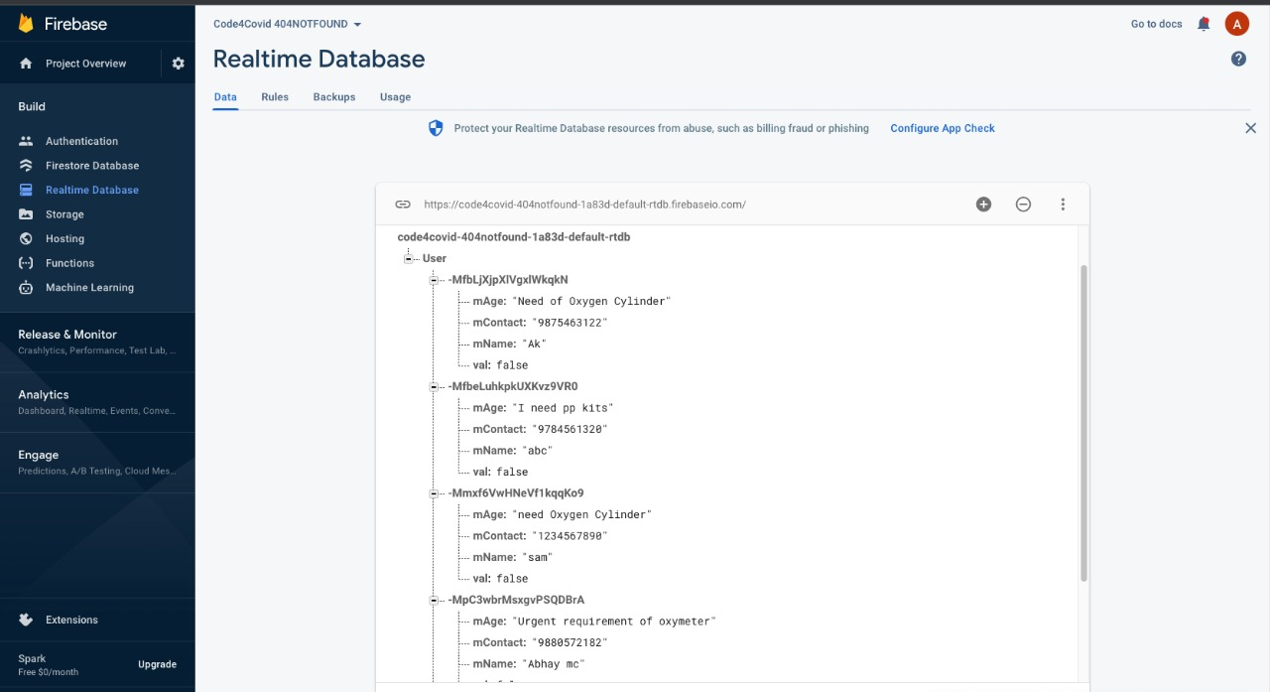
Result analysis Community Forum

Slide 15
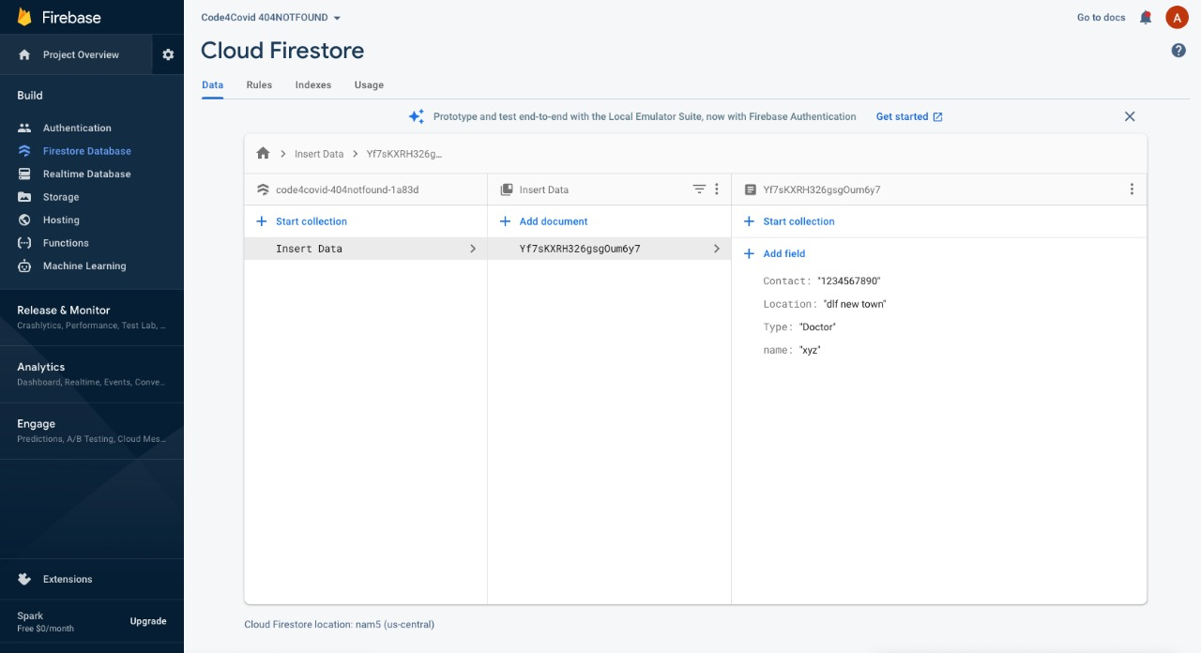
Result analysis FrontLine health workers

Slide 16
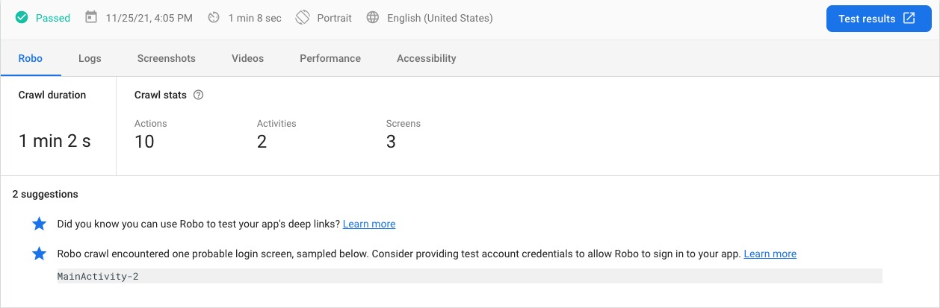
Testing(Robo testing)

Slide 17
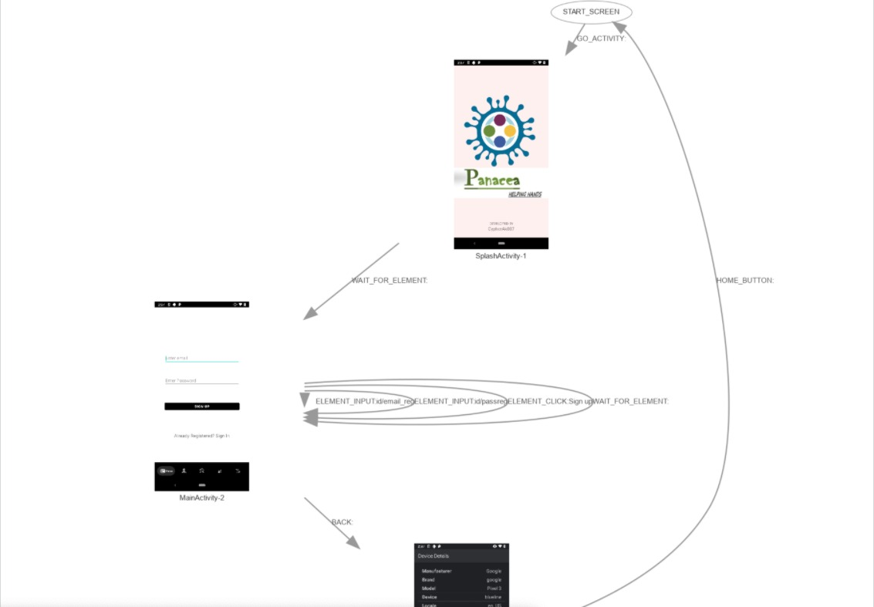
Testing(Testing Flow)

Slide 18
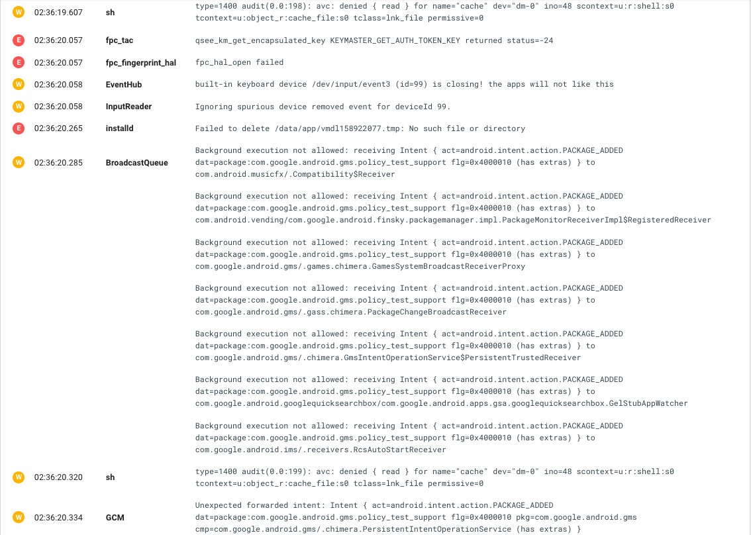
Testing(log cat)

Slide 19
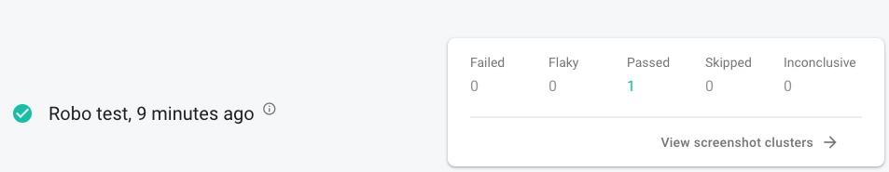
Testing(test cases passed)

Slide 20
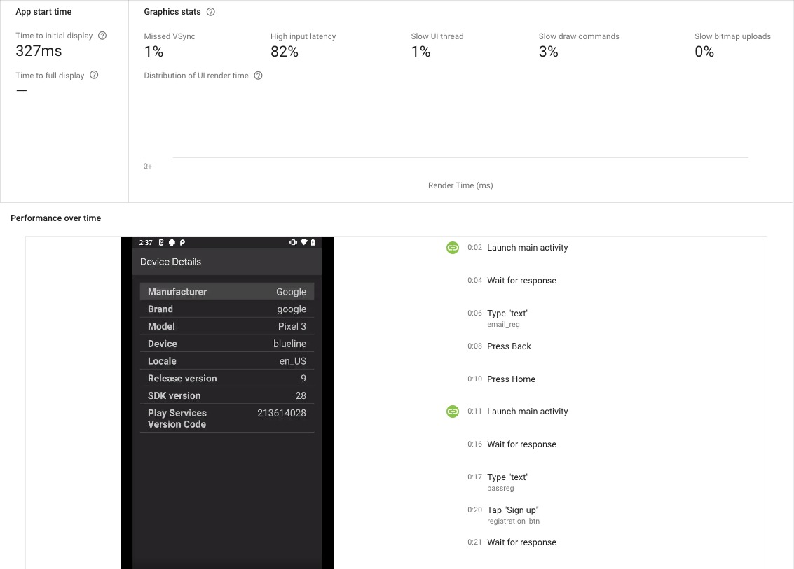
Performance

Slide 21
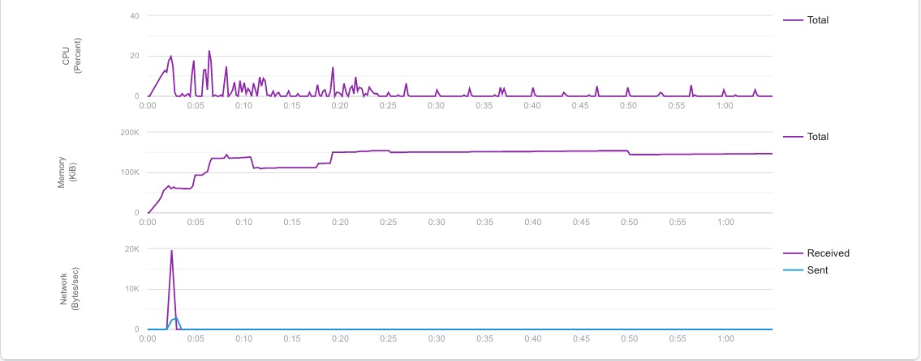
Performance

Slide 22
Conclusion
Our app contains the solution to all the covid related problems and to help the frontline health workers. In contrast to other apps where there are only solution to a particular problem. We have made sure to have solution to all the problems.
App contains
User Friendly UI/UX design. Real-time data of vaccine tracker, latest news alerts through API requests . Firebase API Client. Community Forums. Analyzing the users mental health condition.

