Slide 1
GOLANG
ABHISHEK KRISHNA TM - ENG19CS0011

Slide 2
CONTENTS
- METHOD DECLARATION
- FUNCTIONS VS. METHODS
- POINTER AND VALUES RECEIVERS
- METHOD VALUES AND EXPRESSION
- INTERFACES TYPES AND VALUES
- TYPE ASSERTIONS AND TYPE SWITCHES
- METHOD SETS WITH INTERFACES
- EMBEDDED INTERFACES
- WORKING WITH INTERFACES

Slide 3
WHAT IS RECEIVER FUNCTION ?
type person struct {
name string
age int
}
func (p person) print() {
fmt.Printf("%s is of %d years \n", p.name, p.age)
}
func main() {
alex := person{
name: "Alex",
age: 18,
}
alex.print()
}

Slide 4
WHAT IS RECEIVER FUNCTION ?
This parameter (p of type person in the example) is what makes the print() function a receiver function. More precisely, the print() function is a function which can receive a person.
This has an interesting application. Notice that we make an alex variable of type person. As print() function can receive a person, we can do alex.print().

Slide 5
WHAT IS RECEIVER FUNCTION ?
- Go is not OOPS based.
- Main advantage of using receiver function is when we couple it with interfaces.
- By using interfaces we can use the same receiver function to receive arguments of multiple types.

Slide 6
Methods in Golang
- Go methods are similar to Go function with one difference, i.e, the method contains a receiver argument in it.
- With the help of the receiver argument, the method can access the properties of the receiver.
- When you create a method in your code the receiver and receiver type must be present in the same package.
- And you are not allowed to create a method in which the receiver type is already defined in another package including inbuilt type like int, string, etc. If you try to do so, then the compiler will give an error.

Slide 7
Methods in Golang
Syntax:
func(reciver_name Type) method_name(parameter_list)(return_type){
// Code
}

Slide 8
Functions vs Methods
func MyFunction(a, b int) int {
return a + b
}
// Usage:
// MyFunction(1, 2)
type MyInteger int func (a MyInteger) MyMethod(b int) int {
return a + b
}
// Usage:
// var x MyInteger = 1
// x.MyMethod(2)

Slide 9
Pointer And Value Receivers
Value receiver makes a copy of the type and pass it to the function. The function stack now holds an equal object but at a different location on memory. That means any changes done on the passed object will remain local to the method. The original object will remain unchanged.
Pointer receiver passes the address of a type to the function. The function stack has a reference to the original object. So any modifications on the passed object will modify the original object.

Slide 10
type Person struct {
Name string
Age int
}
func ValueReceiver(p Person) {
p.Name = "John"
fmt.Println("Inside ValueReceiver : ", p.Name)
}
func PointerReceiver(p *Person) {
p.Age = 24
fmt.Println("Inside PointerReceiver model: ", p.Age)
}
func main() {
p := Person{"Tom", 28}
p1:= &Person{"Patric", 68}
ValueReceiver(p)
fmt.Println("Inside Main after value receiver : ", p.Name)
PointerReceiver(p1)
fmt.Println("Inside Main after value receiver : ", p1.Age)
}
O/P-
Inside ValueReceiver : John
Inside Main after value receiver : Tom
Inside PointerReceiver : 24
Inside Main after pointer receiver : 24

Slide 11
Interface Types
- The interface is a custom type that is used to specify a set of one or more method signatures and the interface is abstract, so you are not allowed to create an instance of the interface. But you are allowed to create a variable of an interface type and this variable can be assigned with a concrete type value that has the methods the interface requires.
- The interface is a collection of methods as well as it is a custom type.

Slide 12
Interface Types
Syntax -
type interface_name interface{
// Method signatures
}
// Ex - Creating an interface
type myinterface interface{
// Methods
fun1() int
fun2() float64
}

Slide 13
Type Assertion
Type assertions in Golang provide access to the exact type of variable of an interface. If already the data type is present in the interface, then it will retrieve the actual data type value held by the interface. A type assertion takes an interface value and extracts from it a value of the specified explicit type. Basically, it is used to remove the ambiguity from the interface variables.

Slide 14
Type Assertion
Syntax -
t := value.(typeName)
Ex -
func main() {
// an interface that has
// a string value
var value interface{} = "GeeksforGeeks"
// retrieving a value
// of type string and assigning
// it to value1 variable
var value1 string = value.(string)
// printing the concrete value
fmt.Println(value1)
// this will panic as interface
// does not have int type
var value2 int = value.(int)
fmt.Println(value2)
}
Ex-
GeeksforGeeks
panic: interface conversion: interface {} is string, not int

Slide 15
Type Switches
A Switch is a multi-way branch statement used in place of multiple if-else statements but can also be used to find out the dynamic type of an interface variable.
A type switch is a construct that performs multiple type assertions to determine the type of variable (rather than values) and runs the first matching switch case of the specified type. It is used when we do not know what the interface{} type could be.

Slide 16
Type Switches
package main
import (
"fmt"
)
func main() {
var value interface{} = "CypherAk"
switch t := value.(type){
case int64:
fmt.Println("Type is an integer:", t)
case float64:
fmt.Println("Type is a float:", t)
case string:
fmt.Println("Type is a string:", t)
case nil:
fmt.Println("Type is nil.")
case bool:
fmt.Println("Type is a bool:", t)
default:
fmt.Println("Type is unknown!")
}
}
Output -
Type is a string: GeeksforGeeks

Slide 17
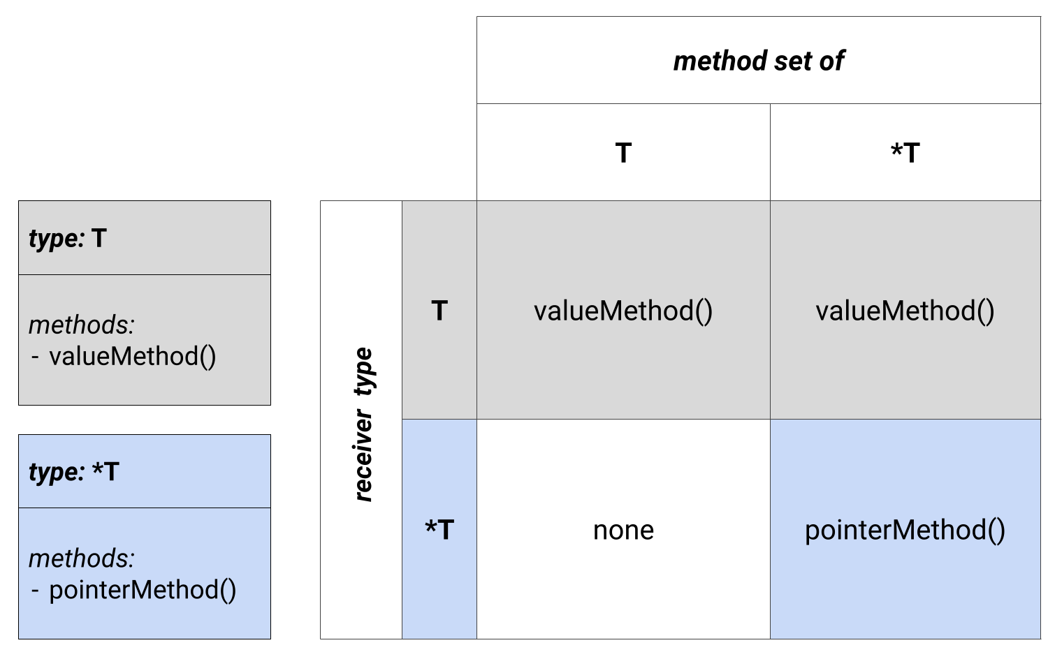

Slide 18
Embedding Interfaces
As we know that the Go language does not support inheritance, but the Go interface fully supports embedding. In embedding, an interface can embed other interfaces or an interface can embed other interface’s method signatures in it, the result of both is the same

Slide 19
type interface_name1 interface {
Method1()
}
type interface_name2 interface {
Method2()
}
type finalinterface_name interface {
interface_name1
interface_name2
}
type interface_name1 interface {
Method1()
}
type interface_name2 interface {
Method2()
}
type finalinterface_name interface {
Method1()
Method2()
}

Slide 20
Empty Interface
- An empty interface can be used to hold any data and it can be a useful parameter since it can work with any type.
- Empty interfaces are used by code that handles values of unknown type. For example, fmt.Print takes any number of arguments of type interface{}.

Slide 21
Empty Interface
func main() {
var i interface{}
describe(i)
i = 42
describe(i)
i = "hello"
describe(i)
}
func describe(i interface{}) {
fmt.Printf("(%v, %T)\n", i, i)
}
Output -
(<nil>, <nil>)
(42, int)
(hello, string)

Slide 22
Working With Interfaces
- Go interface slice
- Go Stringer interface
- Go interface{}
- Go type assertion
- Go type switch

Slide 23
Resources and Closure
Reference
https://go.dev/
Check out..
- Github - CypherAk007
- LinkedIn - Abhishek Krishna TM

Slide 24
THANK YOU
ABHISHEK KRISHNA TM - ENG19CS0011

