Slide 1
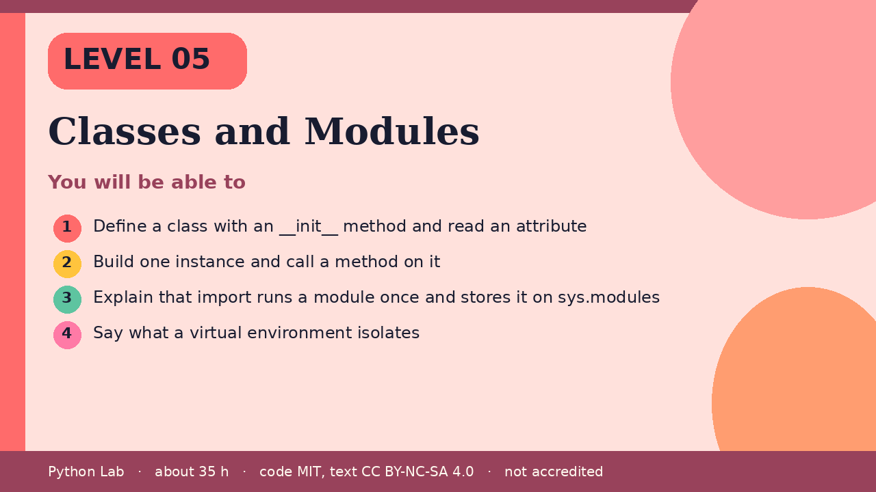

LEVEL 05
Classes and Modules
About 35 hours · Python 3.8+
Project: A Note class plus a one-line import check
Examples run on CPython 3.12.3
Define a class with an __init__ method and read
an attribute
Cover card for this Level
1
How to use these slides
Read a slide, then try the code
in your editor or the lab runner.
Green panels are real output.
Not accredited coursework.
Build one instance and call a method on it
2
Explain that import runs a module once and
stores it on sys.modules
3
Say what a virtual environment isolates
4
cyphermonkeylabs.com
Python Lab · Level 05 · Classes and Modules · 1 / 11

Slide 2
You will be able to
Define a class with an __init__ method and read an
attribute
1
2
Build one instance and call a method on it
Explain that import runs a module once and stores it
on sys.modules
3
4
Say what a virtual environment isolates
cyphermonkeylabs.com
Python Lab · Level 05 · Classes and Modules · 2 / 11

Slide 3
A class bundles data and methods
›
The tutorial describes a class as a way to
bundle data and the operations on that data.
›
__init__ runs when you call the class.
›
self is the instance.
cyphermonkeylabs.com
Python Lab · Level 05 · Classes and Modules · 3 / 11

Slide 4
A class bundles data and methods
Python
Output
class Note:
def __init__(self, text):
self.text = text
def shout(self):
return self.text.upper()
note = Note("hello")
print(note.text)
print(note.shout())
hello
HELLO
Printed by CPython 3.12.3. Not invented.
cyphermonkeylabs.com
Python Lab · Level 05 · Classes and Modules · 4 / 11

Slide 5
import runs the module once
›
import executes a module and keeps the
module object in sys.modules.
›
Importing again returns that same
object.
›
json is in the standard library, so this
sample does not install anything.
cyphermonkeylabs.com
Python Lab · Level 05 · Classes and Modules · 5 / 11

Slide 6
import runs the module once
Python
Output
import json
import sys
print("json" in sys.modules)
print(json.dumps({"ok": True}))
True
{"ok": true}
Printed by CPython 3.12.3. Not invented.
cyphermonkeylabs.com
Python Lab · Level 05 · Classes and Modules · 6 / 11

Slide 7
A virtual environment isolates installs
›
venv creates an environment with its own
site-packages.
›
PEP 405 is the design.
›
This page does not create an environment during
the build, because that would write a folder.
›
The check below only reports that the venv
module can be found.
cyphermonkeylabs.com
Python Lab · Level 05 · Classes and Modules · 7 / 11

Slide 8
A virtual environment isolates installs
Python
import importlib.util
print(importlib.util.find_spec("venv") is not None)
cyphermonkeylabs.com
Python Lab · Level 05 · Classes and Modules · 8 / 11

Slide 9
A virtual environment isolates installs
output (1/1)
Output
True
Printed by CPython 3.12.3. Not invented.
cyphermonkeylabs.com
Python Lab · Level 05 · Classes and Modules · 9 / 11

Slide 10
Check yourself
1
When does __init__ run?
2
Where does Python keep a module after
the first import?
3
What does a virtual environment keep
separate?
cyphermonkeylabs.com
Python Lab · Level 05 · Classes and Modules · 10 / 11

Slide 11
Sources and licence
Python tutorial: Classes
https://docs.python.org/3/tutorial/classes.html
1
Python tutorial: Modules
https://docs.python.org/3/tutorial/modules.html
2
Python docs: venv
https://docs.python.org/3/library/venv.html
3
PEP 405 – Python Virtual Environments
https://peps.python.org/pep-0405/
4
Code © CypherMonkeyLabs, MIT. Text CC BY-NC-SA 4.0.
Educational material, not accredited coursework. No outcome is promised.
Python is a trademark of the Python Software Foundation.
cyphermonkeylabs.com
Python Lab · Level 05 · Classes and Modules · 11 / 11

