Slide 1
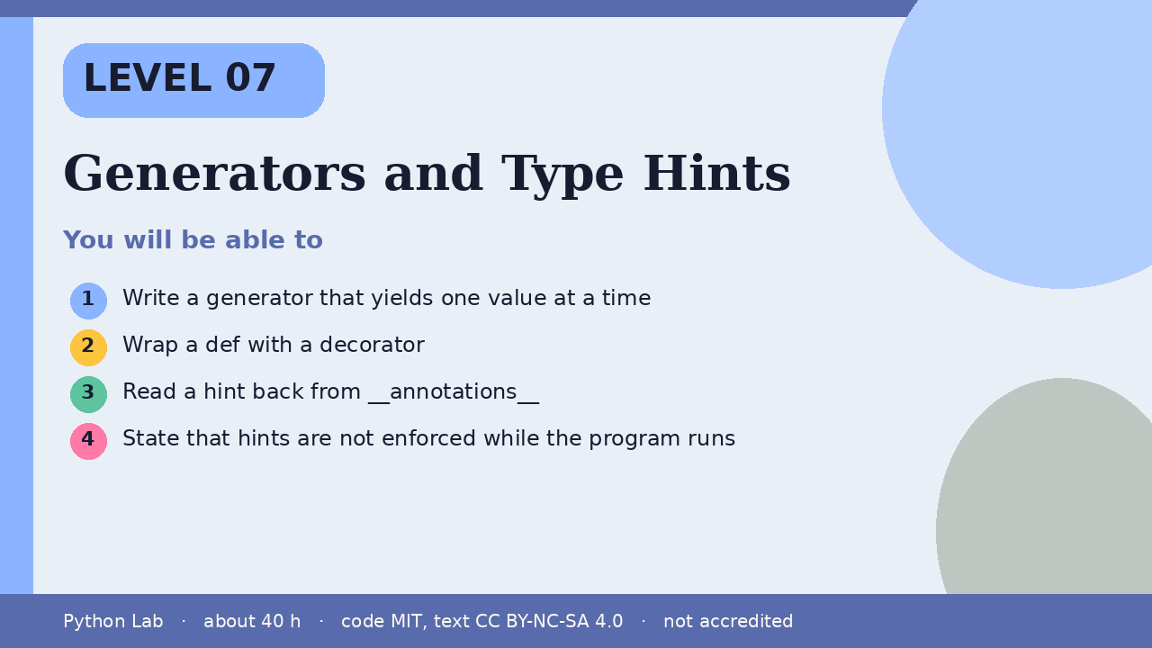

LEVEL 07
Generators and Type Hints
About 40 hours · Python 3.9+
Project: A countdown generator with a hinted total
Examples run on CPython 3.12.3
Write a generator that yields one value at a
time
Cover card for this Level
1
How to use these slides
Read a slide, then try the code
in your editor or the lab runner.
Green panels are real output.
Not accredited coursework.
Wrap a def with a decorator
2
Read a hint back from __annotations__
3
State that hints are not enforced while the
program runs
4
cyphermonkeylabs.com
Python Lab · Level 07 · Generators and Type Hints · 1 / 11

Slide 2
You will be able to
1
Write a generator that yields one value at a time
2
Wrap a def with a decorator
3
Read a hint back from __annotations__
State that hints are not enforced while the program
runs
4
cyphermonkeylabs.com
Python Lab · Level 07 · Generators and Type Hints · 2 / 11

Slide 3
yield pauses and resumes
›
A generator produces values one at a
time.
›
list pulls every yielded value.
›
The reference describes yield as the way
a generator sends a value to its caller.
cyphermonkeylabs.com
Python Lab · Level 07 · Generators and Type Hints · 3 / 11

Slide 4
yield pauses and resumes
Python
Output
def countdown(n):
while n:
yield n
n -= 1
print(list(countdown(3)))
[3, 2, 1]
Printed by CPython 3.12.3. Not invented.
cyphermonkeylabs.com
Python Lab · Level 07 · Generators and Type Hints · 4 / 11

Slide 5
A decorator wraps a def
The glossary defines a decorator as a way to
return a new object, usually a wrapper, that
replaces the original.
›
›
This wrapper uppercases the returned
text.
›
Hints are not involved yet.
cyphermonkeylabs.com
Python Lab · Level 07 · Generators and Type Hints · 5 / 11

Slide 6
A decorator wraps a def
Python
Output
def shout(fn):
def wrapped(text):
return fn(text).upper()
return wrapped
@shout
def greet(text):
return "hi " + text
print(greet("ada"))
HI ADA
Printed by CPython 3.12.3. Not invented.
cyphermonkeylabs.com
Python Lab · Level 07 · Generators and Type Hints · 6 / 11

Slide 7
Hints are readable, not a gate
›
PEP 484 says type hints are optional and are
not required at runtime.
›
CPython stores them on __annotations__.
›
It does not reject a call that ignores them.
›
typing is the standard-library module for the
hint names.
cyphermonkeylabs.com
Python Lab · Level 07 · Generators and Type Hints · 7 / 11

Slide 8
Hints are readable, not a gate
Python
def add(a: int, b: int) -> int:
return a + b
print(add(2, 5))
print(add.__annotations__["return"].__name__)
cyphermonkeylabs.com
Python Lab · Level 07 · Generators and Type Hints · 8 / 11

Slide 9
Hints are readable, not a gate output (1/1)
Output
7
int
Printed by CPython 3.12.3. Not invented.
cyphermonkeylabs.com
Python Lab · Level 07 · Generators and Type Hints · 9 / 11

Slide 10
Check yourself
1
What does yield do that return does not?
2
What does a decorator return?
3
Does Python stop you when a call ignores
a hint?
cyphermonkeylabs.com
Python Lab · Level 07 · Generators and Type Hints · 10 / 11

Slide 11
Sources and licence
Python reference: Yield expressions
https://docs.python.org/3/reference/expressions.html#yield-expressions
1
Python glossary: decorator
https://docs.python.org/3/glossary.html#term-decorator
2
Python docs: typing
https://docs.python.org/3/library/typing.html
3
PEP 484 – Type Hints
https://peps.python.org/pep-0484/
4
Code © CypherMonkeyLabs, MIT. Text CC BY-NC-SA 4.0.
Educational material, not accredited coursework. No outcome is promised.
Python is a trademark of the Python Software Foundation.
cyphermonkeylabs.com
Python Lab · Level 07 · Generators and Type Hints · 11 / 11

