Slide 1
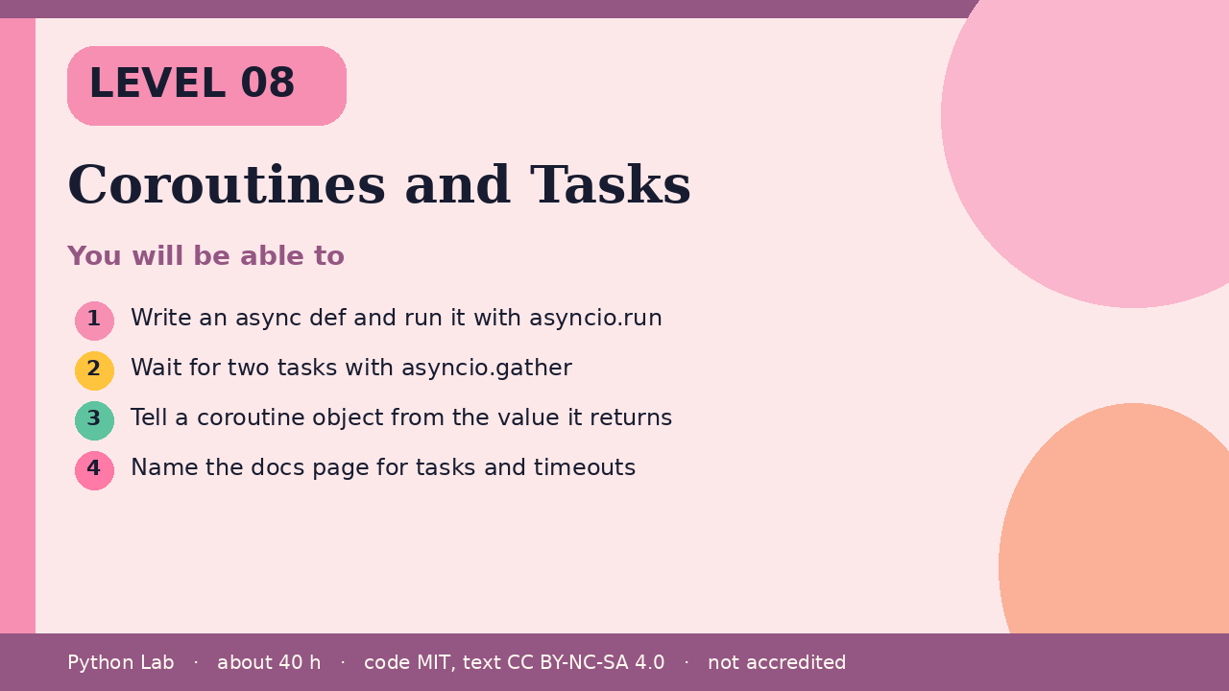

LEVEL 08
Coroutines and Tasks
About 40 hours · Python 3.8+
Project: Two tiny coroutines gathered into one result
Examples run on CPython 3.12.3
Write an async def and run it with asyncio.run
Cover card for this Level
1
How to use these slides
Read a slide, then try the code
in your editor or the lab runner.
Green panels are real output.
Not accredited coursework.
Wait for two tasks with asyncio.gather
2
Tell a coroutine object from the value it
returns
3
Name the docs page for tasks and timeouts
4
cyphermonkeylabs.com
Python Lab · Level 08 · Coroutines and Tasks · 1 / 11

Slide 2
You will be able to
1
Write an async def and run it with asyncio.run
2
Wait for two tasks with asyncio.gather
3
Tell a coroutine object from the value it returns
4
Name the docs page for tasks and timeouts
cyphermonkeylabs.com
Python Lab · Level 08 · Coroutines and Tasks · 2 / 11

Slide 3
asyncio.run drives one coroutine
›
async def defines a coroutine.
›
Calling it does not run the body; it
returns a coroutine object.
›
asyncio.run creates an event loop, runs
that coroutine, and closes the loop.
cyphermonkeylabs.com
Python Lab · Level 08 · Coroutines and Tasks · 3 / 11

Slide 4
asyncio.run drives one coroutine
Python
Output
import asyncio
async def ping():
return "pong"
print(asyncio.run(ping()))
pong
Printed by CPython 3.12.3. Not invented.
cyphermonkeylabs.com
Python Lab · Level 08 · Coroutines and Tasks · 4 / 11

Slide 5
gather waits for more than one
asyncio.gather schedules the awaitables
together and returns their results in
order.
›
›
The tasks page in the docs covers
gather, cancellation, and timeouts.
cyphermonkeylabs.com
Python Lab · Level 08 · Coroutines and Tasks · 5 / 11

Slide 6
gather waits for more than one
Python
import asyncio
async def add(a, b):
return a + b
async def main():
return await asyncio.gather(add(1, 2), add(3, 4))
print(asyncio.run(main()))
cyphermonkeylabs.com
Python Lab · Level 08 · Coroutines and Tasks · 6 / 11

Slide 7
gather waits for more than one output (1/1)
Output
[3, 7]
Printed by CPython 3.12.3. Not invented.
cyphermonkeylabs.com
Python Lab · Level 08 · Coroutines and Tasks · 7 / 11

Slide 8
A coroutine is not the result
Printing the coroutine object without
awaiting it does not print the return
value.
›
This sample closes it so the build does
not warn about a coroutine that was
never awaited.
›
cyphermonkeylabs.com
Python Lab · Level 08 · Coroutines and Tasks · 8 / 11

Slide 9
A coroutine is not the result
Python
Output
async def ping():
return "pong"
coro = ping()
print(type(coro).__name__)
coro.close()
coroutine
Printed by CPython 3.12.3. Not invented.
cyphermonkeylabs.com
Python Lab · Level 08 · Coroutines and Tasks · 9 / 11

Slide 10
Check yourself
1
What does calling an async def return
before you await it?
2
What does asyncio.gather preserve about
order?
3
Which docs page describes create_task
and timeouts?
cyphermonkeylabs.com
Python Lab · Level 08 · Coroutines and Tasks · 10 / 11

Slide 11
Sources and licence
Python docs: asyncio
https://docs.python.org/3/library/asyncio.html
1
Python docs: Coroutines and Tasks
https://docs.python.org/3/library/asyncio-task.html
2
Code © CypherMonkeyLabs, MIT. Text CC BY-NC-SA 4.0.
Educational material, not accredited coursework. No outcome is promised.
Python is a trademark of the Python Software Foundation.
cyphermonkeylabs.com
Python Lab · Level 08 · Coroutines and Tasks · 11 / 11

