Slide 1
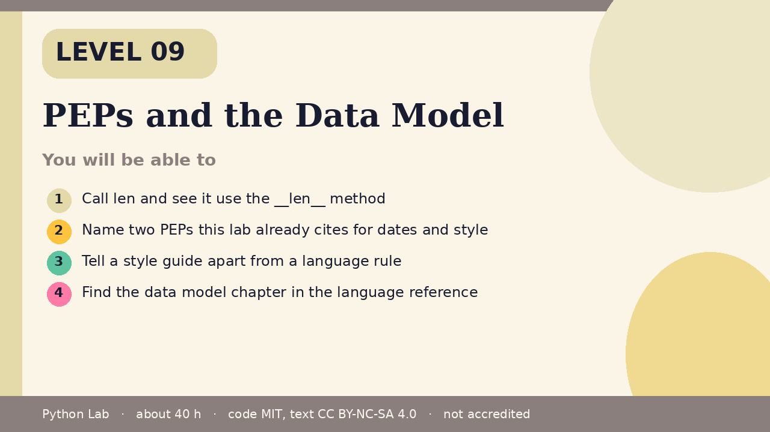

LEVEL 09
PEPs and the Data Model
About 40 hours · Python 3.8+
Project: A small Bag whose len is the number of items
you stored
Examples run on CPython 3.12.3
Cover card for this Level
Call len and see it use the __len__ method
1
How to use these slides
Read a slide, then try the code
in your editor or the lab runner.
Green panels are real output.
Not accredited coursework.
Name two PEPs this lab already cites for dates
and style
2
Tell a style guide apart from a language rule
3
Find the data model chapter in the language
reference
4
cyphermonkeylabs.com
Python Lab · Level 09 · PEPs and the Data Model · 1 / 10

Slide 2
You will be able to
1
Call len and see it use the __len__ method
Name two PEPs this lab already cites for dates and
style
2
3
Tell a style guide apart from a language rule
Find the data model chapter in the language
reference
4
cyphermonkeylabs.com
Python Lab · Level 09 · PEPs and the Data Model · 2 / 10

Slide 3
len asks the object
›
The data model says operations such as
len look up special methods.
›
A class can supply __len__.
›
len then returns that integer.
cyphermonkeylabs.com
Python Lab · Level 09 · PEPs and the Data Model · 3 / 10

Slide 4
len asks the object
Python
Output
class Bag:
def __init__(self, items):
self.items = list(items)
def __len__(self):
return len(self.items)
print(len(Bag(["pen", "ink"])))
print("py".__len__())
2
2
Printed by CPython 3.12.3. Not invented.
cyphermonkeylabs.com
Python Lab · Level 09 · PEPs and the Data Model · 4 / 10

Slide 5
A PEP is a design document
›
PEP 8 is the style guide.
›
Formatting tools may warn about it.
›
CPython does not reject a program for ignoring
it.
›
PEP 790 is the 3.15 release schedule.
cyphermonkeylabs.com
Python Lab · Level 09 · PEPs and the Data Model · 5 / 10

Slide 6
A PEP is a design document (continued)
›
This lab's sources record 3.15.0 final
as 9 October 2026 from that PEP.
›
The PEP index lists the documents.
cyphermonkeylabs.com
Python Lab · Level 09 · PEPs and the Data Model · 6 / 10

Slide 7
A PEP is a design document
Python
Output
cited = ["PEP 8", "PEP 790"]
print(", ".join(cited))
print("style guide" != "syntax rule")
PEP 8, PEP 790
True
Printed by CPython 3.12.3. Not invented.
cyphermonkeylabs.com
Python Lab · Level 09 · PEPs and the Data Model · 7 / 10

Slide 8
Where to read next
›
Open the data model chapter when you
want the rule for a special method.
›
Open the PEP index when you want the
history of a change.
›
The pages linked under Sources are the
ones this Level uses.
cyphermonkeylabs.com
Python Lab · Level 09 · PEPs and the Data Model · 8 / 10

Slide 9
Check yourself
1
Which method does len call?
2
Is PEP 8 a compiler rule?
3
Which PEP in the sources is the 3.15
schedule?
cyphermonkeylabs.com
Python Lab · Level 09 · PEPs and the Data Model · 9 / 10

Slide 10
Sources and licence
Python reference: Data model
https://docs.python.org/3/reference/datamodel.html
1
PEP 8 – Style Guide for Python Code
https://peps.python.org/pep-0008/
2
PEP 790 – Python 3.15 Release Schedule
https://peps.python.org/pep-0790/
3
PEP index
https://peps.python.org/
4
Code © CypherMonkeyLabs, MIT. Text CC BY-NC-SA 4.0.
Educational material, not accredited coursework. No outcome is promised.
Python is a trademark of the Python Software Foundation.
cyphermonkeylabs.com
Python Lab · Level 09 · PEPs and the Data Model · 10 / 10

