Slide 1
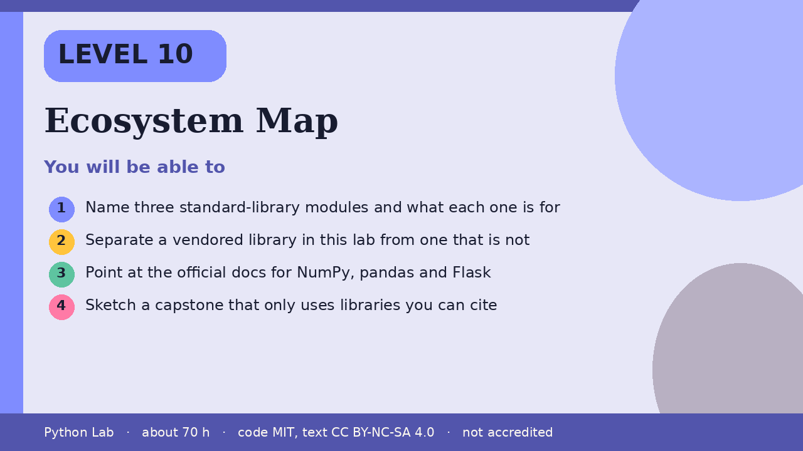

LEVEL 10
Ecosystem Map
About 70 hours · Python 3.8+
Project: A one-page map of three libraries, each with
its docs link
Examples run on CPython 3.12.3
Cover card for this Level
Name three standard-library modules and what
each one is for
1
How to use these slides
Read a slide, then try the code
in your editor or the lab runner.
Green panels are real output.
Not accredited coursework.
Separate a vendored library in this lab from
one that is not
2
Point at the official docs for NumPy, pandas
and Flask
3
Sketch a capstone that only uses libraries you
can cite
4
cyphermonkeylabs.com
Python Lab · Level 10 · Ecosystem Map · 1 / 10

Slide 2
You will be able to
Name three standard-library modules and what each
one is for
1
Separate a vendored library in this lab from one
that is not
2
Point at the official docs for NumPy, pandas and
Flask
3
Sketch a capstone that only uses libraries you can
cite
4
cyphermonkeylabs.com
Python Lab · Level 10 · Ecosystem Map · 2 / 10

Slide 3
Start from the standard library
›
json, pathlib and math ship with Python.
›
You do not install them.
This sample only checks that math.sqrt
returns the value the docs describe for a
perfect square.
›
cyphermonkeylabs.com
Python Lab · Level 10 · Ecosystem Map · 3 / 10

Slide 4
Start from the standard library
Python
Output
import math
mods = ["json", "pathlib", "math"]
print(", ".join(mods))
print(math.sqrt(9))
json, pathlib, math
3.0
Printed by CPython 3.12.3. Not invented.
cyphermonkeylabs.com
Python Lab · Level 10 · Ecosystem Map · 4 / 10

Slide 5
This lab vendors some libraries and not others
›
The browser runtime in this site vendors
Pyodide, NumPy 2.4.6 and pandas 3.0.2.
›
Flask is not part of that runtime.
›
The build machine for these files does not import Flask or
NumPy, so this page does not print their versions.
›
Read their docs from the links under Sources.
cyphermonkeylabs.com
Python Lab · Level 10 · Ecosystem Map · 5 / 10

Slide 6
This lab vendors some libraries and not others
Python
vendored_here = ["Pyodide", "NumPy", "pandas"]
not_vendored_here = ["Flask"]
print("vendored: " + ", ".join(vendored_here))
print("not vendored: " + ", ".join(not_vendored_here))
cyphermonkeylabs.com
Python Lab · Level 10 · Ecosystem Map · 6 / 10

Slide 7
This lab vendors some libraries and not others
output (1/1)
Output
vendored: Pyodide, NumPy, pandas
not vendored: Flask
Printed by CPython 3.12.3. Not invented.
cyphermonkeylabs.com
Python Lab · Level 10 · Ecosystem Map · 7 / 10

Slide 8
A capstone is a project you choose
Pick one small program that uses the standard
library, and optionally NumPy or pandas
inside the lab's browser runner.
›
›
Write down the docs page you followed.
›
This Level does not grade it and does not
promise a job, a certificate, or a result.
cyphermonkeylabs.com
Python Lab · Level 10 · Ecosystem Map · 8 / 10

Slide 9
Check yourself
1
Name one standard-library module from
the first sample.
2
Which of NumPy and Flask is vendored in
this lab's browser runtime?
3
What belongs on your capstone map
besides the library name?
cyphermonkeylabs.com
Python Lab · Level 10 · Ecosystem Map · 9 / 10

Slide 10
Sources and licence
The Python Tutorial
https://docs.python.org/3/tutorial/index.html
1
NumPy documentation
https://numpy.org/doc/stable/
2
pandas documentation
https://pandas.pydata.org/docs/
3
Flask documentation
https://flask.palletsprojects.com/
4
Pyodide
https://pyodide.org/en/stable/
5
Code © CypherMonkeyLabs, MIT. Text CC BY-NC-SA 4.0.
Educational material, not accredited coursework. No outcome is promised.
Python is a trademark of the Python Software Foundation.
cyphermonkeylabs.com
Python Lab · Level 10 · Ecosystem Map · 10 / 10

