Slide 1
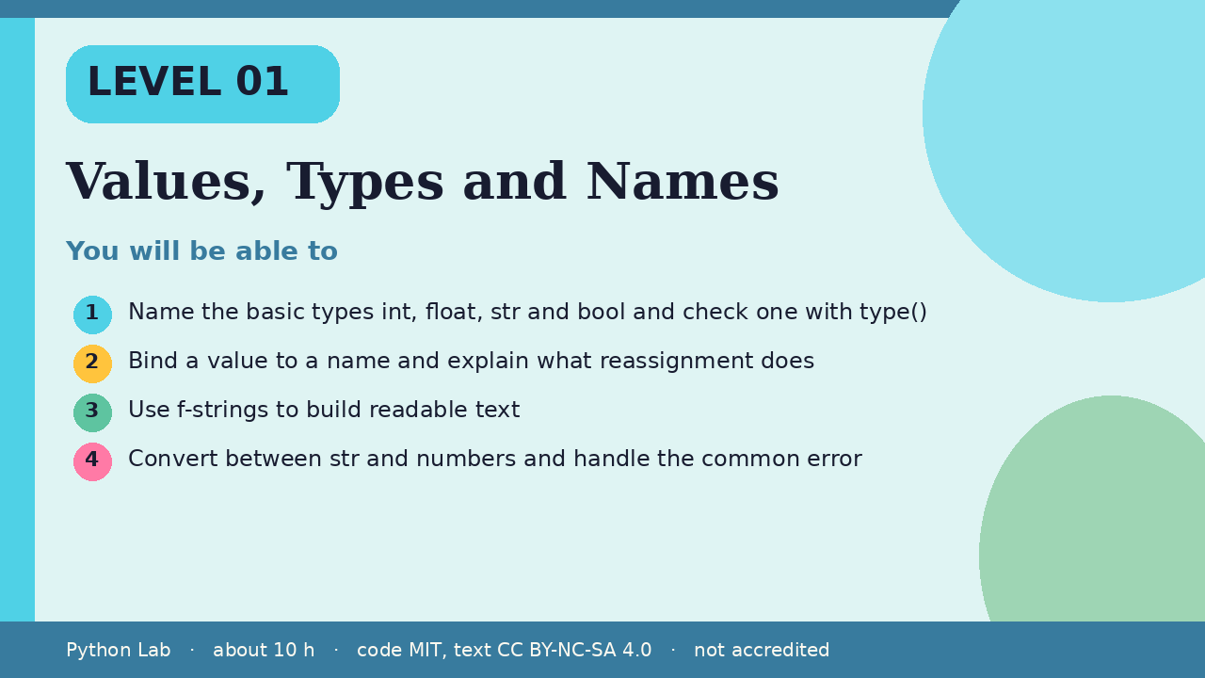
LEVEL 01
Values, Types and Names
About 10 hours · Python 3.8+
Project: A tip and tax calculator
Examples run on CPython 3.12.3
Name the basic types int, float, str and bool
and check one with type()
Cover card for this Level
1
How to use these slides
Read a slide, then try the code
in your editor or the lab runner.
Green panels are real output.
Not accredited coursework.
Bind a value to a name and explain what
reassignment does
2
Use f-strings to build readable text
3
Convert between str and numbers and handle the
common error
4
Python Lab · Level 01 · Values, Types and Names · 1 / 16

Slide 2
You will be able to
Name the basic types int, float, str and bool and
check one with type()
1
Bind a value to a name and explain what reassignment
does
2
3
Use f-strings to build readable text
Convert between str and numbers and handle the
common error
4
Python Lab · Level 01 · Values, Types and Names · 2 / 16

Slide 3
Values have types
›
Every value has a type.
›
type() tells you which.
Python Lab · Level 01 · Values, Types and Names · 3 / 16

Slide 4
Values have types
Python
Output
print(type(42))
print(type(3.5))
print(type("hi"))
print(type(True))
<class 'int'>
<class 'float'>
<class 'str'>
<class 'bool'>
Printed by CPython 3.12.3. Not invented.
Python Lab · Level 01 · Values, Types and Names · 4 / 16

Slide 5
Names point at values
›
A name is a label stuck to a value.
›
Reassigning moves the label; it does not
change the old value.
Python Lab · Level 01 · Values, Types and Names · 5 / 16

Slide 6
Names point at values
Python
Output
total = 10
total = total + 5
print(total)
15
Printed by CPython 3.12.3. Not invented.
Python Lab · Level 01 · Values, Types and Names · 6 / 16

Slide 7
Numbers and arithmetic
›
/ always gives a float.
›
// divides and rounds down.
›
% gives the remainder.
Python Lab · Level 01 · Values, Types and Names · 7 / 16

Slide 8
Numbers and arithmetic
Python
Output
print(7 / 2)
print(7 // 2)
print(7 % 2)
print(2 ** 10)
3.5
3
1
1024
Printed by CPython 3.12.3. Not invented.
Python Lab · Level 01 · Values, Types and Names · 8 / 16

Slide 9
Strings and f-strings
›
An f-string puts values into text.
›
Format specs control decimals.
Python Lab · Level 01 · Values, Types and Names · 9 / 16

Slide 10
Strings and f-strings
Python
Output
name = "Ada"
price = 19.5
print(f"{name} pays {price:.2f}")
print(name.upper(), len(name))
Ada pays 19.50
ADA 3
Printed by CPython 3.12.3. Not invented.
Python Lab · Level 01 · Values, Types and Names · 10 / 16

Slide 11
Converting types
›
input() always returns text.
›
Convert it before doing arithmetic.
Python Lab · Level 01 · Values, Types and Names · 11 / 16

Slide 12
Converting types
Python
text = "12"
print(int(text) + 1)
try:
int("twelve")
except ValueError as err:
print("ValueError:", err)
Python Lab · Level 01 · Values, Types and Names · 12 / 16

Slide 13
Converting types output (1/1)
Output
13
ValueError: invalid literal for int() with base 10: 'twelve'
Printed by CPython 3.12.3. Not invented.
Python Lab · Level 01 · Values, Types and Names · 13 / 16

Slide 14
Check yourself
1
What is type(7 / 2)?
2
After total = 10 and total = total + 5,
what does total name?
3
Why must you convert the result of
input() before adding numbers?
Python Lab · Level 01 · Values, Types and Names · 14 / 16

Slide 15
Project: Tip and tax calculator
Ask for a bill, a tip percent and a tax
percent, convert them, and print the
total with two decimals using an
f-string.
›
Python Lab · Level 01 · Values, Types and Names · 15 / 16

Slide 16
Sources and licence
Python tutorial: An informal introduction
https://docs.python.org/3/tutorial/introduction.html
1
Python reference: The data model
https://docs.python.org/3/reference/datamodel.html
2
Python docs: Formatted string literals
https://docs.python.org/3/reference/lexical_analysis.html#f-strings
3
PEP 8 Style Guide for Python Code
https://peps.python.org/pep-0008/
4
Code © CypherMonkeyLabs, MIT. Text CC BY-NC-SA 4.0.
Educational material, not accredited coursework. No outcome is promised.
Python is a trademark of the Python Software Foundation.
Python Lab · Level 01 · Values, Types and Names · 16 / 16

