Slide 1
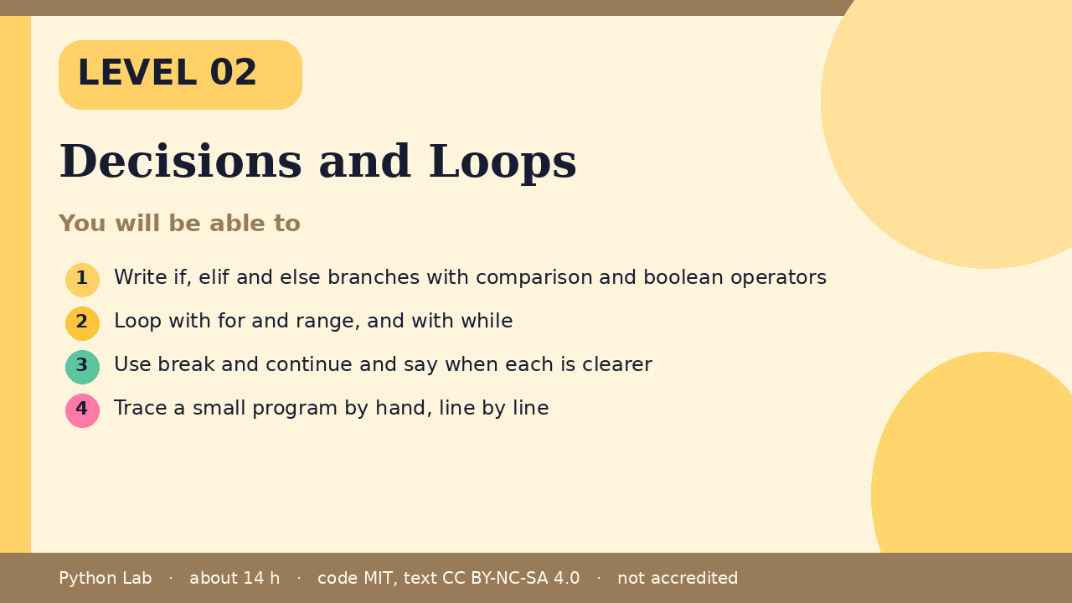
LEVEL 02
Decisions and Loops
About 14 hours · Python 3.8+
Project: A number-guess game
Examples run on CPython 3.12.3
Write if, elif and else branches with
comparison and boolean operators
Cover card for this Level
1
How to use these slides
Read a slide, then try the code
in your editor or the lab runner.
Green panels are real output.
Not accredited coursework.
Loop with for and range, and with while
2
Use break and continue and say when each is
clearer
3
Trace a small program by hand, line by line
4
Python Lab · Level 02 · Decisions and Loops · 1 / 17

Slide 2
You will be able to
Write if, elif and else branches with comparison and
boolean operators
1
2
Loop with for and range, and with while
3
Use break and continue and say when each is clearer
4
Trace a small program by hand, line by line
Python Lab · Level 02 · Decisions and Loops · 2 / 17

Slide 3
Decisions with if
›
Python runs the first branch whose test
is true.
›
Indentation shows which lines belong to
the branch.
Python Lab · Level 02 · Decisions and Loops · 3 / 17

Slide 4
Decisions with if
Python
Output
score = 72
if score >= 90:
grade = "A"
elif score >= 70:
grade = "C or better"
else:
grade = "keep practising"
print(grade)
C or better
Printed by CPython 3.12.3. Not invented.
Python Lab · Level 02 · Decisions and Loops · 4 / 17

Slide 5
Comparing and combining
›
Comparisons give booleans.
›
Combine them with and, or, not.
Python Lab · Level 02 · Decisions and Loops · 5 / 17

Slide 6
Comparing and combining
Python
Output
age = 15
has_ticket = True
print(age >= 13 and has_ticket)
print(not has_ticket)
True
False
Printed by CPython 3.12.3. Not invented.
Python Lab · Level 02 · Decisions and Loops · 6 / 17

Slide 7
Loops with for and range
›
range(n) counts from 0 up to n - 1.
Python Lab · Level 02 · Decisions and Loops · 7 / 17

Slide 8
Loops with for and range
Python
Output
for i in range(3):
print("lap", i)
print(sum(range(1, 6)))
lap 0
lap 1
lap 2
15
Printed by CPython 3.12.3. Not invented.
Python Lab · Level 02 · Decisions and Loops · 8 / 17

Slide 9
Loops with while
›
A while loop repeats as long as its test
is true.
›
Change something inside, or it never
ends.
Python Lab · Level 02 · Decisions and Loops · 9 / 17

Slide 10
Loops with while
Python
Output
n = 3
while n > 0:
print(n)
n -= 1
print("go")
3
2
1
go
Printed by CPython 3.12.3. Not invented.
Python Lab · Level 02 · Decisions and Loops · 10 / 17

Slide 11
break and continue
›
break leaves the loop.
›
continue skips to the next pass.
Python Lab · Level 02 · Decisions and Loops · 11 / 17

Slide 12
break and continue
Python
Output
for i in range(10):
if i % 2 == 0:
continue
if i > 7:
break
print(i)
1
3
5
7
Printed by CPython 3.12.3. Not invented.
Python Lab · Level 02 · Decisions and Loops · 12 / 17

Slide 13
Tracing by hand
›
Write each name and its value after
every line.
›
Compare your table with the output.
Python Lab · Level 02 · Decisions and Loops · 13 / 17

Slide 14
Tracing by hand
Python
Output
total = 0
for i in range(1, 4):
total += i
print(i, total)
1 1
2 3
3 6
Printed by CPython 3.12.3. Not invented.
Python Lab · Level 02 · Decisions and Loops · 14 / 17

Slide 15
Check yourself
1
Which branch runs when score is 70?
2
How many times does for i in range(3)
run its body?
3
What does continue do?
Python Lab · Level 02 · Decisions and Loops · 15 / 17

Slide 16
Project: Number-guess game
›
The computer picks a number from 1 to 20
(use a fixed number first).
Loop until the guess is right, print
"higher" or "lower", and stop after 6
tries.
›
Python Lab · Level 02 · Decisions and Loops · 16 / 17

Slide 17
Sources and licence
Python tutorial: More control flow tools
https://docs.python.org/3/tutorial/controlflow.html
1
PEP 8 Style Guide for Python Code
https://peps.python.org/pep-0008/
2
Python docs: Truth value testing
https://docs.python.org/3/library/stdtypes.html#truth-value-testing
3
Code © CypherMonkeyLabs, MIT. Text CC BY-NC-SA 4.0.
Educational material, not accredited coursework. No outcome is promised.
Python is a trademark of the Python Software Foundation.
Python Lab · Level 02 · Decisions and Loops · 17 / 17

