Slide 1
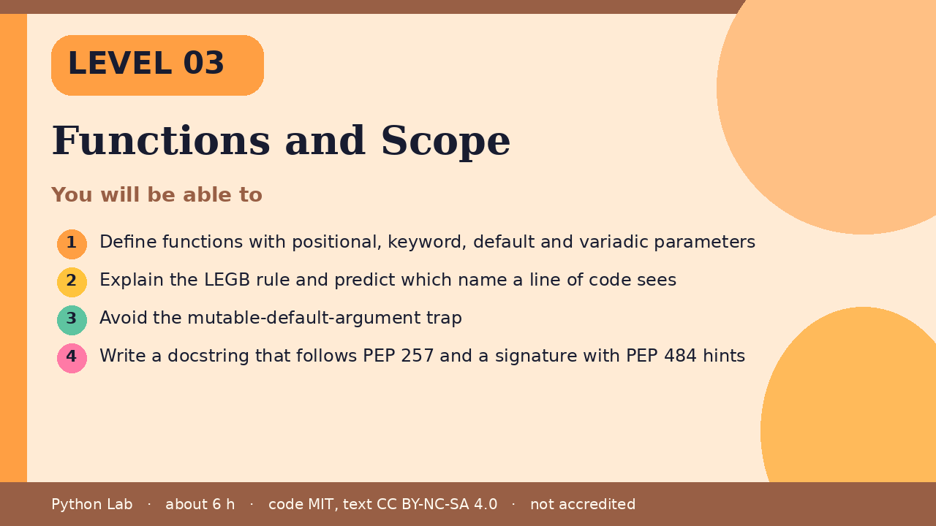
LEVEL 03
Functions and Scope
About 6 hours · Python 3.8+
Project: Unit converter CLI with tested pure functions
Examples run on CPython 3.12.3
Define functions with positional, keyword,
default and variadic parameters
Cover card for this Level
1
How to use these slides
Read a slide, then try the code
in your editor or the lab runner.
Green panels are real output.
Not accredited coursework.
Explain the LEGB rule and predict which name a
line of code sees
2
Avoid the mutable-default-argument trap
3
Write a docstring that follows PEP 257 and a
signature with PEP 484 hints
4
Python Lab · Level 03 · Functions and Scope · 1 / 20

Slide 2
You will be able to
Define functions with positional, keyword, default
and variadic parameters
1
Explain the LEGB rule and predict which name a line
of code sees
2
3
Avoid the mutable-default-argument trap
Write a docstring that follows PEP 257 and a
signature with PEP 484 hints
4
Python Lab · Level 03 · Functions and Scope · 2 / 20

Slide 3
Why functions
›
A function gives a block of code a name
so you can reuse it and test it alone.
Keep each function doing one thing and
returning a value instead of printing
it.
›
Python Lab · Level 03 · Functions and Scope · 3 / 20

Slide 4
Defining and calling
Python
Output
def area(width, height=1):
"""Return the area of a rectangle."""
return width * height
print(area(3, 4))
print(area(5))
print(area(height=2, width=6))
12
5
12
Printed by CPython 3.12.3. Not invented.
Python Lab · Level 03 · Functions and Scope · 4 / 20

Slide 5
Defining and calling
›
width is a required parameter; height
has a default value.
›
Keyword arguments let you pass values by
name, in any order.
Python Lab · Level 03 · Functions and Scope · 5 / 20

Slide 6
Variadic parameters
args collects extra positional arguments
into a tuple; kwargs collects extra
keyword arguments into a dict.
›
Python Lab · Level 03 · Functions and Scope · 6 / 20

Slide 7
Variadic parameters
Python
def describe(*args, **kwargs):
return len(args), sorted(kwargs)
print(describe(1, 2, 3, unit="cm", colour="red"))
Python Lab · Level 03 · Functions and Scope · 7 / 20

Slide 8
Variadic parameters output (1/1)
Output
(3, ['colour', 'unit'])
Printed by CPython 3.12.3. Not invented.
Python Lab · Level 03 · Functions and Scope · 8 / 20

Slide 9
The LEGB rule
Python looks a name up in this order:
Local, Enclosing function, Global,
Built-in.
›
Assigning to a name inside a function
makes it local to that function unless
you declare global or nonlocal.
›
Python Lab · Level 03 · Functions and Scope · 9 / 20

Slide 10
The LEGB rule
Python
Output
x = "global"
def outer():
x = "enclosing"
def inner():
nonlocal x
x = "changed by inner"
inner()
return x
print(outer())
print(x)
changed by inner
global
Printed by CPython 3.12.3. Not invented.
Python Lab · Level 03 · Functions and Scope · 10 / 20

Slide 11
The mutable default trap
›
Default values are evaluated once, when
the def runs, not on each call.
Python Lab · Level 03 · Functions and Scope · 11 / 20

Slide 12
The mutable default trap (1/2)
Python
def add_item(item, bucket=[]):
bucket.append(item)
return bucket
print(add_item("a"))
print(add_item("b"))
def add_item_safe(item, bucket=None):
if bucket is None:
bucket = []
bucket.append(item)
return bucket
print(add_item_safe("a"))
Python Lab · Level 03 · Functions and Scope · 12 / 20

Slide 13
The mutable default trap (2/2)
Python
print(add_item_safe("b"))
Python Lab · Level 03 · Functions and Scope · 13 / 20

Slide 14
The mutable default trap output (1/1)
Output
['a']
['a', 'b']
['a']
['b']
Printed by CPython 3.12.3. Not invented.
Python Lab · Level 03 · Functions and Scope · 14 / 20

Slide 15
Docstrings and hints
›
PEP 257 describes docstring conventions: a
short summary line, then detail if needed.
›
PEP 484 defines the type-hint syntax.
›
Hints are not enforced at run time; a checker
such as mypy or pyright reads them.
Python Lab · Level 03 · Functions and Scope · 15 / 20

Slide 16
Docstrings and hints
Python
def celsius_to_fahrenheit(c: float) -> float:
"""Convert degrees Celsius to degrees Fahrenheit."""
return c * 9 / 5 + 32
print(celsius_to_fahrenheit(100))
Python Lab · Level 03 · Functions and Scope · 16 / 20

Slide 17
Docstrings and hints output (1/1)
Output
212.0
Printed by CPython 3.12.3. Not invented.
Python Lab · Level 03 · Functions and Scope · 17 / 20

Slide 18
Check yourself
1
What does area(height=2, width=6)
return?
2
Why does add_item("b") print ['a', 'b']?
3
Which scope does a name assigned inside
inner belong to without nonlocal?
Python Lab · Level 03 · Functions and Scope · 18 / 20

Slide 19
Project: Unit converter CLI
Build three pure functions (km to miles,
kg to pounds, Celsius to Fahrenheit),
add docstrings and hints, then write
four pytest tests.
›
›
Stretch: accept values with argparse.
Python Lab · Level 03 · Functions and Scope · 19 / 20

Slide 20
Sources and licence
Python tutorial: More on defining functions
https://docs.python.org/3/tutorial/controlflow.html#defining-functions
1
PEP 257 Docstring Conventions
https://peps.python.org/pep-0257/
2
PEP 484 Type Hints
https://peps.python.org/pep-0484/
3
PEP 8 Style Guide for Python Code
https://peps.python.org/pep-0008/
4
Python reference: Naming and binding
https://docs.python.org/3/reference/executionmodel.html#naming-and-binding
5
Code © CypherMonkeyLabs, MIT. Text CC BY-NC-SA 4.0.
Educational material, not accredited coursework. No outcome is promised.
Python is a trademark of the Python Software Foundation.
Python Lab · Level 03 · Functions and Scope · 20 / 20

