Slide 1
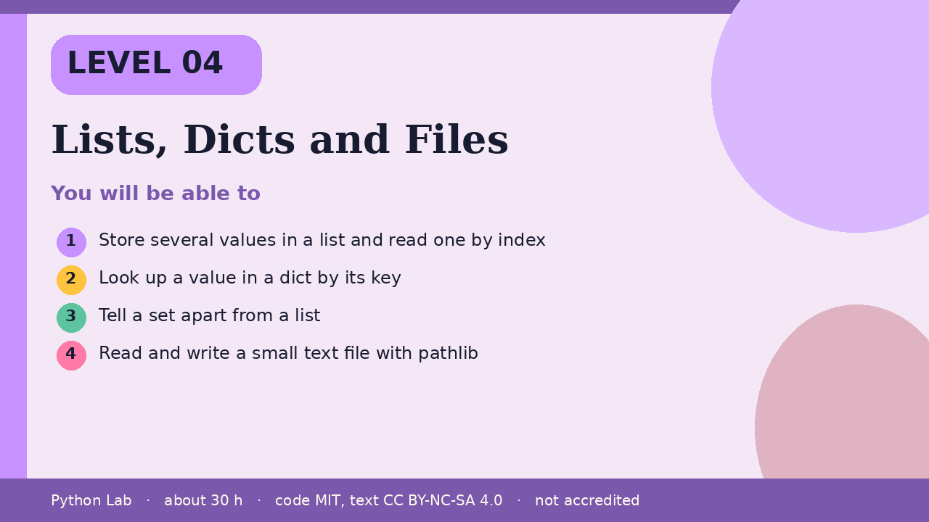
LEVEL 04
Lists, Dicts and Files
About 30 hours · Python 3.8+
Project: An address card kept in a dict and saved as a
text file
Examples run on CPython 3.12.3
Cover card for this Level
Store several values in a list and read one by
index
1
How to use these slides
Read a slide, then try the code
in your editor or the lab runner.
Green panels are real output.
Not accredited coursework.
Look up a value in a dict by its key
2
Tell a set apart from a list
3
Read and write a small text file with pathlib
4
Python Lab · Level 04 · Lists, Dicts and Files · 1 / 14

Slide 2
You will be able to
1
Store several values in a list and read one by index
2
Look up a value in a dict by its key
3
Tell a set apart from a list
4
Read and write a small text file with pathlib
Python Lab · Level 04 · Lists, Dicts and Files · 2 / 14

Slide 3
A list keeps an order
›
A list is a mutable sequence.
›
Indexes start at 0.
›
append adds at the end.
Python Lab · Level 04 · Lists, Dicts and Files · 3 / 14

Slide 4
A list keeps an order (continued)
The Python wiki's TimeComplexity page
describes CPython list costs; it is
community notes, not a language
guarantee.
›
Python Lab · Level 04 · Lists, Dicts and Files · 4 / 14

Slide 5
A list keeps an order
Python
Output
names = ["Ada", "Grace"]
names.append("Guido")
print(names[0], len(names))
print(names[1:3])
Ada 3
['Grace', 'Guido']
Printed by CPython 3.12.3. Not invented.
Python Lab · Level 04 · Lists, Dicts and Files · 5 / 14

Slide 6
A dict looks up by key
›
A dict maps each key to one value.
›
in tests keys, not values.
Python Lab · Level 04 · Lists, Dicts and Files · 6 / 14

Slide 7
A dict looks up by key
Python
Output
card = {"name": "Ada", "year": 1815}
print(card["name"])
print("year" in card)
print(card.get("city", "unknown"))
Ada
True
unknown
Printed by CPython 3.12.3. Not invented.
Python Lab · Level 04 · Lists, Dicts and Files · 7 / 14

Slide 8
A set keeps unique items
›
A set does not keep order you can rely
on, and it drops duplicates.
Python Lab · Level 04 · Lists, Dicts and Files · 8 / 14

Slide 9
A set keeps unique items
Python
Output
tools = {"pen", "ink", "pen"}
print(len(tools))
print("ink" in tools)
2
True
Printed by CPython 3.12.3. Not invented.
Python Lab · Level 04 · Lists, Dicts and Files · 9 / 14

Slide 10
A file should say its encoding
›
pathlib.Path is the object-oriented way
to name a file.
›
write_text and read_text take an
encoding.
›
This sample uses a temporary directory so the
build does not leave a file behind.
Python Lab · Level 04 · Lists, Dicts and Files · 10 / 14

Slide 11
A file should say its encoding
Python
import tempfile
from pathlib import Path
folder = Path(tempfile.mkdtemp())
path = folder / "card.txt"
path.write_text("Ada\n", encoding="utf-8")
print(path.read_text(encoding="utf-8").strip())
Python Lab · Level 04 · Lists, Dicts and Files · 11 / 14

Slide 12
A file should say its encoding output (1/1)
Output
Ada
Printed by CPython 3.12.3. Not invented.
Python Lab · Level 04 · Lists, Dicts and Files · 12 / 14

Slide 13
Check yourself
1
What is the index of the first item in a
list?
2
Does in on a dict test keys or values?
3
Why pass encoding="utf-8" when you read
text?
Python Lab · Level 04 · Lists, Dicts and Files · 13 / 14

Slide 14
Sources and licence
Python docs: Built-in types
https://docs.python.org/3/library/stdtypes.html
1
Python docs: pathlib
https://docs.python.org/3/library/pathlib.html
2
Python tutorial: Input and output
https://docs.python.org/3/tutorial/inputoutput.html
3
Python wiki: TimeComplexity
https://wiki.python.org/moin/TimeComplexity
4
Code © CypherMonkeyLabs, MIT. Text CC BY-NC-SA 4.0.
Educational material, not accredited coursework. No outcome is promised.
Python is a trademark of the Python Software Foundation.
Python Lab · Level 04 · Lists, Dicts and Files · 14 / 14

