Slide 1
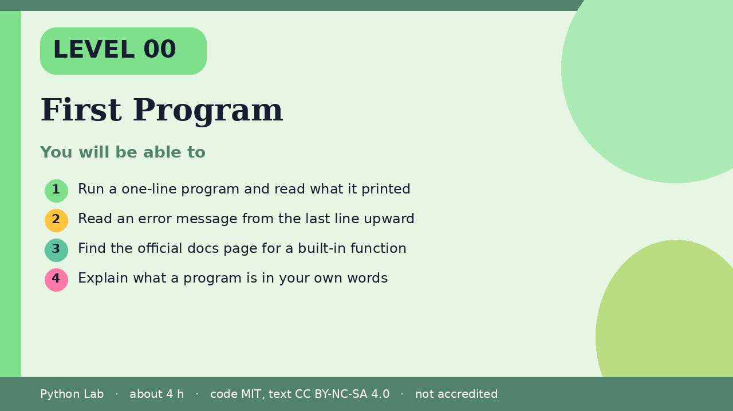

LEVEL 00
First Program
About 4 hours · Python 3.8+
Project: A Hello, me card
Examples run on CPython 3.12.3
Run a one-line program and read what it printed
Cover card for this Level
1
How to use these slides
Read a slide, then try the code
in your editor or the lab runner.
Green panels are real output.
Not accredited coursework.
Read an error message from the last line upward
2
Find the official docs page for a built-in
function
3
Explain what a program is in your own words
4
cyphermonkeylabs.com
Python Lab · Level 00 · First Program · 1 / 15

Slide 2
You will be able to
1
Run a one-line program and read what it printed
2
Read an error message from the last line upward
3
Find the official docs page for a built-in function
4
Explain what a program is in your own words
cyphermonkeylabs.com
Python Lab · Level 00 · First Program · 2 / 15

Slide 3
What a program is
›
A program is a list of instructions a
computer follows in order.
›
Python reads your file from the top and
does each instruction in turn.
cyphermonkeylabs.com
Python Lab · Level 00 · First Program · 3 / 15

Slide 4
Your first print
›
print shows a value on the screen.
›
Text goes inside quotes.
cyphermonkeylabs.com
Python Lab · Level 00 · First Program · 4 / 15

Slide 5
Your first print
Python
Output
print("Hello, me")
print("My first program")
Hello, me
My first program
Printed by CPython 3.12.3. Not invented.
cyphermonkeylabs.com
Python Lab · Level 00 · First Program · 5 / 15

Slide 6
Printing more than text
›
You can print numbers and do arithmetic.
›
Python works the answer out before it
prints.
cyphermonkeylabs.com
Python Lab · Level 00 · First Program · 6 / 15

Slide 7
Printing more than text
Python
Output
print(2 + 3)
print("2 + 3 =", 2 + 3)
5
2 + 3 = 5
Printed by CPython 3.12.3. Not invented.
cyphermonkeylabs.com
Python Lab · Level 00 · First Program · 7 / 15

Slide 8
Reading an error
›
An error is not a failure.
›
A traceback is a map: start at the last
line, which names the problem.
›
This example catches the error so you
can see its message.
cyphermonkeylabs.com
Python Lab · Level 00 · First Program · 8 / 15

Slide 9
Reading an error
Python
try:
print(undefined_name)
except NameError as err:
print("NameError:", err)
cyphermonkeylabs.com
Python Lab · Level 00 · First Program · 9 / 15

Slide 10
Reading an error output (1/1)
Output
NameError: name 'undefined_name' is not defined
Printed by CPython 3.12.3. Not invented.
cyphermonkeylabs.com
Python Lab · Level 00 · First Program · 10 / 15

Slide 11
Find the docs
›
Every built-in function has a page in
the official documentation.
›
Search for print() and read its
parameters, such as sep and end.
cyphermonkeylabs.com
Python Lab · Level 00 · First Program · 11 / 15

Slide 12
Find the docs
Python
Output
print("a", "b", "c", sep="-")
print("no newline", end="!")
print()
a-b-c
no newline!
Printed by CPython 3.12.3. Not invented.
cyphermonkeylabs.com
Python Lab · Level 00 · First Program · 12 / 15

Slide 13
Check yourself
1
What does print("2 + 3") show, compared
with print(2 + 3)?
2
Which line of a traceback names the
problem?
3
What does sep change?
cyphermonkeylabs.com
Python Lab · Level 00 · First Program · 13 / 15

Slide 14
Project: Hello, me card
Print four lines: your name, one thing
you are learning, one thing you like,
and today's goal.
›
›
Then change the sep between two items.
cyphermonkeylabs.com
Python Lab · Level 00 · First Program · 14 / 15

Slide 15
Sources and licence
Python tutorial: An informal introduction
https://docs.python.org/3/tutorial/introduction.html
1
Python docs: print()
https://docs.python.org/3/library/functions.html#print
2
Python tutorial: Errors and exceptions
https://docs.python.org/3/tutorial/errors.html
3
Code © CypherMonkeyLabs, MIT. Text CC BY-NC-SA 4.0.
Educational material, not accredited coursework. No outcome is promised.
Python is a trademark of the Python Software Foundation.
cyphermonkeylabs.com
Python Lab · Level 00 · First Program · 15 / 15

