Slide 1
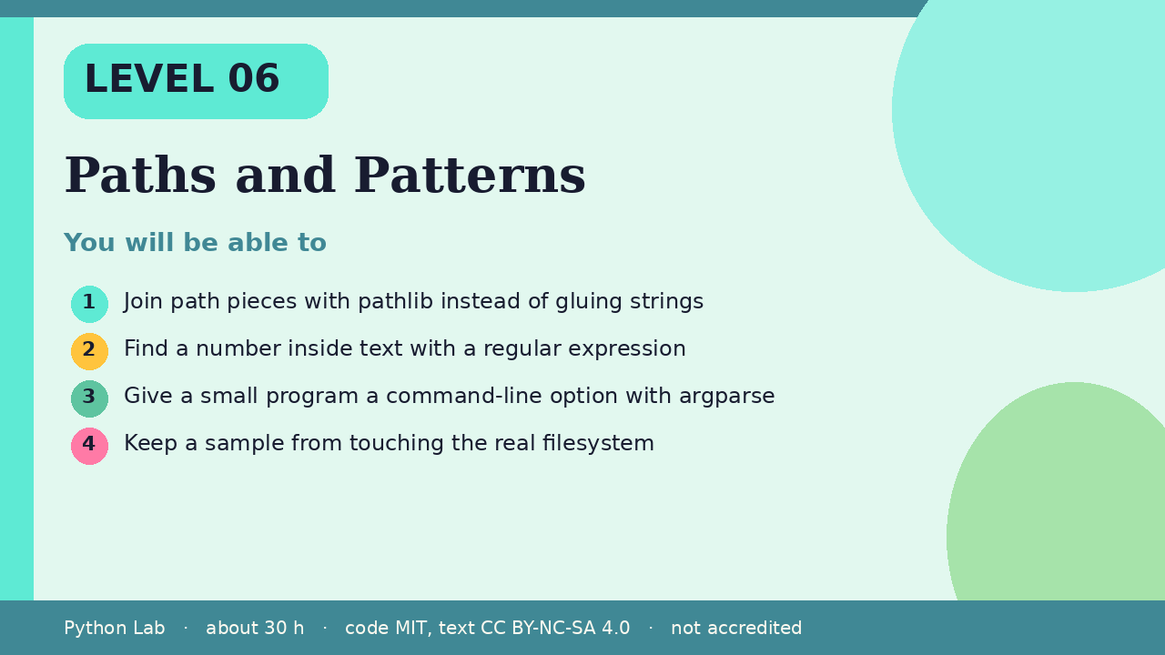

LEVEL 06
Paths and Patterns
About 30 hours · Python 3.8+
Project: A tiny note-sorter that accepts --title
Examples run on CPython 3.12.3
Join path pieces with pathlib instead of gluing
strings
Cover card for this Level
1
How to use these slides
Read a slide, then try the code
in your editor or the lab runner.
Green panels are real output.
Not accredited coursework.
Find a number inside text with a regular
expression
2
Give a small program a command-line option with
argparse
3
Keep a sample from touching the real filesystem
4
cyphermonkeylabs.com
Python Lab · Level 06 · Paths and Patterns · 1 / 11

Slide 2
You will be able to
Join path pieces with pathlib instead of gluing
strings
1
2
Find a number inside text with a regular expression
Give a small program a command-line option with
argparse
3
4
Keep a sample from touching the real filesystem
cyphermonkeylabs.com
Python Lab · Level 06 · Paths and Patterns · 2 / 11

Slide 3
Paths are objects
›
pathlib.Path joins pieces with /.
›
as_posix shows the forward-slash form,
which is what the docs use in examples.
cyphermonkeylabs.com
Python Lab · Level 06 · Paths and Patterns · 3 / 11

Slide 4
Paths are objects
Python
Output
from pathlib import Path
path = Path("notes") / "week" / "a.txt"
print(path.as_posix())
print(path.suffix)
notes/week/a.txt
.txt
Printed by CPython 3.12.3. Not invented.
cyphermonkeylabs.com
Python Lab · Level 06 · Paths and Patterns · 4 / 11

Slide 5
Patterns find a piece of text
›
re.search returns a match object, or
None when nothing matched.
›
This example looks for digits.
cyphermonkeylabs.com
Python Lab · Level 06 · Paths and Patterns · 5 / 11

Slide 6
Patterns find a piece of text
Python
Output
import re
match = re.search(r"\d+", "room 12b")
print(match.group(0) if match else "none")
print(re.sub(r"\s+", "-", "a b c"))
12
a-b-c
Printed by CPython 3.12.3. Not invented.
cyphermonkeylabs.com
Python Lab · Level 06 · Paths and Patterns · 6 / 11

Slide 7
argparse reads options
parse_args([]) reads an empty argument
list, so the build does not depend on
how the script was started.
›
›
The default is what a user would get if
they passed no flags.
cyphermonkeylabs.com
Python Lab · Level 06 · Paths and Patterns · 7 / 11

Slide 8
argparse reads options
Python
import argparse
parser = argparse.ArgumentParser(prog="notes")
parser.add_argument("--title", default="inbox")
args = parser.parse_args([])
print(args.title)
cyphermonkeylabs.com
Python Lab · Level 06 · Paths and Patterns · 8 / 11

Slide 9
argparse reads options output (1/1)
Output
inbox
Printed by CPython 3.12.3. Not invented.
cyphermonkeylabs.com
Python Lab · Level 06 · Paths and Patterns · 9 / 11

Slide 10
Check yourself
1
What does Path("notes") / "a.txt"
produce?
2
What does re.search return when the
pattern is missing?
3
Why does this page call parse_args([])?
cyphermonkeylabs.com
Python Lab · Level 06 · Paths and Patterns · 10 / 11

Slide 11
Sources and licence
Python docs: pathlib
https://docs.python.org/3/library/pathlib.html
1
Python docs: re
https://docs.python.org/3/library/re.html
2
Python docs: argparse
https://docs.python.org/3/library/argparse.html
3
Code © CypherMonkeyLabs, MIT. Text CC BY-NC-SA 4.0.
Educational material, not accredited coursework. No outcome is promised.
Python is a trademark of the Python Software Foundation.
cyphermonkeylabs.com
Python Lab · Level 06 · Paths and Patterns · 11 / 11

