Slide 1
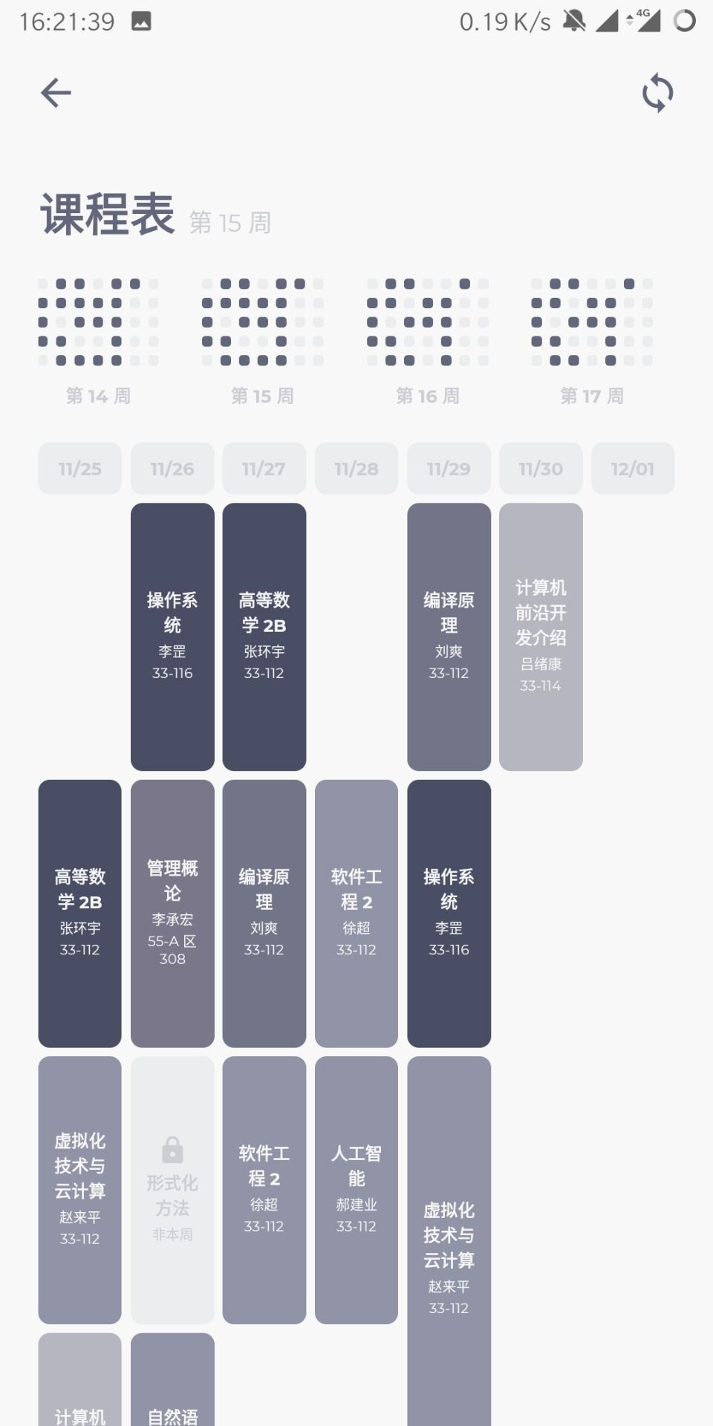
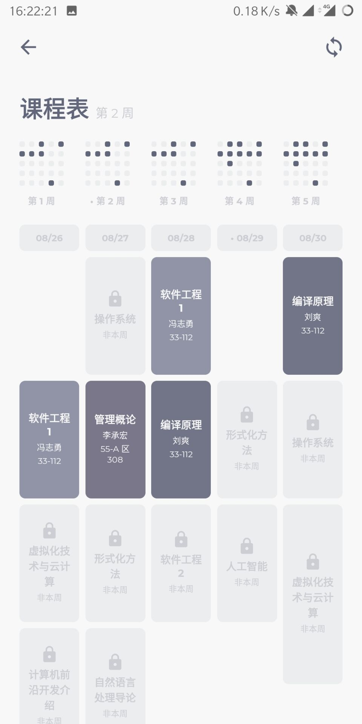

Slide 2
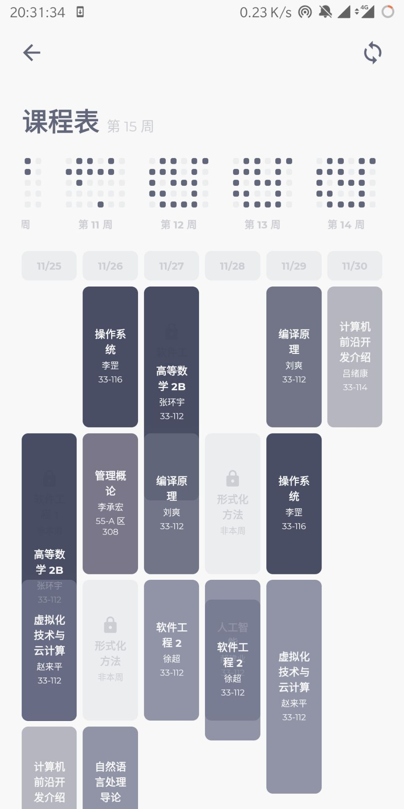

Slide 3
WEEK 1
WEEK 2
WEEK 3
WEEK 1
WEEK 2
WEEK 3
WEEK 1
WEEK 2
WEEK 3
WEEK 1
WEEK 2
WEEK 3

Slide 4
WEEK 12

Slide 5
A
A
A
A
CONFLICT
+
B
B
B
SCHEDULING
CONFLICT
SOLUTION I
WePeiyang 4.0
SOLUTION II
TimeTable++
SOLUTION III
WePeiyang 3.0

Slide 6
B
B
A
B
A
B
A
A
+
+
TYPE a
Complete overlap
SOLUTION
TYPE b
Proper subset
SOLUTION
(A on the top layer)

Slide 7
A
A
A
B
C
A
B
C
+
B
B
+
+
TYPE c
Mutual overlap
SOLUTION
TYPE d
Conflict of 3 or more courses
SOLUTION

Slide 8
B
A
B
A
A
B
+
+
+
TYPE a
TYPE b
TYPE c

Slide 9
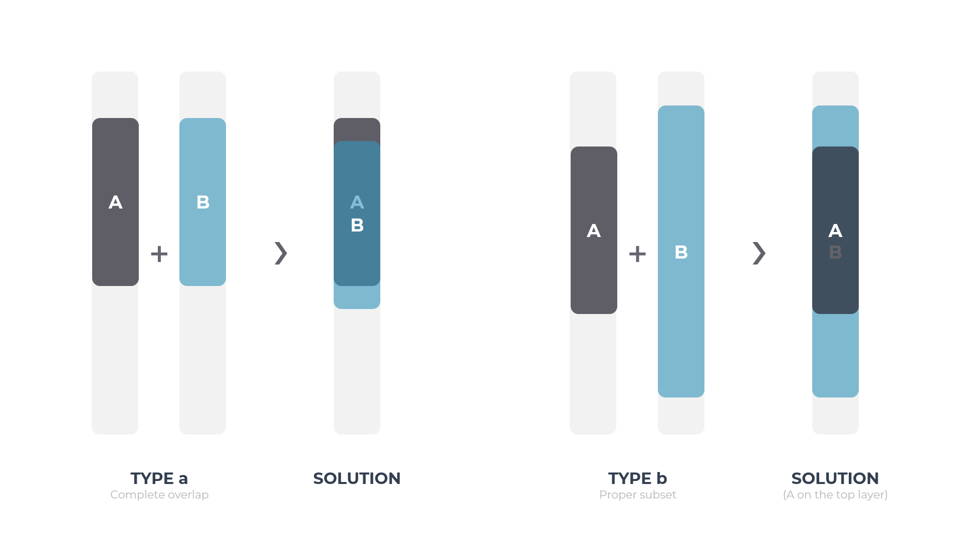

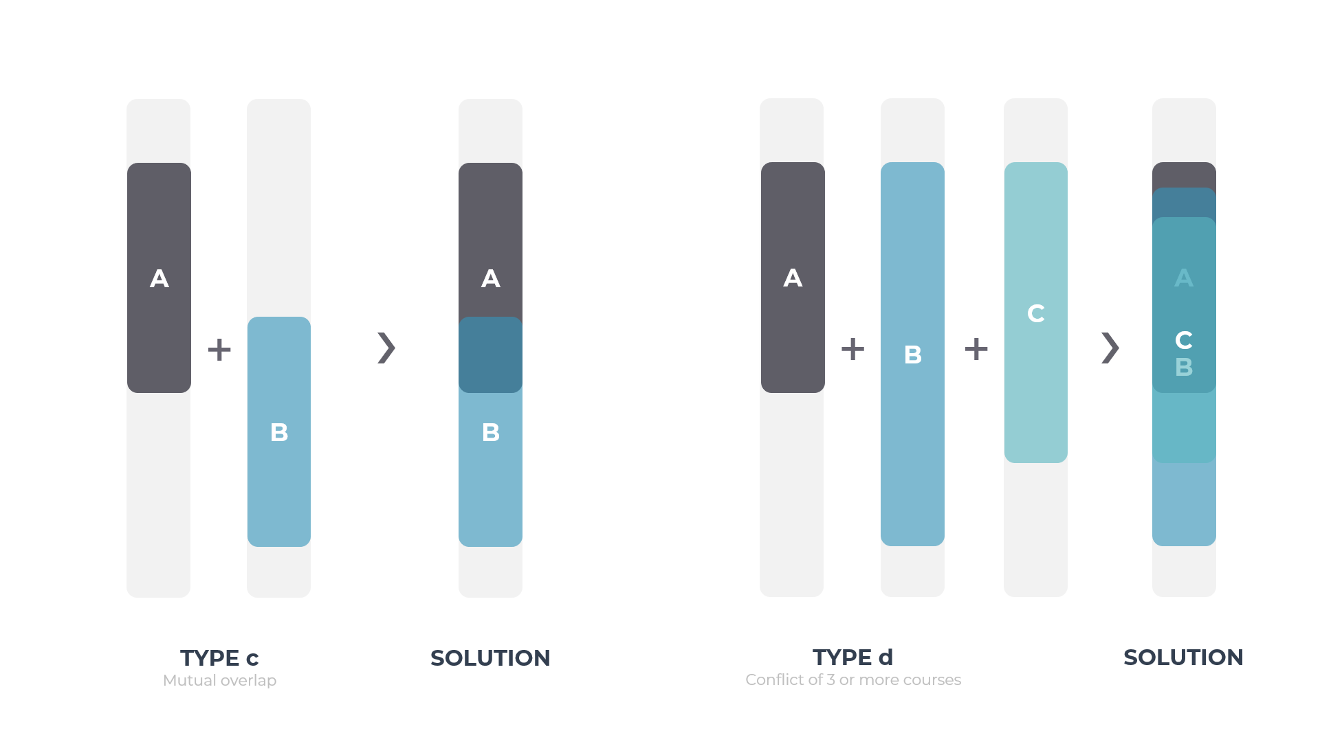

Slide 10
A
B
B
A
B
C
A
A
+
+
+
B
+
+
TYPE a
Complete overlap
TYPE b
Proper subset
TYPE c
Mutual overlap
Special Case
Conflict of 3 or more courses

