Slide 1
African Governance Landscape
Ibrahim Index Analysis 2014-2023
By Cyprian Fusi
Binati AInalytics
https://binati-ai.com

Slide 2
Presentation Agenda
Overview: What is the Ibrahim Index?
Continental Snapshot: Current State of Governance
Top Performers: Success Stories
Improvement Champions: Countries Making Progress
Challenges: Areas Needing Attention
Regional Analysis: Geographic Patterns
Category Deep Dive: What Drives Good Governance?
Recommendations & Next Steps

Slide 3
What is the Ibrahim Index of African Governance?
Most comprehensive assessment of African governance
Covers 54 countries across the continent (2014-2023)
Measures 4 key categories with 16 subcategories
Scores range from 0-100 (100 = best governance)
Data from 100+ indicators (World Bank, UN, AfDB, etc.)
Published annually by Mo Ibrahim Foundation (MIF)

Slide 4
Four Pillars of African Governance
1. Security & Rule of Law - Safety, justice, accountability, anti-corruption
2. Participation, Rights & Inclusion - Democracy, rights, equality
3. Foundations for Economic Opportunity - Infrastructure, business environment
4. Human Development - Health, education, social protection, environment
2023 Continental Averages:
Security & Rule of Law: 47.9 | Participation & Rights: 48.7
Economic Opportunity: 48.9 | Human Development: 51.6

Slide 5
Continental Snapshot (2023)
54
49.3
75.3
19.0
African
Countries
Continental
Average
Highest Score
(Seychelles)
Lowest Score
(South Sudan)
56.3-point spread demonstrates vast governance diversity across Africa

Slide 6
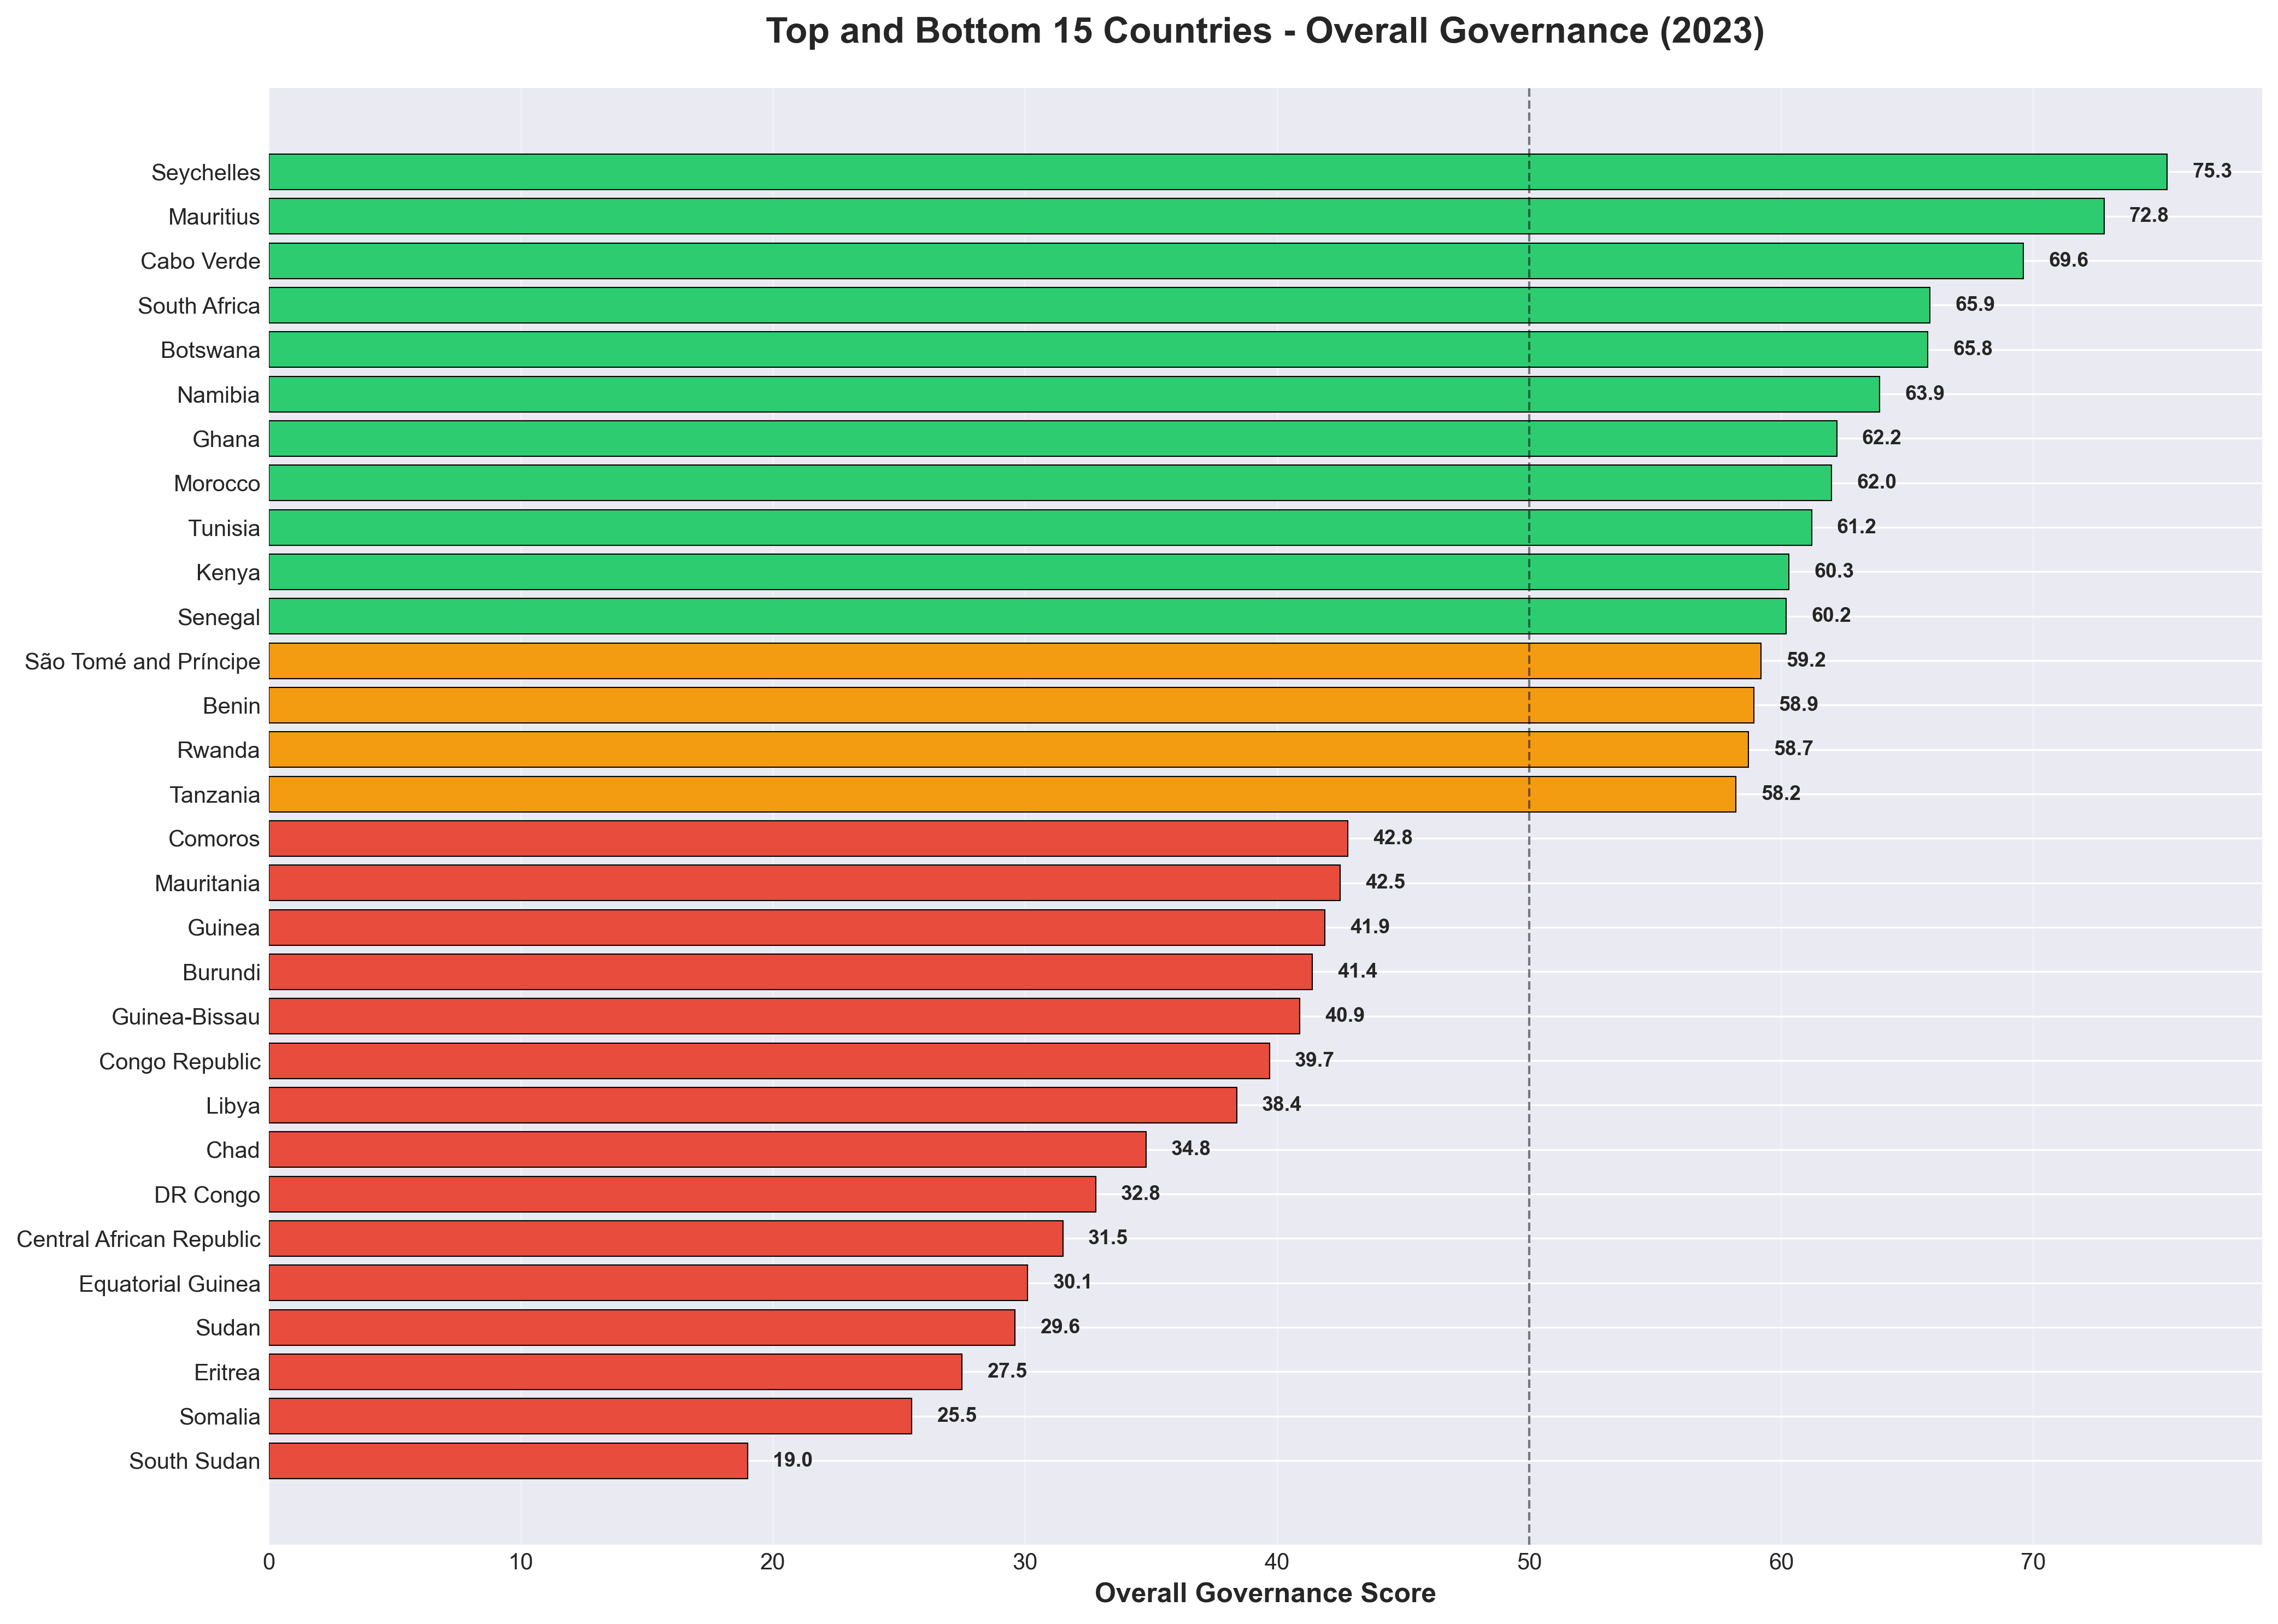
Top & Bottom Performers (2023)

Slide 7
Excellence in Governance: Top 10 Countries
Rank | Country | Score
1 | Seychelles | 75.3
2 | Mauritius | 72.8
3 | Cabo Verde | 69.6
4 | South Africa | 65.9
5 | Botswana | 65.8
6 | Namibia | 63.9
7 | Ghana | 62.2
8 | Morocco | 62.0
9 | Tunisia | 61.2
10 | Kenya | 60.3

Slide 8
What Makes Top Performers Succeed?
Island Nation Advantage: Top 3 are all islands (Seychelles, Mauritius, Cabo Verde)
Manageable scale of governance
Economic specialization (tourism, services)
Strong institutions and political stability
Mainland Leaders: South Africa (4th), Botswana (5th) demonstrate continental success
Common Success Factors:
Strong rule of law and judicial independence
Low corruption levels
High human development investments
Democratic governance and civic participation

Slide 9
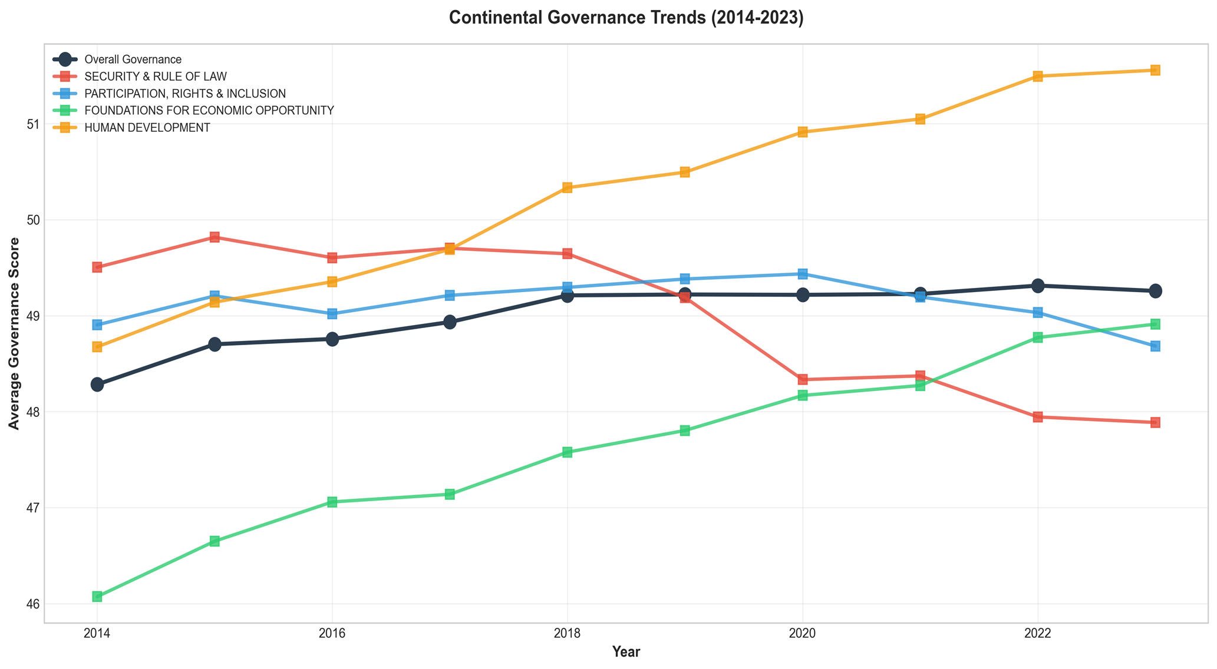
10-Year Governance Trends (2014-2023)

Slide 10
Remarkable Improvements: Top Gainers (2014-2023)
Rank | Country | Improvement
1 | Seychelles | +10.0
2 | Gambia | +7.2
3 | Somalia | +6.8
4 | Sierra Leone | +6.4
5 | Angola | +5.8
6 | Morocco | +5.3
7 | Togo | +4.2
8 | Côte d'Ivoire | +4.1

Slide 11
Success Stories: What Drove Improvement?
Seychelles (+10.0 points): Sustained economic diversification and institutional strengthening
Gambia (+7.2 points): Democratic transition after 22-year autocracy
2016 election marked peaceful transfer of power
Restoration of civil liberties and press freedom
Somalia (+6.8 points): Post-conflict recovery and state-building
Federal government formation
Security sector improvements
Key Lesson: Transformation is possible with political will and sustained reform

Slide 12
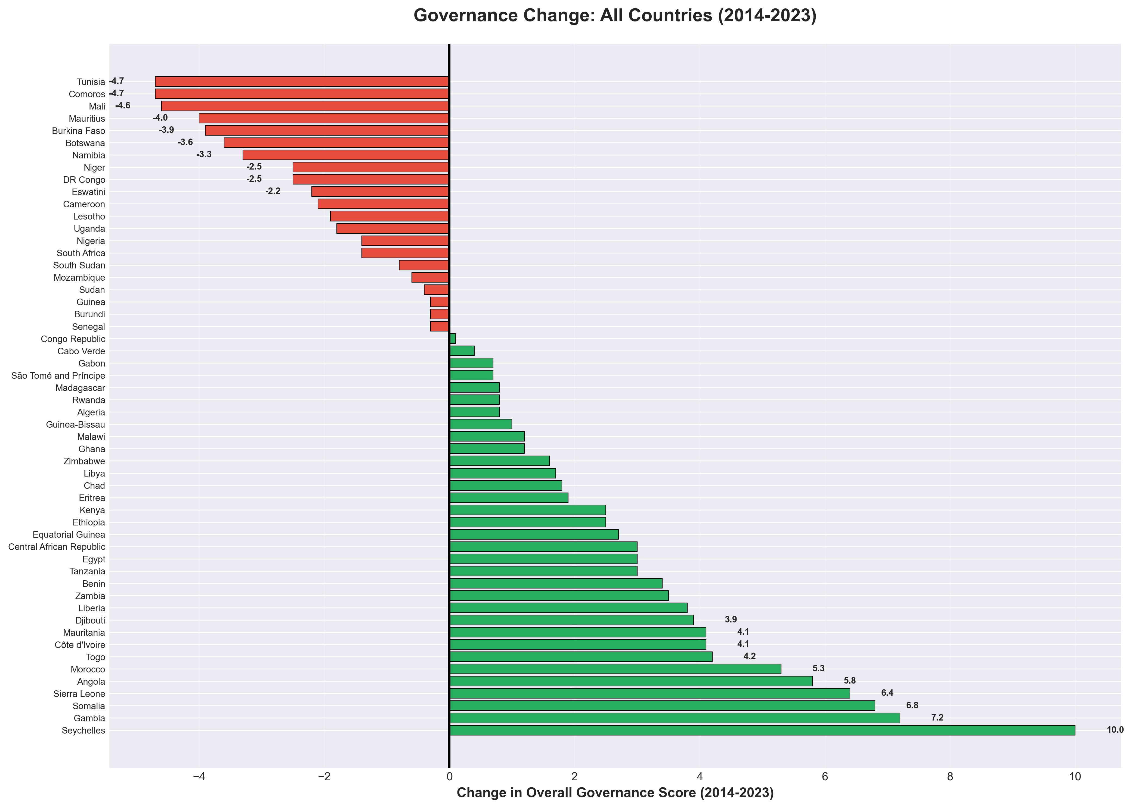
Improvers vs. Decliners: Complete Picture

Slide 13
Governance Challenges: Countries in Decline
Concerning trends in previously strong performers:
Botswana: -3.6 points
Burkina Faso: -3.9 points
Mauritius: -4.0 points
Mali: -4.6 points
Comoros: -4.7 points
Tunisia: -4.7 points
Common factors driving decline:
Democratic backsliding and erosion of civil liberties
Economic pressures reducing governance capacity
Security deterioration (especially Sahel region)
Institutional complacency after years of strong performance

Slide 14
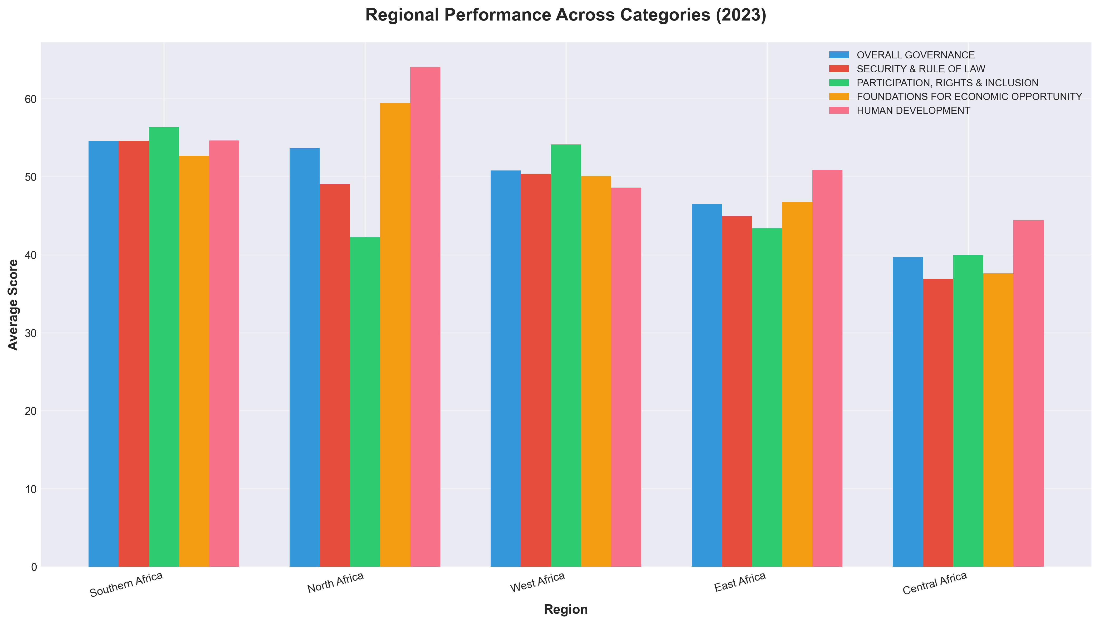
Regional Patterns: Geographic Governance Divide

Slide 15
Regional Performance Analysis
Southern Africa leads at 54.6 average
Benefits from SADC integration and relatively stable democracies
Strong performers: Botswana, Namibia, South Africa
Central Africa faces challenges at 39.7 average
Lowest regional score - 15 points below leaders
Persistent conflicts and weak institutions
East Africa shows highest variation (includes both Seychelles at 75.3 and South Sudan at 19.0)
Key Insight: Regional cooperation matters - integrated regions perform better

Slide 16
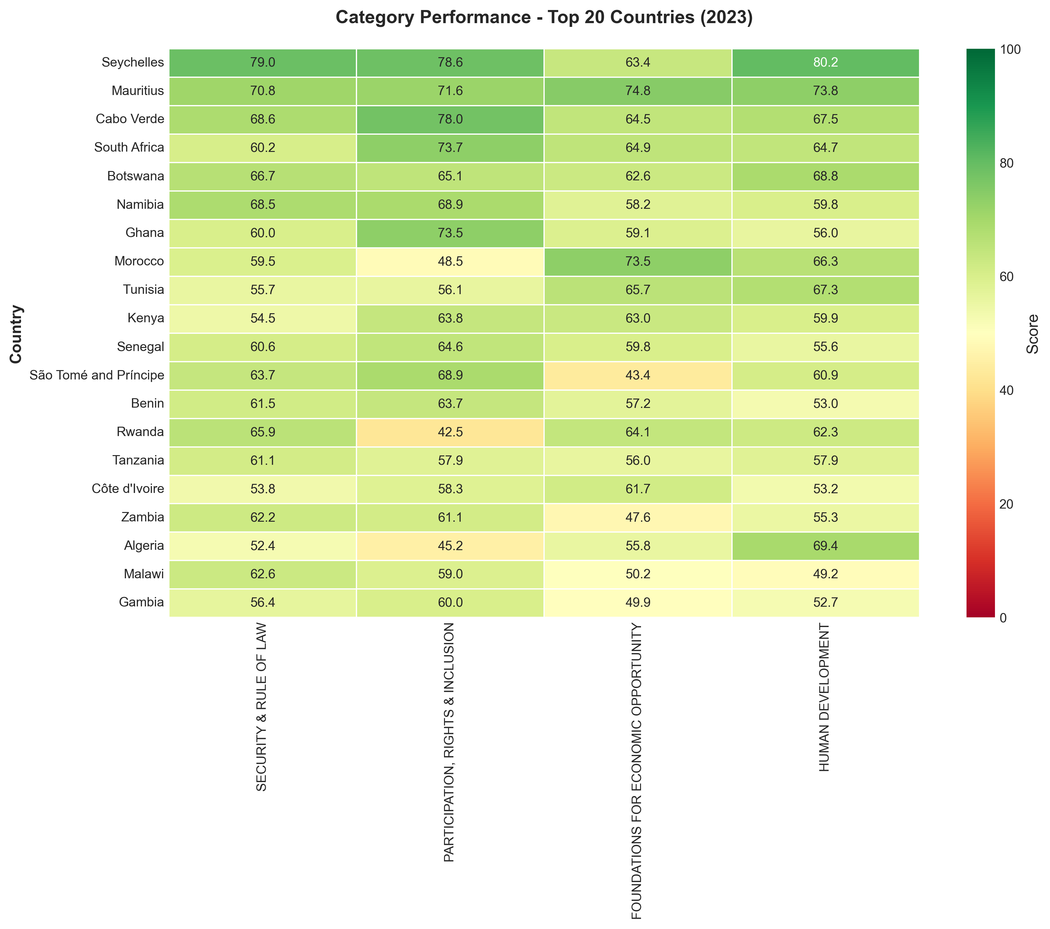
Multi-Dimensional View: Category Performance

Slide 17
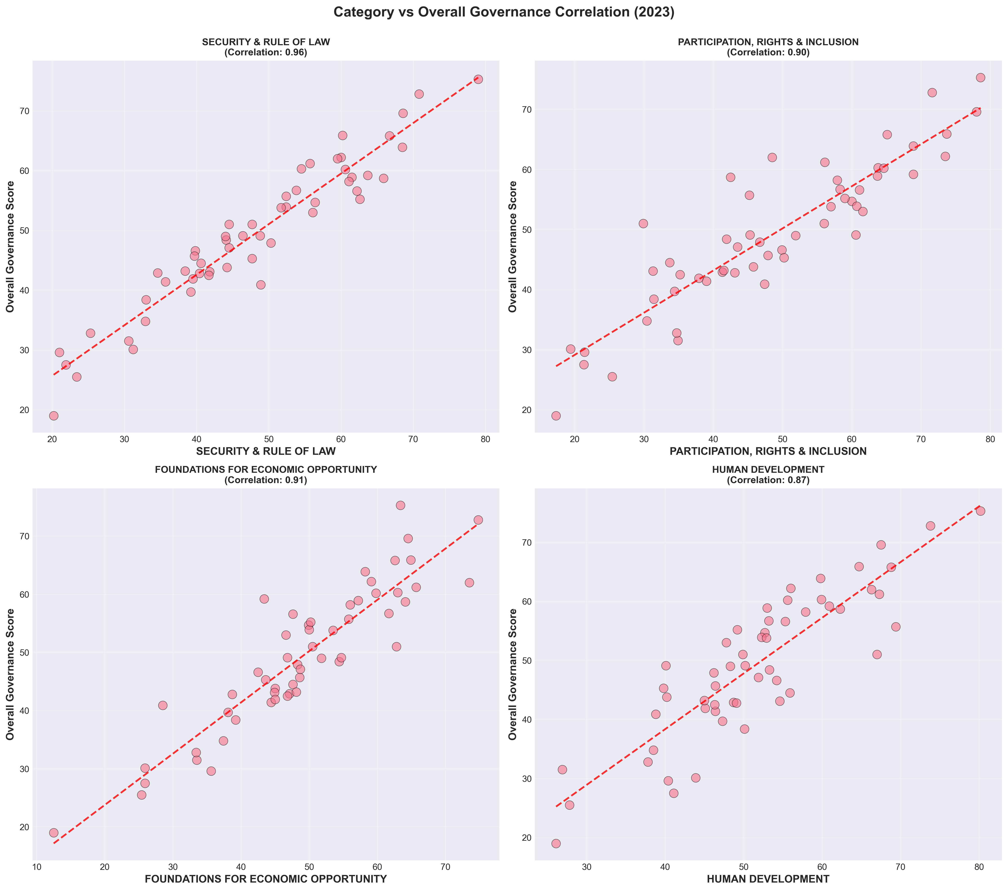
What Drives Overall Governance?

Slide 18
Key Insights & Takeaways
Island nations excel - but mainland success is possible (South Africa, Botswana)
Reform momentum works - Gambia, Somalia show dramatic improvements possible
Vigilance required - even strong performers can decline (Tunisia, Mauritius)
Regional disparities persist - 15-point gap between best and worst regions
All categories matter - strong correlations show interconnected reform needed
Human Development leads - highest average score (51.6)
Security & Rule of Law most variable - critical foundation for progress

Slide 19
Recommendations for Action (I)
For Policymakers:
Prioritize Security & Rule of Law - foundation for other improvements
Learn from improvers - study Gambia, Somalia, Seychelles reforms
Monitor backsliding - early intervention in declining countries
For Development Partners:
Target Central Africa - greatest need, significant impact potential
Support post-conflict recovery - Somalia proves ROI
Strengthen regional institutions - integration correlates with performance

Slide 20
Recommendations for Action (II)
For All Stakeholders:
Take integrated approach - categories are interconnected
Sustain long-term commitment - governance gains require persistence
Share best practices - facilitate South-South learning

Slide 21
Thank You
Questions & Discussion
Data Source: Mo Ibrahim Foundation
Ibrahim Index of African Governance (IIAG) 2024
https://iiag.online

