Slide 1
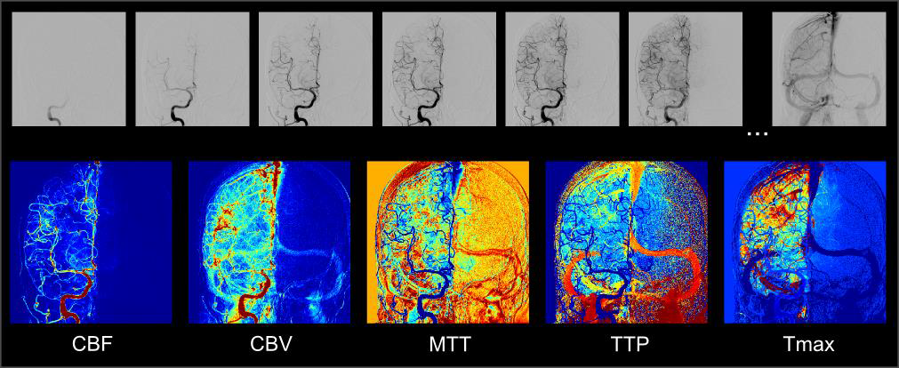
Machine Learning for Optical Communication
Alex Wang (105029620) Matthew Luzenski (804945138)
Department of Electrical and Computer Engineering
University of California, Los Angeles
Background
Fiber-optic communications are becoming more prevalent in telecommunications and computer networking.
The advantages include cable flexibility, high speed and bandwidth, and low signal loss.
The signal is encoded by modulating light, which remains confined in the optical fibers due to total internal reflection.
The issue is that once the light has propagated through the fiber, the signal detected by the photodiode is highly distorted.
The goal of this project is to use machine learning algorithms to decode the signal passed through a simulated dispersive fiber.
Methods
We will examine two encodings: binary, where we classify two symbols, and PAM4, where we classify four symbols.
We test the performance of three adaptive algorithms: expectation maximization, neural networks, and support vector machines.
Our benchmark estimator is maximum likelihood using Matlab, where the distribution of each symbol is calculated from labels, and unlabeled symbols are compared to each distribution for classification.
The neural network is built in Python TensorFlow starting with two 1D dilated convolutions alternated with max-pooling layers to train features. The features are then flattened into a single vector and densely connected to an output layer which contains the probability of belonging to each class. The filter weights are trained using stochastic gradient descent.
The support vector machine is written in Matlab and trains hyperplanes to partition the features. Each symbol is cast as a 16-dimensional vector, and the hinge loss function is evaluated to calculate the amount of misclassification. The hinge loss is minimized using subgradient descent.
Results
Maximum likelihoo alsdkfjadlfjaldsfkjl
Neural network adsflkdjlf
The support vector machine asdlfkjdl
Conclusion
Machine learning algorithms show high performance for decoding distorted signals received through dispersive optical fibers. The models are able to be trained to learn the non-linear behaviors even without knowledge of the physical laws governing the distortion. All three algorithms we implemented have high accuracy, and the support vector machine trains faster than the neural network.
References
D. Wang, et al., Nonlinear Decision Boundary Created by a Machine Learning-based Classifier to Mitigate Nonlinear Phase Noise. Ecoc (2015); ID: 0720.
B. Zhao, et al., Waveforms Classification based on Convolutional Neural Networks. IEEE (2017); DOI: 10.1109.
D. J. Sebald, et al., Support vector machines and the multiple hypothesis test problem. Trans. Signal Process., vol. 49, no. 11, p. 2865 (2001).
Figure 1. Illustration of perfusion angiography applied to a DSA run obtained from a patient with acute ischemic stroke (after successful MCA m1 recanalization).
The DSA run, whose subset of images is shown in the upper row, is used to compute CBV, CBF, MTT, TTP, and Tmax. Results are normalized to match a color-scale.
Tmax > 6 sec is shown in red.

