Slide 1


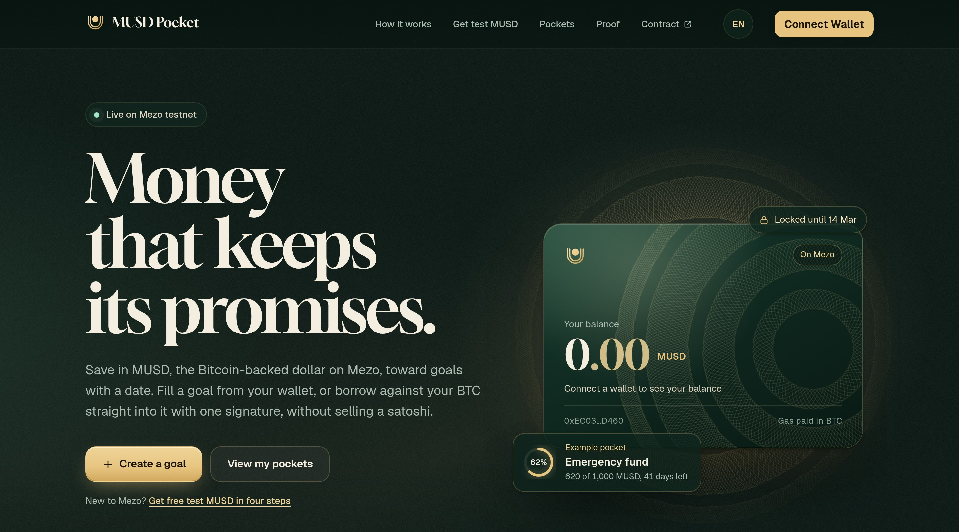
MEZO BUILDATHON · WAVE 2 · ACCESS & DISTRIBUTION
Bitcoin-backed savings goals, built on Mezo.
Save in MUSD toward a goal with a date. Borrow into it against your BTC without selling. Let friends and family anywhere chip in with a link.
Live on Mezo testnet 31611
MUSDPocketV2 verified
Live app, captured 3 Nov 2026
musd-pocket-mezo.vercel.app
Narendra Varma · github.com/Cyptoboy777/musd-pocket
Notes:
MUSD Pocket for Mezo Buildathon Wave 2. Everything shown runs on Mezo testnet (chain 31611). Live app: https://musd-pocket-mezo.vercel.app (the only primary URL). Contract: https://explorer.test.mezo.org/address/0xEC03F758219746b6e773f107a05cF17b66E7D460. Sources: README.md, wave2-submission.md.

Slide 2


MUSD Pocket
MEZO TESTNET · WAVE 2
01 THE PROBLEM
Saving for a date is hard when your money is either volatile or loose.
01
02
03
Selling BTC to pay for life
Stable dollars drift away
Family help lives off-chain
People who hold Bitcoin and need cash for a deposit, a trip or school fees usually sell, and give up the upside they waited for.
Stablecoins sitting in a wallet have no date and no lock. Without a commitment built in, savings quietly turn into spending.
When parents, siblings or friends want to help, it happens through bank transfers and group chats, with no shared view of progress.
The gap: Mezo already gives Bitcoin holders a dollar, MUSD. What is missing is a friendly savings layer that gives that dollar a purpose and a date.
02 / 12
musd-pocket-mezo.vercel.app
Notes:
Problem framing for a global audience. No market-size numbers are claimed. Product context from README.md and wave2-winning-plan.md section 4.

Slide 3
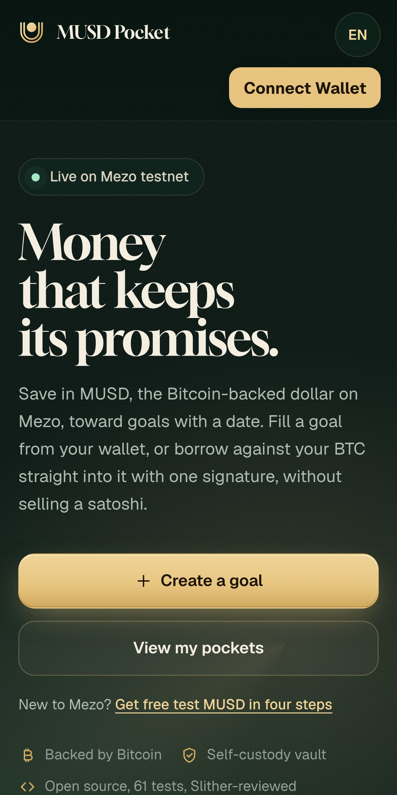
MUSD Pocket
MEZO TESTNET · WAVE 2
02 THE SOLUTION
MUSD Pocket turns MUSD into goals people actually keep.
1
Savings goals in MUSD
Name a goal, set a target and an unlock date. Withdraw on time for free, or early for a 2% fee.
2
Borrow into a goal
Borrow MUSD against your BTC with one Mezo signature. It lands straight in the goal, so nothing is sold.
3
Chip in by invite link
Share a link. Anyone can read the goal without a wallet, then follow a guided testnet setup to chip in.
4
Protect my loan
Live ICR and liquidation price, with one click to add collateral or repay before things get tight.
Global by default: English, Spanish, Portuguese, Chinese and French on key screens. Gas is paid in BTC on Mezo.
Mobile, live
03 / 12
musd-pocket-mezo.vercel.app
Notes:
Features from README.md Wave 2 section and wave2-qa-checklist.md section E: borrow-into-goal, early-withdraw 2% fee, invite link chip-in, Protect addColl/repay, i18n en/es/pt/zh/fr. Screenshot: live app at 390px width, 3 Nov 2026.

Slide 4
MUSD Pocket
MEZO TESTNET · WAVE 2
03 HOW IT COMPOSES WITH MEZO
Built on Mezo's core contracts, not beside them.
MEZO PROTOCOL
BorrowerOperations + Signatures
WithdrawMUSD (EIP-712), addColl, repayMUSD
MUSDPocketV2
0xEC03F758…D460
Verified on explorer
borrowToGoal, deposits, chip-in
Goals
Dated
Shared
Chip-in
tBTC collateral
User's BTC locked in a Mezo trove
MUSD
minted
TroveManager
Trove debt and collateral for live ICR
PriceFeed
BTC price for liquidation price
Protect my loan reads TroveManager and PriceFeed for ICR and liquidation price, previews both, then calls addColl or repayMUSD on BorrowerOperations. borrowToGoal reverts below 150% ICR.
Any size Wallet MUSD can go into a goal with a plain deposit. No trove needed.
sMUSD Savings Vault: gated Turns on only if vault code exists on the connected chain. Testnet 31611 has none, and the app says so. sMUSD does not raise ICR; collateral is BTC only.
04 / 12
musd-pocket-mezo.vercel.app
Notes:
All addresses are Mezo testnet 31611, from docs/ONCHAIN-ACTIVITY.md. BorrowerOperations 0xCdF7028ceAB81fA0C6971208e83fa7872994beE5; BorrowerOperationsSignatures 0xD757e3646AF370b15f32EB557F0F8380Df7D639e; TroveManager 0xE47c80e8c23f6B4A1aE41c34837a0599D5D16bb0; PriceFeed 0x86bCF0841622a5dAC14A313a15f96A95421b9366; MUSDPocketV2 0xEC03F758219746b6e773f107a05cF17b66E7D460 (verified). Documented mainnet sMUSD vault 0xb4D498029af77680cD1eF828b967f010d06C51CC has empty code on 31611. 150% ICR revert from wave2-winning-plan.md section 5.

Slide 5
MUSD Pocket
MEZO TESTNET · WAVE 2
04 WAVE 1 FEEDBACK, ANSWERED
Every point from Wave 1 review, and what changed.
WHAT JUDGES ASKED
WHAT WAVE 2 SHIPS
STATUS
Integration was L2: plain ERC-20 MUSD only
borrowToGoal composes BorrowerOperationsSignatures WithdrawMUSD; Protect calls addColl and repayMUSD
Fixed
Borrow-into-goal source not in repo, unverified, unused
MUSDPocketV2.sol in repo, verified on explorer, wired into the goal card and exercised on-chain
Fixed
No live ICR or liquidation price
Read from TroveManager and PriceFeed and previewed before every send
Fixed
Consider the MUSD Savings Vault
Honest sMUSD panel behind a code check; never claims an ICR benefit
Fixed
Live link collided with another team
One primary URL everywhere: musd-pocket-mezo.vercel.app
Fixed
Debt floor clarity
Loan readiness panel: 1,800 + 200 gas deposit, about 2,000 MUSD; small goals keep plain deposit
Fixed
Label testnet vs mainnet
Testnet badge in the app footer, README, tester guide and this deck
Fixed
Real users beyond two wallets
One confirmed outside tester created goal #10, Emergency fund. Builder test wallets remain separately labelled. Goal creation only; no community deposit claimed.
Goal created
Thanks to the civ_defi_mezo review and builder notes from dsh_agent (MezoGig) for the precise feedback.
05 / 12
musd-pocket-mezo.vercel.app
Notes:
Sources: docs/ONCHAIN-ACTIVITY.md; community evidence in the Wave 2 field-ready notes; goal-creation tx https://explorer.test.mezo.org/tx/0x25051be7bd23ca4751d13723410bcc16e983614ec6327545f26efbed2ed73fc2 from outside wallet 0x63efdf0633a5cf057103ccb7dd657c9bd7aed2d1. One confirmed outside tester created goal #10, Emergency fund. This is goal-creation evidence only; no community deposit or mainnet usage is claimed. Builder test wallets remain separately labelled. Status is Goal created, not a completed-adoption Fixed.

Slide 6
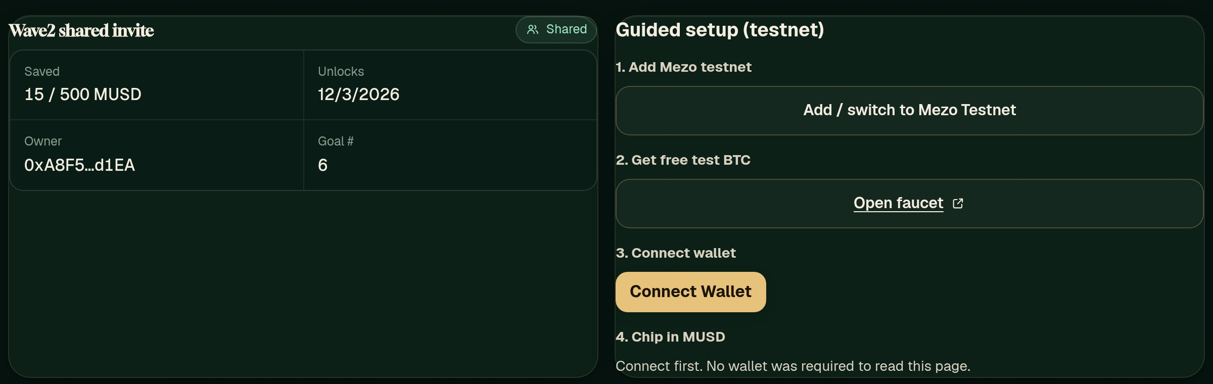
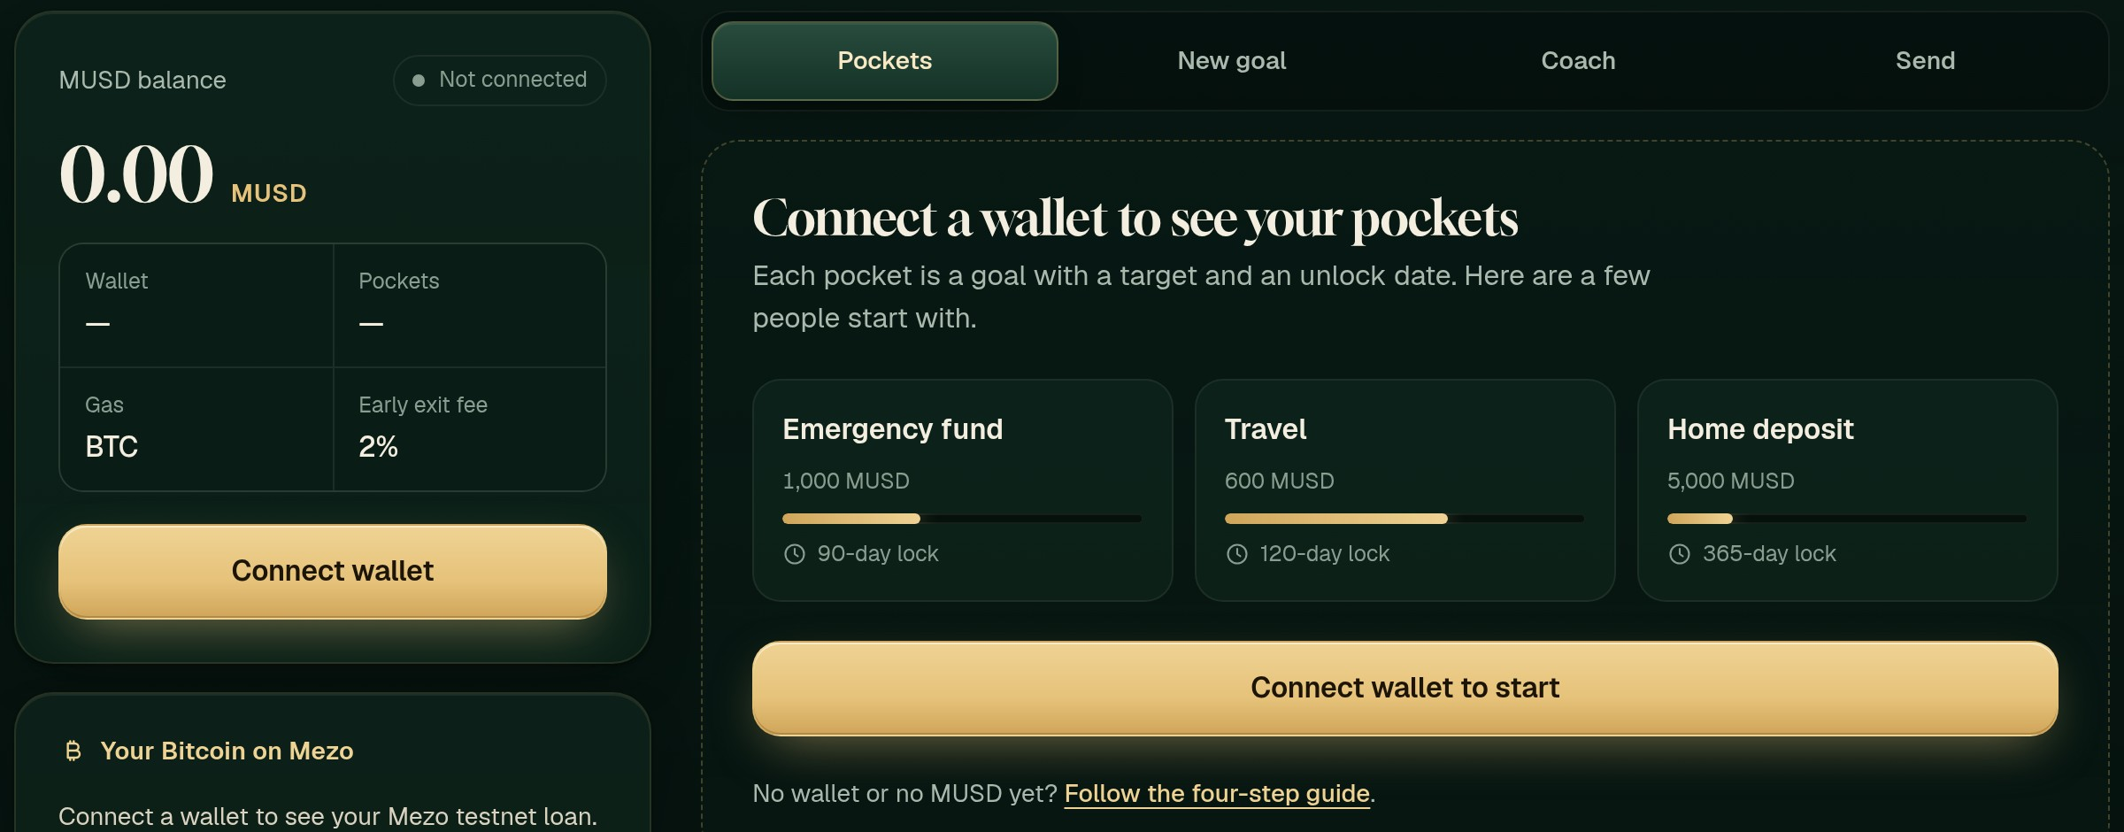
MUSD Pocket
MEZO TESTNET · WAVE 2
05 LIVE PRODUCT
The live app today, no wallet required to look around.
Invite link: a friend reads the shared goal, then gets a guided testnet setup
Home: save in MUSD toward a date, or borrow against BTC into a goal
Pockets: dated goals, 2% early exit fee shown up front
06 / 12
musd-pocket-mezo.vercel.app
Notes:
Real screenshots of https://musd-pocket-mezo.vercel.app and https://musd-pocket-mezo.vercel.app/?invite=6 captured with headless Chrome on 3 Nov 2026, desktop 1440px, no wallet connected. Shared goal #6 shows 15 / 500 MUSD saved on Mezo testnet.

Slide 7
MUSD Pocket
MEZO TESTNET · WAVE 2
06 ON-CHAIN PROOF
Transaction evidence for the exercised Wave 2 paths
Mezo testnet 31611, exercised 3 Nov 2026 (Asia/Calcutta) from builder test wallets. Click any hash.
THE CONTRACT
borrowToGoal 5 MUSD into goal #7
0x15ee0df8…ba7f
Pocket + BOS
MUSDPocketV2
addColl 0.001 BTC (Protect)
0x2da3e123…0c22
BorrowerOps
0xEC03F758219746b6e773
f107a05cF17b66E7D460
repayMUSD 10 (Protect)
0x6bc43691…fe5e
BorrowerOps
earlyWithdraw #5 (2% fee path)
0x136b1533…45c9
Pocket
• Source verified on explorer.test.mezo.org
• Source in repo: contracts/src/MUSDPocketV2.sol
• Contract and frontend tests, with project-maintained security-review notes in the public repository.
• Slither output kept in docs/
Helper chip-in 15 MUSD into #6
0x83439819…d63f
Pocket
setFamilyMember for invite chip-in
0xe115dff3…5eb8
Pocket
Deposit 25 MUSD into #5
0x017c424a…c7b5
Pocket
createGoal shared invite #6
0xb5237d0f…42d3
Pocket
Deploy tx 0xa58ddba9…64f6
createGoal borrow target #7
0x5eeb18a5…50d2
Pocket
Close trove is wired in the UI but not re-run this wave: the test wallet lacked spare test BTC.
createGoal early buffer #5
0x3c3b1ea7…32a6
Pocket
07 / 12
musd-pocket-mezo.vercel.app
Notes:
All builder tx hashes from docs/ONCHAIN-ACTIVITY.md, Wave 2 lifecycle table. Receipts re-checked via https://rpc.test.mezo.org on 3 Nov 2026: status 0x1 for each checked tx; addColl and repay go to BorrowerOperations 0xCdF7...beE5. Explorer base: https://explorer.test.mezo.org/tx/<hash>. Heading covers exercised paths only. Close trove is wired in the UI but not re-run this wave because the test wallet lacked spare test BTC; note from ONCHAIN-ACTIVITY.md. Testing line describes contract and frontend tests plus project-maintained security-review notes in https://github.com/Cyptoboy777/musd-pocket; these are not an independent security audit and no exact test counts are claimed.

Slide 8
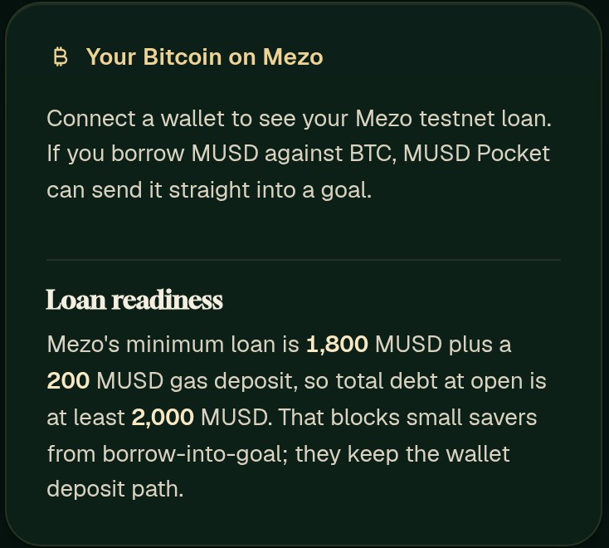
MUSD Pocket
MEZO TESTNET · WAVE 2
07 DEBT FLOOR HONESTY
We say the debt floor out loud, before anyone signs.
~2,000
MUSD minimum total debt to open a Mezo trove
1,800
+ 200
minimum principal
gas deposit, refunded on close
So borrow-into-goal is for people who already have, or will open, a trove of that size. Everyone else still saves: wallet MUSD goes into a goal by plain deposit, any amount.
In the app: the loan readiness panel explains the floor; repay keeps net debt above 1,800, as Mezo requires; sMUSD is never sold as a way to lift ICR.
08 / 12
musd-pocket-mezo.vercel.app
Notes:
Debt floor: 1,800 MUSD minimum principal plus 200 MUSD gas compensation, roughly 2,000 MUSD at open (Mezo borrow docs and builder note from dsh_agent, per wave2-winning-plan.md section 3). Repay test of 10 MUSD stayed above 1,800 min net debt (ONCHAIN-ACTIVITY.md). Screenshot: live app loan readiness panel, 3 Nov 2026.

Slide 9
MUSD Pocket
MEZO TESTNET · WAVE 2
08 REVENUE MODEL
Revenue that rewards keeping the promise.
2%
2%
5%
Early unlock
Contract cap
Live in the contract
Hard maximum in code
early-unlock fee on the locked balance
0%
0%
We earn only when someone breaks their own goal early. Saving on time and helping a friend stay free. Fees accrue on-chain in the contract fee pool, visible to anyone.
Chip-in
On-time unlock
Family and friends
Keep your promise, pay nothing
Being explored, not live: an optional chip-in tip, and paying bills or merchants into a goal. Neither is counted here.
09 / 12
musd-pocket-mezo.vercel.app
Notes:
Revenue from README.md, docs/ONCHAIN-ACTIVITY.md and the in-app Revenue panel: early unlock fee 2% (contract max 5%), chip-in and on-time unlock 0%, fee pool on-chain. Fee path exercised: earlyWithdraw tx 0x136b1533...45c9. Future ideas from wave2-winning-plan.md P1-3 and P2-3; not live, no revenue figures claimed.

Slide 10
MUSD Pocket
MEZO TESTNET · WAVE 2
09 POSITIONING
Where we fit, next to strong Mezo builders.
PROJECT
WHAT THEY DO WELL
WHERE MUSD POCKET SITS
Feasy
BTC savings vault: trove, sMUSD and a veBTC sleeve
Pooled vault. We focus on named, dated personal goals and family chip-in.
MezoRoute
Mainnet executor that compares earn routes and borrows and deploys
Built for DeFi routing. We are a consumer savings front door.
Pylon
Flash loop, unwind and shield on native troves
Power-user leverage. We keep risk low and visible for savers.
Doji
veBTC lock-and-borrow with PriceFeed auctions
Different user. We bring new savers to MUSD; the two can complement.
Our lane: the consumer savings layer for Mezo. Dated goals, family chip-in and optional borrow-into-goal, with honest risk and no yield claims. More people holding MUSD for a reason helps every product above.
10 / 12
musd-pocket-mezo.vercel.app
Notes:
Competitor descriptions summarised from public Wave 1 submissions and judge comments (AKINDO public API), as recorded in wave2-winning-plan.md section 4. Respectful positioning; no scores or payouts of other teams are shown.

Slide 11
MUSD Pocket
MEZO TESTNET · WAVE 2
10 TRACTION, HONESTLY
Builder tests and one outside goal-creation proof, clearly separated.
5
10
v1
1
builder test wallets
Wave 2 lifecycle txs
historical builder txs
confirmed outside tester
recorded evidence, labelled as mine
recorded test evidence on v2
kept on v1, not a live total
Created goal #10. No deposit or mainnet usage claimed.
Outside goal-creation proof
Separated from builder tests
Community wallet
0x63efdf0633a5cf057103ccb7dd657c9bd7aed2d1
Goal-creation transaction
0x25051be7bd23ca4751d13723410bcc16e983614ec6327545f26efbed2ed73fc2
Created goal #10, Emergency fund. Goal creation only; no deposit or mainnet usage claimed.
• Community wallet: 0x63efdf0633a5cf057103ccb7dd657c9bd7aed2d1
• Goal-creation transaction: 0x25051be7…3fc2
• Further independent testing remains a product milestone, not an adoption claim.
11 / 12
musd-pocket-mezo.vercel.app
Notes:
Builder wallets recorded in docs/ONCHAIN-ACTIVITY.md: 0xA8F5...d1EA, 0xEEB0...509a, 0xF02F...bb29, 0xa482...2985, 0x77eb...c580. Ten Wave 2 lifecycle transactions are the recorded test-evidence set listed on slide 7 and in ONCHAIN-ACTIVITY.md; these are recorded test evidence, not live totals. The previous “19 Wave 1 txs” figure was only a parenthetical note beside v1 0x2d5f...A1C8 and is not shown as a count. One confirmed outside tester, wallet 0x63efdf0633a5cf057103ccb7dd657c9bd7aed2d1, created goal #10, Emergency fund: https://explorer.test.mezo.org/tx/0x25051be7bd23ca4751d13723410bcc16e983614ec6327545f26efbed2ed73fc2. Goal-creation evidence only; no community deposit or mainnet usage is claimed. Builder test wallets remain separately labelled. The 3 November 2026 Proof-page screenshot showed an empty community section and was replaced with a text evidence card. Further independent testing remains a product milestone, not an adoption claim. No 3-to-5-user target is presented as a current result.

Slide 12

MUSD Pocket
MEZO TESTNET · WAVE 2
11 ROADMAP AND TEAM
From testnet goals to mainnet, with Mezo.
NOW
NEXT
THEN
MAINNET
AFTER
Wave 2 live on Mezo testnet
Proposed near-term goal
Proposed next-stage goal
Proposed longer-term goal
Mezo Founder Program
Verified contract, borrow-into-goal, Protect, invite chip-in. Mezo Passport/OrangeKit wallet connectors documented in the repository.
Independent testnet usability testing and wallet-linked findings.
Independent security review and mainnet deployment verification before a real-funds release.
Reviewed user pilot and evaluation of optional supported MUSD Savings Vault routing.
Apply with Wave 2 proof as the next step for the product
TEAM
GitHub Cyptoboy777
Repo github.com/Cyptoboy777/musd-pocket
Live musd-pocket-mezo.vercel.app
Thank you, Mezo team.
Narendra Varma
Solo builder: contracts, frontend, design and docs
12 / 12
musd-pocket-mezo.vercel.app
Notes:
NOW is shipped Wave 2 on Mezo testnet 31611 only: verified contract, borrow-into-goal, Protect, invite chip-in, and Mezo Passport/OrangeKit wallet connectors documented in https://github.com/Cyptoboy777/musd-pocket. Passport is shipped repository documentation, not future work. The app is not deployed on mainnet. NEXT / THEN / MAINNET columns are proposed undated goals: independent testnet usability testing and wallet-linked findings; independent security review and mainnet deployment verification before a real-funds release; reviewed user pilot and evaluation of optional supported MUSD Savings Vault routing. These are not delivery dates or a claim that mainnet is live. AFTER retains the Mezo Founder Program as an existing, undated next-step note (https://www.supernormal.foundation/initiative/mezo-founder-program). No 3-to-5 tester target and no dated launch promise. Team: Narendra Varma, solo builder, GitHub Cyptoboy777.

