Slide 1

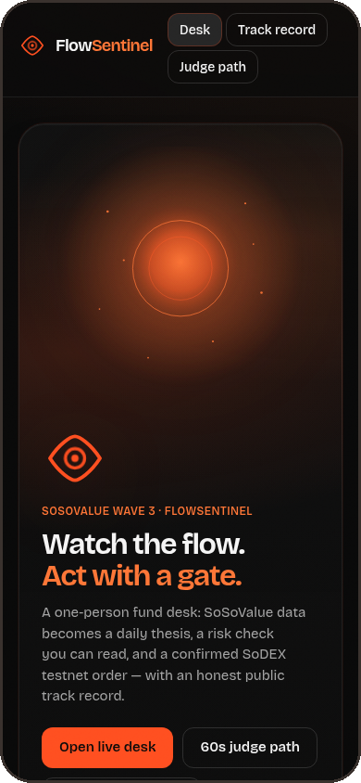
FLOW SENTINEL
AKINDO | SoSoValue Wave 3
Buildathon submission
FlowSentinel
SOSOVALUE WAVE 3 BUILDATHON
FlowSentinel
Watch the flow. Act with a gate.
A one-person AI fund desk on SoSoValue data and SoDEX execution.
Notes:
FlowSentinel turns SoSoValue flow and news data into a written thesis, a readable risk gate and a confirmed SoDEX testnet order. Source: FlowSentinel app (https://flowsentinel-app.vercel.app) and the builder's own SoDEX testnet runs.

Slide 2
NOISE
FlowSentinel
02 / 10
The problem
Signal is cheap. A disciplined path from signal to trade is not.
Data everywhere.
Discipline nowhere.
ETF flows, headlines and index moves arrive all day, across a dozen tabs.
Traders react to the loudest signal, not the most relevant one.
Between a hunch and a market order there is no thesis, no size check and no stop.
OVERLOAD
The gap we close
One desk that turns every signal into a written thesis, a readable risk check and a confirmed order.
Notes:
The pain: too many feeds and no disciplined path from signal to trade. Source: FlowSentinel app (https://flowsentinel-app.vercel.app) and the builder's own SoDEX testnet runs.

Slide 3
FLOW
FlowSentinel
03 / 10
The solution
One flow from data to order
01
02
03
04
→
→
→
Data
Thesis
Risk gate
Order
SoSoValue ETF flows, hot news and the SSI MAG7 index
A plain-English idea with a confidence score and cited news IDs
Size, drawdown and news-shock checks you can read
A confirmed, EIP-712 signed order on SoDEX testnet
Every order passes all four steps. No shortcut from a headline to a fill.
Notes:
The four-step flow mirrors the live desk: Data, Thesis, Risk gate, Order. Source: FlowSentinel app (https://flowsentinel-app.vercel.app) and the builder's own SoDEX testnet runs.

Slide 4
FlowSentinel
API
04 / 10
SoSoValue integration
Every idea is cited
Feed | What FlowSentinel does with it
ETF flows /etfs/summary-history | Daily BTC and ETH ETF net flows set the direction of each thesis
Hot news /news/hot | Live catalysts, plus the news-shock check inside the risk gate
SSI MAG7 index snapshot | A wider risk-on or risk-off read on the crypto market
Cited, not guessed
Every thesis lists the SoSoValue news IDs it used, so any claim can be traced back to its source in one click.
CITED
The SoSoValue API key stays on the server. The browser only ever sees the result.
Notes:
Endpoints used: /etfs/summary-history, /news/hot and the SSI MAG7 index snapshot. Source: FlowSentinel app (https://flowsentinel-app.vercel.app) and the builder's own SoDEX testnet runs.

Slide 5
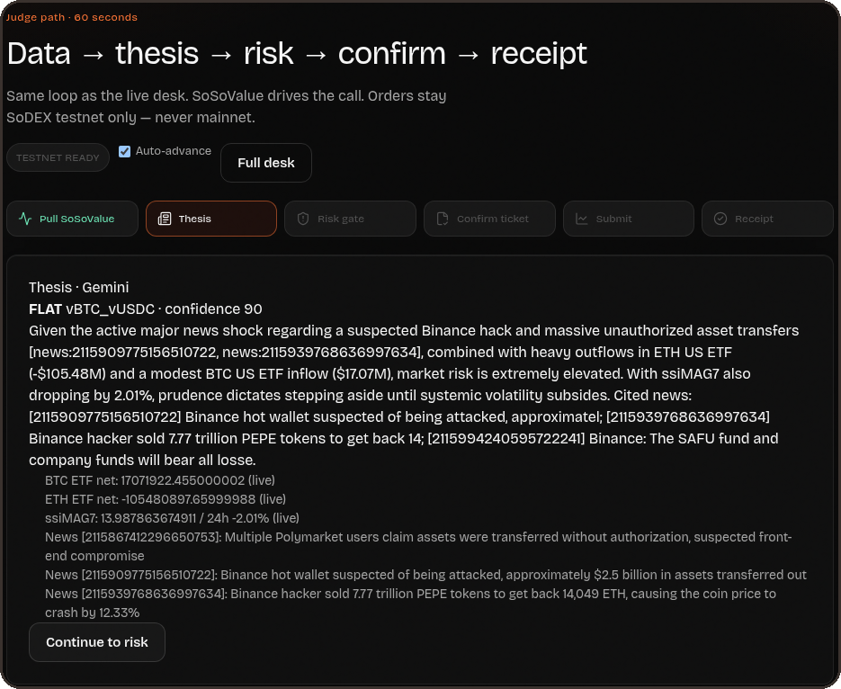
FlowSentinel
JARVIS
05 / 10
Jarvis, the AI advisor
It shows its work
Live thesis from the desk, news IDs cited inline
THINKS
LISTENS
Gemini with function calling
Pulls ETF flows, hot news, SSI, the SoDEX orderbook and an order ticket on demand.
Hands-free voice, in many languages
Silero VAD, Whisper STT, Kokoro or Piper TTS. All open source. Voice never places orders.
Notes:
Jarvis uses Gemini function calling over five tools. Voice stack: Silero VAD, Whisper STT, Kokoro/Piper TTS, all open source. Voice never places orders. Source: FlowSentinel app (https://flowsentinel-app.vercel.app) and the builder's own SoDEX testnet runs.

Slide 6
SIGNED
FlowSentinel
06 / 10
MARKET IOC
FILLED
SoDEX execution
1301914828
1301909841
Real orders.
Signed and capped.
Partial fill on SoDEX testnet
0.00005 vBTC at 78619
SODEX
EIP-712 signed orders, placed live on SoDEX testnet.
LIMIT
HARD CAP
1301909840
10 USDC
Two locks on every order
Accepted with status NEW
Server-side max notional on every order
The risk gate must pass and you must confirm. Only then is the order signed and sent.
Notes:
Order IDs from our SoDEX testnet runs: 1301914828 (market IOC, partial fill), 1301909841 (FILLED, 0.00005 vBTC at 78619), 1301909840 (limit, NEW). Max notional 10 USDC enforced server-side. Source: FlowSentinel app (https://flowsentinel-app.vercel.app) and the builder's own SoDEX testnet runs.

Slide 7
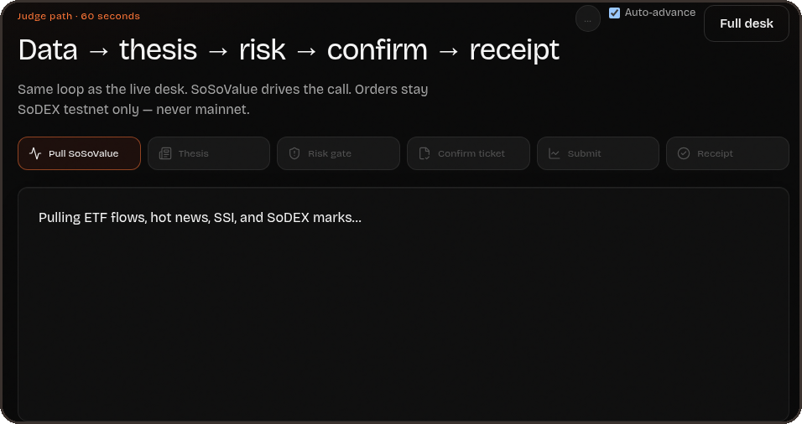
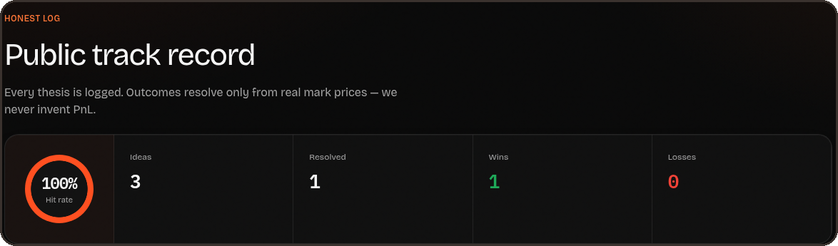
FlowSentinel
Proof, not promises
Check every claim
in 60 seconds
Public track record
Every thesis is logged. Outcomes resolve only from real mark prices, so wins and losses both show.
60-second judge path
flowsentinel-app.vercel.app/judge
/api/diag runs live probes against every integration: 10 of 10 pass.
Notes:
Judge path: https://flowsentinel-app.vercel.app/judge. Diagnostics: https://flowsentinel-app.vercel.app/api/diag, 10/10 live probes. Source: FlowSentinel app (https://flowsentinel-app.vercel.app) and the builder's own SoDEX testnet runs.

Slide 8
SECURE
FlowSentinel
08 / 10
Tech and security
Built to be trusted with keys
Next.js
Gated
95 / 93
FAST
Built with Next.js and deployed on Vercel. SoSoValue, Gemini and SoDEX calls run server-side.
Keys live on the server only. Every order needs the risk gate, an explicit confirm and fits a 10 USDC cap.
Lighthouse score on desktop and on mobile, so the live demo loads fast on any device.
STACK
SECURITY
SPEED
Notes:
Next.js on Vercel, keys server-side only, gated orders, Lighthouse 95 desktop / 93 mobile. Source: FlowSentinel app (https://flowsentinel-app.vercel.app) and the builder's own SoDEX testnet runs.

Slide 9
NEXT
FlowSentinel
Roadmap and business model
What comes after
the buildathon
01
Mainnet launch. Move execution from SoDEX testnet to mainnet with the same risk gate, confirm step and caps.
A PLAN, NOT DATA
PLAN
Mainnet, then subscriptions
02
Nothing on this slide is a result yet. It is where FlowSentinel goes next.
Subscription tiers
From a free read-only desk up to paid tiers with live, gated execution.
Notes:
Forward-looking plan only. No traction, revenue or user numbers are claimed. Source: FlowSentinel app (https://flowsentinel-app.vercel.app) and the builder's own SoDEX testnet runs.

Slide 10
FlowSentinel
Thank you, judges. Every claim in this deck can be checked live in the app, on SoDEX testnet, or in the code.
Watch the flow. Act with a gate.
FlowSentinel, built by Narendra Varma
flowsentinel-app.vercel.app
Open it, run the judge path, then read the code.
Judge path: /judge
github.com/Cyptoboy777/soso-smre
Builder: Narendra Varma
Notes:
Live app: https://flowsentinel-app.vercel.app GitHub: https://github.com/Cyptoboy777/soso-smre Builder: Narendra Varma. Source: FlowSentinel app (https://flowsentinel-app.vercel.app) and the builder's own SoDEX testnet runs.

