Slide 1


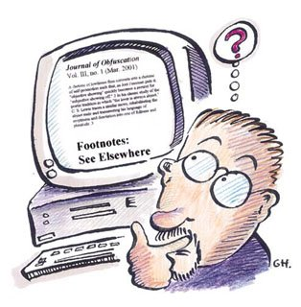

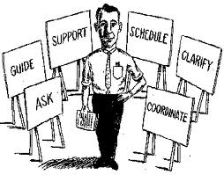
Chap 5 Requirement Engineering (1)

Slide 2
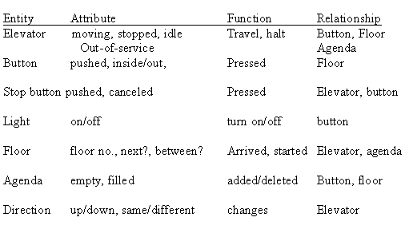

Slide 3
Class Exercise
Using the handout, identify the system component
This is a library system of many universities. Each library contains many books and other media, such as DVD, film, audio media, microfilm and maps. Students and faculties are reading/using the material and can check out. Students can borrow 2 week and read books. Faculty can borrow 4 weeks and make copy. If a material is overdue, a penalty notice is sent.

Slide 4
Analysis
Entity | Attribute | Function(operation) | Relationship

Slide 5
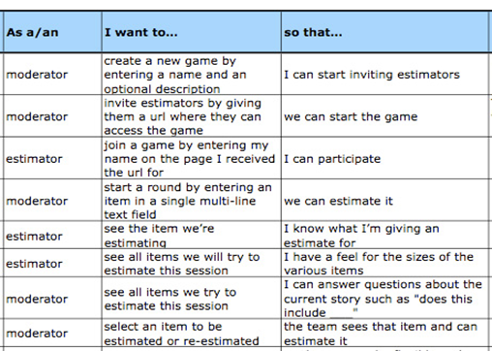

Slide 6
Step 1 : Informal user stories.
· Students can purchase monthly parking passes online. As a student I want to purchase a parking pass so that I can drive to school.
· Parking passes can be paid via credit cards.

Slide 7
Step 1 : Informal user stories.
· Professors can input student marks.
Students can obtain their current seminar schedule.

Slide 8
Step 1 : Informal user stories.
· Students can order official transcripts.
· Students can only enroll in seminars for which they have prerequisites.

Slide 9
Example of card
Front of card: As a student I want to purchase a parking pass so that I can drive to school.
Back of card:
One pass for one month is issued at a time.
The student will not receive a pass of the payment isn’t sufficient.
The person buying two passes must be a currently enrolled student.
The student may only buy one pass per month.

Slide 10
Example of card
Front of card: As a parking pass it is wanted to be paid via credit cards so that it can be used easily.
Back of card:

Slide 11
Example of card
Front of card: As a professor I want to input student marks so that I can do all my duty.
Back of card:

Slide 12
Example of card
Front of card: As a student I want to obtain my current seminar schedule so that I can make a plan.
Back of card:

Slide 13
Example of card
Front of card: As a student I want to order official transcripts so that I can use it.
Back of card:

Slide 14
Example of card
Front of card: As a student I want to enroll in seminars so that I have prerequisites.
Back of card:

Slide 15
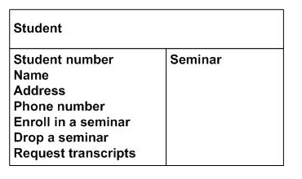
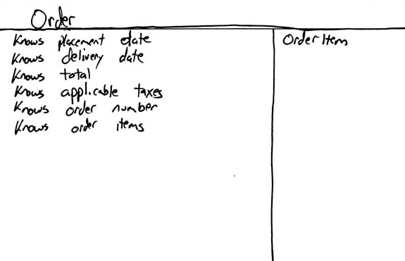

Slide 16
Professor
Seminar

Slide 17
Room
Building

Slide 18
Enrollment
Transcript

Slide 19
Student schedule

