Slide 1


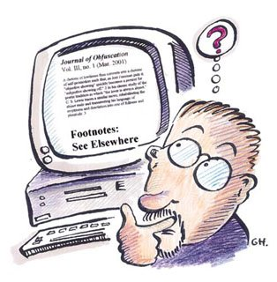

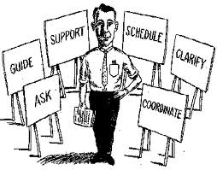
Project: 3rd time

Slide 2
Project
Make a team
Choose a subject
Research
Analysis
Modeling
Design
Coding
Testing

Slide 3
1. Make a team
ID | Name

Slide 4
1. Choose a subject
1) Mobile programming
2) Web programming
3) Game programming
4) Desktop programming
5) AI based programming
Our subject is based on ( ) programming

Slide 5
2. Choose a subject
Detail description about our subject

Slide 6
3. Research a subject
Domestic and international research
1) Domestic research
2) International research

Slide 7
4. Analysis
Write about it’s function
1.
1.1
1.2
1.3

Slide 8
4. Analysis
Write about it’s function
2.
2.1
2.2
2.3

Slide 9
4. Analysis
Write about it’s function
3.
3.1
3.2
3.3

Slide 10
4. Analysis
Write about it’s function
4.
4.1
4.2
4.3

Slide 11
4. Analysis
Write about it’s function
5.
5.1
5.2
5.3

Slide 12
5. Modeling
Usecase diagram

Slide 13
5. Modeling
Activity diagram

Slide 14
5. Modeling
Sequence diagram

Slide 15
5. Modeling
E-R diagram

