Slide 1
Demand analysis

Slide 2


Catalogue
01
Introduce
02
User scenario
03
Class diagram
04
Interface prototype
05
Function description
06
Acceptance verification criteria

Slide 3
Introduce
01

Slide 4
Introduce
With the rapid development of social science and technology, the popularity of mobile devices and the progress of network technology, players' demand for mobile games is gradually increasing. Most players began to pursue a certain challenge and exciting games, so we designed a competitive racing game small program. In this game, players can use different cars to meet different tracks, you can have a good experience of the excitement and challenge of racing, and this game is more convenient to operate, can better bring the majority of players relaxed and happy mood.

Slide 5
User scenario
02

Slide 6
User scenario
the development intention of this racing game small program is to meet the user's entertainment needs, the application goal is to attract and retain users, including leisure entertainment and social interaction. The relationship with other related software is to provide a different entertainment experience with a social nature. In terms of development background, it follows the development trend of mobile Internet and small programs, and is expected to become a popular game application.

Slide 7
User scenario
1. Young people: Racing games are often highly exciting and competitive, and young people are more likely to try them.
2. Male users dominate: Men are more interested in competitive and speed games than women.
3. Like challenges and competition: small programs in racing games usually have leaderboards, achievement systems and other elements to attract users who like challenges and competition.
4. Short-term game enthusiasts: Since the small program of racing games is usually simple and fast-paced, it is easy to attract short-term game enthusiasts to play fast games.
5. Social interaction: The small program of the racing game can support multiplayer battles, and users can make new friends and interact with each other in the game, increasing the social attributes of the game.

Slide 8
User scenario
1. Players can choose from different cars and tracks.
2. Players can adjust the car's Settings, such as speed, acceleration, braking, etc.
3. The player can play against other players, or against the computer.
4. Players can view tournament results and leaderboards.
5. Players can purchase new cars and tracks.
6. Players can save their progress and continue playing.

Slide 9
Class diagram
03

Slide 10
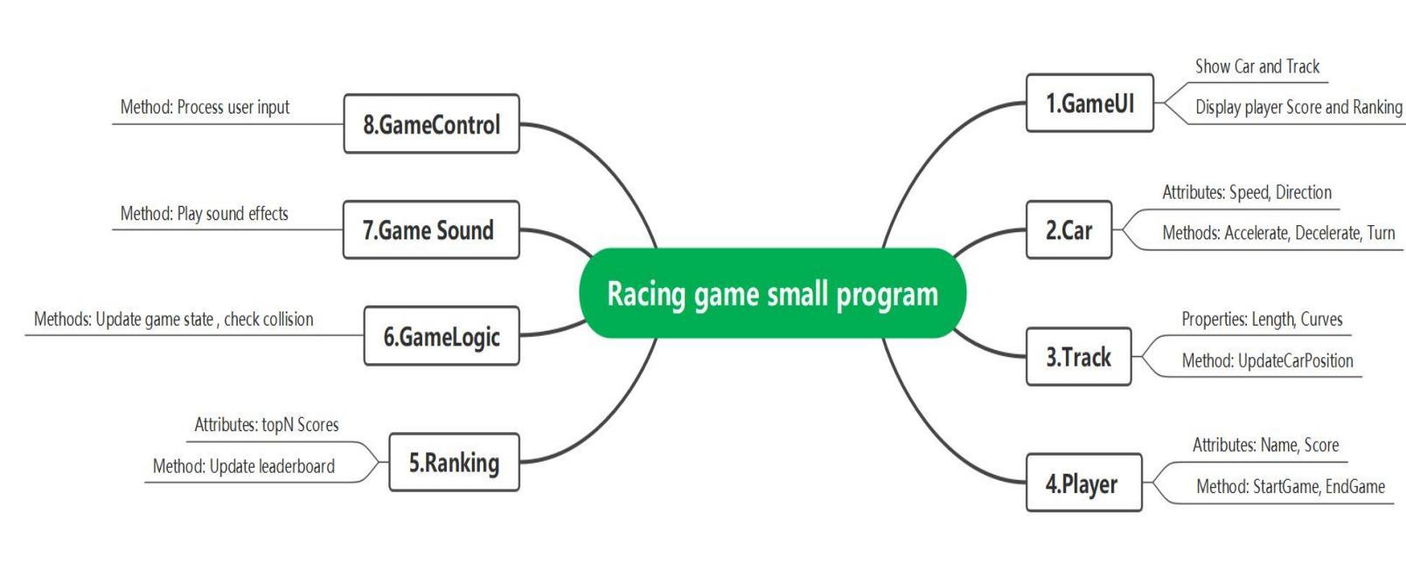
Class diagram

Slide 11
Interface prototype
04

Slide 12
Interface prototype
Main menu interface:
Start the game button: click to enter the game mode selection.
Multiplayer button: Click to enter the multiplayer option.
Set button: click to enter the game Settings.
Exit button: Click on to exit the game.
Single-player game Settings interface.
Select a vehicle: The list displays the available vehicles, allowing the player to select.
Select Track: The list displays the available tracks, allowing the player to select.
Start the game button: Click on it to start the single-player game.
Return button: Return to the game mode selection.

Slide 13
Function description
05

Slide 14
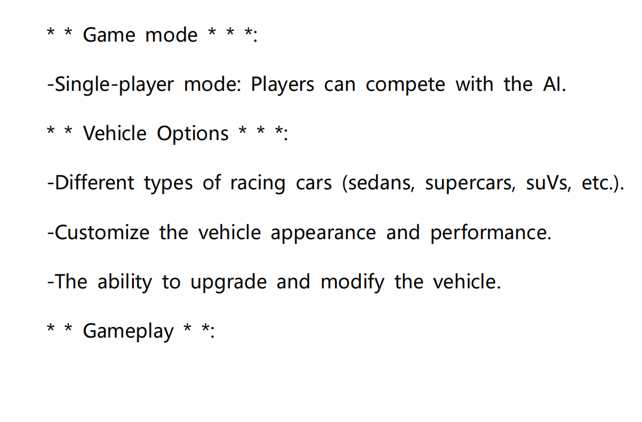
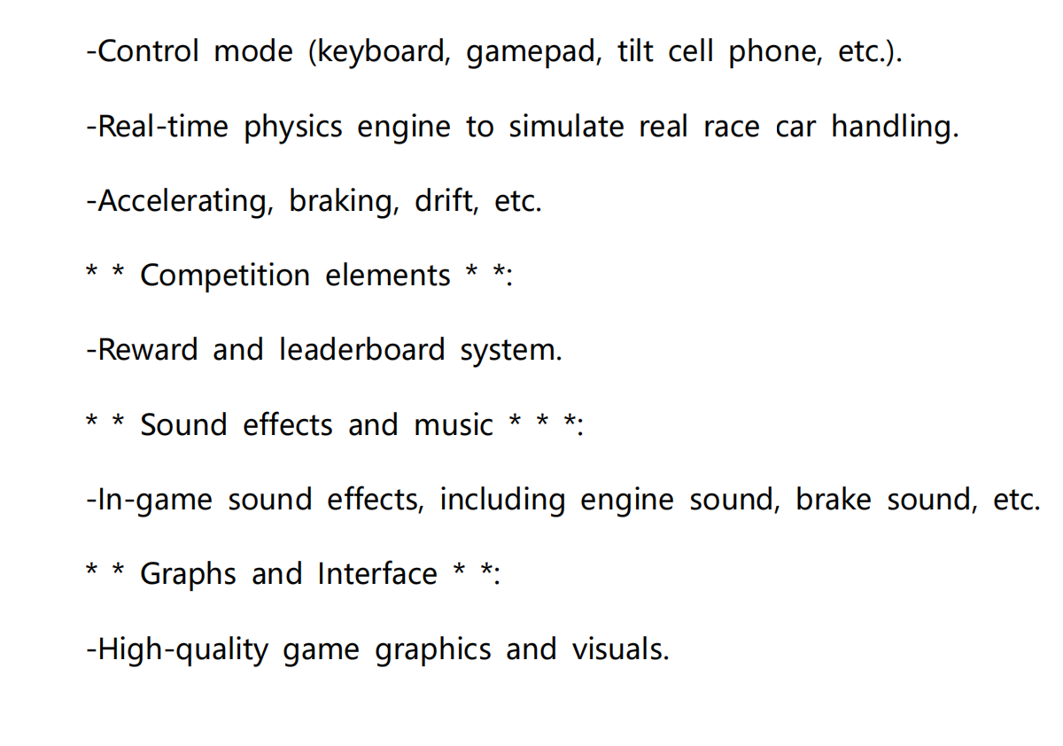
Function description

Slide 15
Acceptance verification criteria
06

Slide 16
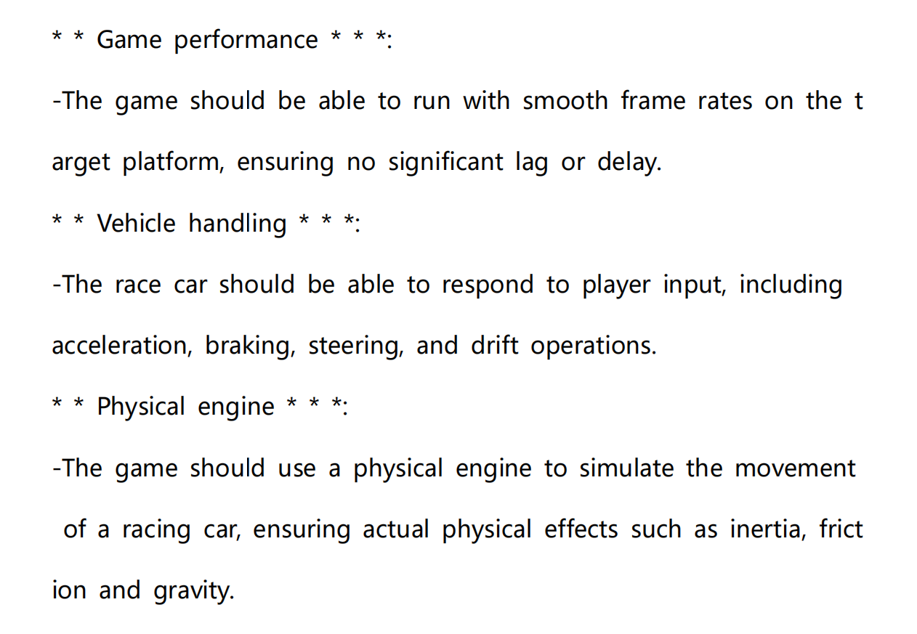
Acceptance verification criteria

Slide 17
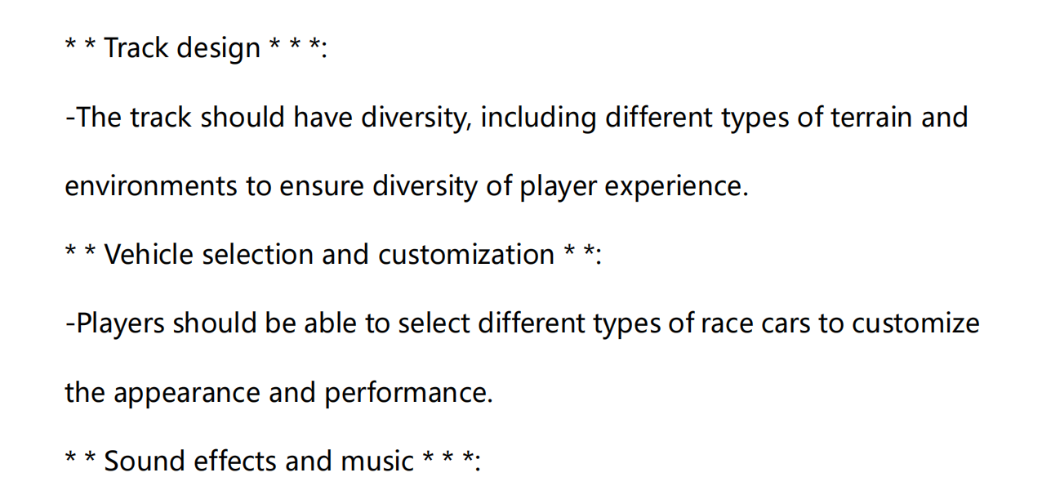
Acceptance verification criteria

Slide 18
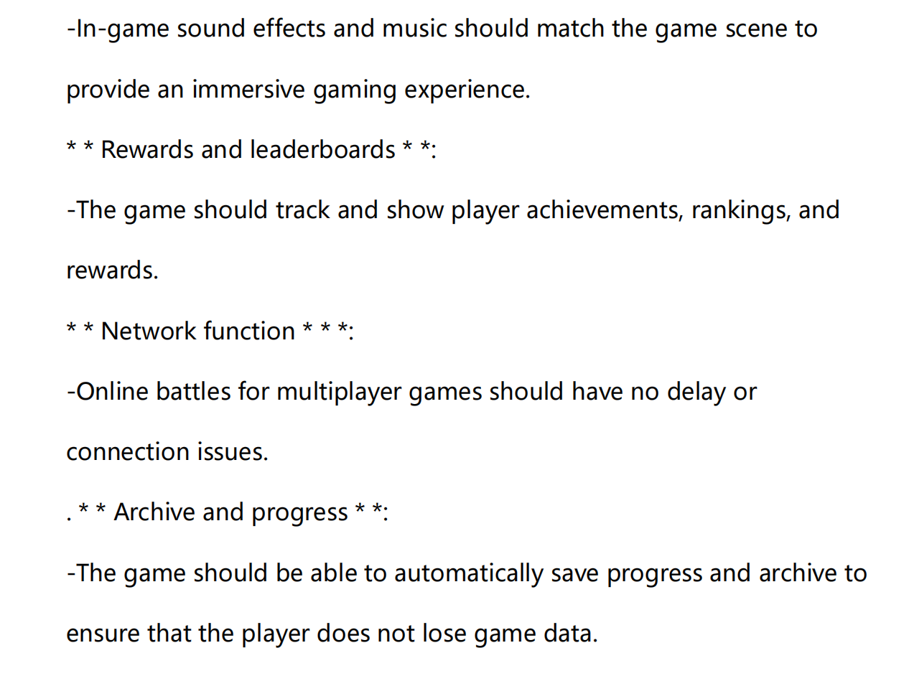
Acceptance verification criteria

Slide 19
Thank you for listening

