Slide 1


Real time pitch shifting
Lkham Nyambuu – Alexis Mermet – Cyril Cadoux

Slide 2
Introduction
Transform speech audio files into higher- or lower-pitched voices
Satisfy the real time constraints
Only partial information is available (1 chunk of small size)
Computations must be very fast
Solutions :
Use look up tables
Use integers variables as often as possible

Slide 3
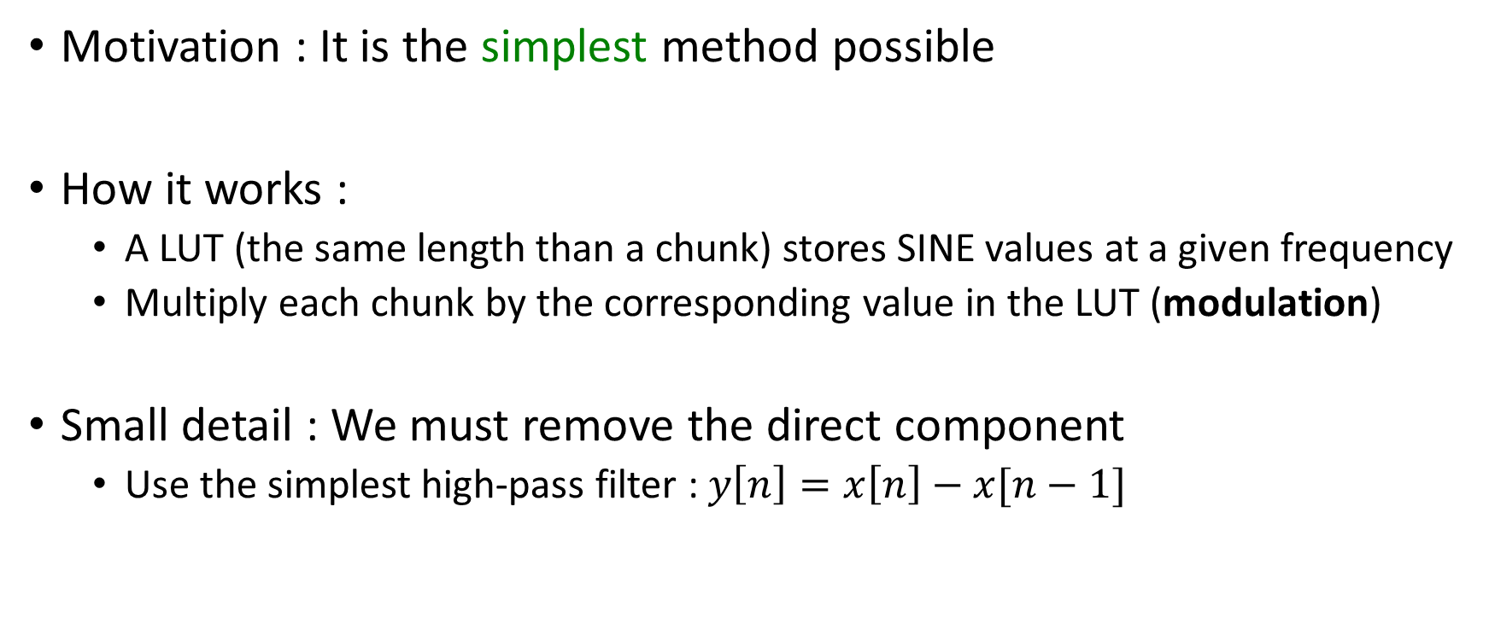
First method : Robot Voice
Motivation : It is the simplest method possible
How it works :
A LUT (the same length than a chunk) stores SINE values at a given frequency
Multiply each chunk by the corresponding value in the LUT (modulation)
Small detail : We must remove the direct component
Use the simplest high-pass filter : $y\left[n\right]=x\left[n\right]−x[n−1]$

Slide 4
Second Method : Granular Synthesis
Motivation :
The ‘aliasing effect’ is what makes the robot voice so special
But if the shifting frequency is too high, the intelligibility becomes too poor
Find a method that uses no ‘explicit’ modulation
How it works :
Use interpolation to create new samples at a higher rate (ie resampling)
Playing those samples at the input-rate will stretch the audio and make it deeper
A few raw samples are used twice, in two different grains
Use a tapered window to merge the overlapping resampled values of consecutive grains

Slide 5
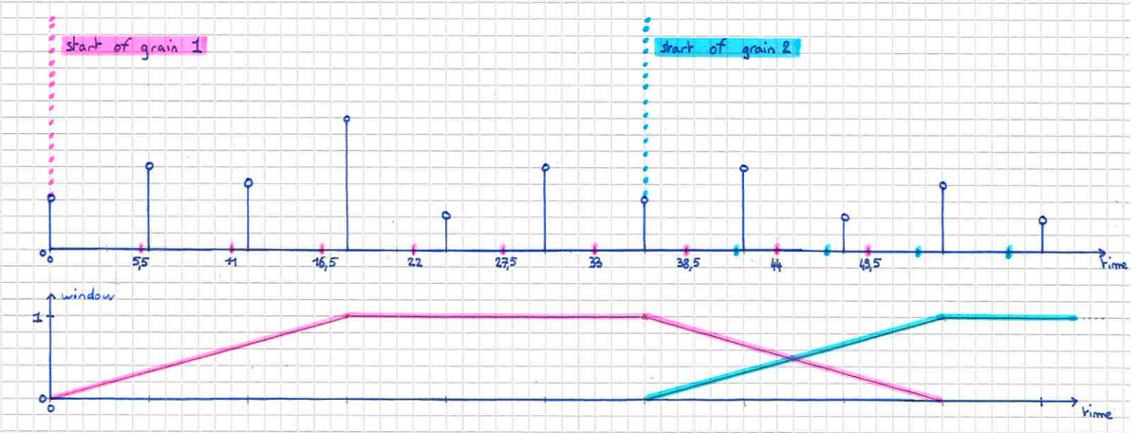
Example

Slide 6
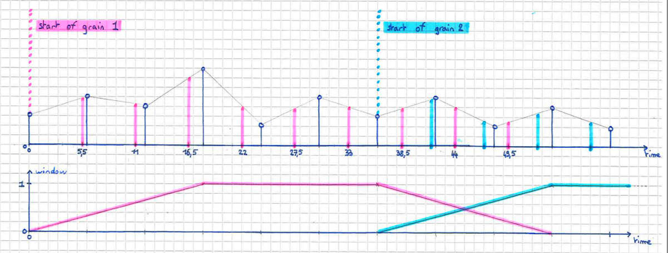
Examples

Slide 7
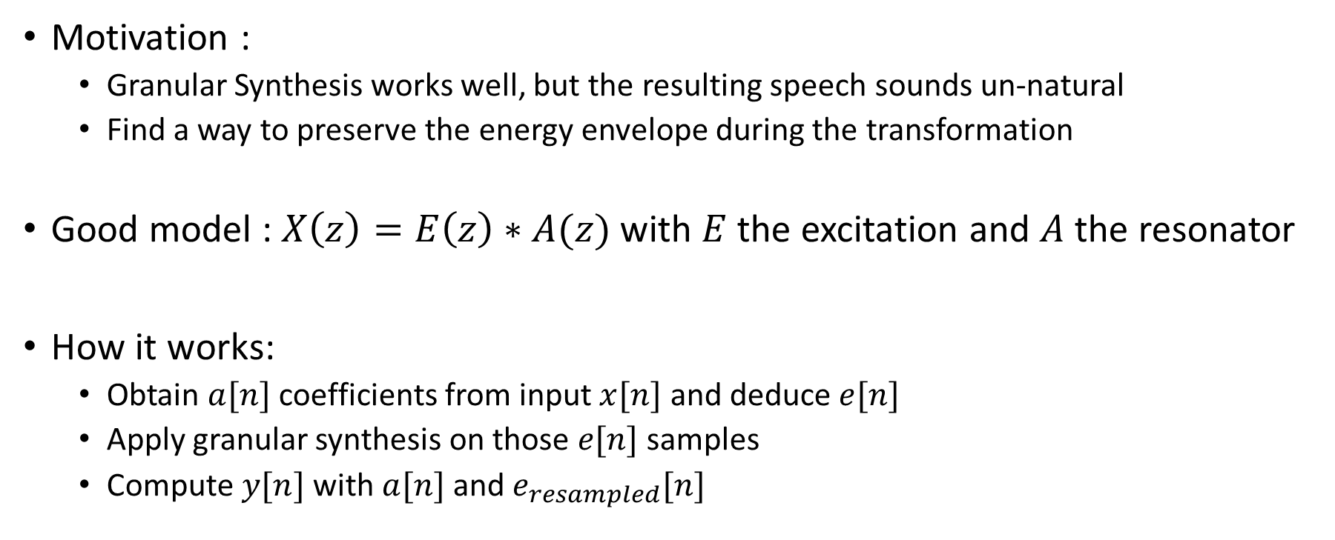
Third Method : Add LPC coefficients to GS
Motivation :
Granular Synthesis works well, but the resulting speech sounds un-natural
Find a way to preserve the energy envelope during the transformation
Good model : $X\left(z\right)=E\left(z\right)∗A(z)$ with $E$ the excitation and $A$ the resonator
How it works:
Obtain $a[n]$ coefficients from input $x[n]$ and deduce $e[n]$
Apply granular synthesis on those $e[n]$ samples
Compute $y[n]$ with $a[n]$ and$e_{resampled}[n]$

