Slide 1
Expected Outcome of the Capstone project
The 12-minute presentation serves as a platform for students to showcase their capstone project, demonstrating their understanding, problem-solving abilities, and communication skills. The presentation should concisely cover the project’s key aspects, including the problem addressed, theoretical analysis, methodology, results, and conclusions.
Suggested Presentation Structure (12 minutes Presentation + 8 minutes Q&A)
Introduction & Problem Statement (3 minutes)
Briefly explain the project’s purpose and relevance.
Theoretical Foundation (3 minutes)
Discuss key theoretical concepts and methods used.
Practical Application (3 minutes)
Showcase your implementation, challenges faced, and the results.
Future Work & Conclusion (3 minutes)
Share potential future applications, possible improvements, and a final summary.
Q&A – Discussion (8 minutes)

Slide 2
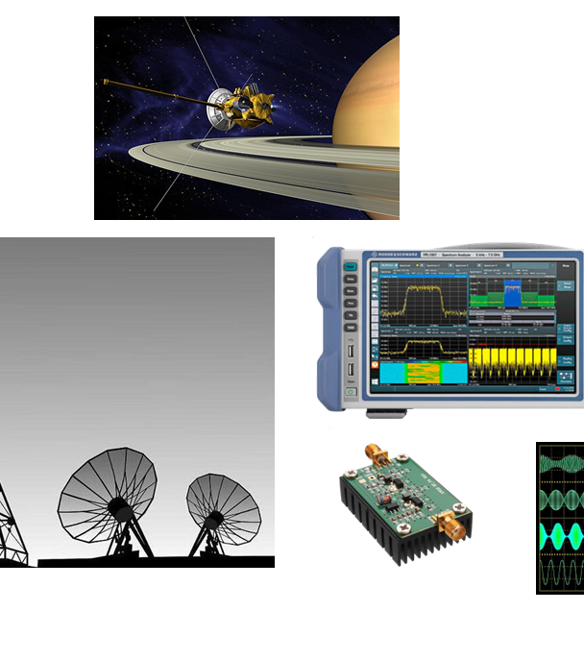
Project 2 - CLEAN
Modulschlussprüfungen
Digital Communication (dcom)
Herzog Cyril

Slide 3
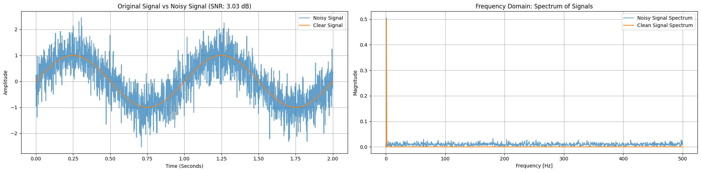
Goals

Slide 4
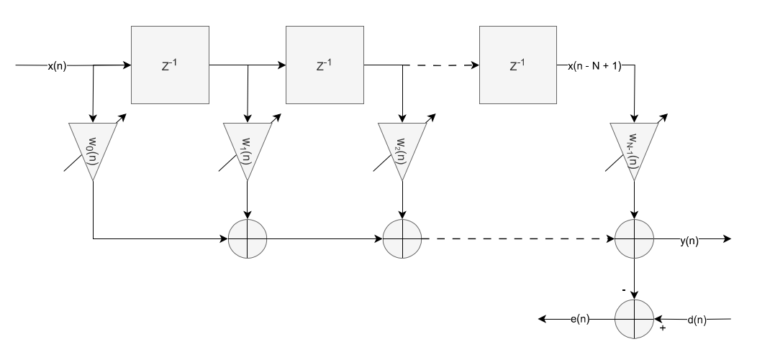
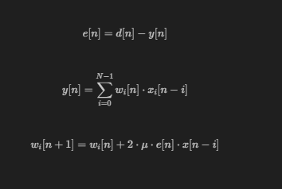
Last Mean Square (LMS) - Filter

Slide 5
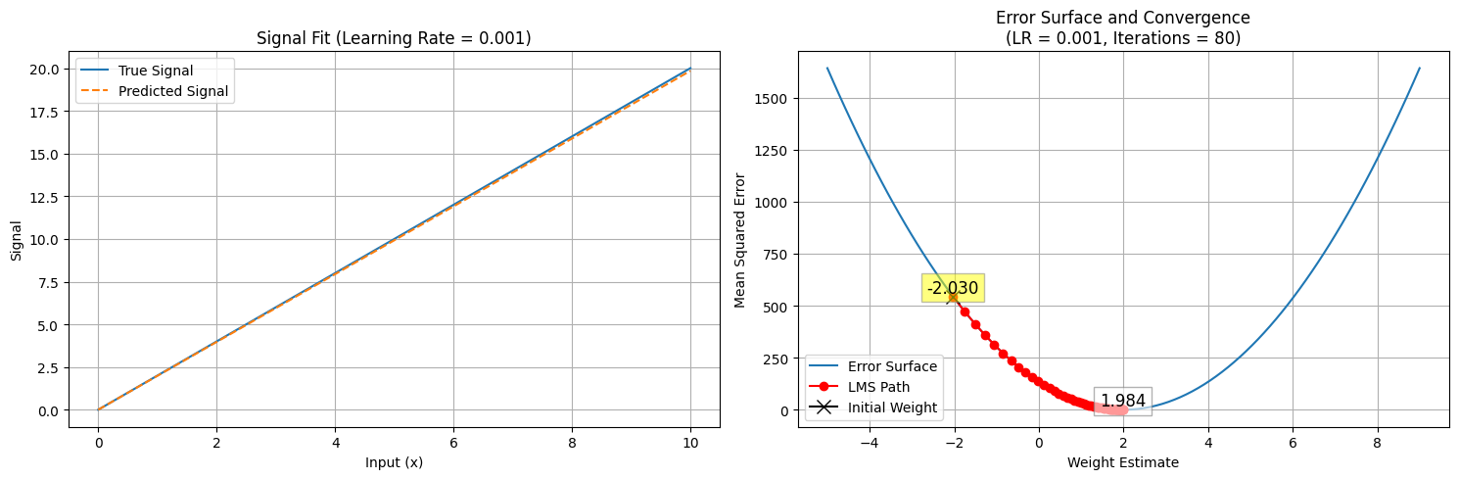
Last Mean Square (LMS) - Filter

Slide 6
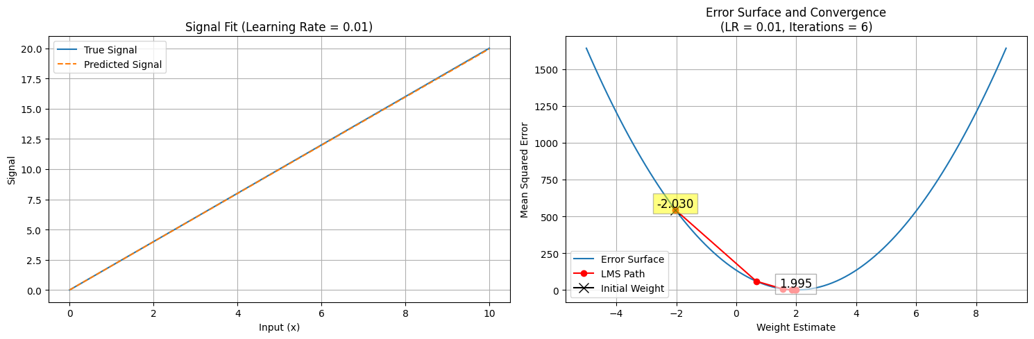
Last Mean Square (LMS) - Filter

Slide 7
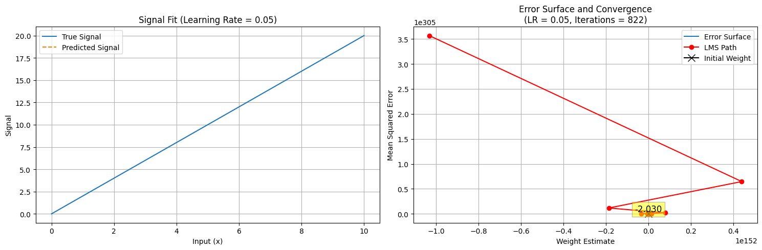
Last Mean Square (LMS) - Filter

Slide 8
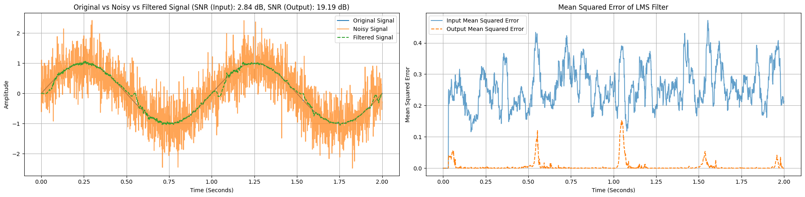
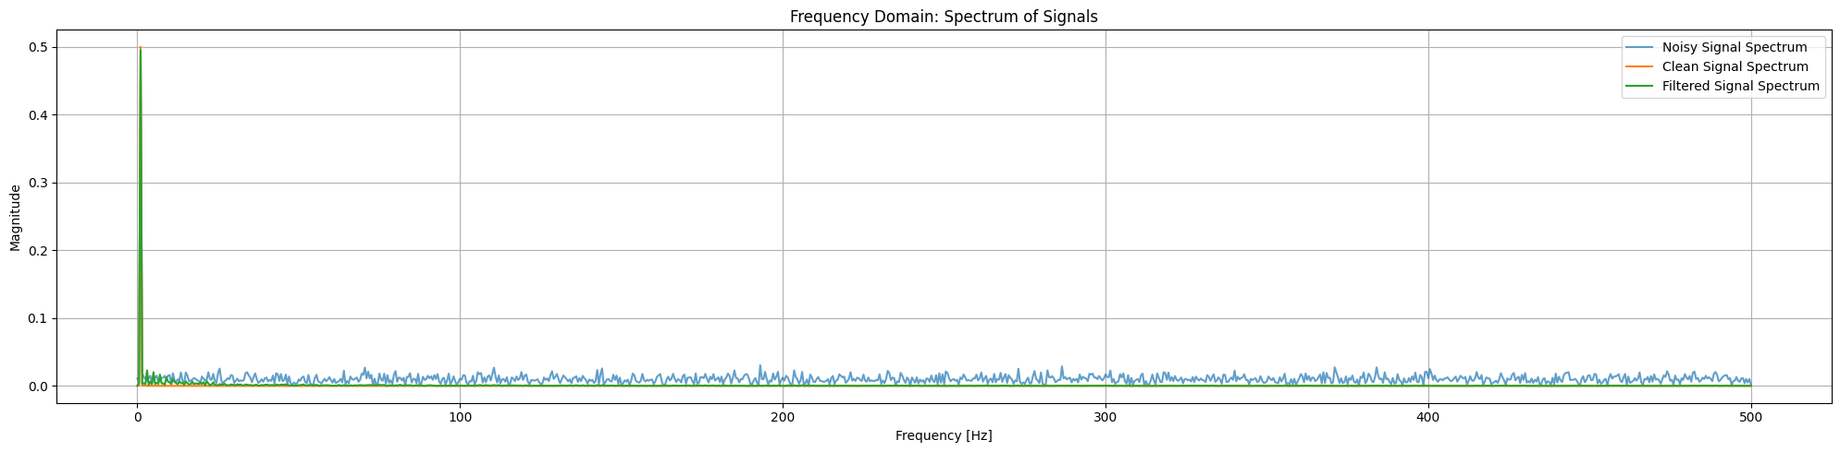
Last Mean Square (LMS) - Filter

Slide 9
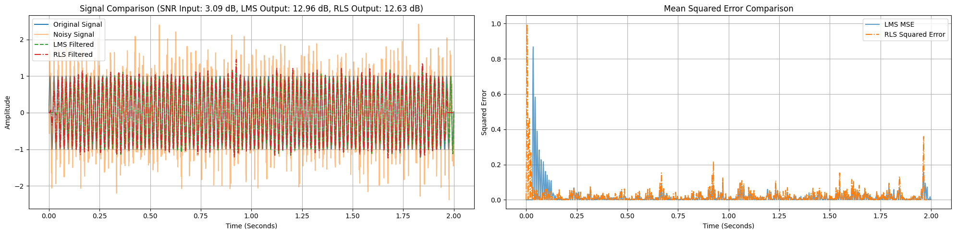
Recursive Least Squares (RLS) - Filter

