Slide 1
Introduction to APIs
Notes:
title: Modules and Libraries type: lesson duration: "00:45"
OverviewThis lesson walks through the idea of application programming interfaces (APIs), starting with their definition. It touches on JSON versus XML, followed by a series of exercises that introduce keys and parameters.
Learning ObjectivesIn this lesson, students will:
Describe what an application programming interface (API) is and why we might use one.
Identify common APIs on the web.
Call an API.
Duration45 minutes
Timing Notes:This is the last lesson of the last unit of core Python material; after this is the unit lab. The slides as laid out here are quite short, designed to allow a lot of flex time for you to add exercises on any topics the students have struggled with (of note, hw-10wk-9 has much more API practice).
Address any remaining questions in the parking lot here.
Suggested AgendaTimeActivity0:00 - 0:03Welcome0:03 - 0:10API Overview0:11 - 0:42Calling APIs0:42 - 0:45SummaryDifferentiation and ExtensionsFor more advanced students, have them call other APIs (refer back to the early slide with the list) and print out the information for that legibly.
Have them look through the jsonplaceholder API and print out even more information.
Fill extra time by chaining together exercises on everything they've learned.
In Class: MaterialsProjector
Internet connection
Python 3

Slide 2
Lesson Objectives
After this lesson, you will be able to…
Describe what an application programming interface (API) is and why we might use one.
Identify common APIs on the web.
Call an API.

Slide 3
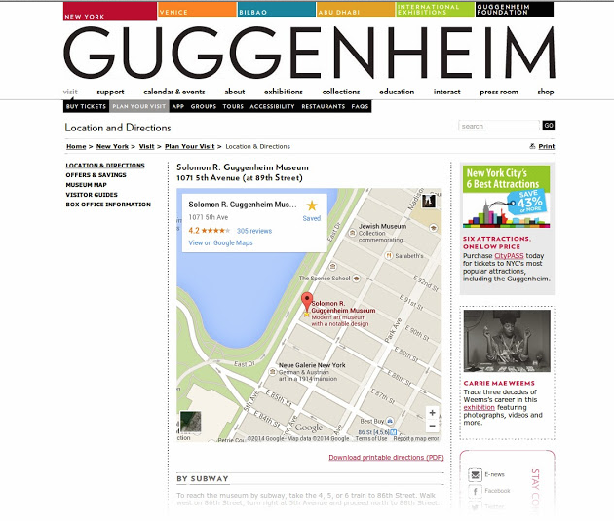
Discussion: Web Magic
Have you seen…
A website with Google Maps on the page (like Yelp)?
A program that had live stock market info?
A website that isn't Twitter but shows a live Twitter feed?
Any app that pulls info from somewhere else?
How did they do this?
Notes:
Talking Points:
Give examples here, like…
Have you seen a website that had a Google Map on it like Yelp? Yelp's developers didn't build that map themselves, as it was created by Google. What if you want a Google Map embedded in your web app to show people where they can visit you? You aren't going to make that map yourself, so somehow you have to call Google. Well, Google has a way you can get that map information — all you have to do is send a request to the URL that Google provides, and it gives you back a map you can use.
Teaching Tips:
Get students discussing.
Terminology note: Google Maps is embedded on the page.

Slide 4
APIs (Application Program Interfaces)
An API is a service that provides raw data for public use.
APIs give us data, maps, anything!
Do you think you've been on websites that call an API?
Does the JSON look unreadable in the browser? If you're using Chrome, install the JSONView plugin.
Notes:
Open each of these URLs in a new window so students can see what happens when you call an API.
Encourage a discussion if students can think of other APIs.
Talking Points:
Basically, an API is a service that provides raw data for public use. As third-party software developers, we can access an organization's API and use its data within our own applications. The term now commonly refers to web URLs that can be accessed for raw data.
Why recreate data when we don't have to? Think about past projects or ideas that would be easier if you could pull in data already gathered elsewhere.
APIs can provide us with data that we would otherwise not be able to create ourselves.
There are a variety of APIs available on the internet. To call an API, send a request to a URL and that API will return data to your program. You can pull data from anywhere that offers an API.
You can make this request as specific as you'd like — each web app out there offers different options for its API. You just have to find out what you can request!
Here are just a few examples of APIs you can use. Check it out — the left column is the common name you might know. The right column is the URL to which you, in your program, would send a request. You can click those URLs to see what each call would return.

Slide 5
How Do We Use an API?
We'll use the requests module.
import requests # Call the API by opening the URL and reading the data. # We use the `get()` function in `requests`. response = requests.get("<API URL HERE>") print(response) # Prints out the requested information!
This works, but there's one very helpful line missing!
Before we see this in action, let's look at what the API might return.
Notes:
Teaching Tip:
Go down the code here — be sure students understand the idea.
Talking Point:
We're going to demo this and write this code soon! But first, we need to see what the API might give us back.

Slide 6
JSON vs. XML
Imagine: You write code for a list.
my_list = [1, 4, 2] my_list.append(len(my_list)) my_list[1] = "new element!" for item in my_list: print item
But then, my_list is unexpectedly a dictionary, or an int, or even a class! The code we wrote won't work.
APIs can give data back in two ways: JSON or XML. Depending on what the API does, we need to write our program a different way.
Notes:
Teaching Tips:
Go down the code here — be sure students understand the idea.
Talking Point:
We're going to demo this and write this code soon! But first, we need to see what the API might give us back.

Slide 7
How Do APIs Give Us Info? Option 1: JSON
Here's a potential return from an API:
{ "users": [ {"name": "Wonder Woman", "id": 0}, {"name": "Black Panther", "id": 1}, {"name": "Batgirl", "id": 2} ] }
Looks like a dictionary with a list of dictionaries inside it, right?
But it's not a dictionary! It's JSON (JavaScript Object Notation).
The requests module has a built-in JSON decoder to turn JSON into a Python dictionary.
We can decode JSON with decoded_data = response_from_request.json().
Notes:
Talking Points:
So, APIs are great… What does it look like?
JSON stands for "JavaScript Object Notation" and has become a universal standard for serializing native data structures for transmission. It is lightweight, easy to read, and quick to parse. JSON looks like this — it's easily readable and information is separated with braces ({}) and commas.

Slide 8
How Do APIs Give Us Info? Option 2: XML
Instead of JSON, we might get XML:
<users> <user id="0"> <name>Wonder Woman</name> </user> <user id="1"> <name>Black Panther</name> </user> <user id="2"> <name>Batgirl</name> </user> </users>
Notes:
Talking Points:
XML, which stands for "Extensible Markup Language," is one of the first serialized data formats (itself based on HTML). XML is messy and cumbersome to parse, but remains a major format because of its legacy usage across the web.
Conveniently, many APIs publish data in multiple formats and let you specify which you'd like. For example, https:///api/index.php?output=json or https:///api/index.php?output=xml.
We'll be using JSON.

Slide 9
Main Benefit of XML
Schema validation for quality control.
https://www.w3schools.com/xml/schema_howto.asp

Slide 10
JSON is certainly easier to read!
We'll stick with JSON whenever we can.
Pro tip: Most of you don't need to know about XML, but if you're working with legacy code or an older API, you may have to use it. In that case, look up Element Tree XML.

Slide 11
Let's Choose an API
To recap: APIs give us data we can use in either XML or JSON.
Let's call one!
http://api.open-notify.org/astros.json tells us the people currently aboard the International Space Station (ISS).
{ "number": 5, "people": [ {"craft": "ISS", "name": "Oleg Novitskiy"}, {"craft": "ISS", "name": "Thomas Pesquet"}, {"craft": "ISS", "name": "Peggy Whitson"}, {"craft": "ISS", "name": "Fyodor Yurchikhin"}, {"craft": "ISS", "name": "Jack Fischer"} ], "message": "success" }
Notes:
Teaching Tips:
The number of astronauts and names currently aboard the International Space Station (ISS).
Go to the website in the browser so that students can see what it returns.
Ask if it's JSON or XML to check their memory.

Slide 12
Calling an API
Import the request module.
Call the API (requests.get()).
Parse the response with response.json().
https://repl.it/@GAcoding/python-programming-apis-iss?lite=true
Notes:
Teaching Tips:
Go down this code line by line. Why do we import these modules? What does each line do? Where do .read and .loads come from?
Terminology: parse.
Repl.it note:
# Call the API by opening the URL and reading the data. response = requests.get("http://api.open-notify.org/astros.json") # Decode the raw JSON data. response_data = response.json() print(response_data)

Slide 13
You Do: Calling an API
Open a new file, my_api.py. Type and run the code:
import requests # Call the API by opening the URL and reading the data. response = requests.get("http://api.open-notify.org/astros.json") # Decode the raw JSON data. response_data = response.json() print(response_data)
Notes:
Teaching Tips:
It's the same code to get them used to typing it with an expected output. Discourage copying anything but the URL.
Walk around to be sure everyone can do it.

Slide 14
You Do: Back to JSON
Back in your file, change the API call back to http://api.open-notify.org/astros.json.
Once it's decoded, it's a dictionary!
Replace your print statement:
for key, ratings in response_data_decoded.items(): print("Key:", key, "Value:", ratings, "\n")
Can we go further? Try to only print the names of the astronauts.
Notes:
5 MINUTES
Teaching Tip:
Walk through printing the original output again, but give students a few minutes to try to print only the names before showing the answer on the next slide.

Slide 15
Name Printing: Solution
Working backward, we have a:
Dictionary (key: name).
Which is inside a list (the value of people).
Which is inside a dictionary (key: people).
For message the value is success. For people the value is [{'craft': 'ISS', 'name': 'Oleg Artemyev'}, {'craft': 'ISS', 'name': 'Andrew Feustel'}, .....]. For number the value is 6.
for item in response_data_decoded["people"]: print(item["name"])
Notes:
Teaching Tips:
Walk through this with the students.
Show the code!

Slide 16
Quick Review
When we convert JSON, it keeps the same format, only in a Python structure.
When parsing an API's return, look through the JSON to find the exact structure you need. Is it the string value from the poem key? Or the value from each name key in a list of dictionaries, which is the value of the people key?
Think it through before writing your code.
(next slide)
Notes:
Teaching Tip:
Do a quick check for understanding.

Slide 17
# From the ISS API: { # The outer dictionary "number": 5, # Key: value "people": [ # Key and value, again. Here, the value is a list of dictionaries. {"craft": "ISS", "name": "Oleg Novitskiy"}, {"craft": "ISS", "name": "Thomas Pesquet"}, {"craft": "ISS", "name": "Peggy Whitson"}, {"craft": "ISS", "name": "Fyodor Yurchikhin"}, {"craft": "ISS", "name": "Jack Fischer"} ], "message": "success" # Key and value. } # From the Shakespeare API { # The outer dictionary. # The first key: value is the poem. 'poem': 'Pardoned!\nNurs.\nBepaint my cheek?', 'markov': 2, # The second key: value pair. 'lines': 3 # The third key: value pair. This is the number of lines in the poem. }

Slide 18
FYI: JSONPlaceholder API
Read about the API https://jsonplaceholder.typicode.com/ here.
Call this URL: https://jsonplaceholder.typicode.com/users/1 .
Display the name, username, email and phone that came back from the API.
Notes:
5-10 MINUTES
Teaching Tips:
Give students five or 10 minutes — encourage them to look through the API result. If students look lost, run this as a We Do and open the API call with them. It's not a quiz — it's just to get their brains thinking.

Slide 19

Equity Market API
https://iextrading.com/developer/docs/#batch-requests

Slide 20

MBTA API
https://www.mbta.com/developers/v3-api (Homepage)
https://api-v3.mbta.com/docs/swagger/index.html#/ (Documentation)
api-v3.mbta.com (actual API)

Slide 21
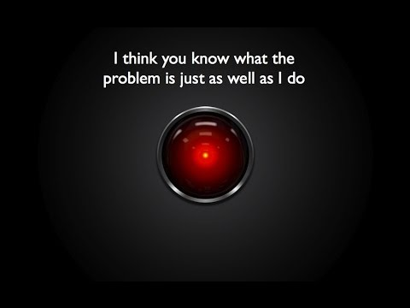
AI
Machine Vision
Code

Slide 22

Twilio API

Slide 23
Summary
APIs:
Handy URLs from which we can get information.
Sometimes require keys.
Usually free.
Call with the requests() module.
XML and JSON:
Two formats in which APIs might return information to us.
XML is legacy.
JSON looks like a dictionary.
https://repl.it/@GAcoding/unit-5-apis-placeholder-solution?lite=true

Slide 24
I Do: API Authentication
Many APIs are free but require a key. This identifies the developer requesting access.
If we call the Giphy API:
With no key, http://api.giphy.com/v1/gifs/search?q=funny+cat, we get Error - Unauthorized!
With a key, http://api.giphy.com/v1/gifs/search?q=funny+cat&api_key=dc6zaTOxFJmzC, it works!

Slide 25
I Do: API Authentication
Syntax Notes:
The main API URL is http://api.giphy.com/v1/gifs/search.
? always delineates a URL and its parameters.
(The ? is a standard for every URL! Searching Google for "banana," with q short for "query:" https://www.google.com/search?q=banana).
(Here's another one! Searching Amazon for "banana:" https://www.amazon.com/s?field-keywords=banana.)
Most importantly, never publish your key for a backend service, including on GitHub! (This is an example.) There are other ways to provide your key to a server in order to keep that key safe. However, if your code is using JavaScript, that's ok as that provides only read access in general (assuming you have your permissions properly configured.) This is a sticking point for developers coming to Python from a front-end perspective.
Notes:
Teaching Tips:
Syntax is called out here for the first time. Continue calling it out throughout the rest of the lesson. Stress that every API has different parameters — read the docs!
Show this in a browser.
Talking Points:
While the majority of APIs are free to use, many of them require an API "key" that identifies the developer requesting data access.
This is done to regulate usage and prevent abuse. Some APIs also rate-limit developers, meaning they have caps on the free data allowed during a given time period.
Some APIs, such as Spotify's music catalog, might seem like they should be available for anyone to access, but imagine if PayPal had an API from which shops could request your money. Now, imagine Etsy calls PayPal when you buy something. You'd want Etsy to have to prove it was actually Etsy, right? You don't want anyone to be able to pretend to be Etsy, go to PayPal, and charge you $500. Instead, you'd want Etsy to somehow authenticate to PayPal.
This is accomplished by giving Etsy a private key to use at PayPal that only Etsy knows. Every time Etsy makes a request to PayPal, Etsy can say, "Hey, I'm requesting this. Here is my proof that I'm allowed to do so."
When you are calling APIs that require a key, it's up to you to store those keys somewhere private. They are the only proof that you are you and you are allowed to call that API, after all.

Slide 26
Additional Resources
Here's an example of a stolen key horror story.
The Programmable Web API Directory
Element Tree XML

