Slide 1


GIT Training
02

Slide 2

SUMMARY
1
Advanced Commands
2
Pull Request
3
Simulation

Slide 3

Advanced Commands
01

Slide 4


List
Amend
Reflog
Fetch
Rebase
Stash
Reset
Clean
Revert
Tag
Cherry Pick
Blame
Revert

Slide 5
Fetch
Command | Comment
git fetch | Update the local remote-tracking.
git fetch --prune | Update the local remote-tracking and delete unused branch in the local repository that have been deleted in the remote repository.
Why Fetch?
Keep your remote-tracking up-to-date
Get notified when changes are ready to be pulled
It’s possible to call periodically git fetch

Slide 6
Rebase
Why Rebase?
Merge branch
Keep linear branch history
Rebase from Remote
git pull --rebase origin [name]
Master
Feature
git checkout feature
git rebase master
Master
Feature
Notes:
https://stackoverflow.com/questions/13193787/why-would-i-want-to-do-git-rebase
https://www.atlassian.com/git/tutorials/merging-vs-rebasing#the-golden-rule-of-rebasing
http://onlywei.github.io/explain-git-with-d3/#freeplay

Slide 7
Stashing
Command | Comment
git stash | Stash tracked files.
git stash –u | Stash all files.
git stash save “[name]” | Specify stash name.
git stash branch [name] | Stash to a specific new branch.
git stash list | List all stashes.
git stash apply | Apply a stash.
git stash drop | Delete a stash.
git stash pop | Apply and delete last stash.
git stash show [stash id] | Show specifc stash.
Why Stash?
Wrong branch
Emergency
Keep for later
Bug/adaptation/evolution analysis

Slide 8
Reset
Command | Comment
git reset | Remove the last commit from the repository and move it to the working directory (--mixed).
git reset --soft HEAD | Remove the last commit from the local directory and move it to the staging area.
git reset --hard HEAD | Delete the last commit.
Why Reset?
Remove a commit
Commit in the wrong local branch
Local
Working Directory
Staging
Area
Repository
(.git folder)
--soft
--mixed
--hard
Notes:
https://stackoverflow.com/questions/2221658/whats-the-difference-between-head-and-head-in-git
https://www.atlassian.com/git/tutorials/undoing-changes/git-reset

Slide 9
Tagging
Command | Comment
git tag [name] | Create a tag.
git tag -a [name] | Create an annotated tag.
git tag --list | List all tags.
git tag --delete [name] | Delete a tag.
Why Tagging?
Each Release version
Keep track of specific change
Helps to find specific version

Slide 10
Cherry PiCK
Command | Comment
git cherry-pick [commit id] | Get a specific commit in the current branch.
Why Cherry Pick?
Get specific commit
Example
2 branches
One commit from the dev branch is needed to hot fix an issue.
Cherry pick help to get the specific commit into another branch.

Slide 11
Pull Request
02

Slide 12
Why
Helps to ensure quality
Code Review
Automated Build
Automated Unit Tests
Improves teamwork
Learn from others
Teach others
Follow the source code evolution

Slide 13
Best Practices
Small
Often (daily basis)
Review daily
Limit amount per user

Slide 14
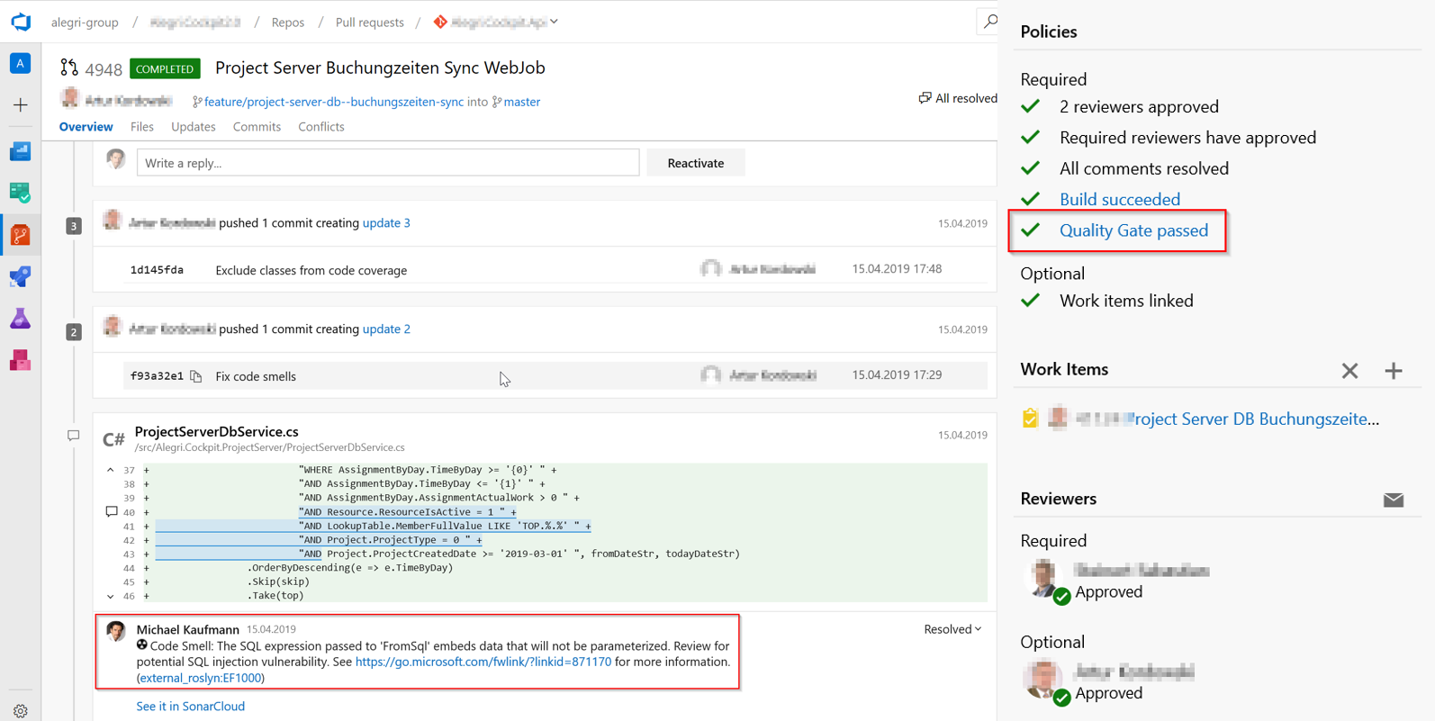
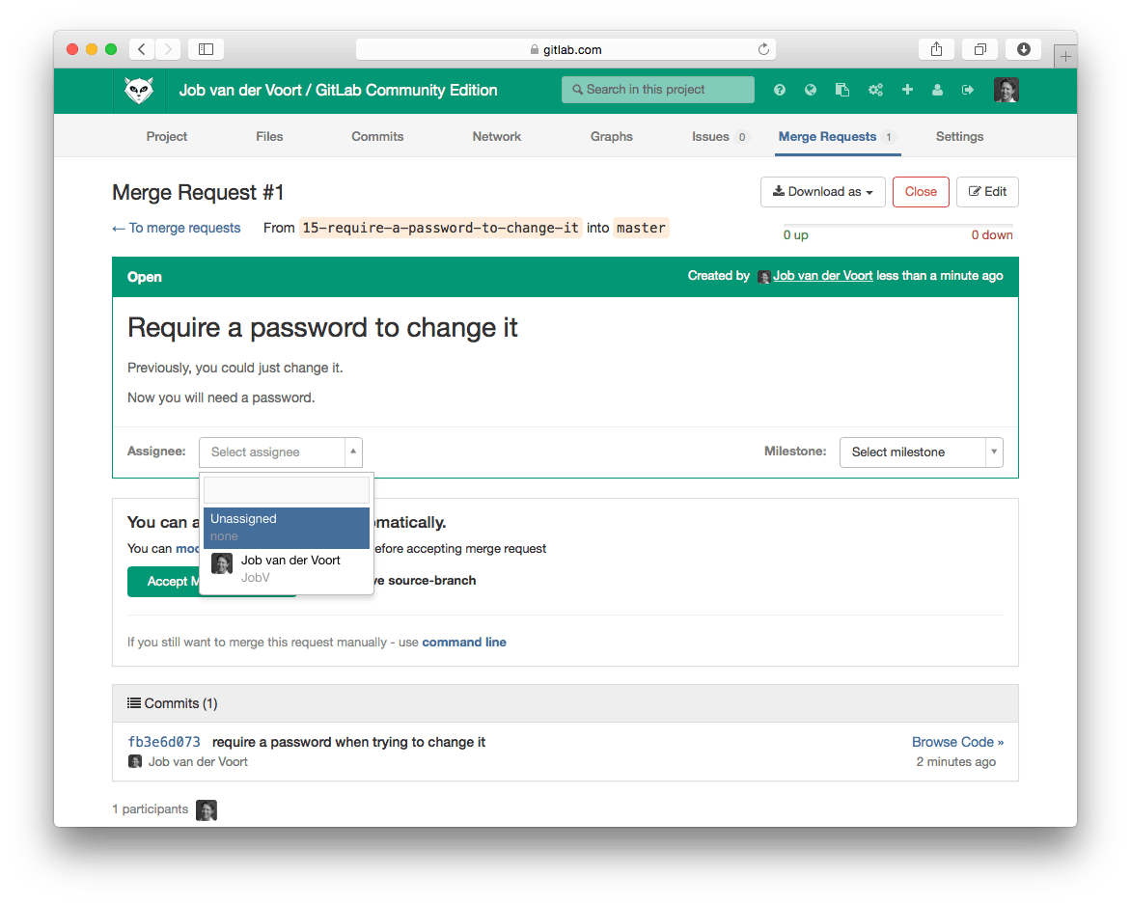
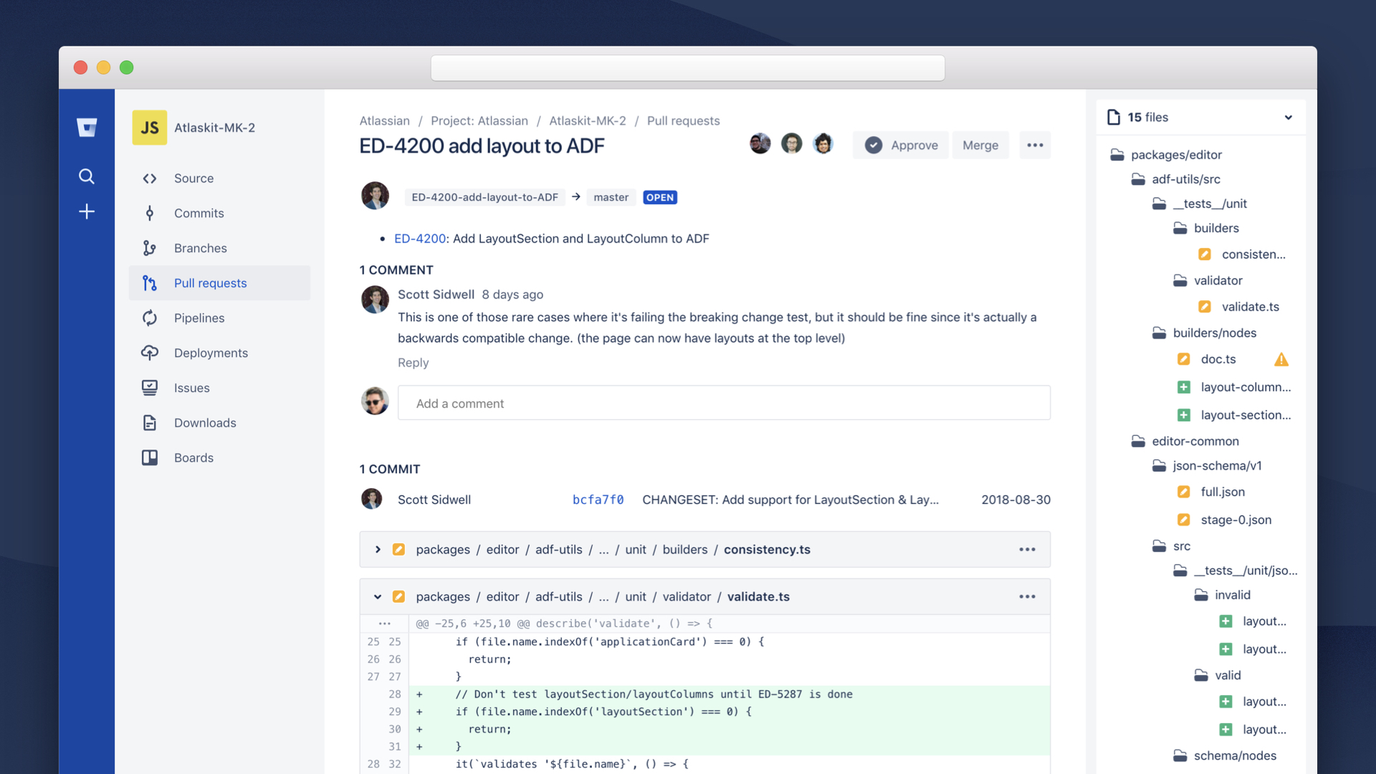
Tools
Azure DevOps
GitLab
GitHub
BitBucket

Slide 15
Advanced Merging
03
TBD

Slide 16
Simulation
03

Slide 17

Setup
You need a GitHub account
Visual Studio Code
Install Lua extension
Install LOVE extension
Install Löve
https://love2d.org/
https://love2d.org/wiki/Getting_Started
Clone Repo
https://github.com/CyrilLacroix/GitTraining.git
Simulation Parameters
One Day (7 min)
One Sprint – 3 Days (21 min)
3 Sprints (1h03 min)
Simulation meetings/tasks
Pull Request
Sprint Planning
Planning Poker
Daily Scrum
Sprint Retrospective
Sprint Review

