Slide 1
Android存储系统
陈恒

Slide 2




分区结构
Mount分区
Vold实现机制

Slide 3

分区结构
Android存储类型
RAM：SRAM、DRAM(SDRAM、DDR)
ROM：Nor Flash、Nand Flash、eMMC
SRAM: Static Random Access Memory
DRAM: Dynamic Random Access Memory
SDRAM: Synchronous Dynamic Random Access Memory
DDR: Double Data Rate Synchronous Dynamic Random Access Memory
Nor Flash:具有完整的寻址与数据总线，可以直接寻址随机访问
Nand Flash:依赖主控IC和驱动电路，需要以I/O接口方式访问
eMMC:对Nand Flash+主控IC的封装，简化电路，标准化接口

Slide 4
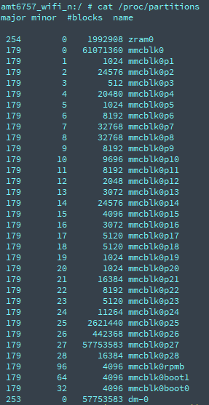
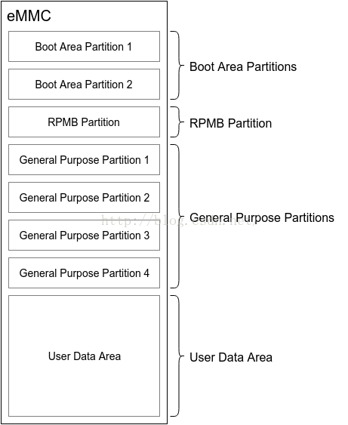
分区结构
eMMC

Slide 5
分区结构
Android分区
device/mediatek/build/build/tools/ptgen/MT6757/partition_table_MT6757.xls
device/mediatek/build/build/tools/ptgen/MT6757/ptgen.pl
out/target/product/amt6757_wifi_n/MT6757_Android_scatter.txt
Partition_Name | Type | Size_KB |  | Region
 |  | eng | user
preloader | Raw data | 256 |  | EMMC_BOOT1_BOOT2
pgpt | Raw data | 32 |  | EMMC_USER
recovery | Raw data | 24576 |  | EMMC_USER
persist | EXT4 | 49152 |  | EMMC_USER
nvram | Raw data | 5120 |  | EMMC_USER
lk | Raw data | 1024 |  | EMMC_USER
lk2 | Raw data | 1024 |  | EMMC_USER
boot | Raw data | 16384 |  | EMMC_USER
system | EXT4 | 2621440 |  | EMMC_USER
cache | EXT4 | 442368 |  | EMMC_USER
userdata | EXT4 | 3145728 |  | EMMC_USER
intsd | FAT | 0 |  | EMMC_USER
otp | Raw data | 44032 |  | EMMC_USER
flashinfo | Raw data | 16384 |  | EMMC_USER
sgpt | Raw data | 16.5 |  | EMMC_USER

Slide 6

Mount分区挂载
init.mt6757.rc：
on fs
mount_all /fstab.mt6757
/dev/block/platform/mtk-msdc.0/11230000.msdc0/by-name/system /system ext4 ro wait
/dev/block/platform/mtk-msdc.0/11230000.msdc0/by-name/userdata /data ext4 noatime,nosuid,nodev,noauto_da_alloc,discard wait,check,resize,forceencrypt=/dev/block/platform/mtk-msdc.0/11230000.msdc0/by-name/metadata,
/dev/block/platform/mtk-msdc.0/11230000.msdc0/by-name/cache /cache ext4 noatime,nosuid,nodev,noauto_da_alloc,discard wait,check
/dev/block/platform/mtk-msdc.0/11230000.msdc0/by-name/nvdata /nvdata ext4 noatime,nosuid,nodev,noauto_da_alloc,discard wait,check,formattable
/dev/block/platform/mtk-msdc.0/11230000.msdc0/by-name/nvcfg /nvcfg ext4 noatime,nosuid,nodev,noauto_da_alloc,commit=1,nodelalloc wait,check,formattable
/devices/platform/mtk-msdc.0/11230000.msdc0* auto vfat defaults voldmanaged=sdcard0:auto
/devices/platform/mtk-msdc.0/11240000.msdc1* auto auto defaults voldmanaged=sdcard1:auto,encryptable=userdata
/devices/platform/11270000.usb3_xhci* auto vfat defaults voldmanaged=usbotg:auto
/dev/block/platform/mtk-msdc.0/11230000.msdc0/by-name/frp /persistent emmc defaults defaults
/dev/block/platform/mtk-msdc.0/11230000.msdc0/by-name/nvram /nvram emmc defaults defaults
/dev/block/platform/mtk-msdc.0/11230000.msdc0/by-name/lk /bootloader emmc defaults defaults
/dev/block/platform/mtk-msdc.0/11230000.msdc0/by-name/boot /boot emmc defaults defaults
/dev/block/platform/mtk-msdc.0/11230000.msdc0/by-name/recovery /recovery emmc defaults defaults

Slide 7
Mount分区挂载
fstab格式
<src> | <mnt_point> | <type> | <mnt_flags> | <fs_mgr_flags>
/devices/platform/mtk-msdc.0/11230000.msdc0* | auto | vfat | defaults | voldmanaged=sdcard0:auto
atime/noatime：是否更新文件系统上 inode 访问记录，以提升性能
auto/noauto: 当下载mount -a 的命令时，此文件系统是否被主动挂载。默认为auto rw/ro: 是否以以只读或者读写模式挂载 exec/noexec: 限制此文件系统内是否能够进行”执行”的操作 user/nouser: 是否允许用户使用mount命令挂载 suid/nosui： 是否允许SUID的存在 defaults： 同时具有rw,suid,dev,exec,auto,nouser,async等默认参数的设置
Vold忽略mnt_flags选项

Slide 8
Mount分区挂载
fstab格式
<src> | <mnt_point> | <type> | <mnt_flags> | <fs_mgr_flags>
/devices/platform/mtk-msdc.0/11230000.msdc0* | auto | vfat | defaults | voldmanaged=sdcard0:auto
wait: 系统等待分区挂载完毕 check: 检查分区是否正常挂载 formattable: 能否init进程被格式化
resize:自动调整分区大小（MTK专有）
forceencrypt：强制加密
forceencrypt=/dev/block/platform/mtk-msdc.0/11230000.msdc0/by-name/metadata
voldmanaged=sdcard1:auto,encryptable=userdata
voldmanaged=sdcard0:auto
voldmanaged=usbotg:auto

Slide 9

Vold实现机制

Slide 10
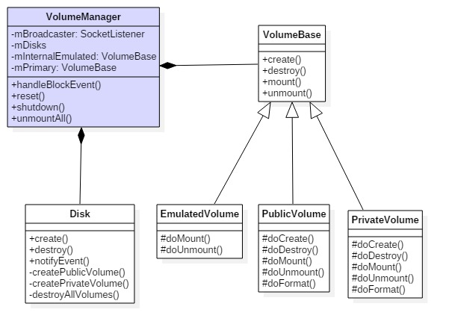
Vold实现机制

Slide 11
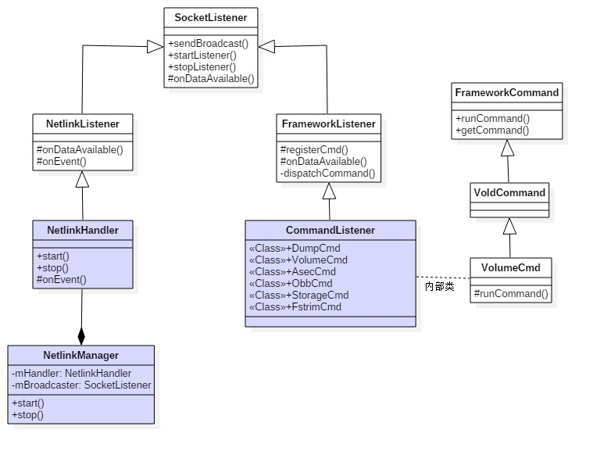
Vold实现机制

Slide 12
望各位批评指正！

