Slide 1
CJM Template Completion Guide
What it does
This tool helps customer journey mapping workshop organizers to guide workshop participants to complete the CJM template.
Instructions
Slide 1: Refer to this slide for an overview of the steps involved in completing the CJM template.
Slides 2 - 4: Refer to these slides to guide participants through the process of completing the CJM template.
Slide 5: Refer to this slide for a completed sample CJM template.
Notes:
UPDATED 04 December 2018
Presenter's Name
Presenter's Name

Slide 2
Steps to Completing the CJM Template
Step 1: Identify the Stages
(Slide 2)
Step 2: Set the Steps
(Slide 3)
Step 3: Fill in the Categories
(Slide 4)
Source: Gartner (May 2019)

Slide 3
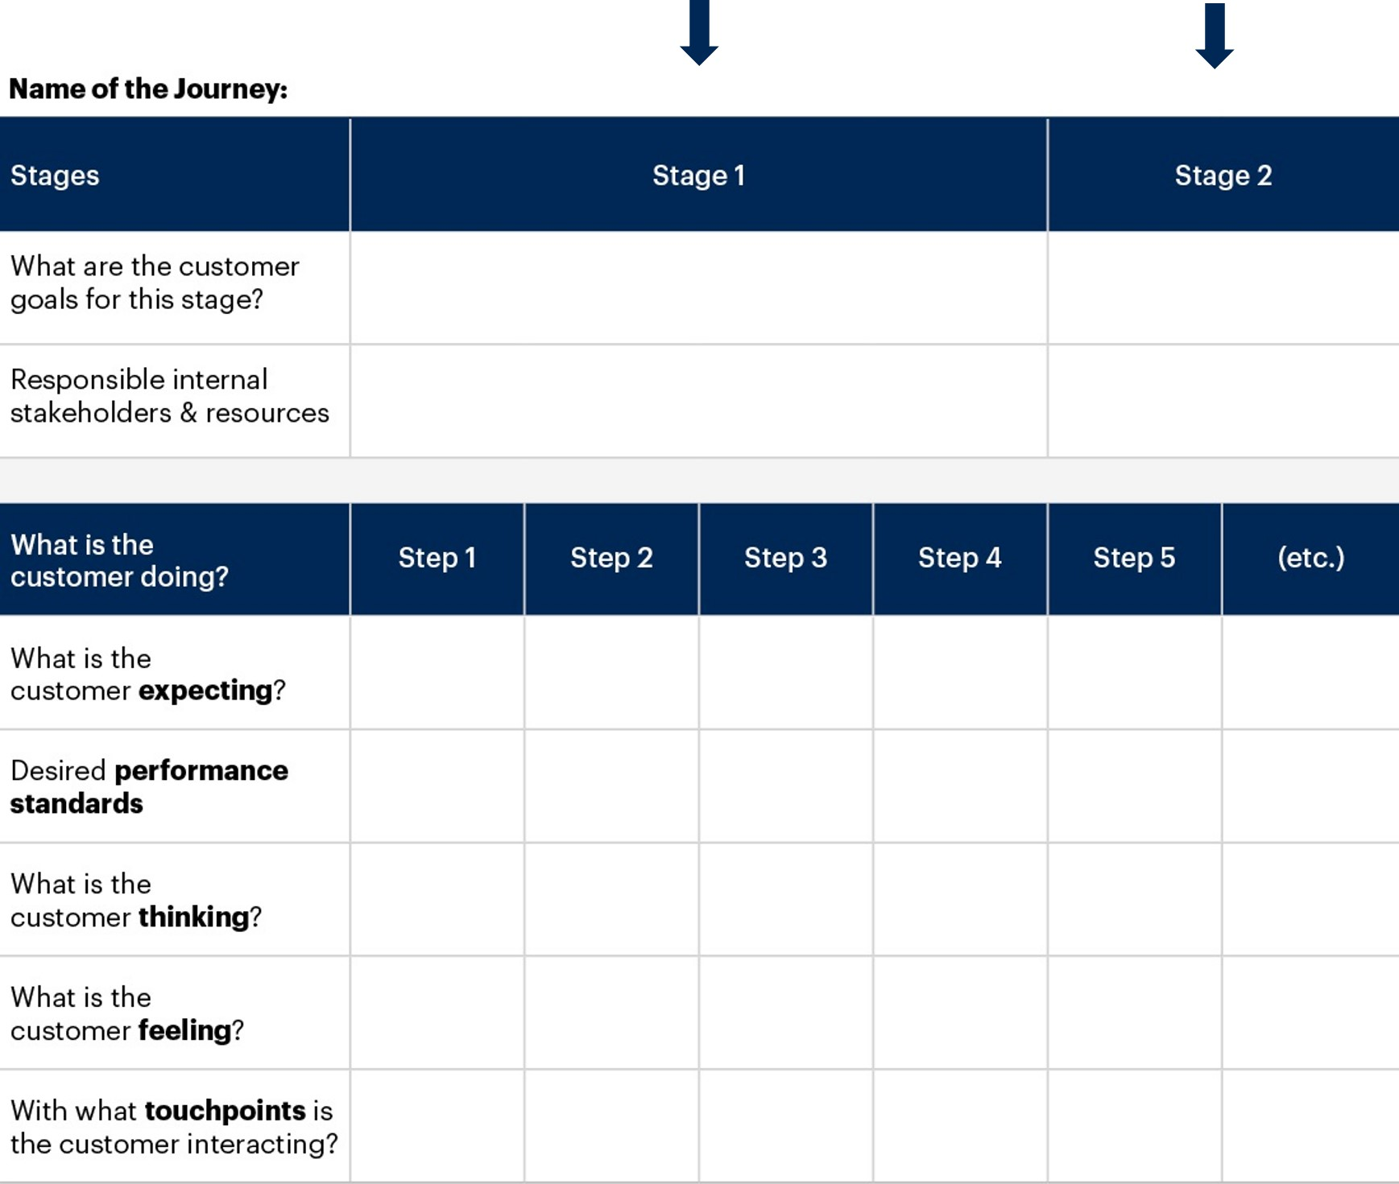
Step 1: Identify the Stages
Instructions:
- Identify the stages for the chosen journey.
- Stages are groups of steps the customer will take during the given journey (for example, the steps that lead up to a transaction can be grouped into the “buy” stage). For each stage, write down the customer goals and the internal stakeholders/resources aligned to it.

Slide 4
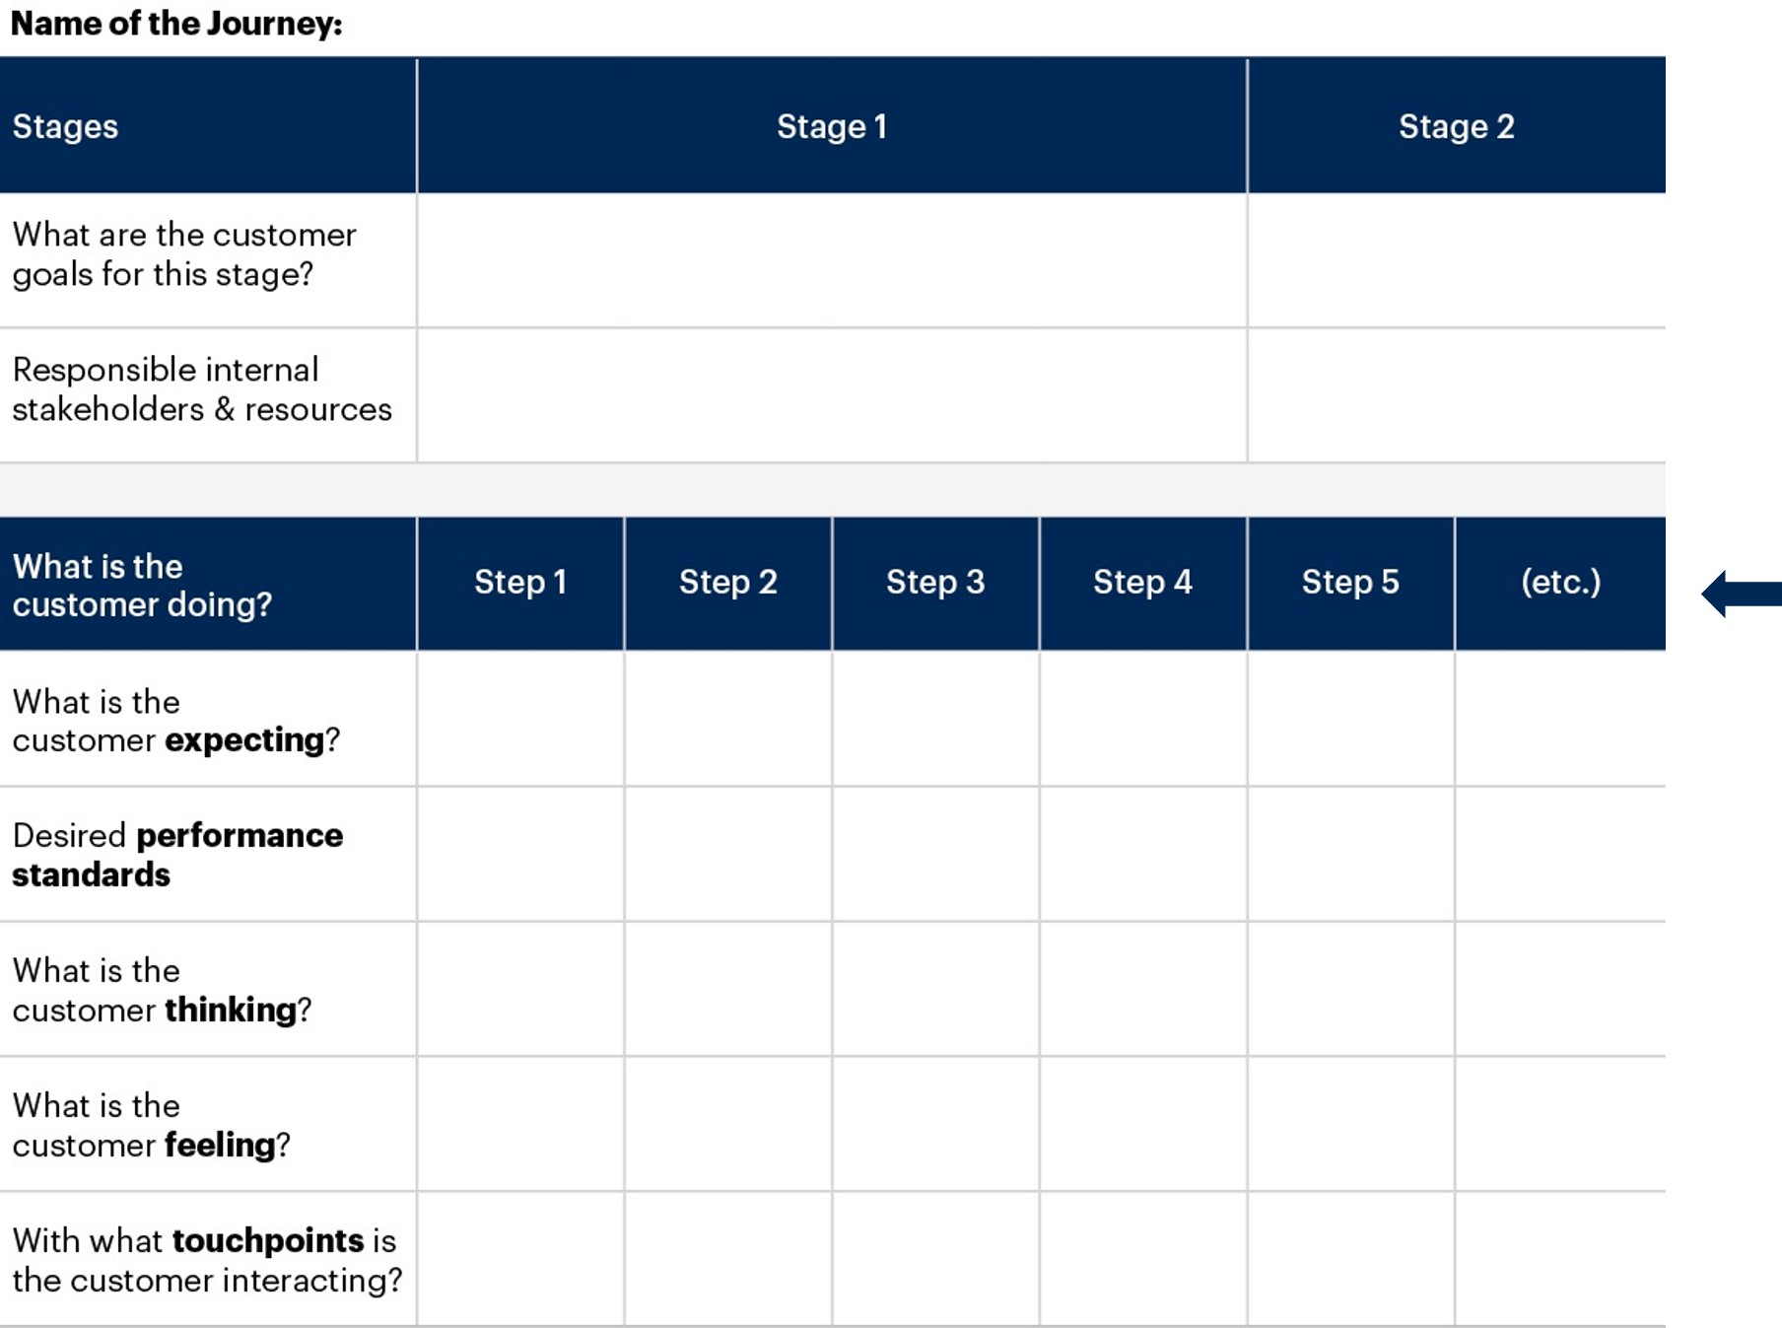
Step 2: Set the Steps
Instructions:
- fill in the steps the customer will take during the given journey.
- Once the steps have been decided, ask the participants to write them on sticky notes and paste these on the white board/wall (for an in-person workshop) as these steps tend to change through the course of the session.

Slide 5
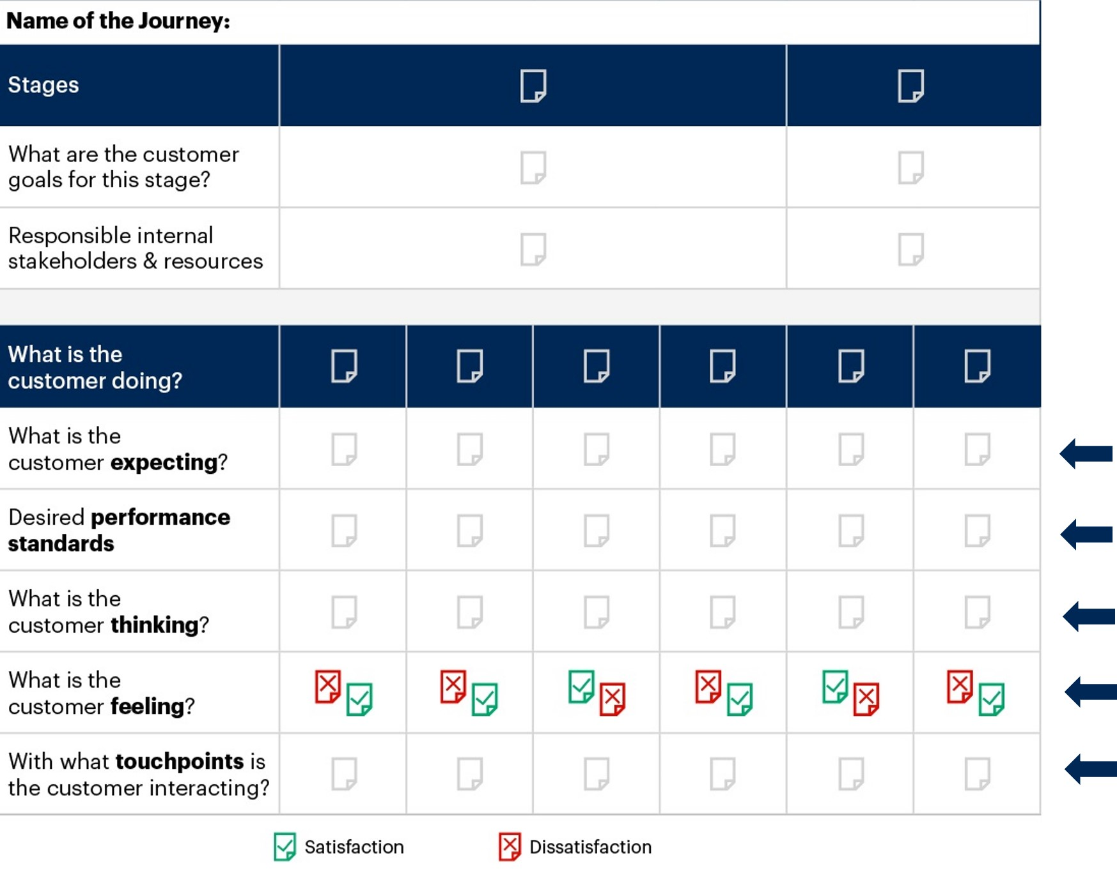
Step 3: Fill in the Categories
Instructions:
- While filling in the categories, you should think about the customer’s expectations, desired performance standards, thoughts, feelings, challenges and the touchpoints they interact with along their journey.
- Within the “feelings” category, use red sticky notes to represent feelings of dissatisfaction, and green to represent feelings of satisfaction. This facilitates quick identification of pain points and enjoyable points along the journey.

Slide 6
Sample Completed CJM Template
Stages | Getting to the menu |  | Buying and transacting |  |  |  |  | Showing loyalty to the brand | Advocating for the brand
What are Emily’s Goals at this stage? | To get to the menu review in the safest, shortest time possible. |  | To receive the items she wants at the price she expects at the shortest time possible; to receive friendly service. |  |  |  |  | To have a similar experience as last time. | For her friends and family to visit the store and have a similar experience.
Responsible internal stakeholders/resources. | Store locators on the website |  | Placement of menu board, staff at the billing counter, barista, billing machine. |  |  |  |  | CX team, management, store staff. | CX team, store staff, management, social media team.
What is Emily doing? | Craves for a coffee | Enters coffee shop | Reviews the menu | Places an order | Pays for the coffee | Waits for order | Drinks coffee | Returns to store for next coffee run | Recommends store to friends and family
What is Emily expecting? | To find a coffee shop close to her workplace. | To not wait in a long queue. | Easy layout | Friendly staff, availability of item. | Availability of various payment methods. | Less waiting time. | Tastes as per expectation. | Consistent experience. | For her friends and family to visit the store and have a similar experience.
Desired performance standards | Locate stores close to office spaces. | Maintain 2 counters in all stores. If queues go beyond 6 persons, open a third counter. | Big, easy-to-read menu boards with updated menu and prices. | Items listed on the menu should always be available. | Payment can be made using cash, card or digital means. | Preparation of order should not take more than expected time. | Should contain all add-ons customer asked for. | Maintain (or enhance) quality of experience. | Maintain (or enhance) quality of experience.
What is Emily thinking? | Will there be a long queue? | What should I order? | Will they have the item? | How should I pay? | How long will I have to wait? | What will it taste like? | Have I got the correct order? | When should I come next? What should I order next? | Will my friends and family like the store as much as I did?
What is Emily feeling? | Groggy, sleepy | Short line: happy; long line: irritated. | Good board: happy; Bad board: irritated. | Irritated if item not available. | Irritated if preferred payment not available. | On/before time: happy; Long time: irritated. | Tastes good: happy; tastes bad: irritated. | Satisfaction or dissatisfaction based on consistency of experience. | Loved the experience and excited to be sharing about it with her friends and family.
With what touchpoints is Emily interacting? | Store website (for store timings, location) | Store layout | Menu board | Staff | Staff, Billing machine | Store seating | Product and service

