Slide 1
Labs on Generation of Random Numbers for Data Security Patrick Haddad ST Microelectronics, France Viktor Fischer FIT CVUT, Prague, Czech republic, UJM Saint-Etienne, France

Slide 2
Part 1: True random number generator design

Slide 3
Physical True Random Number Gererator - P-TRNG
Source of el. noise
A/D conversion
&
Randomness extraction
Alarm
Online test
Source of el. noise
DRNG
Source of el. noise
Random bit stream
….
Source of el. noise
Oscillators, diodes, PLLs, latches
Samplers or counters + XOR gates
Deterministic RNG -
Cryptographically secure (one way) function

Slide 4
Elementary oscillator-based TRNG - EO-TRNG (1/2)

Slide 5
Elementary oscillator-based TRNG - EO-TRNG (2/2)

Slide 6
Exercise 1: Impact of the EO-TRNG input parameters on the RNG output
Observed parameters:
duty cycle
jitter variance
accumulation time
Analyzed using output 4-bit bit-vectors and their:
distribution
auto-correlation
Goal:
Find the smallest D, for which the EO-TRNG would not be distinguishable from an ideal RNG, by repeating the procedure while changing σ_{tot} /T₁ and α₁.
Note: In the case of an ideal RNG, the distribution and the auto-correlation are in 99.9 %
cases between the red lines.

Slide 7
Multi-ring-oscillator based RNG – MO TRNG (Sunar et al. 2007, Wold and Tan, 2008)

Slide 8
Exercise 2: Impact of the MO-TRNG input parameters on the RNG output
Observed parameters:
jitter variance
accumulation time
number of oscillators
Analyzed using output 4-bit bit-vectors and their:
distribution
auto-correlation
Goal:
Find the values of σ_{tot} /T_{i} , D and m, for which the EO-TRNG would not be distinguishable from an ideal RNG, by repeating the procedure while changing σ_{tot} /T_{i} , D, and m (α_{i} is equal to 0.5 in this exercise)
Note: In the case of an ideal RNG, the distribution and the auto-correlation are in 99.9 %
cases between the red lines.

Slide 9
How to set up a MO TRNG?
Which parameters determine its performance?
Which parameters determine the cost?

Slide 10
How to set up a MO TRNG?
Which parameters determine its performance?
Size of the jitter
Jitter accumulation time (period of the sampling clock)
Number of oscillators
Which parameters determine the cost?
Number of oscillators and flip-flops

Slide 11
Exercise 3: Impact of the MO-TRNG input parameters on the output entropy rate
Observed parameters:
jitter variance
accumulation time
number of oscillators
Analyzed using output entropy rate:
Shannon entropy
min-entropy
Goal:
Find the values of σ_{tot} /T_{i} , D and m, for which the EO-TRNG would not be distinguishable from an ideal RNG, by repeating the procedure while changing σ_{tot} /T_{i} , D, and m (α_{i} is equal to 0.5 in this exercise).
Note: In the case of an ideal RNG, the distribution and the auto-correlation are in 99.9 %
cases between the red lines.

Slide 12
Part 2: Statistical tests

Slide 13
Online test
What is the objective of the test?
How to implement the test?
Why is the test needed?

Slide 14
Online test
What is the objective of the test?
Online verification of the quality of generated numbers
How to implement the test?
In general, it is realized by physical measurements, by a dedicated statistical test or by a set of statistical tests in a special testing procedure
Why is the test needed?
To detect TRNG malfunction and/or dynamic attacks

Slide 15

Monobit test
Noise sources = Ring oscillators
Sampling clock
Parameter n (size of the window)
DFFs + XORs
DFF
D
Q
XOR
clk
DFF
D
Q
clk
r
r
r
r
r
r
r
r
r
r
r
r
r
r
r
r
r
r
r
r
r
r
r
r
r
r
r
r
r
r
r
r
r
r
r
r
r
r
r
r
r
r
r
r
r
r
r
DFF
D
Q
….
clk
DFF
T₁: number of bits equal to 1 in the window
D
Q
clk
The test triggers an alarm if T₁ is too big or too small
How to determine the two thresholds?

Slide 16
Recall: Two types of test errors
Null hypothesis H₀ | Test alarm is triggered | Test alarm is not triggered
H₀ is true (RNG is perfect) | Type 1 error (false reject) (Probability α) | Alarm operation is justified (Probability 1 - β
H₀ is not true (RNG is not perfect) | Alarm operation is justified (Probability 1 - α) | Type 2 error (false accept) (Probability β)

Slide 17
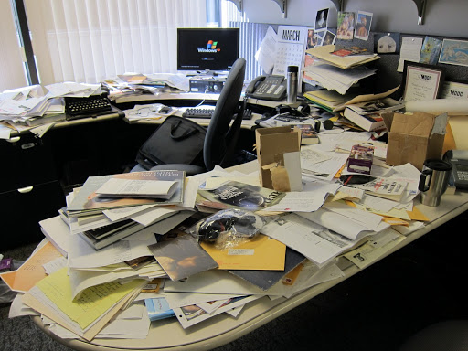
Entropy
A measure of disorder (unpredictability)
For a bit stream
Value between 0 and 1 for one bit
H₁ = -p.log₂(p)-(1-p).log₂(1-p)

Slide 18
Exercise 4: Setting up parameters of the Monobit test
Objective:
Observe how the threshold and the block size affect the error Type 1 and 2 (this test triggers alarm if the number of ones is bigger than Number of input bits/2 + relative threshold or smaller than Number of input bits/2 - relative threshold ).
Goal:
Find the lowest relative threshold giving α bigger than 10⁻⁶. Then you should note the highest Shannon entropy (H₁) for which β is smaller than 10⁻6. This H₁ will be the lowest entropy rate at TRNG output, which will not trigger alarm. You should repeat the procedure for n = 4096, 8192, 16384, 32768.
Question:
What are the parameters of the Monobit test is included in the AIS31 and FIPS 140-1 test suites?

Slide 19
Exercise 5: Impact of parameters of the MO-TRNG on black box statistical tests
Objective:
Observe how the duty cycle, the variance and the accumulation time are affecting the results of five black box tests that are included in the AIS31 test suite (four of them are also in the FIPS 140-1).
Goal:
Find the smallest D (which determines the jitter accumulation time), for which the generated data would pass all five black box tests. Repeat the procedure for all possible σ_{tot} /T₁ and m values.

