Slide 1




SMART Coin Tracker: Automated Coin Counter and Sorter System
Chapter I
Chapter II
Chapter III
Members:
Togonon, Kata D.
Chan, Kenji John C.
Sumalinog, Cyrll Hanz B.
Lucero, Resha Mae
Abuyan, April A.

Slide 2
INTRODUCTION
Project Context
Purpose and Description
Objectives
Scope and Limitation
Significance of the study
Coins play a fundamental role in trade, commerce, and economic interactions, with various denominations, designs, and histories. Coin counters and coin segregation are primary technology techniques used in various sectors, including banks, transit agencies, casinos, and humanitarian organizations. There are no existing coin counter and sorter systems with web-based displays in Hinunangan, making manual counting and sorting laborious and time-consuming.
Researchers are motivated to design and develop a Smart Coin Tracker: Automated Coin Counter and Sorter System to alleviate human fatigue, enhance the sorting process, and improve overall utilization.
Chapter I
Chapter II
Chapter III

Slide 3
INTRODUCTION
Project Context
Purpose and Description
Objectives
Scope and Limitation
Significance of the study
The purpose of this project is to assist stores and other businesses in Hinunangan, Southern Leyte in efficiently keeping a record of the quantity and total value of coins while also automating the process of sorting them into designated slots. The use of this system is to modernize the traditional system and automate the manual procedure of coin sorting and counting.
The system will automate the tedious and time-consuming tasks associated with coin handling, thereby improving efficiency and accuracy. It will maintain records of daily profits generated by businesses and stores, providing valuable insights into financial performance.
Chapter I
Chapter II
Chapter III

Slide 4
INTRODUCTION
Project Context
Purpose and Description
Objectives
Scope and Limitation
Significance of the study
Determine the present business processes of manual counting, manual segregation, record-keeping, and report generation.
Design and develop a prototyping machine that integrates separate containers for each distinct coin, offers quick function settings for efficient segregation on the go, includes receipt generation capabilities, operates on battery power, features a portable design, and provides monitoring and revenue reports.
Chapter I
Chapter II
Chapter III

Slide 5
INTRODUCTION
Project Context
Purpose and Description
Objectives
Scope and Limitation
Significance of the study
3 Implement and test the functionality and usability of the developed system using the system usability scale (SUS).
4. Assess the developed system's performance according to ISO/IEC 25010 standards. Evaluate its functional suitability, performance efficiency, compatibility, and interaction capability. This comprehensive evaluation ensures the system meets requirements, performs efficiently, integrates seamlessly, and interacts effectively.
Chapter I
Chapter II
Chapter III

Slide 6
INTRODUCTION
Project Context
Purpose and Description
Objectives
Scope and Limitation
Significance of the study
The Smart Coin Tracker project aims to automate coin sorting, counting, and record-keeping processes in Hinunangan, Southern Leyte, improving efficiency and accessibility for businesses and individuals.
The system will be designed with inclusivity features, accommodating people with disabilities and those with difficulty counting coins manually. The project's initial pilot testing will be limited to a single store, excluding businesses and individuals outside the area.
Chapter I
Chapter II
Chapter III

Slide 7
INTRODUCTION
Project Context
Purpose and Description
Objectives
Scope and Limitation
Significance of the study
Fostering Innovation. By adopting innovative technologies like the SMART Coin Tracker: Automated Sorter and Counter System, businesses and individuals are committed to modernizing coin management practices
Store owners. By adopting and adapting the system, store owners will ensure accuracy in financial records, reduce labor costs, enhance customer experience, and gain valuable insights into coin usage patterns and coin transactions.
Chapter I
Chapter II
Chapter III

Slide 8
INTRODUCTION
Project Context
Purpose and Description
Objectives
Scope and Limitation
Significance of the study
Research, innovation, and extension. The study offers potential benefits to the university, including the likelihood of publication in academic journals. Furthermore, it demonstrates innovation by addressing the practical issues and limitations faced by stores and businesses during the transition from traditional manual methods to modernized systems.
Chapter I
Chapter II
Chapter III

Slide 9
REVIEW OF RELATED
LITERATURE AND STUDIES
Review of Related Literature
Technologically advanced countries like Japan have achieved success, in part due to innovations like coin recognition. Kazuo Toji (2020) defines coin recognition as using a magnetic sensor to detect characteristics like temperature, pressure, and light. This method parallels the researchers' study, which also involves a sensor detecting light. In this study, an IR sensor, commonly used in coin counters, indicates when a coin is inserted, akin to coin recognition's use of sensors to detect coin presence.
In addition, there is also a study in the United States about coin processing. According to Thomas P. Adams et al. (2020), coin processing receives coins and has a coin receptacle for slowing processed coins. The study involves a disk-type coin sorter which includes a rotatable disk that is driven by an electric motor. The study is related because it involves a coin processor which primarily means that it processes the coin or identifies it which is considerably like the researchers’ study.
Chapter I
Chapter II
Chapter III

Slide 10
REVIEW OF RELATED
LITERATURE AND STUDIES
Coin Counting
According to P. Vidhushini (2021), the coin counting and programming process involves checking the sum and amount of coins. The coin tallying programming framework can view, print, and save all counting results to a PC. A comprehensive database can be created to store the coin-counting results. Features of the coin counting system include uploading results to a PC, storing results, printing results, and viewing transaction history. The goal of developing this coin sorter is to create a compact machine that sorts coins quickly and accurately.
Kavale, A., Shukla, S., and Bramhe, P. (2019) highlight the challenge of accurately counting and interpreting money coins for banks, retailers, and customers. To address this, they propose a coin-operated machine that automatically distinguishes between different coins. Their prototype, powered by an Arduino Uno, sorts and counts coins with precision. The machine features a display screen for showing total amounts and coin numbers, a coin acceptor to determine denominations, and a DC motor for distributing coins to designated slots.
Chapter I
Chapter II
Chapter III

Slide 11
REVIEW OF RELATED
LITERATURE AND STUDIES
Coin Segregation
A. Paramasivam's study (2021) explores coin discriminators, which consist of key components such as sensors for coin differentiation, coin entrance, anvil, coin tubes, and electronic circuits. Coins are inserted into the coin opening and pass through a sensor along the coin path to measure their physical properties, including dimensions, weight, elasticity, conductivity, and dropping time. Various types of sensors, such as electromagnetic, magnetic, acoustic, and optical sensors, are predominantly used to enhance functionality and efficiency in coin discriminators.
The IJECCT paper from May 2019 describes an algorithm for identifying different denomination coins. The suggested method recognizes coins and determines their radii by using CHT (Circular Hough transform) after using clever edge detection to create an edge map. Coins with varying denominations are categorized according to their radius. The experimental outcome demonstrates that, even in the presence of noise, the Hough transform is a useful tool for coin detection.
Chapter I
Chapter II
Chapter III

Slide 12
REVIEW OF RELATED
LITERATURE AND STUDIES
Record Keeping
“Records and Information Management” by William Saffady (2021) states that Records Management is a specialized discipline that is concerned with the systematic analysis and control of information created, received, maintained, or used by an organization according to its mission, operations, business processes, and activities. The term “record” is variously used to denote an information-bearing object, the information that the object contains, or both. It defines a record as “information created, received, and maintained evidence and as an asset by an organization or person in pursuit of legal obligations or the transaction of business. Records management is concerned with information that is recorded or “written down” as opposed to merely memorized or exchanged verbally. The concept of a record as a written instrument is well established.
Chapter I
Chapter II
Chapter III

Slide 13
REVIEW OF RELATED
LITERATURE AND STUDIES
Report Generation
According to Ryan Wheritty (2024), Too many organizations are still doing things the hard way, like working with outdated or overly complicated tools (Excel, Power BI) or trying to handle too many aspects of reporting manually. Struggling each month to produce reports makes it less likely you’ll stick with it (in addition to the fact that most manual tasks are simply timewasters), so it’s worth your while to investigate options that will make this job easier. It has essentially four elements that are key to the report generation process: data collection, data synthesis, analysis and insight, and report generation and distribution. ClearPoint brings together each of these elements to streamline strategy reporting and offers a variety of features that put our solution head and shoulders above other report-generation tools.
Chapter I
Chapter II
Chapter III

Slide 14
REVIEW OF RELATED
LITERATURE AND STUDIES
Related Works/studies
Alburo, M., Tindugan, L., and Dacuno, A. (2020) discuss the "WiFi Vendo Machine System," emphasizing the internet's importance as an invaluable resource for accessing vast knowledge. They propose using coin-operated vending machines as a cost-effective means to provide internet access, inspired by the Piso-net concept. The founders named their venture J2KLC, derived from the researchers' initials, aiming to offer a simple and affordable way for neighborhoods to connect to the internet while generating revenue. The company was established to meet market needs and provide convenient internet access to clients.
In the study "Indian Coin Separator and Counting Machine using Edge Detection Technique" by Salehittal, A., and Shetti, V. (2020), a multilayer neural network is employed for preprocessing, utilizing rotational inductive inputs. The goal is to separate recently issued Indian coins, classify them into denominations, and calculate their total value in Indian National Rupee (INR). Various edge detection methods such as Robert's, Gaussian, and Canny are employed, achieving accuracies of 93%, 94%, and 97.5%, respectively. Comparisons with existing techniques, particularly image processing methods, reveal a maximum accuracy of 99.7% for Canadian coins using decision trees in 1996, as summarized by Modi et al.
Chapter I
Chapter II
Chapter III

Slide 15
REVIEW OF RELATED
LITERATURE AND STUDIES
In the research on the "Coin-counting Machine System of Bangko Sentral ng Pilipinas (BSP)" by Chipongian, L. (2019), BSP Governor Benjamin E. Diokno has mandated a survey of coin-counting machines and compiled a list of supermarket chains for potential trial sites for coin-counting services. The initiative aims to address the abundance of unused coins in households by providing coin-counting services in large stores and groceries. Additionally, efforts are made to encourage increased usage of lower-denomination coins, such as the 10-piso, 5-piso, and 1-piso coins, which are often overlooked. The BSP ensures an adequate supply of six coin denominations, including 10-piso, 5-piso, 1-piso, 25-sentimo, 5-sentimo, and 1-sentimo, utilizing laser-engraving technology for security features. As of March, there are 31.8 billion coins in circulation, valued at P39.5 billion, with a ratio of 298 coins per person. The BSP has been proactive in minting enough coins to maintain inventory levels and prevent a repeat of the coin depletion experienced in 2010.
Chapter I
Chapter II
Chapter III

Slide 16
REVIEW OF RELATED
LITERATURE AND STUDIES
In Varadarajan's study "The Research Automated Smart Water Vendor" (2019), he utilized an infrared sensor in his research on the Automated Smart Water Vendor Machine to detect metal bodies. Infrared sensors emit or detect infrared radiation to identify specific characteristics of their surroundings. The concept behind infrared obstacle detection involves emitting an IR signal and receiving the reflected signal from an object's surface. Mobile robots use infrared sensors to navigate and avoid obstacles. UV sensors, on the other hand, measure the power or intensity of UV radiation at the source. Polycrystalline diamond is commonly used for accurate UV sensing. UV sensors detect UV exposure in an environment by receiving and transmitting energy signals. These signals are then directed to an electrical meter for observation and recording. Output signals are processed through an Analog-to-Digital Converter (ADC) and sent to a computer running software to generate graphs and reports.
Chapter I
Chapter II
Chapter III

Slide 17
REVIEW OF RELATED
LITERATURE AND STUDIES
According to Laporan Akhir (2023), the "E-coin Sort and Count" project aims to address common challenges faced by students by introducing an innovative coin sorting and money counting system. This system combines the Arduino Uno Atmega 328p microcontroller with a MySQL database to sort coins, count the number of coins, and calculate their corresponding money value simultaneously. Specifically designed for Malaysian coins, including the 10-cent, 20-cent, and 50-cent coins, the system utilizes six infrared sensors to accurately detect coins inserted into designated slots. The Arduino Uno Atmega328p microcontroller is programmed to perform coin counting and money calculation tasks, with the results stored in the MySQL database for comprehensive and easily accessible records.
Chapter I
Chapter II
Chapter III

Slide 18
REVIEW OF RELATED
LITERATURE AND STUDIES
In their study "Coin Counting and Sorting Machine (2019)," Anupa, K., Shraddha, S., and Prachi, B. emphasized the difficulty of accurately and efficiently counting and interpreting currency coins, which poses challenges for banks, stores, and consumers. Existing coin-counting machines often face issues in detecting coin values accurately, resulting in calculation errors. To tackle this challenge, the study introduced a coin-operated machine designed for precise and automatic coin differentiation. The prototype of this machine, developed with the ARDUINO UNO as the main controller, aims to provide a solution for accurate and automated coin counting and sorting.
Chapter I
Chapter II
Chapter III

Slide 19
TECHNICAL BACKGROUND
Hardware
Software
Programming
Development Method
System Architecture
Arduino UNO R3
Power Supply
Servo Motor
IR Sensor
Orange pi
Coin Feeder
Chapter I
Chapter II
Chapter III

Slide 20
TECHNICAL BACKGROUND
Hardware
Software
Programming
Development Method
System Architecture
Visual Studio Code
XAMPP
MySQL Workbench
Arduino IDE
Chapter I
Chapter II
Chapter III

Slide 21
TECHNICAL BACKGROUND
Hardware
Software
Programming
Development Method
System Architecture
PHP
JavaScript
Bootstrap
Chapter I
Chapter II
Chapter III

Slide 22
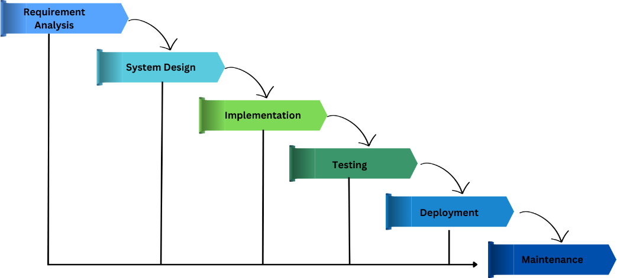
TECHNICAL BACKGROUND
Hardware
Software
Programming
Development Method
System Architecture
Chapter I
Chapter II
Chapter III
Waterative Model

Slide 23
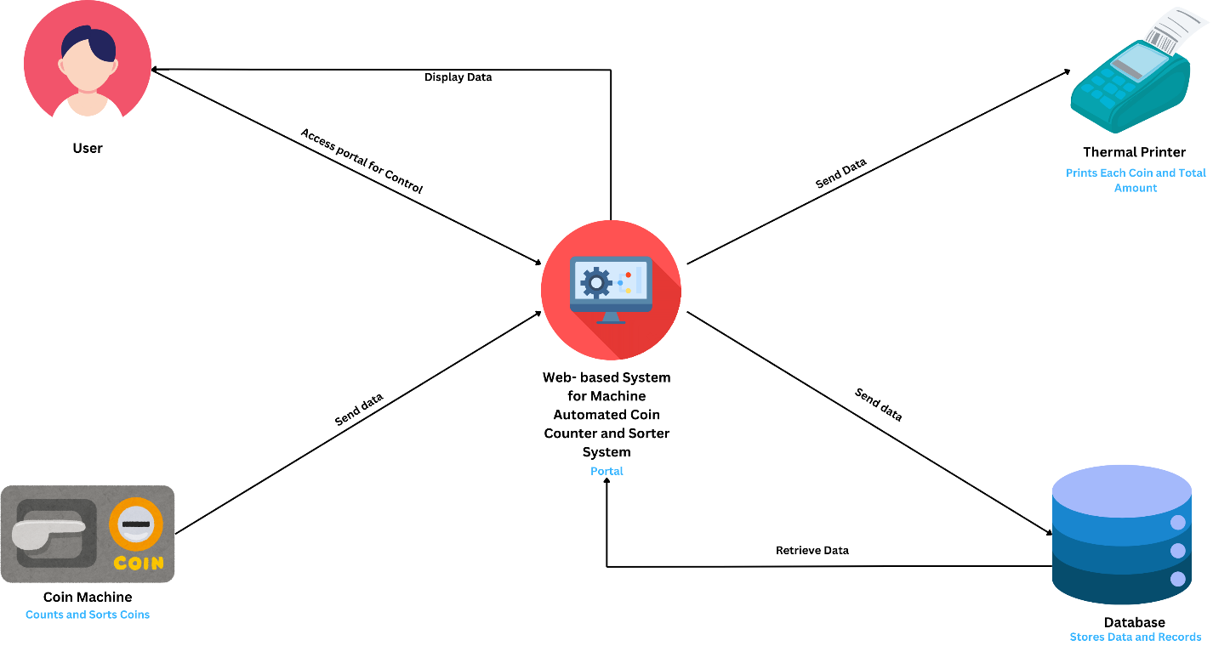
TECHNICAL BACKGROUND
Hardware
Software
Programming
Development Method
System Architecture
Chapter I
Chapter II
Chapter III
Architectural Design of the Proposed System

Slide 24
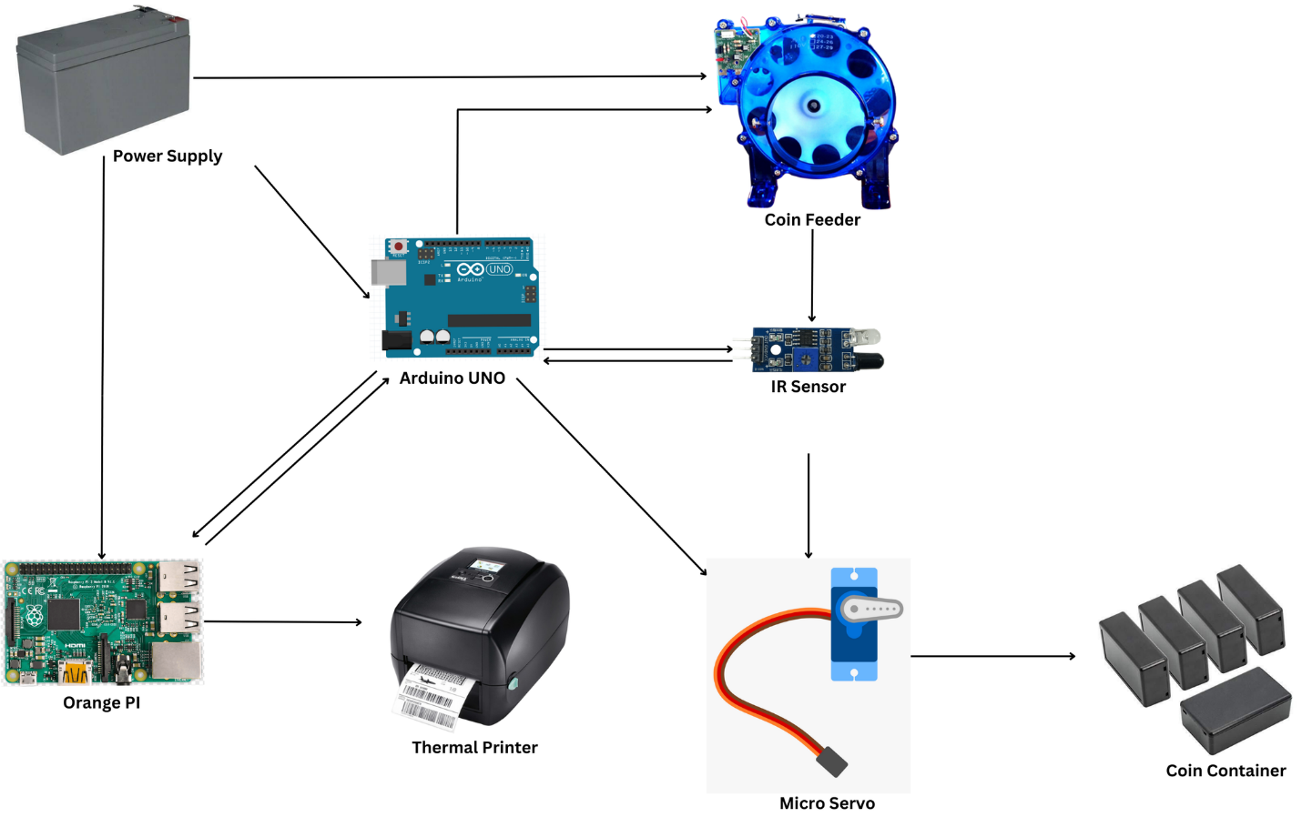
TECHNICAL BACKGROUND
Hardware
Software
Programming
Development Method
System Architecture
Chapter I
Chapter II
Chapter III
Architectural Design of the Hardware System

Slide 25
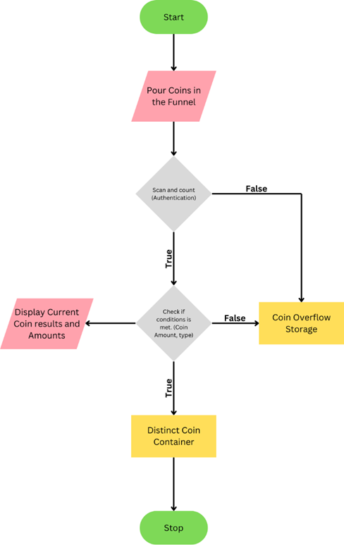
TECHNICAL BACKGROUND
Hardware
Software
Programming
Development Method
System Architecture
Chapter I
Chapter II
Process Flow of The
Proposed Project
Chapter III

Slide 26
THANK YOU

