Slide 1


Microsoft Azure Training
Cyrus Cheng
ITSWS - FO Cashout Team

Slide 2
Welcome
Thank you for joining us today. We’ve worked together with the Microsoft Partner Network and Microsoft IT Academies to bring you a world-class learning experience. | Microsoft Certified Trainers + Instructors. Your instructor is a premier technical and instructional expert who meets ongoing certification requirements.
Customer Satisfaction Guarantee. Our partners offer a satisfaction guarantee, and we hold them accountable for it. At the end of class, please complete an evaluation of today’s experience. We value your feedback! | Certification Exam Benefits. After training, consider pursuing a Microsoft Certification to help distinguish your technical expertise and experience. Ask your instructor about available exam promotions and discounts. We wish you a great learning experience and ongoing career success!

Slide 3
About this course
This course provides foundational level knowledge on cloud concepts; core Azure services; security, privacy, compliance, and trust; and Azure pricing and support.
The audience for this course is just beginning to learn about cloud computing and how Microsoft Azure provides that service.
There are no prerequisites for the course, but students with an IT background will find the concepts easier to understand.
This course originally is a 5 days courses for Microsoft Certified: Azure Solutions Architect Expert
Customized with some content change and abstracted into 1 days 5 hours course
Demo and lab is skipped due to running out of time

Slide 4
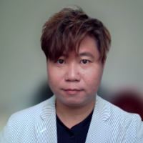
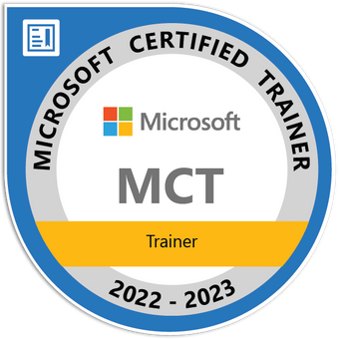


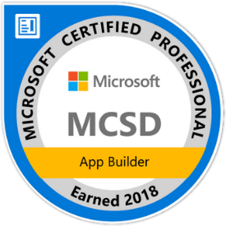

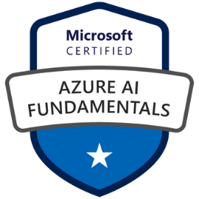

Hello, World!
Cyrus Cheng
Microsoft Certified Trainer (Since 2019)
Azure Solutions Architect
Azure Developer Associate
ITSWS - Cashout Team Tech. Lead
HKMU Parttime Lecturer
Specialized in
  Azure, SharePoint, .NET
  Spring Boot / Spring Cloud
  React, Vue
  K8S Development
  Microservices Arch. Design
Notes:
Cyrus had deliver Azure training or consultancy services to CLP, Smartone, HPH, MTRC, etc.

Slide 5


Facilities
Class hours
Building hours
Parking
Restrooms
Meals
Phones
Messages
Smoking
Internet access
Recycling
Emergency procedures

Slide 6

How to pronounce “Azure”
https://bit.ly/3EVYAj7
Azure
Meaning : sky-blue colour

Slide 7
Course Agenda
Module 01 – Cloud Adoption & Migration Planning
Module 02 – Core Azure services
Module 03 – Data Integration Solutions
Module 04 – Message And Event Integration
Module 05 – Identity, governance, privacy, and compliance

