Slide 1


Module 01:
Cloud Adoption & Migration Planning
Cyrus Cheng
ITSWS - FO Cashout Team

Slide 2

Module Outline

Slide 3

Module 01 - Outline
You will learn the following concepts:
Cloud Adoption Framework
Cloud Migration Tools
Multi-Cloud Strategy by Azure Arc

Slide 4
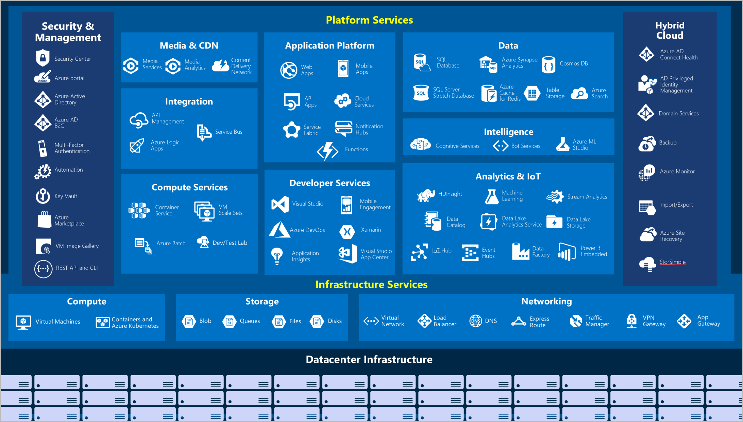
High level Azure Services

Slide 5

Explore Azure Marketplace
Azure Marketplace allows customers to find, try, purchase, and provision applications and services from hundreds of leading service providers, which are
all certified to run on Azure.
Open source container platforms.
Virtual machine and database images.
Application build and deployment software.
Developer tools.
And much more, with 10,000+ listings!
Notes:
Connects end users with Microsoft partners, Independent Software Vendors (ISVs), and start-ups that offer solutions and services for Azure.
Azure customers, IT professionals and cloud developers can find, try, purchase, and provision Azure applications and services from certified service providers.
Includes close to 10,000 product listings.
There is also a Marketplace FAQ available at https://azure.microsoft.com/en-us/marketplace/faq/
Azure Marketplace - https://azuremarketplace.microsoft.com/en-us/
Learn and SkillPipe content order note:
Note in Learn

Slide 6





Tools for interacting with Azure
Azure Portal
Azure PowerShell
Command-Line Interface (CLI)
Azure Cloud Shell
Notes:
https://docs.microsoft.com/learn/modules/describe-features-tools-for-managing-deploying-azure-resources/2-describe-interacting-azure

Slide 7
Cloud Adoption Framework

Slide 8
Review the Cloud Adoption Framework
Adopt
Define Strategy
Understand motivations
Business outcomes
Business justification
Prioritize project
Plan
Digital estate
Initial organization alignment
Skills readiness plan
Cloud adoption plan
Ready
Azure readiness guide
First landing zone
Expand the blueprint
Best practice Validation
Migrate
• First workload migration
• Expanded scenarios
• Best practice validation
• Process improvements
Innovate
• Innovation guide
• Expanded scenarios
• Best practice validation
• Process improvements
Govern
Methodology • Benchmark
initial best practice • Governance maturity
Manage
Business commitments
operations baseline •
Ops maturity
Notes:
Cloud Adoption Strategy Evaluator
https://docs.microsoft.com/en-us/assessments/?mode=pre-assessment&session=local
The cloud adoption journey
https://azure.microsoft.com/cloud-adoption-framework/#cloud-adoption-journey
Azure migration guide overview
https://docs.microsoft.com/azure/cloud-adoption-framework/migrate/azure-migration-guide
Azure cloud migration best practices checklist
https://docs.microsoft.com/azure/cloud-adoption-framework/migrate/azure-best-practices
Microsoft Cloud Adoption Framework for Azure
https://docs.microsoft.com/learn/modules/microsoft-cloud-adoption-framework-for-azure/

Slide 9
Planning
  Azure suggest Power-Of-10 Approach
  Decisions
    Items to be migrated
    Migration approach
    Requirements
      Compliance
      SLA
  Don’t missing dependants components
  Cloud Adoption Strategy Evaluator

Slide 10
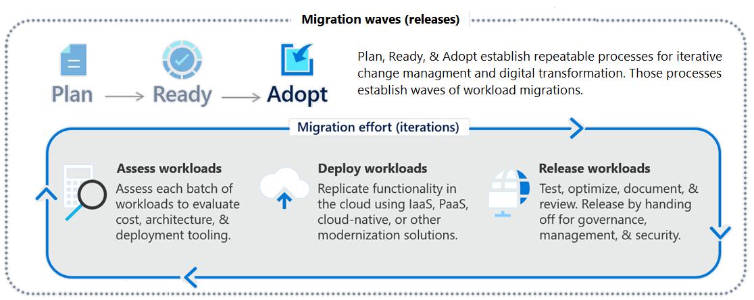
Focus on migration efforts
Notes:
Cloud Adoption Framework migration model - https://docs.microsoft.com/azure/cloud-adoption-framework/migrate/migration-considerations/
The One Migrate approach to migrating the IT portfolio - https://docs.microsoft.com/azure/cloud-adoption-framework/scenarios
Questions:
Why are we moving the solution to Azure?
What are the business objectives or quantifiable business goals?
What outcomes will you achieve?
Is there a timeline for building the solution Azure?
Is there a targeted event or date for an announcement about the solution's availability on Azure?

Slide 11
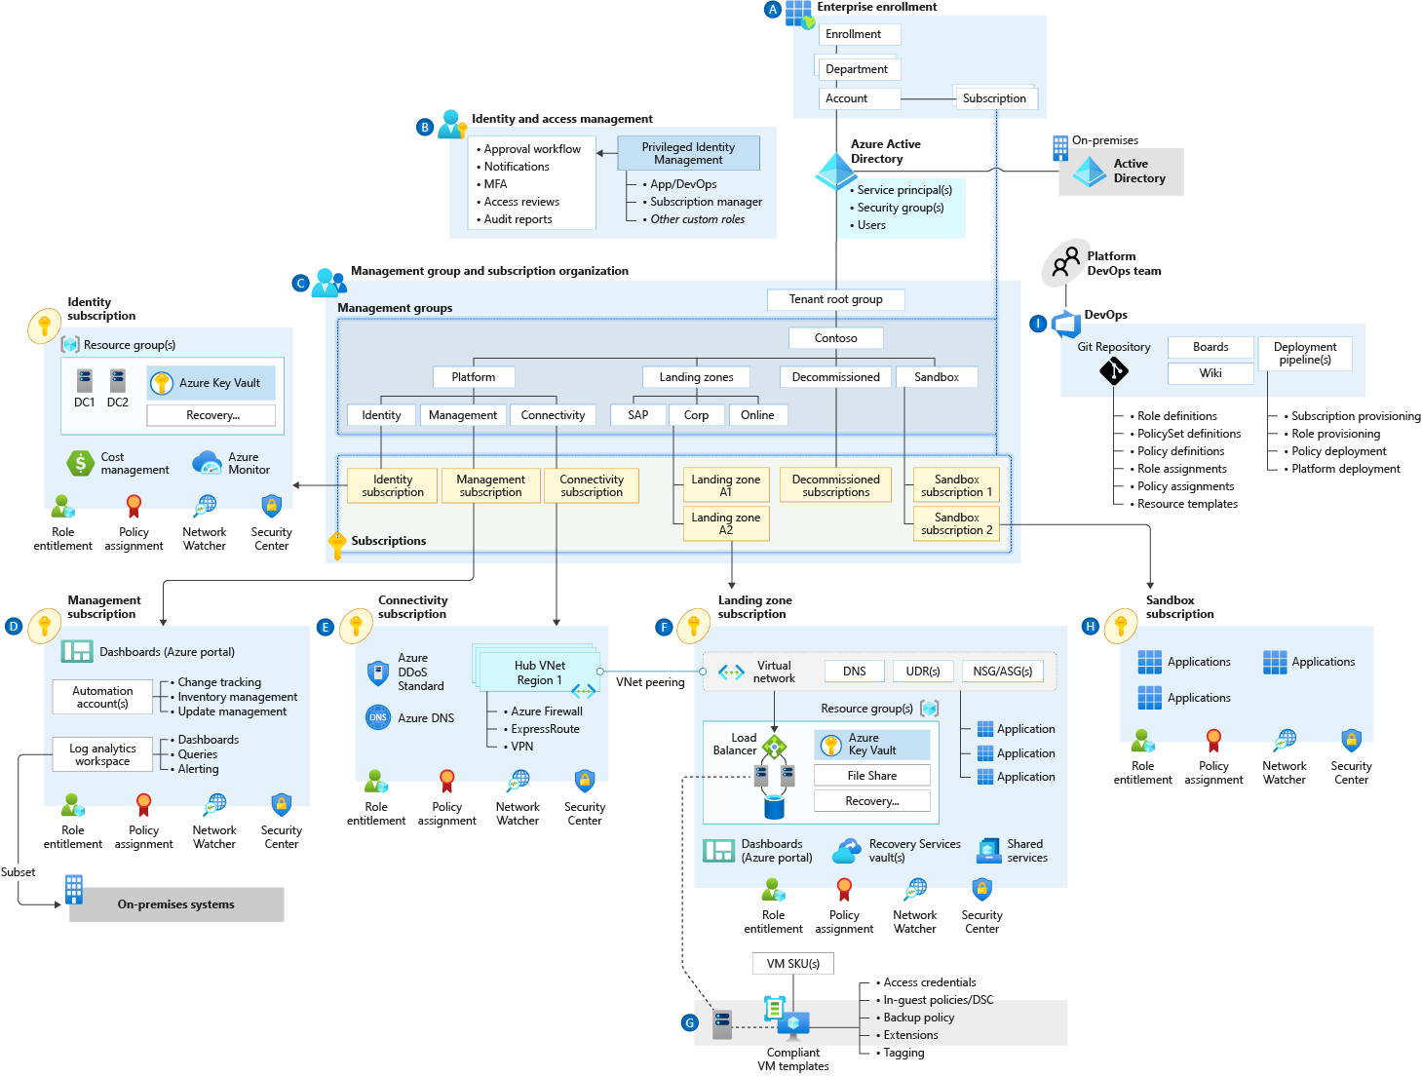
Azure Landing Zone (*)
Fast provision the Azure services
  Speed up
  Standardize
  Easy Config.
  Adapt to fast business change
5 Areas
  Workload
  Security
  Governance
  Networking
  Identity
Notes:
Azure landing zone
https://docs.microsoft.com/en-us/azure/cloud-adoption-framework/ready/landing-zone/
Example
https://docs.microsoft.com/en-us/azure/cloud-adoption-framework/ready/landing-zone/implementation-options
ALZ implementation option
https://docs.microsoft.com/en-us/azure/cloud-adoption-framework/ready/landing-zone/implementation-options

Slide 12
Cloud Migration Tools

Slide 13
Migration Stages
4 stages
  Assess your on-premises environment
    4 R’s approach
  Migrate your workloads
    Deploy cloud infrastructure targets
    Migrate workloads by tools/services
      Server
      Apps
      DB
      Data
    Decommission on-premises infrastructure
      Archive and Backup
  Optimize the migrated workloads
  Monitor your workloads

Slide 14




Determine your migration strategy
Select a strategy that meets your goals – you may need several strategies
Pattern | When to use
Rehost | Move workloads quickly to the cloud Don't need immediate changes to app capabilities
Refactor | Apply Azure DevOps practices or using a container strategy for workloads. Consider the portability of your existing code base and available development skills.
Rearchitect | Use existing application investments, Apps need major revisions for new features and to work effectively on a cloud platform.
Rebuild (new) | Rapid development and existing apps have limited functionality and lifespan. Expedite business innovation by using Azure DevOps practices. Legacy apps as no code or low apps in the cloud.
Notes:
Overview of application migration examples for Azure - https://docs.microsoft.com/azure/cloud-adoption-framework/migrate/azure-best-practices/contoso-migration-overview
The options Replace and Retire would not be considered migration strategies for the purposes of our discussion.

Slide 15
Identify migration tools
Tool | Usage
Cloud Adoption Strategy Evaluator (*) URL | Assesses your strategy posture across distinct areas of the Strategy methodology Identifying motivations Evaluating financial considerations Technical considerations in creating a business case
Azure Migrate: Server Assessment | Physical servers and on-premises VMs running in Hyper-V and VMware environments as preparation for migrating to Azure.
Azure Migrate: Server Migration (Example) | Physical servers and on-premises VMs running in Hyper-V, VMware environments, and other public cloud VMs.
Azure Migrate: Database Assessment | Performs an assessment of on-premises Microsoft SQL Server databases as preparation for migration to Azure SQL Database, an Azure SQL Managed Instance, or Azure VMs running Microsoft SQL Server.
Azure Migrate: Database Migration | Migrates data from your existing on-premises databases to databases running in Azure.
Azure Migrate: Web App Assessment | Assessment of on-premises web apps and migrates them to Azure.
Azure Migrate: Data Box | Move of large amounts of offline data to Azure by using Azure Data Box.
Notes:
Plan your Azure migration - https://docs.microsoft.com/learn/modules/design-your-migration-to-azure/2-plan-your-azure-migration
There are also optimization tools like Azure Cost Management and Azure Advisor. And other tools like TCO calculator and Service Map.
And more Integration Tools - https://docs.microsoft.com/azure/migrate/migrate-services-overview#integrated-tools.

Slide 16
Discussion
HKJC adoption readiness & migration planning
Business motivation and outcome?
  Concern? SLA? Business Commitment?
  Digital Estate? Power-Of-N planning?
  Adoption and Skill Readiness?
Any use cases?

Slide 17
Multi-Cloud Strategy by Azure Arc

Slide 18
Why?
Information Security Teams say - We need to manage security and incident management across our entire IT estate through policy enforcement and automation. We also want our on-premises servers to have strong integration with Azure and tools like Security Center and Sentinel.
Site Reliability Engineers say - We need to have health visibility to all our infrastructure and applications in single pane of glass fashion.
SQL DBAs say - We do use SQL Server with our mission critical application, but the Database layer must remain on-premises due to sensitive patient data and data availability needs.
Notes:
Let us start with what we hear from our customers in relation to Hybrid Scenarios.
So, these are some of the pain points of the people or teams in specific roles that we hear from the Field.

Slide 19
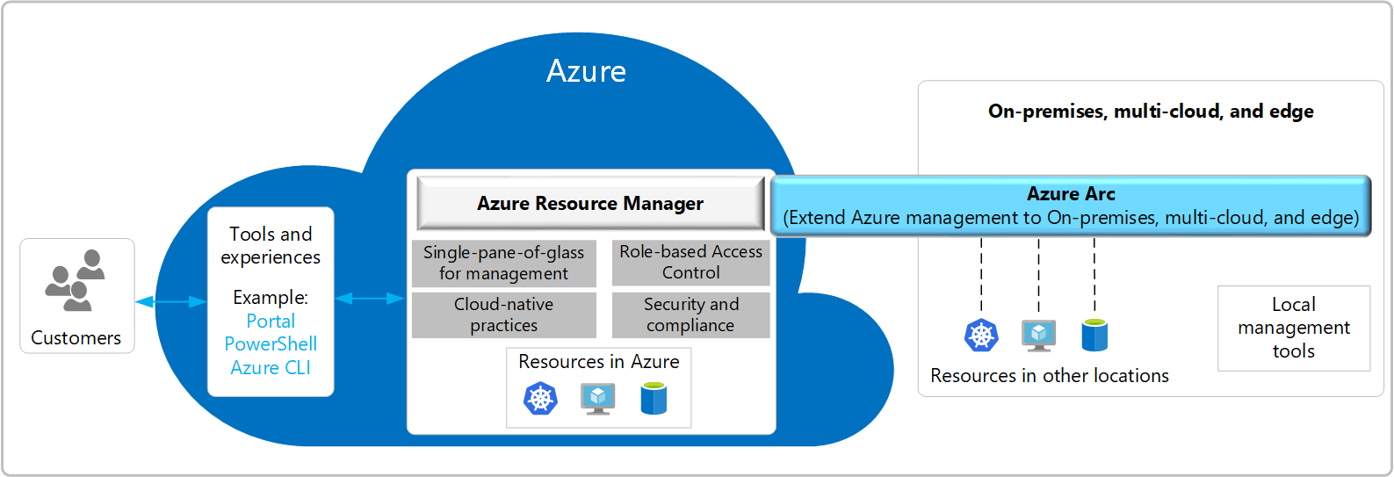
Azure Arc Overview
Notes:
Let us now have a bird's eye view of the Azure Arc service. Imagine we have resources…
Exta Info:
To support this momentum, Azure offers unique hybrid and multicloud capabilities that give customers the flexibility to innovate anywhere in their environment.
It’s starts with Azure Arc. Azure Arc enables you to standardize visibility, operations, and compliance across a wide range of resources and locations by extending the Azure control plane. Right from Azure, you can easily organize, govern, and secure Windows, Linux, SQL server, and Kubernetes clusters across data centers, edge, and multi-cloud.
Enabled by Azure Arc, you can bring Azure services to any existing infrastructure including other clouds you are using, so you can take advantage of cloud benefits everywhere, such as scalability, fast deployment, and always up-to-date cloud innovation.
You can build Azure-consistent new cloud infrastructure in your own datacenter with Azure Stack, so you can modernize your datacenter and run cloud native applications on-premises while taking advantage of existing investments and meeting regulatory compliances.
You can extend AI to edge devices with Azure IoT, so you can run machine learning and advanced analytics close to the users and the data. As a result, you can gain real-time insights and deliver immersive experiences at the edge of your network, opening up endless new business opportunities.
This is our portfolio of capabilities to support customer’s hybrid and multicloud strategy.
<CLICK>

Slide 20







Azure Arc – Enabled Infrastructure and Enabled Services
Microsoft Azure
Single control plane with Azure Arc
Azure Arc enabled infrastructure
Connect and operate hybrid resources
as native Azure resources
Azure Arc enabled services
Deploy and run Azure services outside of Azure while still operating it from Azure
Multi-cloud
Datacenter
Edge
Notes:
So, How does Azure Arc make all of this possible.
There are 2 key parts here:
The first part is, Azure Arc enabled infrastructure which enables us to connect our resources, which live outside of Azure today, and operate them as if they were native Azure resources, using the same management tools and services that Azure provides.
And the second is, Azure Arc enabled services, which gives us the flexibility to deploy fully managed Azure services anywhere – be it on-premises or in other public clouds so that we can take advantage of cloud benefits everywhere, such as scalability, faster deployment, and always up-to-date cloud innovation. The most awesome is that you can initiate and manage these deployments, right from the Azure Portal.
To summarize, Azure Arc is a set of technologies that unlocks new hybrid scenarios for our customers by extending Azure services and management to any infrastructure irrespective of where the infrastructure resides, so that customers can build, operate, and manage all of their resources in a consistent way across their entire IT estate.

Slide 21
The main components of Azure Arc
Azure
Custom locations
Azure Resource Manager
Azure Data Services
Azure Management
SQL
PostgreSQL
Resource specific tools
Azure Arc data agent
Azure Data Studio
Azure Portal
Identity
Azure Arc data RP
Azure Arc data controller
Azure CLI
Azure SDK
RBAC
Kubernetes
K8s Native Tools
Container registry
GitOps Manager
Azure PaaS Control
Cluster provisioning​
Cluster upgrade and patch management​
Cluster lifecycle management​
Cluster monitoring
Policy
Azure Arc K8s RP
Azure Arc K8s agent
K8s API
Groups
Etc.
Azure Arc server RP
Servers
Azure Arc server agent
Linux
Server Admin Tools
Azure Arc server agent
Windows Server
Azure Arc:
Notes:
Now, Let us understand about the key components of Azure Arc.
Just to summarize, it’s the Agents which do most of the heavy lifting here and make all the magic possible.
For more info:
We need a Kubernetes cluster as the orchestrating fabric in the environment to run Azure data services.
Azure SQL offers several different deployment and management options across IaaS and PaaS for the SQL Server engine hosted on Azure. While Azure Arc-enabled SQL Managed Instance provides the cloud Platform-as-a-Service benefits, SQL Server on Azure Arc-enabled servers provides capabilities similar to SQL Server in Azure Virtual Machines. To help your decision-making process.
https://azure.microsoft.com/en-in/services/azure-arc/hybrid-data-services/#faq

Slide 22
Azure Arc Key Benefits
Organize all resources using - Azure management groups, subscriptions, resource groups, and tags.​
Consolidated view via - Azure portal, CLI, PowerShell, and REST API.​
Policies​
Update Management​
Inventory​
Change Tracking​
Delegation of permissions using Role Based Access Control (RBAC).​
Extend Azure Monitor to on-premises and other clouds.​
Notes:
Let us now summarize the key benefits of Azure Arc.

Slide 23
back

Slide 24
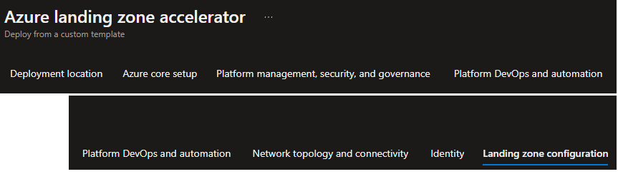
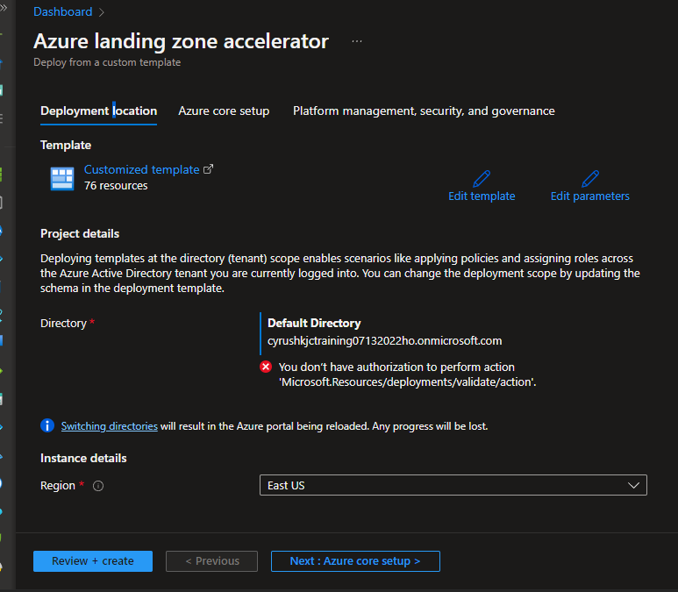
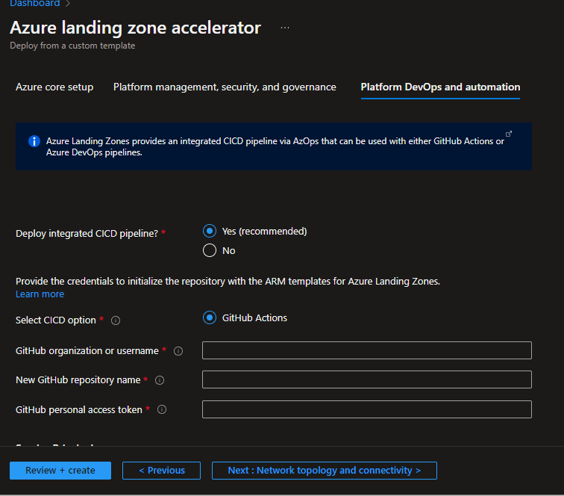
back

Slide 25
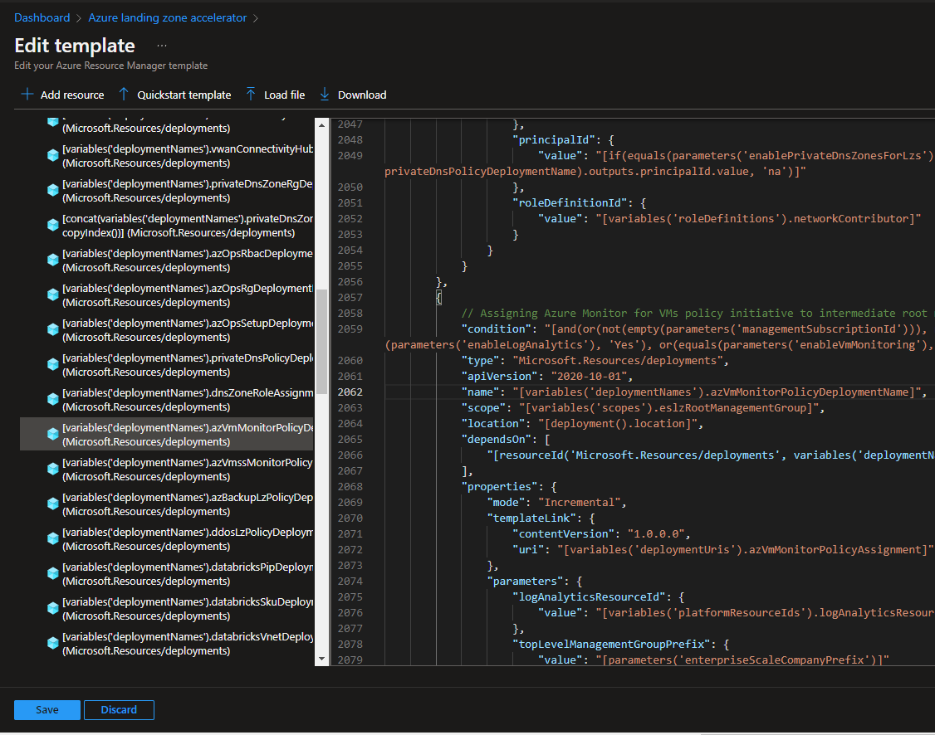
back

Slide 26
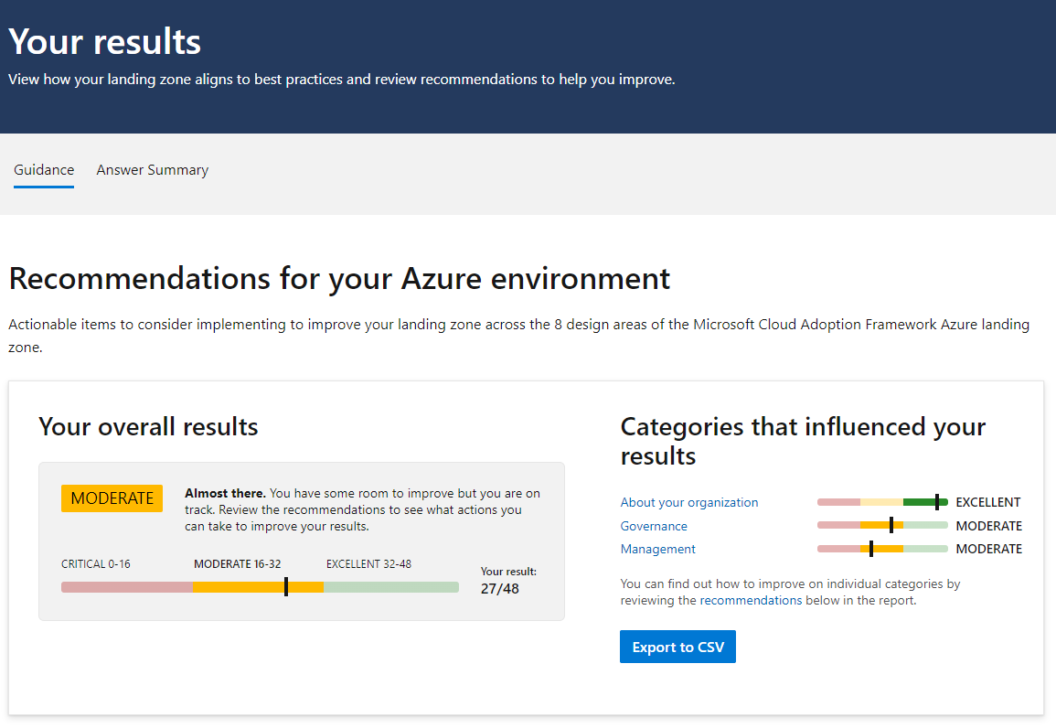
back

Slide 27
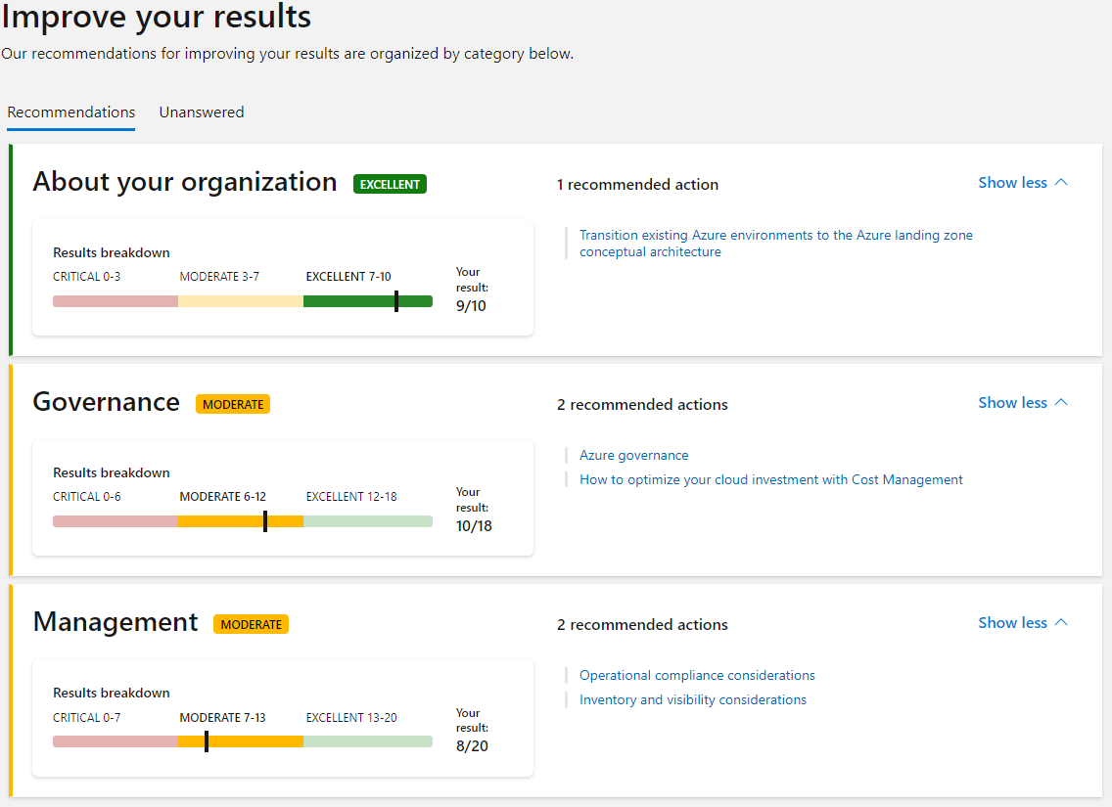
back

