Slide 1


Module 03:
Data integration solution
Cyrus Cheng
ITSWS - FO Cashout Team

Slide 2

Module Outline
Notes:
Learn and SkillPipe content order note:
Slides 1-5
https://docs.microsoft.com/en-us/learn/modules/azure-architecture-fundamentals/introduction
https://docs.microsoft.com/en-us/learn/modules/azure-architecture-fundamentals/overview

Slide 3
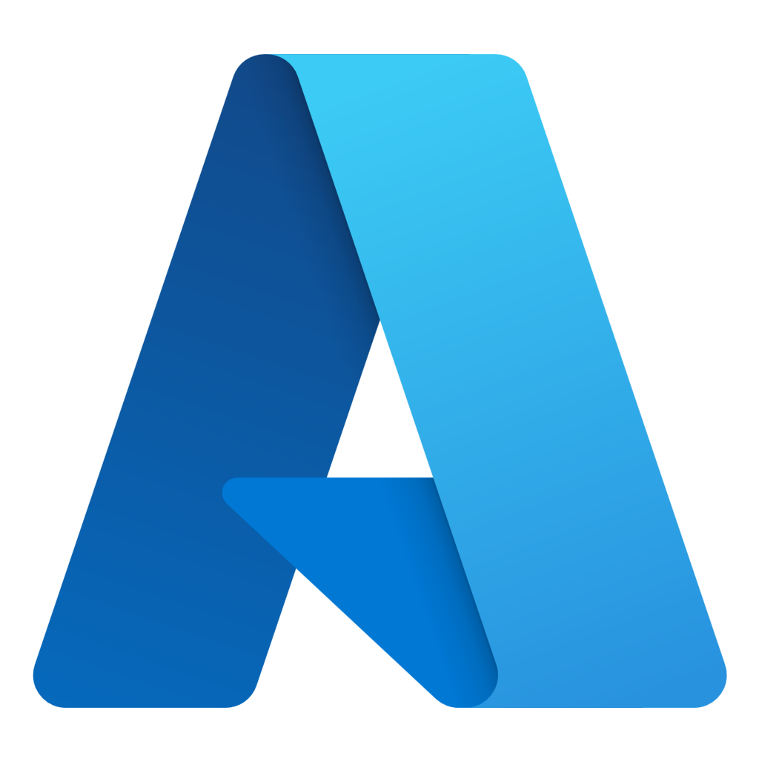
Module 03 – Outline
You will learn the following concepts:
Azure Data integration solution
  Azure Data Factory
  Azure Data Lake
Azure Data analytics solution
  Azure Databricks
  Azure Synapse Analytics
  Azure Stream Analytics
Other Azure Solutions
  AI / ML
  Serverless
  CI / CD
Notes:
Learn and SkillPipe content order note:
Slides 3-5
https://docs.microsoft.com/en-us/learn/modules/azure-architecture-fundamentals/introduction
https://docs.microsoft.com/en-us/learn/modules/azure-architecture-fundamentals/overview

Slide 4
Azure Data integration solution

Slide 5

Azure Data Factory

Slide 6
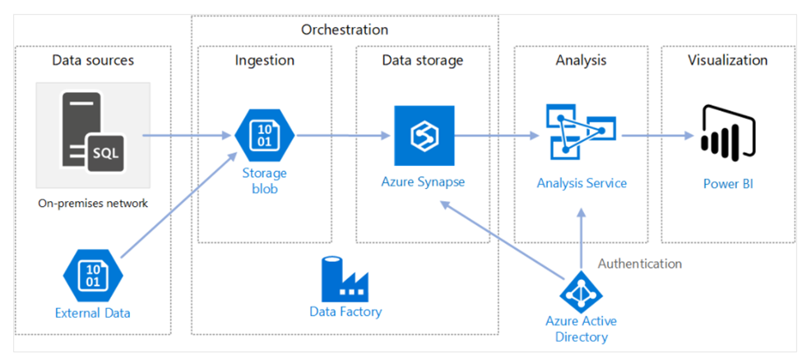
Data-driven workflows
Azure Data Factory is a cloud-based ETL and data integration service that can help you create and schedule data-driven workflows (called pipelines) that can ingest data from disparate data stores.
You can use Azure Data Factory to:
Orchestrate data movement.
Transform data at scale.
Notes:
Connect and collect – Data ingestion is the first step to collecting all the data from different sources into a centralized location.
Transform and enrich – Now you will use a compute service like Azure Databricks and Azure HDInsight Hadoop to transform the data
Continuous integration and delivery (CI/CD) and publish – Support for CI/CD through GitHub and Azure DevOps enables to deliver your ETL process incrementally before publishing the data to the analytics engine.
Monitor – Via the Azure portal, you can monitor the pipeline for scheduled activities and for any failures.
Requirements for data integration – Azure Data Factory serves two communities – Big data community and the Relational data warehousing community that uses SQL Server Integration Services (SSIS). Depending on your organization’s data needs you would set up pipelines in the cloud using Azure Data Factory that can access data from both cloud and on-premises data services.
Coding resources – If you prefer a graphical interface to set up pipelines, then Azure Data Factory authoring and monitoring tool is the right fit for your needs. Azure Data Factory provides a low code/no code process for working with data sources
Support for multiple data sources – Azure Data Factory supports 90+ connectors to integrate with disparate data sources.
Serverless infrastructure – There are advantages in using a fully managed, serverless solution for data integration - No need to maintain, configure or deploy servers, and the ability to scale with fluctuating workloads.

Slide 7
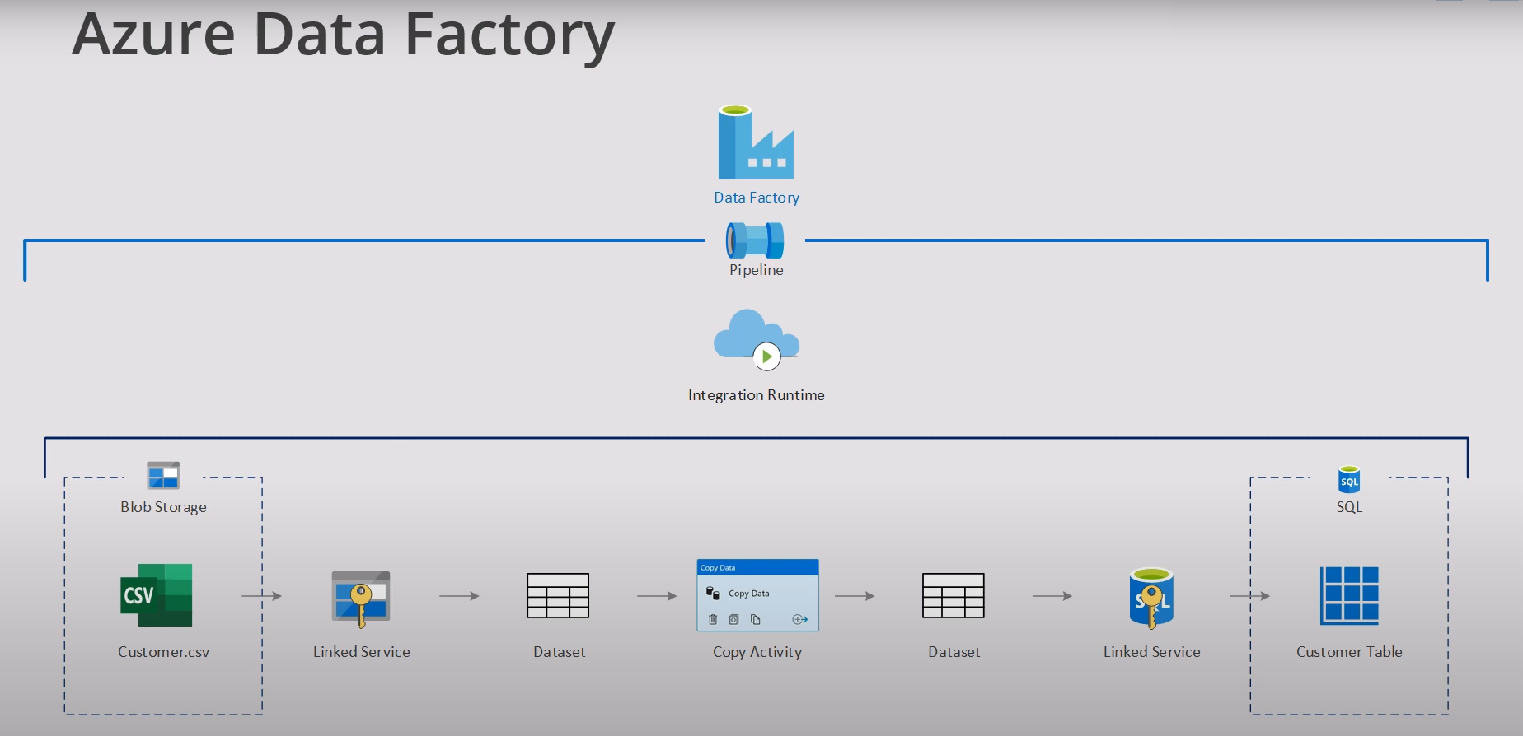

Slide 8
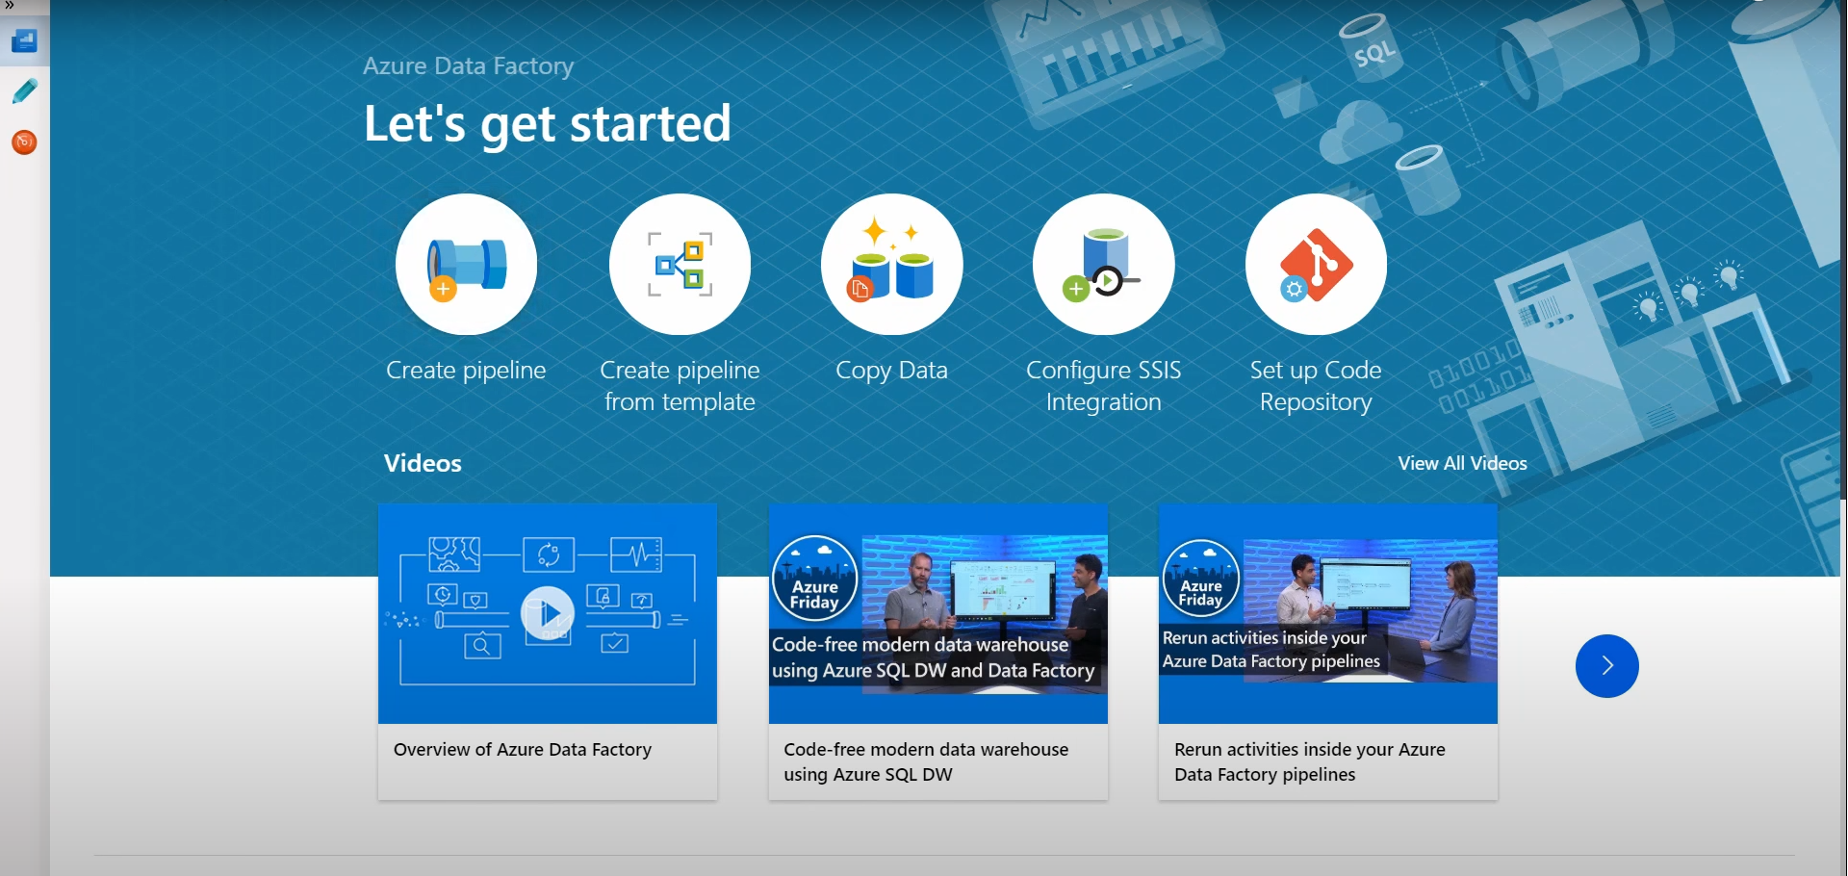

Slide 9
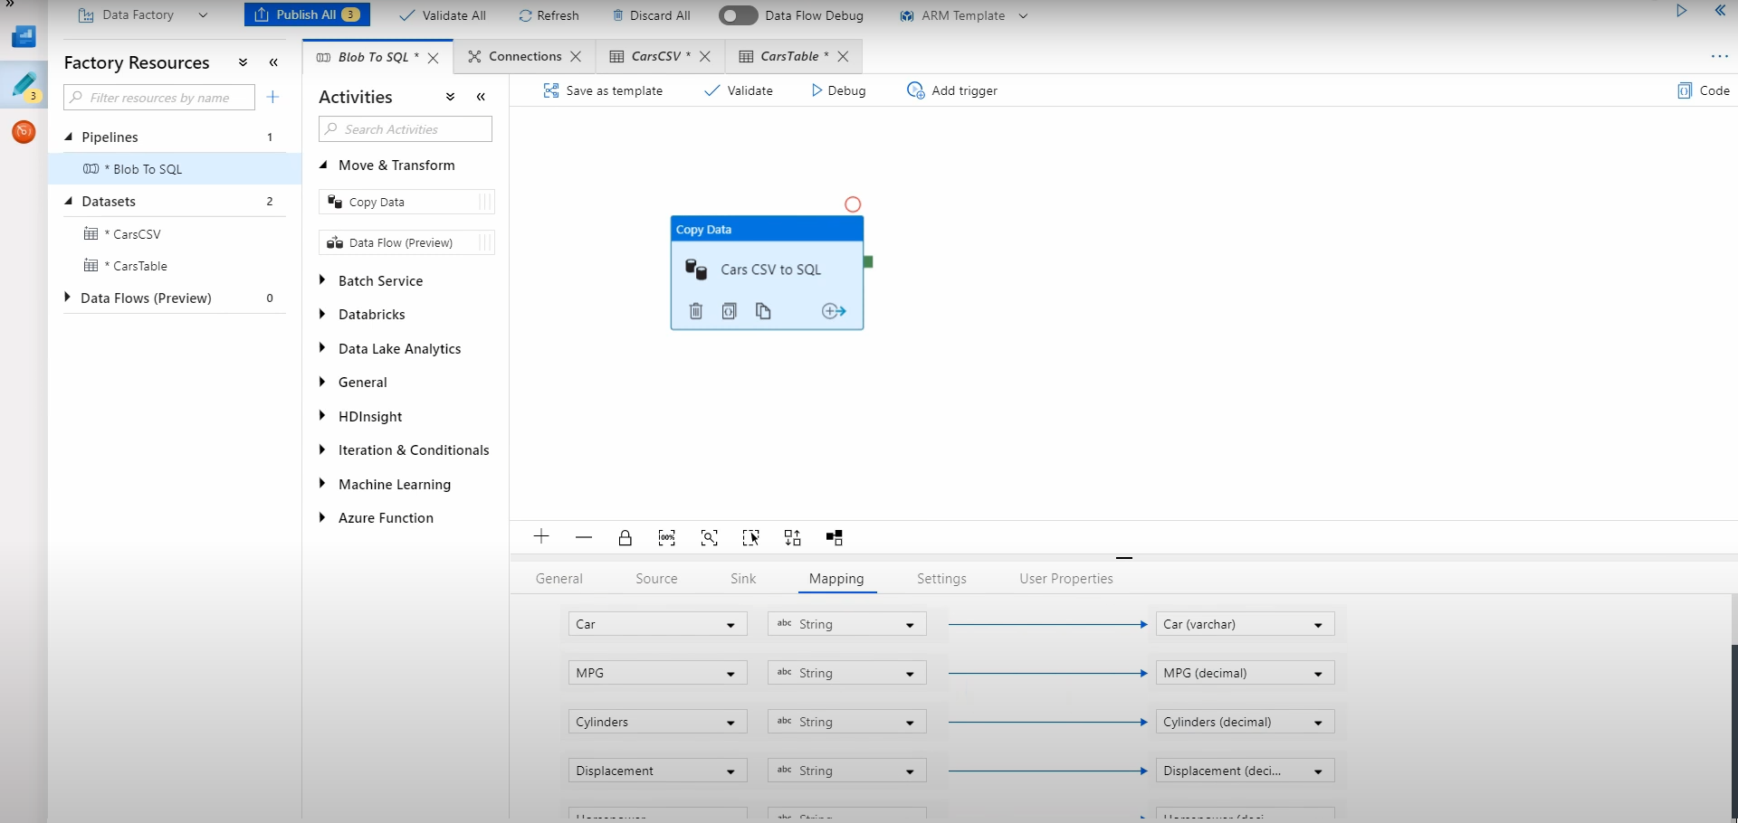

Slide 10

Azure Data Lake
Notes:
There are 2 units in Learn under this one banner.

Slide 11
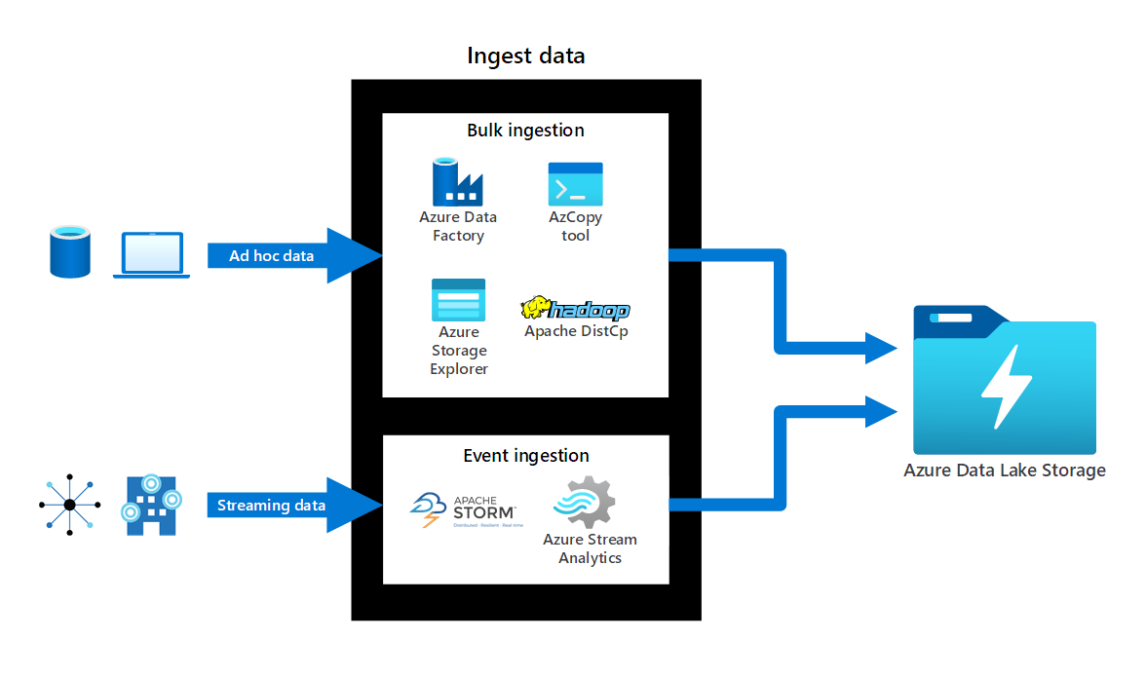
Azure Data Lake
Azure Data Lake Storage is a comprehensive, scalable, and cost-effective data lake solution for big data analytics built into Azure.
Use Azure Data Lake when you need:
a data repository on the cloud for managing large volumes of data
To manage a diverse collection of data types such as JSON files, CSV, log files or other diverse formats
Real-time data ingestion and storage
Notes:
A data lake is a repository of data that is stored in its natural format, usually as blobs or files.
Azure Data Lake Storage combines a file system with a storage platform to help you quickly identify insights into your data.
Data Lake Storage Gen2 builds on Azure Blob storage capabilities to optimize it specifically for analytics workloads.
Azure Data Lake Storage runs on virtual hardware on the Azure platform, making storage scalable, fast, and reliable without incurring massive charges.
Azure Data Lake Storage enables data democratization for your organization by storing all your data formats (including raw data) in a single location.
Azure Data Lake Storage can ingest real-time data directly from an instance of Apache Storm on Azure HDInsight, Azure IoT Hub, Azure Event Hubs, or Azure Stream Analytics.

Slide 12
Compare Azure Data Lake to Azure Blob storage
Criteria | Azure Data Lake | Azure Blob Storage
Data type | Good for storing large volumes of text data | Good for storing unstructured non- text-based data such as photos, videos, backup etc.
Namespace support | Supports hierarchical namespaces | Supports flat namespaces
Hadoop compatibility | Optimized for big data, like Hadoop | Is not Hadoop compatible
Security | Access Control Lists (ACLs), shared keys, SAS and RBAC | Shared keys, SAS, and RBAC
Blob Storage feature support in Azure storage accounts | Microsoft Docs
Notes:
https://docs.microsoft.com/azure/storage/blobs/storage-feature-support-in-storage-accounts#standard-general-purpose-v2-accounts
This article above shows whether a feature is fully supported, supported at the preview level, or is not yet supported. Support levels are impacted by storage account type, and whether certain capabilities or protocols are enabled on the account.
The items that appear in these tables will change over time as support continues to expand.

Slide 13
Azure Data analytics solution

Slide 14

Azure Databricks

Slide 15
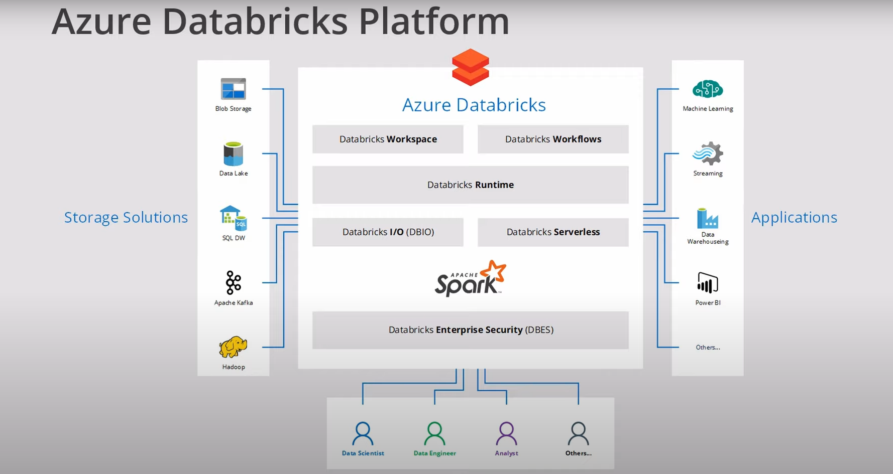
Azure Databricks
Azure Databricks is a fully managed, cloud-based Big Data and Machine Learning platform, which empowers developers to accelerate AI and innovation.
Provides data science and engineering teams with a single platform for Big Data processing and Machine Learning.
Offers three environments for developing data intensive applications:
Databricks SQL
Databricks Data Science & Engineering
Databricks Machine Learning.
Notes:
If a workload requires Spark, Databricks usually is the go-to solution.
You can use Azure Databricks as a solution for the following scenarios.
Data science preparation of data - Create, clone and edit clusters of complex, unstructured data, turn them into specific jobs and deliver them to data scientists and data analysts for review
Find relevant insights in the data - Recommendation engines, churn analysis, and intrusion detection are common scenarios that many organizations solve across multiple industries using Azure Databricks.
Improve productivity across data and analytics teams - Create a collaborative environment and shared workspaces for data engineers, analysts, and scientists to work together across the data science lifecycle with shared workspaces, saving teams precious time and resources.
Big data workloads – Leverage Delta Lake and engine to get the best performance and reliability for your big data workloads, and to create no-fuss multi-step data pipelines
Machine learning programs – Leverage integrated end-to-end machine learning environment incorporating managed services for experiment tracking, model training, feature development and management, and feature and model serving

Slide 16
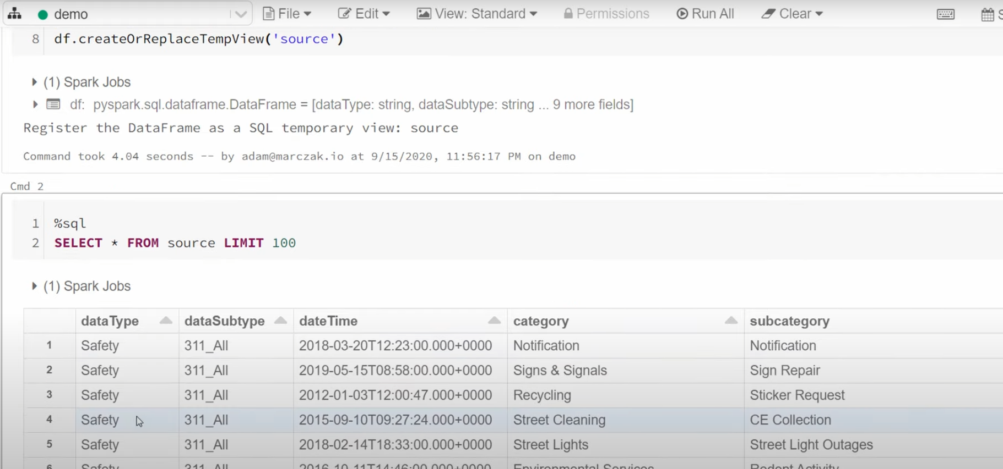

Slide 17

Azure Synapse Analytics
Notes:
The are two units in Learn for this section.

Slide 18
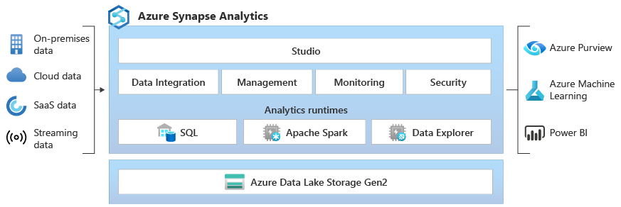
Azure Synapse Analytics
Azure Synapse Analytics is an integrated analytics platform that brings together data integration, enterprise data warehousing, big data analytics and visualization into a single service. Azure Synapse Analytics is an evolution of Azure SQL Data Warehouse.
Modern data warehousing
Advanced analytics
Data exploration and discovery
Real time analytics
Data integration
Integrated analytics
Machine Learning
Notes:
Initial analysis shows that the data needs to be cleaned, modeled, and visualized before data science can be applied.
Initial analysis would like to interface with all of their existing on-premises apps, cloud services subscriptions through a central interface.
Use Azure Synapse Analytics when:
You have a variety of data sources use Azure Synapse Analytics for code-free ETL and data flow activities.
You have a need to implement Machine Learning solutions using Apache Spark, use Azure Synapse Analytics for built-in support for AzureML.
You have existing data stored on a data lake and need integration with the Data Lake and additional input sources, Azure Synapse Analytics provides seamless integration between the two.

Slide 19
Compare Azure Data Factory to Azure Synapse Analytics
Criteria | Azure Data Factory | Azure Synapse Analytics
Integration runtime sharing | Can be shared across different data factories | No sharing
Solution templates | Provided with Azure Data Factory template gallery | Provided with Synapse Workspace Knowledge center
Integration Runtime cross region support | Support Cross region data flows | Does not support cross region data flows
Monitoring of Spark Jobs for Data Flow | Not supported | Supported by the Synapse Spark pools
Notes:
Short discussion on different uses of Data Factory and Synapse Analytics
Available features in ADF & Azure Synapse Analytics - https://docs.microsoft.com/azure/synapse-analytics/data-integration/concepts-data-factory-differences#available-features-in-adf--azure-synapse-analytics

Slide 20
Compare Synapse to Databricks
Azure Synapse Analytics and Azure Databricks offer different capabilities which may be combined if required
Capabilities | Databricks | Synapse
Machine Learning | Optimized runtimes with support for TensorFlow, PyTorch, and Keras. GPU support | Built-in support Azure ML Train models using SparkML, MLlib and other open-source libraries GPU-accelerated pools
Feature Set | Optimized Apache Spark environment | Distributed T-SQL system Spark environment Data Integration Unified experience with Synapse Studio
Reporting | Azure Databricks connection available in PowerBI | PowerBI available directly from Synapse Studio

Slide 21

Azure Stream Analytics
Notes:
Different order from the Learn content: Azure Stream Analytics is ahead of hot/warm/cold data path.

Slide 22
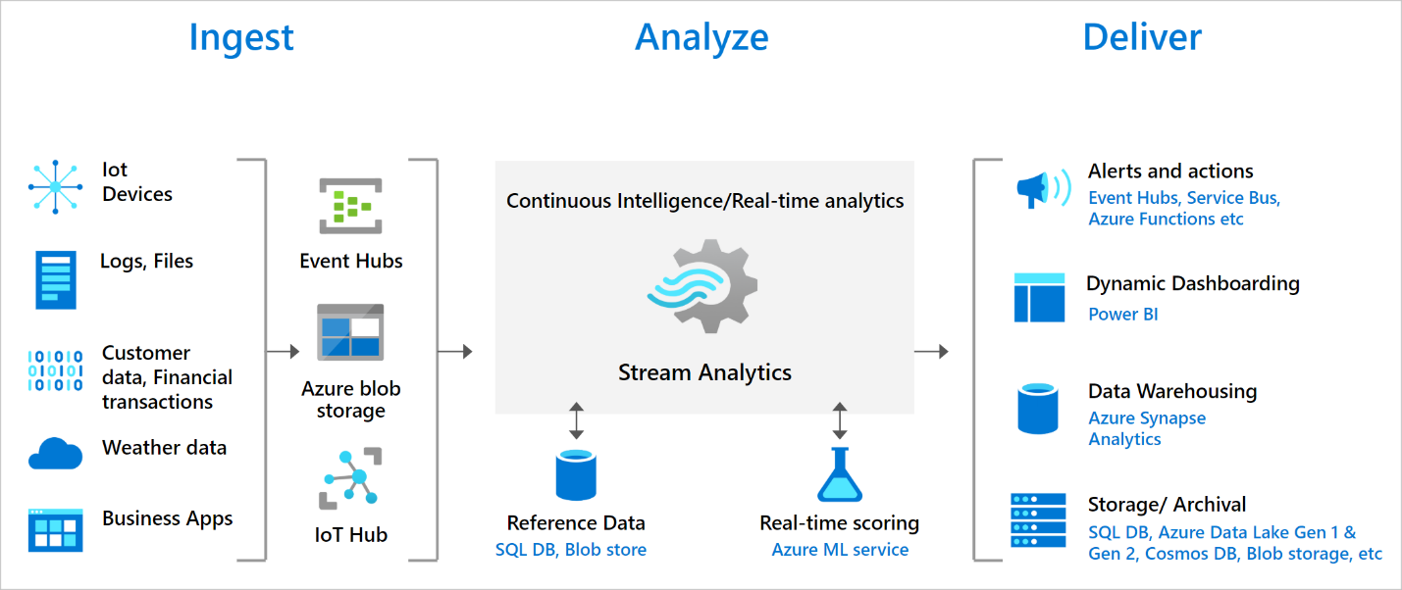
Azure Stream Analytics
Azure Stream Analytics is a real-time analytics and complex event-processing engine that is designed to analyze and process high volumes of fast streaming data from multiple sources simultaneously.
Analyze real-time telemetry streams from IoT devices
Web logs/clickstream analytics
Geospatial analytics for fleet management and driverless vehicles
Remote monitoring and predictive maintenance of high value assets
Real-time analytics on point-of-sale data for inventory control and anomaly detection
Notes:
Data stream- Data streams are continuous data generated by applications, IoT devices or sensors. These data streams are analyzed, and actionable insights are extracted from it. For example, monitoring data stream from industrial and manufacturing equipment, Monitoring data of water pipelines by utility providers. Data streams help understand change over time.
Event processing - Event processing refers to consumption and analysis of a continuous data stream to extract actionable insights from the events happening within that stream. For example, a car passing through a tollbooth should include temporal information, such as a timestamp, indicating when it occurred.
An Azure Stream Analytics job consists of an input, query, and an output. You can do the following with the job output:
Route data to storage systems like Azure Blob storage, Azure SQL Database, Azure Data Lake Store, and Azure CosmosDB.
You can send data to Power BI for real-time visualization.
You can store data in Data Warehouse service like Azure Synapse Analytics to train a machine learning model based on historical data or perform batch analytics.
You can trigger custom downstream workflows by sending the data to services like Azure Functions, Service Bus Topics or Queues.

Slide 23
Other Azure Solutions

Slide 24




Artificial Intelligence & Machine Learning
Azure Machine Learning: cloud-based to develop, train, and deploy machine learning models.
Cognitive Services: quickly enable apps to see, hear, speak, understand, and interpret a user’s needs.
Azure Bot Service: develop intelligent, enterprise-grade bots.
Notes:
Azure Machine Learning service provides a cloud-based environment used to develop, train, test, deploy, manage, and track machine learning models.
Cognitive Services builds intelligent and supported algorithms into apps, websites, and bots to see, hear, speak, understand, and interpret your user needs.
Azure Bot Service develops intelligent, enterprise-grade bots that let you maintain control of your data.
Learn more at:
Azure Machine Learning Service - https://azure.microsoft.com/en-us/services/machine-learning-service/
Azure Machine Learning Studio - https://azure.microsoft.com/en-us/services/machine-learning-studio/
Note: For a full list of Artificial Intelligence and Machine Learning services available with Azure, see the AI + Machine Learning section on the https://azure.microsoft.com/en-us/overview/ai-platform/ page.
Learn and SkillPipe content order note:
Multiple Learn units cover the content in this slide
https://docs.microsoft.com/en-us/learn/modules/ai-machine-learning-fundamentals/1-introduction
https://docs.microsoft.com/en-us/learn/modules/ai-machine-learning-fundamentals/2-identify-product-options
https://docs.microsoft.com/en-us/learn/modules/ai-machine-learning-fundamentals/3-analyze-decision-criteria
https://docs.microsoft.com/en-us/learn/modules/ai-machine-learning-fundamentals/4-use-machine-learning
https://docs.microsoft.com/en-us/learn/modules/ai-machine-learning-fundamentals/5-use-cognitive-services
https://docs.microsoft.com/en-us/learn/modules/ai-machine-learning-fundamentals/6-use-bot-services

Slide 25


Serverless Computing
Azure Functions
Azure Logic Apps
Event based code running your service and not the underlying infrastructure.
Automate and orchestrate tasks, business processes, and workflows to integrate apps.
Notes:
Note: This topic is also introduced in Module 1, slide 23 (as it works well there), but is listed in the objective domain here.
Serverless computing is the evolution of cloud platforms in the direction of pure cloud native code. Serverless brings developers closer to business logic while insulating them from infrastructure concerns. It's a pattern that doesn't imply "no server" but rather, "less server." Serverless code is event-driven. Code may be triggered by anything from a traditional HTTP web request to a timer or the result of uploading a file. The infrastructure behind serverless allows for instant scale to meet elastic demands and offers micro-billing to truly "pay for what you use." Serverless requires a new way of thinking and approach to building applications and isn't the right solution for every problem.
Azure Functions is code running your service and not the underlying platform or infrastructure. Creates infrastructure based on an event.
Azure Logic Apps is a cloud service that helps you automate and orchestrate tasks, business processes, and workflows when you need to integrate apps, data, systems, and services.
Azure Event Grid is a fully-managed, intelligent event routing service that uses a publish-subscribe model for uniform event consumption.
Azure Functions - https://docs.microsoft.com/en-us/azure/azure-functions/
Azure Logic Apps - https://docs.microsoft.com/en-us/azure/logic-apps/
Azure Event Grid - https://docs.microsoft.com/en-us/azure/event-grid/
Note: For more details about serverless services available with Azure, see https://azure.microsoft.com/en-us/solutions/serverless/
Learn and SkillPipe content order note:
Multiple Learn units cover the content in this slide
https://docs.microsoft.com/en-us/learn/modules/serverless-fundamentals/1-introduction
https://docs.microsoft.com/en-us/learn/modules/serverless-fundamentals/2-identify-product-options
https://docs.microsoft.com/en-us/learn/modules/serverless-fundamentals/3-analyze-decision-criteria
https://docs.microsoft.com/en-us/learn/modules/serverless-fundamentals/4-use-azure-functions
https://docs.microsoft.com/en-us/learn/modules/serverless-fundamentals/5-use-azure-logic-apps

Slide 26

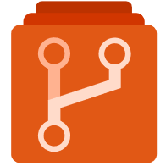
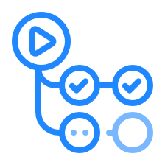

Develop your apps with DevOps and GitHub
Azure DevOps: development collaboration tools including pipelines, Kanban boards, and automated cloud-based load testing.
GitHub: software development hosting with version control, source code management, and bug/task management.
GitHub Actions for Azure: automate software workflow to build, test, and deploy from withing GitHub.
Azure DevTest Labs: quickly create environments in Azure while minimizing waste and controlling cost.
Notes:
Azure DevOps services provides development collaboration tools including pipelines, Git repositories, Kanban boards, and extensive automated and cloud-based load testing.
Azure DevTest Labs allows you to quickly create environments in Azure while minimizing waste and controlling cost.
GitHub is an American provides hosting for software development and version control using Git. It offers the distributed version control and source code management (SCM) functionality of Git, plus its own features. It provides access control and several collaboration features such as bug tracking, feature requests, task management, and wikis for every project.
GitHub Actions makes it easy to automate all your software workflows, now with world-class CI/CD. Build, test, and deploy your code right from GitHub. Make code reviews, branch management, and issue triaging work the way you want.
Azure DevOps Services - https://docs.microsoft.com/en-us/azure/devops/
Azure DevTest Labs - https://azure.microsoft.com/en-us/services/devtest-lab/
Note: For more general details on DevOps services available with Azure, see https://docs.microsoft.com/en-us/azure/#pivot=products&panel=devops
Learn and SkillPipe content order note:
Multiple Learn units cover the content in this slide
https://docs.microsoft.com/en-us/learn/modules/azure-devops-devtest-labs/1-introduction
https://docs.microsoft.com/en-us/learn/modules/azure-devops-devtest-labs/2-identify-product-options
https://docs.microsoft.com/en-us/learn/modules/azure-devops-devtest-labs/3-analyze-decision-criteria
https://docs.microsoft.com/en-us/learn/modules/azure-devops-devtest-labs/4-use-azure-devops
https://docs.microsoft.com/en-us/learn/modules/azure-devops-devtest-labs/5-use-github
https://docs.microsoft.com/en-us/learn/modules/azure-devops-devtest-labs/6-use-azure-devtest-labs

Slide 27
Discussion
HKJC use case
  Any use case for Big Data Analysis?
  Privacy? Latency? Synchronization issue?
CI / CD in Azure DevOps vs on premises Jenkins + Spinnaker

