Slide 1
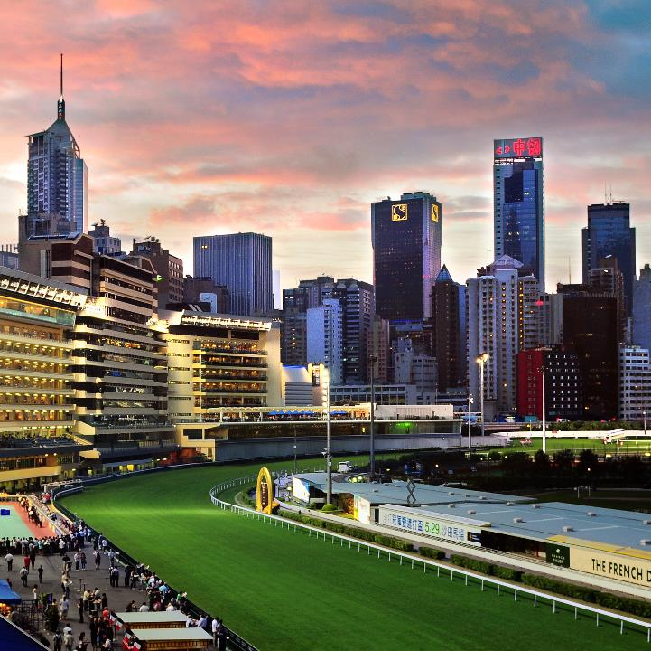

Module 04:
Message And Event Integration
Cyrus Cheng
ITSWS - FO Cashout Team

Slide 2

Module 04 – Outline
You will learn the following concepts:
Messaging solution
  Azure Queue
  Service Bus Topic and Queue
Event solution
  Event Hub
  Event Grid
Application optimization solution
  Azure for Redis
  API Management
Application Configuration
  Infrastructure As Code
  Azure Application Configuration
Notes:
Learn and SkillPipe content order note:
Slides 3-5
https://docs.microsoft.com/en-us/learn/modules/azure-architecture-fundamentals/introduction
https://docs.microsoft.com/en-us/learn/modules/azure-architecture-fundamentals/overview

Slide 3

Messaging solution

Slide 4
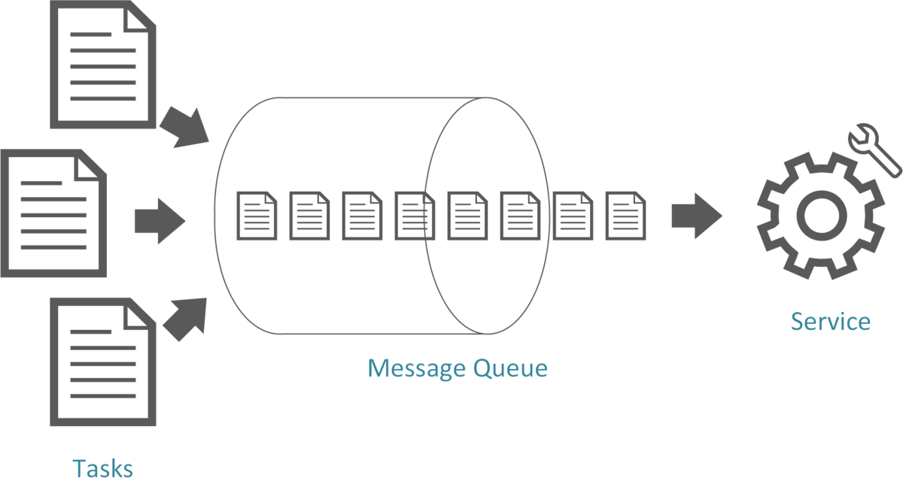
Design for Azure Queue storage
Azure Storage Queue is a service for storing large number of messages.
Accessed with authenticated calls using HTTP or HTTPS
Messages can be up to 64 KB in size
May contain millions of messages, up to the total capacity limit of a storage account
Create a backlog of work to process asynchronously
Example: customer placing orders online added to the queue and processed
Notes:
Azure Queue storage - https://docs.microsoft.com/azure/storage/queues/storage-queues-introduction

Slide 5

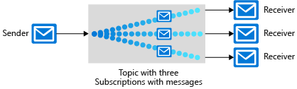
Design for Service Bus queues and topics
Service Bus decouples applications and services from each other.
Service bus queues
Service bus publish-subscribe topics
Built on top of a dedicated messaging infrastructure
Holds messages until the target is ready to receive them – different from queues
Like bus queues but with multiple subscribers
When a message is sent to a topic, multiple components can be triggered to perform a task
Notes:
Azure Service Bus queues - https://docs.microsoft.com/azure/service-bus-messaging/service-bus-queues-topics-subscriptions
Azure Service Bus topics - https://docs.microsoft.com/azure/service-bus-messaging/service-bus-queues-topics-subscriptions
Examples: Sports reporting passing information to multiple agencies.

Slide 6
Compare messaging solutions
Solution | Usage cases | SLA
Queue storage | A simple queue to organize messages. Queue to exceed 80 GB in size. To track progress for processing a message inside of the queue. | Based on storage tier
Service bus queues | A first-in-first-out guarantee. At-Least-Once message processing (PeekLock receive mode) At-Most-Once message processing (ReceiveAndDelete receive mode) Can group operations into transactions Receive messages without polling the queue. Publish and consume batches of messages. | 99.9%
Service bus topics | Multiple receivers to handle each message. Multiple destinations for a single message. | 99.9%
Notes:
Storage queues and Service Bus queues - compared and contrasted - https://docs.microsoft.com/azure/service-bus-messaging/service-bus-azure-and-service-bus-queues-compared-contrasted#foundational-capabilities
Overview of transaction processing in Azure Service Bus - https://docs.microsoft.com/azure/service-bus-messaging/service-bus-transactions
TTL – time to live

Slide 7

Event solution
Notes:
There are 2 Learn units that are covered under this one divider: Event Hub and Event-driven. There is no student content for IoT Hub which is not on the exam, but included for completeness.

Slide 8
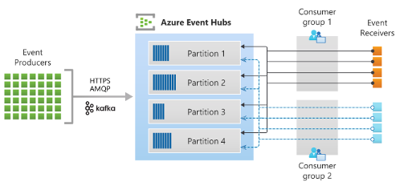
Design an Event Hub messaging solution
Azure Event Hubs is a fully managed, real time data ingestion service
Orders events by when they are received - by time offsets
Uses a pull model allowing multiple reads from consumers
  Scaling is controlled by how many throughput units or processing units you purchase
  Receiving IoT and real-time streaming data
Notes:
Azure Event Hubs — A big data streaming platform and event ingestion service - https://docs.microsoft.com/azure/event-hubs/event-hubs-about
Use event hub from Apache Kafka app - https://docs.microsoft.com/azure/event-hubs/event-hubs-for-kafka-ecosystem-overview
Online retailer uses cloud database to deliver world-class shopping experiences - https://customers.microsoft.com/story/asos-retail-and-consumer-goods-azure
Discussion: What is the main consideration for the ‘pull’ model provided by Event Hubs? Pull models make it the responsibility of the consumer(s) to ensure data are processed before they expire. This provides flexibility but also can mean that messages are lost in exceptional circumstances.

Slide 9
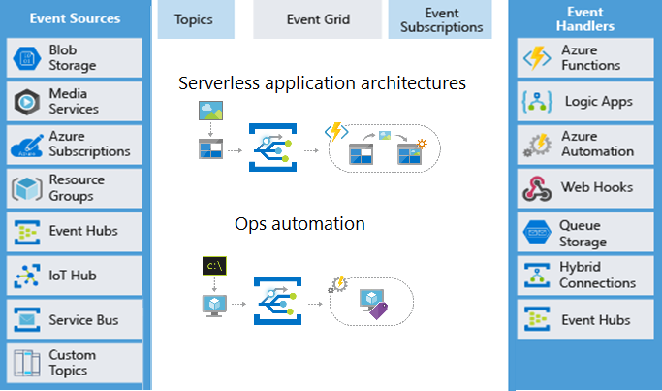
Design an event-driven solution
Azure Event Grid is a routing service connecting data sources with event handlers.
  Events sources include Azure resources or custom topics (you create)
  Event handlers react to an event
  Useful for serverless applications and operations automation
  Uses a pay-per-operation or pay-per-use pricing models
Notes:
Azure Event Grid - https://docs.microsoft.com/azure/event-grid/overview
Serverless application architectures - Event Grid connects data sources and event handlers. For example, use Event Grid to trigger a serverless function that analyzes images when added to a blob storage container.
Ops automation - Event Grid allows you to speed automation and simplify policy enforcement. For example, use Event Grid to notify Azure Automation when a virtual machine or database in Azure SQL is created. Use the events to automatically check that service configurations are compliant, put metadata into operations tools, tag virtual machines, or file work items.

Slide 10
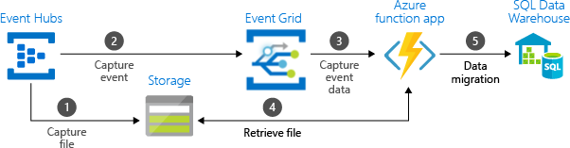
Comparison of message and event solutions
Consider combining several solutions
Service | Purpose | Type | When to use
Event Grid | Reactive programming | Event distribution (discrete) | React to status changes
Event Hubs | Big data pipeline | Event streaming (series) | Telemetry and distributed data streaming
Service Bus | High-value enterprise messaging | Message | Order processing and financial transactions
Notes:
Diagram shows example but table is a summary of options. Treat as separate topics.
In some cases, you use the services side by side to fulfill distinct roles. For example, an e-commerce site can use Service Bus to process the order, Event Hubs to capture site telemetry, and Event Grid to respond to events like an item was shipped. In other cases, you link them together to form an event and data pipeline. You use Event Grid to respond to events in the other services.

Slide 11
Suggested Solution Diagram

Slide 12

Application optimization solution
Notes:
There are two Learn units under this banner: Redis and API management.

Slide 13
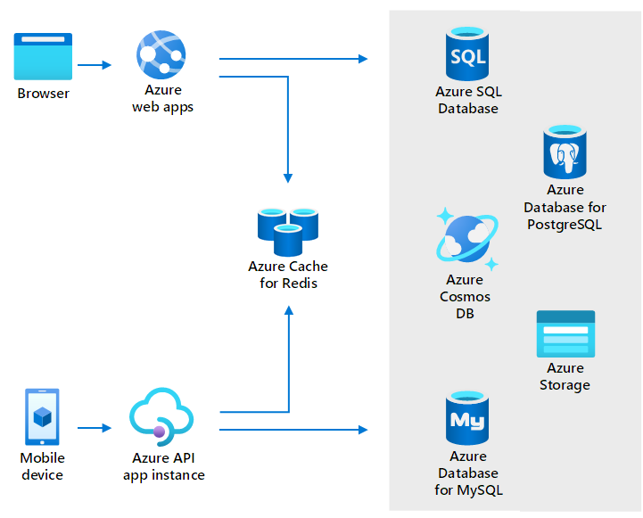
When to use Azure Cache for Redis
Store frequently accessed data so that applications can be responsive to users.
Key scenarios - data cache, content cache, session store, job and message queuing, and distributed transactions
Fully managed solution
High availability - responds automatically to both anticipated and unanticipated changes in demand
Same performance and scaling benefits throughout the world – network isolation, data encryption in transit
Notes:
About Azure Cache for Redis - https://docs.microsoft.com/azure/azure-cache-for-redis/cache-overview
What is Azure Cache Redis - https://docs.microsoft.com/learn/modules/intro-to-azure-cache-for-redis/2-what-is-azure-cache-for-redis

Slide 14
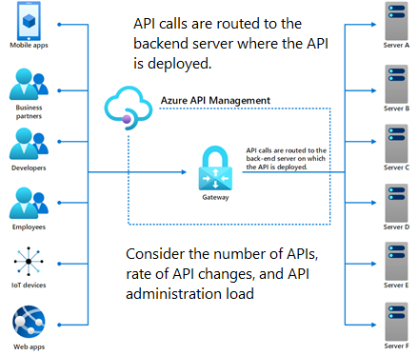
Design an Azure API management solution
Publish, secure, maintain, and analyze all your company's APIs.
  Bring multiple APIs under a single administrative umbrella – centralized management
  Manage permissions and access
  Ensure compliance across API
  Standardize API specs
  Protect the APIs from malicious usage
Notes:
Azure API Management - https://docs.microsoft.com/azure/api-management/api-management-key-concepts

Slide 15

Application Configuration
Notes:
There are 2 Learn units under this banner: Automated Deployment and App Configuration.

Slide 16
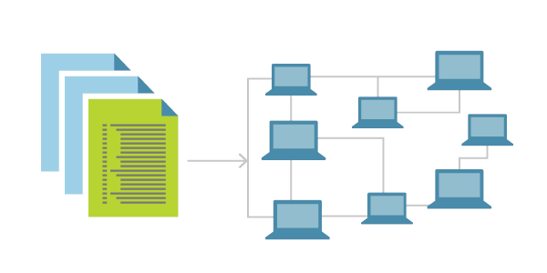
What is Infrastructure as Code?
Infrastructure as Code (IaC) is the process of automating your infrastructure provisioning.
  The IaC model generates the same environment every time it is applied
  Solves the problem of environmental drift
  Enables teams to test applications in production-like environments early
  Where possible, uses declarative definition files
Notes:
What is Infrastructure as Code? https://docs.microsoft.com/devops/deliver/what-is-infrastructure-as-code
Use this slide to introduce IaC and why it is important. The next slide covers the tooling that can be used.

Slide 17
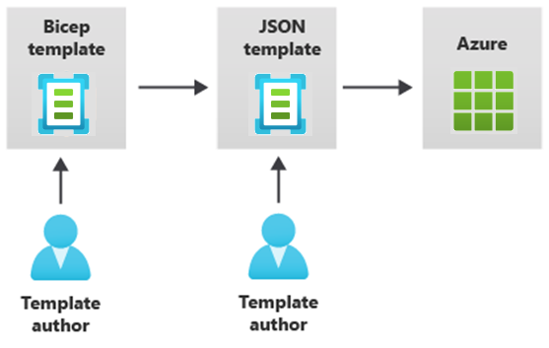

Provision resources with Infrastructure as Code
Azure supports IaC with Azure Resource Manager and third-party platforms.
  Azure Resource Manager templates – Bicep, JSON
  Azure Automation
  Azure DevOps services
  GitHub actions
  Terraform
  Jenkins
Notes:
Student content does not cover all the options shown on the slide.
Azure Resource Manager (ARM) templates - https://docs.microsoft.com/azure/azure-resource-manager/templates/overview
Bicep - https://docs.microsoft.com/azure/azure-resource-manager/bicep/overview
Automation deployment - https://docs.microsoft.com/azure/virtual-machines/infrastructure-automation
Azure DevOps documentation - https://docs.microsoft.com/azure/devops
GitHub Actions - https://docs.github.com/actions
Terraform by Hashicorp - https://www.terraform.io/
Jenkins - https://www.jenkins.io/
Could also mention:
Python with Pulumi - https://devblogs.microsoft.com/devops/infrastructure-as-code-azure-python-wpulumi/
Chef Automate - https://docs.chef.io/azure_marketplace/
Ansible - https://docs.microsoft.com/azure/developer/ansible/overview
And:
Azure Chaos Studio - https://azure.microsoft.com/services/chaos-studio/

Slide 18
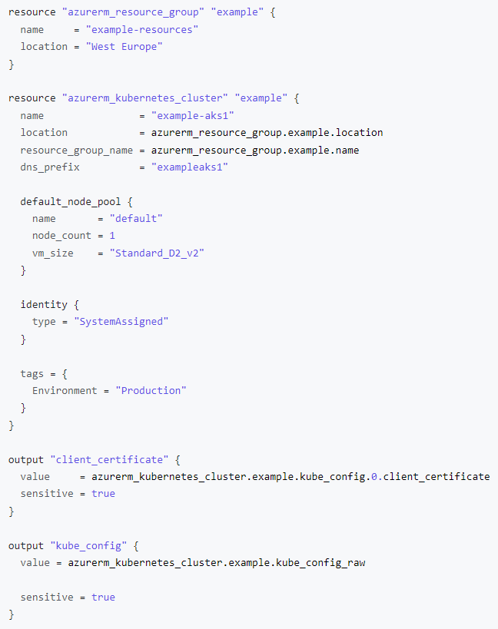
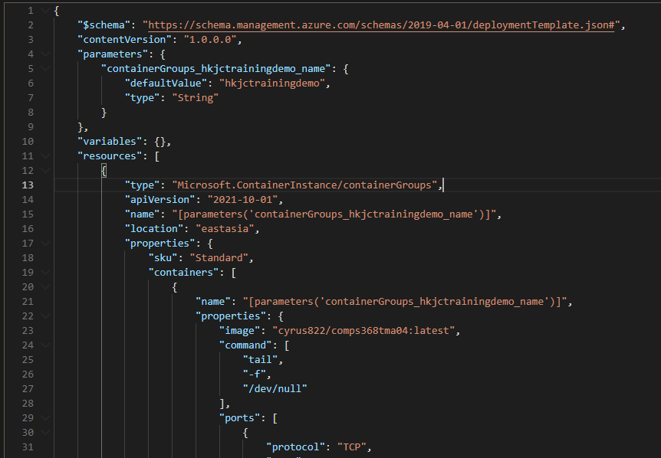

Slide 19




Design an Azure App Configuration solution
Azure App Configuration centrally manages application settings and feature flags.
Flexible key representations and mappings
Point-in-time replay of settings
Dedicated UI for feature flag management
Comparison of two sets of configurations on custom-defined dimensions
Enhanced security through Azure-managed identities and encryption
Config A
Config B
App Configuration
Notes:
Azure App Configuration - https://docs.microsoft.com/azure/azure-app-configuration/overview
While any application can make use of App Configuration, the following examples are the types of application that benefit from the use of it:
Microservices based on Azure Kubernetes Service, Azure Service Fabric, or other containerized apps deployed in one or more geographies
Serverless apps, which include Azure Functions or other event-driven stateless compute apps
Continuous deployment pipeline

Slide 20

End of presentation

