Slide 1


Module 05:
Identity, governance, privacy, and compliance
Cyrus Cheng
ITSWS - FO Cashout Team

Slide 2

Module outline
Notes:
Learn and SkillPipe content order note:
Slides 1-5
https://docs.microsoft.com/en-us/learn/modules/secure-access-azure-identity-services/1-introduction

Slide 3

Module 05 – Outline
You will learn the following concepts:
Azure identity services
  Authentication versus Authorization
  Azure AD, MFA, SSO and Conditional Access
Azure governance features
  RBAC
  Resource locks and tags
  Policy, Blueprints, and CAF
Notes:
Learn and SkillPipe content order note:
Slides 1-5
https://docs.microsoft.com/en-us/learn/modules/secure-access-azure-identity-services/1-introduction

Slide 4

Core Azure identity services
Notes:
Learn and SkillPipe content order note:
Slides 1-5
https://docs.microsoft.com/en-us/learn/modules/secure-access-azure-identity-services/1-introduction

Slide 5
Azure Identity Services - Objective Domain
Explain the difference between authentication and authorization
Define Azure Active Directory
Describe the functionality and usage of Azure Active Directory
Describe the functionality and usage of Conditional Access, Multi-Factor Authentication (MFA), and Single Sign-On (SSO)
Notes:
Learn and SkillPipe content order note:
Slides 1-5
https://docs.microsoft.com/en-us/learn/modules/secure-access-azure-identity-services/1-introduction

Slide 6



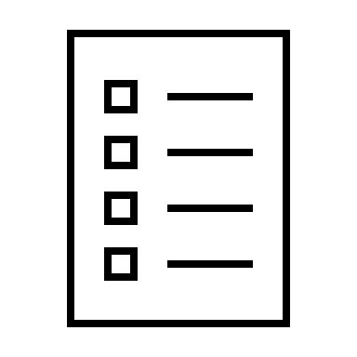





Compare Authentication and Authorization
Authentication
Identifies the person or service seeking access to a resource.
Requests legitimate access credentials.
Basis for creating secure identity and access control principles.
Authorization
Determines an authenticated person’s or service’s level of access.
Defines which data they can access, and what they can do with it.
Notes:
✔️Authentication is sometimes shortened to AuthN, and authorization is sometimes shortened to AuthZ.
Authentication
Identifies the person or service seeking access to a resource.
Requests legitimate access credentials.
Basis for creating secure identity and access control principles.
Authorization
Determines an authenticated person’s or service’s level of access.
Defines which data they can access, and what they can do with it.
Learn and SkillPipe content order note:
https://docs.microsoft.com/en-us/learn/modules/secure-access-azure-identity-services/2-compare-authentication-authorization

Slide 7
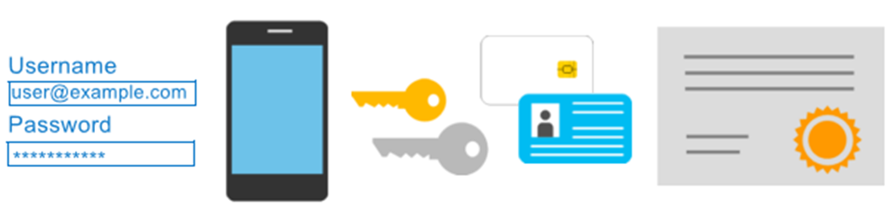
Azure Multi-Factor Authentication
Provides additional security for your identities by requiring two or more elements for full authentication.
  Something you know ←→ Something you possess ←→ Something you are
Notes:
Discuss what could qualify for each of the items listed
Something you know: This could be a password or the answer to a security question.
Something you possess: This might be a mobile app that receives a notification, or a token-generating device.
Something you are: This is typically some sort of biometric property, such as a fingerprint or face scan used on many mobile devices.
MFA - https://docs.microsoft.com/en-us/azure/active-directory/authentication/concept-mfa-howitworks
Learn and SkillPipe content order note:
Slides 7 & 9
https://docs.microsoft.com/en-us/learn/modules/secure-access-azure-identity-services/2-compare-authentication-authorization

Slide 8

Azure Active Directory (AAD)
Azure Active Directory (AAD) is Microsoft Azure’s cloud-based identity and access management service.
  Authentication (employees sign-in to access resources).
  Single sign-on (SSO).
  Application management.
  Business to Business (B2B).
  Business to Customer (B2C) identity services.
  Device management.
Notes:
Azure AD - https://azure.microsoft.com/en-us/services/active-directory/
Azure tenant
A dedicated and trusted instance of Azure AD that's automatically created when your organization signs up for a Microsoft cloud service subscription, such as Microsoft Azure, Microsoft Intune, or Office 365. An Azure tenant represents a single organization.
Azure AD directory
Each Azure tenant has a dedicated and trusted Azure AD directory. The Azure AD directory includes the tenant's users, groups, and apps and is used to perform identity and access management functions for tenant resources.
Learn and SkillPipe content order note:
https://docs.microsoft.com/en-us/learn/modules/secure-access-azure-identity-services/3-what-is-azure-active-directory

Slide 9
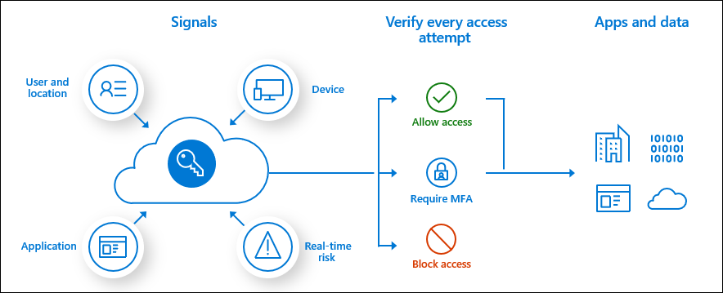
Conditional Access
Conditional Access is used by Azure Active Directory to bring signals together, to make decisions, and enforce organizational policies.
User or Group Membership
IP Location
Device
Application
Risk Detection
Notes:
https://docs.microsoft.com/en-us/azure/active-directory/conditional-access/overview
The modern security perimeter now extends beyond an organization's network to include user and device identity. Organizations can utilize these identity signals as part of their access control decisions.
Conditional Access is the tool used by Azure Active Directory to bring signals together, to make decisions, and enforce organizational policies. Conditional Access is at the heart of the new identity driven control plane.
Conditional Access policies at their simplest are if-then statements, if a user wants to access a resource, then they must complete an action. Example: A payroll manager wants to access the payroll application and is required to perform multi-factor authentication to access it.
Administrators are faced with two primary goals:
Empower users to be productive wherever and whenever
Protect the organization's assets
By using Conditional Access policies, you can apply the right access controls when needed to keep your organization secure and stay out of your user's way when not needed.
Learn and SkillPipe content order note:
Slides 7 & 9
https://docs.microsoft.com/en-us/learn/modules/secure-access-azure-identity-services/2-compare-authentication-authorization

Slide 10
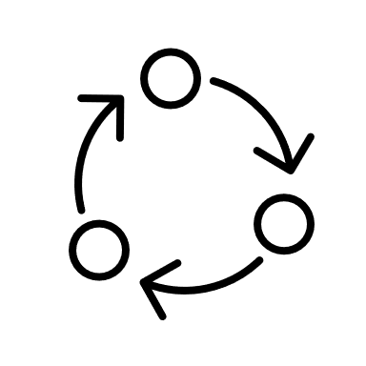
Azure Governance Methodologies
Notes:
Learn and SkillPipe content order note:
Slides 11-12
https://docs.microsoft.com/en-us/learn/modules/build-cloud-governance-strategy-azure/1-introduction

Slide 11
Azure Governance Methodologies - Objective Domain
Describe the functionality and the usage of:
Role-Based Access Control (RBAC)
Resource locks
Tags
Azure Policy
Azure Blueprints
Cloud Adoption Framework for Azure
Notes:
Learn and SkillPipe content order note:
Slides 11-12
https://docs.microsoft.com/en-us/learn/modules/build-cloud-governance-strategy-azure/1-introduction

Slide 12






Explore Role-based access control (RBAC)
Fine-grained access management.
Segregate duties within the team and grant only the amount of access to users that they need to perform their jobs.
Enables access to the Azure portal and controlling access to resources.
Azure
Active Directory
Azure
subscription
User
Apps
User groups
Resource group
Resource group
Notes:
Azure RBAC - https://docs.microsoft.com/en-us/azure/role-based-access-control/overview
Learn and SkillPipe content order note:
https://docs.microsoft.com/en-us/learn/modules/build-cloud-governance-strategy-azure/4-control-access-azure-rbac

Slide 13
Resource locks
Protect your Azure resources from accidental deletion or modification.
Manage locks at subscription, resource group, or individual resource levels within Azure Portal.
Lock Types | Read | Update | Delete
CanNotDelete | Yes | Yes | No
ReadOnly | Yes | No | No
Notes:
Resource Locks - https://docs.microsoft.com/en-us/azure/azure-resource-manager/resource-group-lock-resources
Learn and SkillPipe content order note:
https://docs.microsoft.com/en-us/learn/modules/build-cloud-governance-strategy-azure/5-prevent-changes-resource-locks

Slide 14
Tags
Provides metadata for your Azure resources.
Logically organizes resources into a taxonomy.
Consists of a name-value pair.
Very useful for rolling up billing information.
OR
owner: joe
department: marketing
environment: production
cost-center: marketing
Notes:
Tags - https://docs.microsoft.com/en-us/azure/azure-resource-manager/resource-group-using-tags
Learn and SkillPipe content order note:
https://docs.microsoft.com/en-us/learn/modules/build-cloud-governance-strategy-azure/7-organize-resource-tags

Slide 15

Azure Policy
Azure Policy helps to enforce organizational standards and to assess compliance at-scale. Provides governance and resource consistency with regulatory compliance, security, cost, and management.
  Evaluates and identifies Azure resources that do not comply with your policies.
  Provides built-in policy and initiative definitions, under categories such as Storage, Networking, Compute, Security Center, and Monitoring.
Notes:
Azure Policy - https://azure.microsoft.com/en-us/services/azure-policy
Stay compliant with your corporate standards and service level agreements (SLAs) by using policy definitions to enforce rules and effects for your Azure resources.
Evaluates and identifies Azure resources that do not comply with your policies.
Provides built-in policy and initiative definitions, under categories such as Storage, Networking, Compute, Security Center, and Monitoring.
Learn content notes:
https://docs.microsoft.com/en-us/learn/modules/build-cloud-governance-strategy-azure/8-control-audit-resources-azure-policy

Slide 16

Azure Blueprints
Azure Blueprints makes it possible for development teams to rapidly build and stand up new environments. Development teams can quickly build trust through organizational compliance with a set of built-in components (such as networking) in order to speed up development and delivery.
Role Assignments
Policy Assignments
Azure Resource Manager Templates
Resource Groups
Notes:
Azure Blueprints - https://azure.microsoft.com/en-us/services/blueprints/
Learn and SkillPipe content order note:
https://docs.microsoft.com/en-us/learn/modules/build-cloud-governance-strategy-azure/10-govern-subscriptions-azure-blueprints

