Slide 1


Microsoft Azure Training
Cyrus Cheng
ITSWS - FO Cashout Team

Slide 2
Welcome
Thank you for joining us today. We’ve worked together with the Microsoft Partner Network and Microsoft IT Academies to bring you a world-class learning experience. | Microsoft Certified Trainers + Instructors. Your instructor is a premier technical and instructional expert who meets ongoing certification requirements.
Customer Satisfaction Guarantee. Our partners offer a satisfaction guarantee, and we hold them accountable for it. At the end of class, please complete an evaluation of today’s experience. We value your feedback! | Certification Exam Benefits. After training, consider pursuing a Microsoft Certification to help distinguish your technical expertise and experience. Ask your instructor about available exam promotions and discounts. We wish you a great learning experience and ongoing career success!

Slide 3

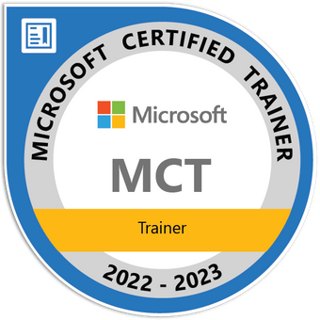




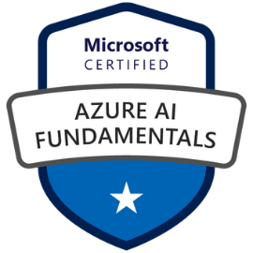
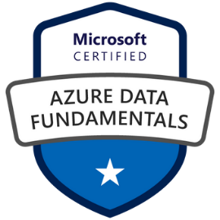
Hello, World!
Cyrus Cheng
Microsoft Certified Trainer (Since 2019)
Azure Solutions Architect
Azure Developer Associate
ITSWS - Cashout Team Tech. Lead
HKMU Parttime Lecturer
Specialized in
  Azure, SharePoint, .NET
  Spring Boot / Spring Cloud
  React, Vue
  K8S Development
  Microservices Arch. Design

Slide 4

How to pronounce “Azure”
https://bit.ly/3EVYAj7
Azure
meaning : Sky-blue colour

Slide 5
About the original course
This course provides foundational level knowledge on cloud concepts; core Azure architecture and services; and Azure management and governance.
The audience for this course is just beginning to learn about cloud computing and how Microsoft Azure provides that service.
This is a two-day course, the content aligns to the AZ-900 exam objective domain.
It’s recommended that you have an IT background for this course.

Slide 6
About this technical sharing
Customized into a 2.5 hour session
High level overview of basic understanding of Azure Services, Architecture and its Solutions
Common use cases of adopting Azure
Discussion : How much can Azure provide to fit HKJC business

Slide 7
Course Agenda
Module 01 – Cloud Adoption and Migration Framework
Module 02 – Core Azure Services
Module 03 – Data Analytics And Other Services
Module 04 – Management And Governance

