Slide 1


Module 01:
Cloud Adoption & Migration Planning
Cyrus Cheng
ITSWS - FO Cashout Team

Slide 2

Module Outline

Slide 3

Module 01 - Outline
You will learn the following concepts:
Azure Architectural Components
  Regions and Availability Zones
  Subscriptions and Resource Groups
Cloud Adoption Framework
Cloud Migration Tools
Multi-Cloud Strategy by Azure Arc

Slide 4
Azure Accounts
Azure account
Azure free account
Azure free student account
Microsoft Learn sandbox
Notes:
https://docs.microsoft.com/learn/modules/describe-core-architectural-components-of-azure/3-get-started-azure-accounts

Slide 5
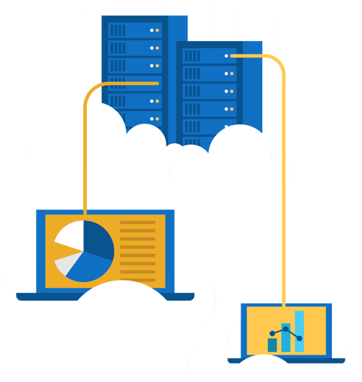
Walkthrough – Create an Azure Account
Create an Azure free account
Create an Azure free account
Notes:
Most exercises will be in the Learn Sandbox – in the last module, there’s a portion that needs an Azure account or can be converted to Demo. This is an optional exercise to help the students create free accounts. Note: They will need a credit card for this exercise.

Slide 6
Exercise – Explore the Learn sandbox
Explore the Learn sandbox
Activate the sandbox
Use PowerShell
Shift to BASH
Shift to Azure Interactive mode
Navigate the portal
Notes:
https://docs.microsoft.com/learn/modules/describe-core-architectural-components-of-azure/4-exercise-explore-learn-sandbox
NOTE: The Learn Sandbox doesn’t require an Azure account, it will work with a Microsoft Account, if you skipped the previous walkthrough.

Slide 7
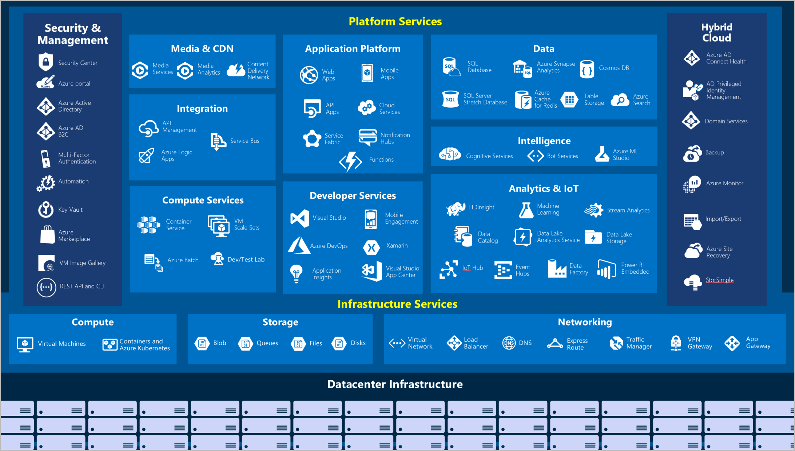
High level Azure Services

Slide 8

Explore Azure Marketplace
Azure Marketplace allows customers to find, try, purchase, and provision applications and services from hundreds of leading service providers, which are
all certified to run on Azure.
Open source container platforms.
Virtual machine and database images.
Application build and deployment software.
Developer tools.
And much more, with 10,000+ listings!
Notes:
Connects end users with Microsoft partners, Independent Software Vendors (ISVs), and start-ups that offer solutions and services for Azure.
Azure customers, IT professionals and cloud developers can find, try, purchase, and provision Azure applications and services from certified service providers.
Includes close to 10,000 product listings.
There is also a Marketplace FAQ available at https://azure.microsoft.com/en-us/marketplace/faq/
Azure Marketplace - https://azuremarketplace.microsoft.com/en-us/
Learn and SkillPipe content order note:
Note in Learn

Slide 9





Tools for interacting with Azure
Azure Portal
Azure PowerShell
Command-Line Interface (CLI)
Azure Cloud Shell
Notes:
https://docs.microsoft.com/learn/modules/describe-features-tools-for-managing-deploying-azure-resources/2-describe-interacting-azure

Slide 10
Azure architectural components

Slide 11
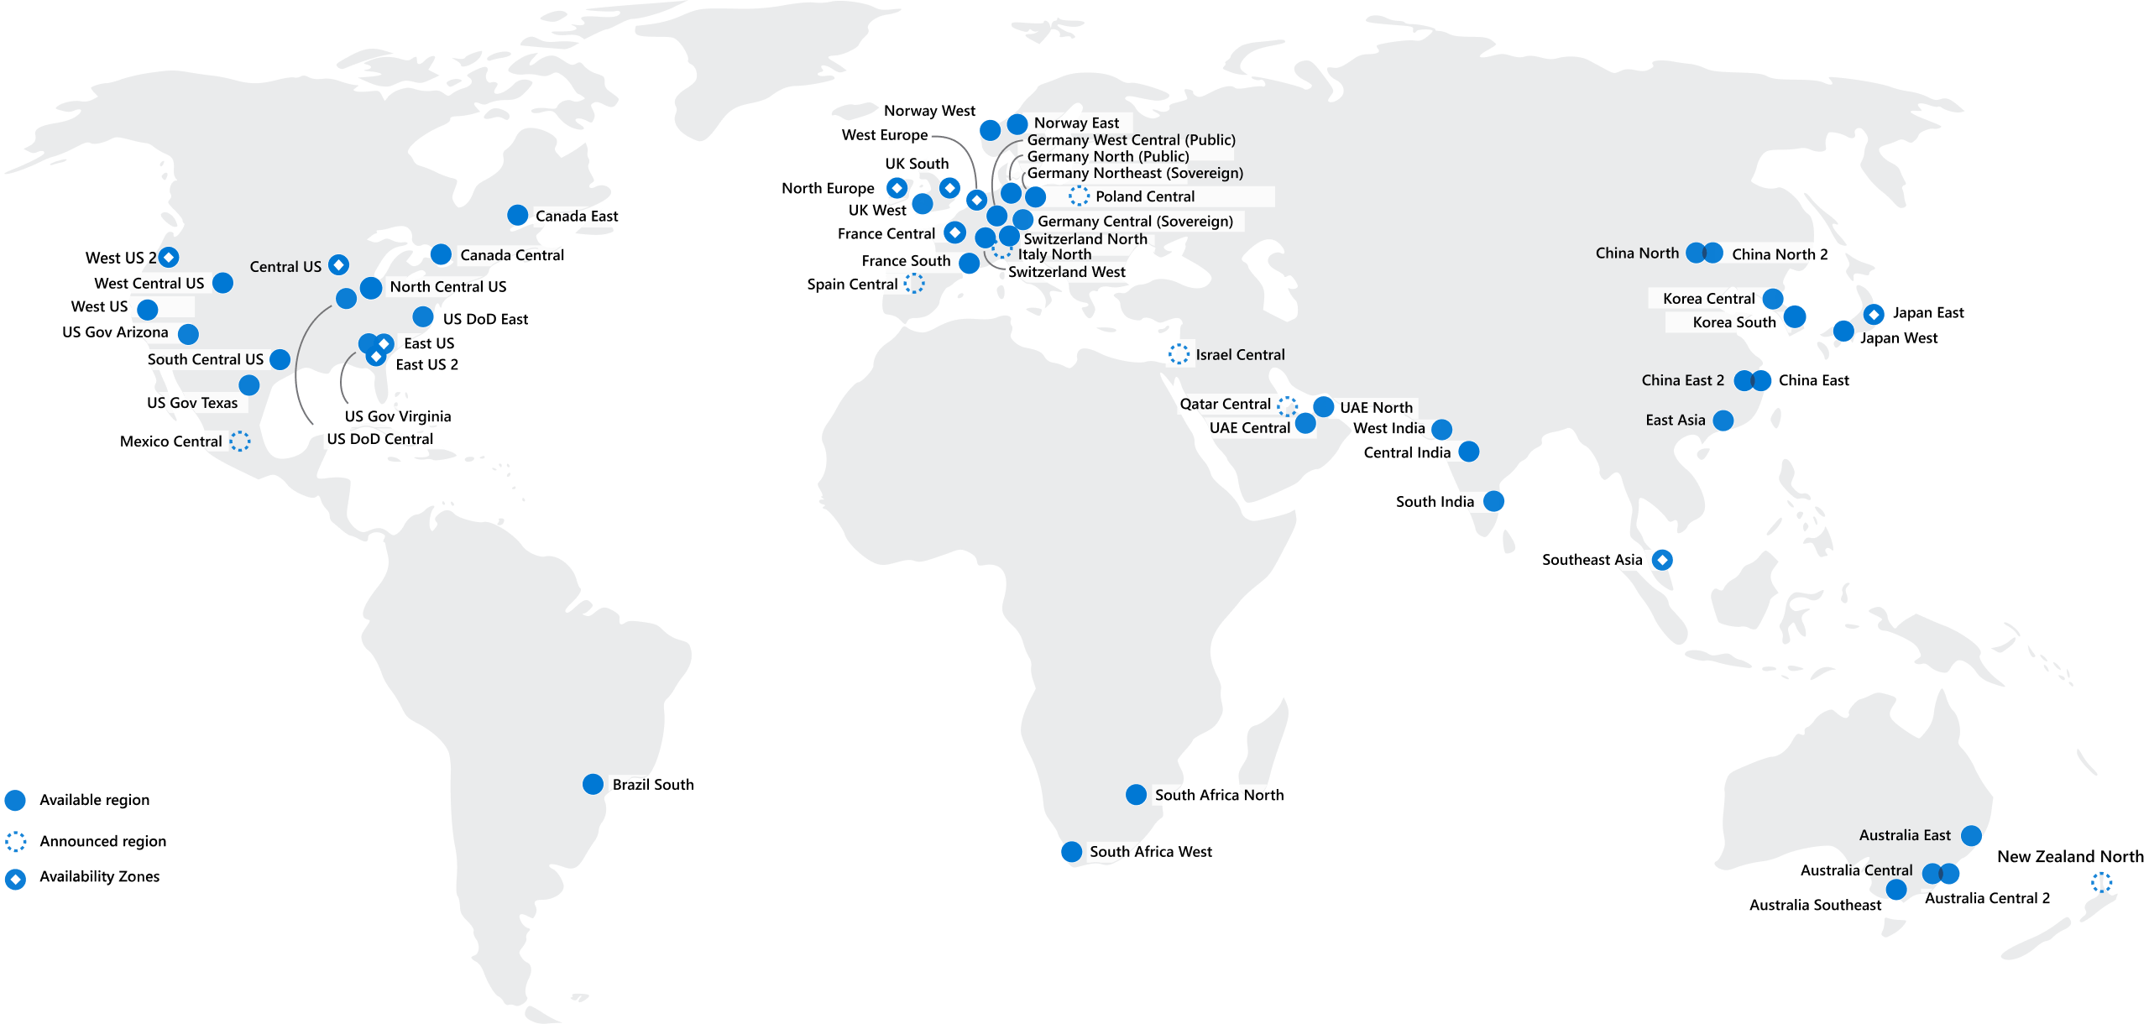
Regions
Azure offers more global regions than any other cloud provider with 60+ regions representing over 140 countries
Regions are made up of one or more datacenters in close proximity.
Provide flexibility and scale to reduce customer latency.
Preserve data residency with a comprehensive compliance offering.
© Copyright Microsoft Corporation. All rights reserved.
Notes:
https://docs.microsoft.com/learn/modules/describe-core-architectural-components-of-azure/5-describe-azure-physical-infrastructure
A region represents a collection of datacenters.
Provide flexibility and scale.
Preserve data residency.
Select regions close to your users.
Be aware of region deployment availability.
There are global services that are region independent.
A list of regions and their locations is available at https://azure.microsoft.com/en-us/global-infrastructure/locations/
Learn and SkillPipe content order note:
Slides 6-10
https://docs.microsoft.com/en-us/learn/modules/azure-architecture-fundamentals/regions-availability-zones

Slide 12
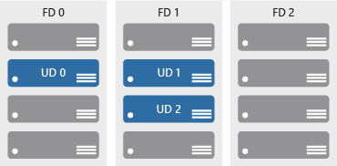

Availability zones
Azure Region
Provide protection against downtime due to datacenter failure.
Physically separate datacenters within the same region.
Each datacenter is equipped with independent power, cooling, and networking.
Connected through private fiber-optic networks.
Availability Zone 1
Availability Zone 2
Availability Zone 3
© Copyright Microsoft Corporation. All rights reserved.
Notes:
https://docs.microsoft.com/learn/modules/describe-core-architectural-components-of-azure/5-describe-azure-physical-infrastructure
Physically separate locations within an Azure region.
Takes availability sets to the next level
Includes one or more datacenters, equipped with independent power, cooling, and networking.
Acts as an isolation boundary.
If one availability zone goes down, the other continues working.
More details about Availability Zones in Azure are available at https://docs.microsoft.com/en-us/azure/availability-zones/az-overview
Learn and SkillPipe content order note:
Slides 6-10
https://docs.microsoft.com/en-us/learn/modules/azure-architecture-fundamentals/regions-availability-zones

Slide 13
Region Pairs
Region
North Central US​
East US​
West US 2​
US East 2​
Canada Central​
North Europe​
UK West​
Germany Central​
South East Asia​
East China​
Japan East​
Australia Southeast​
India South​
Brazil South (Primary)​
Region
South Central US​
West US​
West Central US​
Central US​
Canada East​
West Europe​
UK South​
Germany Northeast​
East Asia​
North China​
Japan West​
Australia East​
India Central​
South Central US ​
At least 300 miles of separation between region pairs.
Automatic replication for some services.
Prioritized region recovery in the event of outage.
Updates are rollout sequentially to minimize downtime.
Web Link: https://aka.ms/PairedRegions
© Copyright Microsoft Corporation. All rights reserved.
Notes:
https://docs.microsoft.com/learn/modules/describe-core-architectural-components-of-azure/5-describe-azure-physical-infrastructure
Each Azure region is paired with another region.
Azure prefers at least 300 miles of separation between datacenters in a regional pair.
Some services provide automatic replication to the paired region.
In an outage, recovery of one region is prioritized out of every pair.
Azure system updates are rolled out to paired regions sequentially (not at the same time).
List of geographies, regions, region-pairs, and other details -https://azure.microsoft.com/en-us/global-infrastructure/geographies/
A full list of region pairs is available at https://docs.microsoft.com/en-us/azure/best-practices-availability-paired-regions#what-are-paired-regions
Learn and SkillPipe content order note:
Slides 6-10
https://docs.microsoft.com/en-us/learn/modules/azure-architecture-fundamentals/regions-availability-zones

Slide 14
Azure Sovereign Regions (Azure China)
Microsoft is China’s first foreign public cloud service provider, in compliance with government regulations.
Azure China features:
Physically separated instance of Azure cloud services operated by 21Vianet
All data stays within China to ensure compliance
Notes:
https://docs.microsoft.com/learn/modules/describe-core-architectural-components-of-azure/5-describe-azure-physical-infrastructure
Azure China 21Vianet - https://docs.microsoft.com/en-us/azure/china/

Slide 15
Walkthrough – Explore the Azure Global infrastructure
https://infrastructuremap.microsoft.com/
Notes:
https://infrastructuremap.microsoft.com/

Slide 16






Azure Resources
Azure resources are components like storage, virtual machines, and networks that are available to build cloud solutions.
Virtual Machines
Storage Accounts
Virtual Networks
App Services
SQL Databases
Functions
Notes:
https://docs.microsoft.com/learn/modules/describe-core-architectural-components-of-azure/6-describe-azure-management-infrastructure

Slide 17
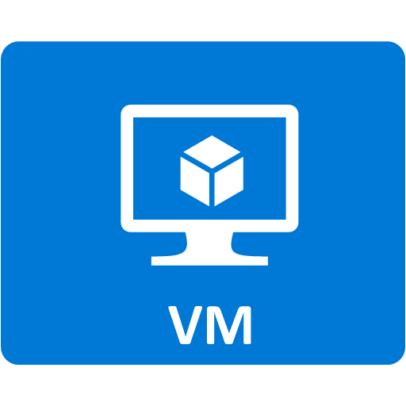


Resource groups
Resource groups
(web + DB, VM, Storage) in one group
A resource group is a container to manage and aggregate resources in a single unit.
Resources can exist in only one resource group.
Resources can exist in different regions.
Resources can be moved to different resource groups.
Applications can utilize multiple resource groups.
OR
Web and DB resource group
Virtual machine resource group
Storage resource group
© Copyright Microsoft Corporation. All rights reserved.
Notes:
https://docs.microsoft.com/learn/modules/describe-core-architectural-components-of-azure/6-describe-azure-management-infrastructure
Containers for multiple resources that share the same life cycle.
Aggregates resources into a single manageable unit.
Every Azure resource must exist in one (and only one) resource group.
Secure at the resource group
(or resource) level - using role-based access control (RBAC).
Learn and SkillPipe content order note:
Slides 11-13
https://docs.microsoft.com/en-us/learn/modules/azure-architecture-fundamentals/resources-resource-manager

Slide 18
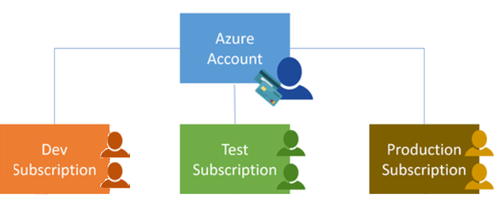
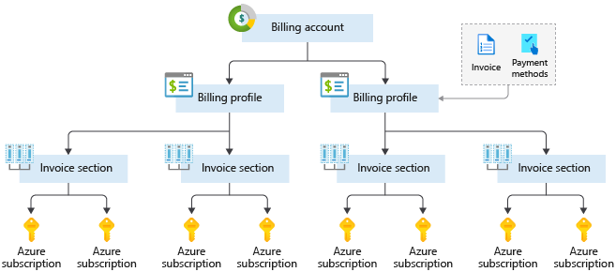
Azure Subscriptions
An Azure subscription provides you with authenticated and authorized access to Azure accounts.
Billing boundary: generate separate billing reports and invoices for each subscription.
Access control boundary: manage and control access to the resources that users can provision with specific subscriptions.
Notes:
https://docs.microsoft.com/learn/modules/describe-core-architectural-components-of-azure/6-describe-azure-management-infrastructure
An account can have one subscription or multiple subscriptions.
Azure subscription offers - https://azure.microsoft.com/en-us/support/legal/offer-details/
Learn and SkillPipe content order note:
Slides 14 & 16
https://docs.microsoft.com/en-us/learn/modules/azure-architecture-fundamentals/management-groups-subscriptions

Slide 19
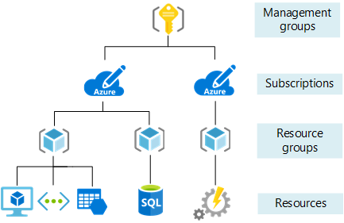
Management Groups
Management groups can include multiple Azure subscriptions.
Subscriptions inherit conditions applied to the management group.
10,000 management groups can be supported in a single directory.
A management group tree can support up to six levels of depth.
Notes:
https://docs.microsoft.com/learn/modules/describe-core-architectural-components-of-azure/6-describe-azure-management-infrastructure
Management groups can include multiple Azure subscriptions.
Subscriptions inherit conditions applied to the management group.
10,000 management groups can be supported in a single directory.
A management group tree can support up to six levels of depth.
Management groups - https://docs.microsoft.com/en-us/azure/governance/management-groups/
Learn and SkillPipe content order note:
Slides 14 & 16
https://docs.microsoft.com/en-us/learn/modules/azure-architecture-fundamentals/management-groups-subscriptions

Slide 20
Exercise – Create an Azure resource
Create an Azure resource, monitor the resource group for needed resources being created in the same group
Create a virtual machine.
Monitor the resource group.
Notes:
https://docs.microsoft.com/learn/modules/describe-core-architectural-components-of-azure/7-exercise-create-azure-resource/
Lab to create an Azure resource. A key component of this lab is noticing that when a VM is created, Azure automatically creates the necessary components (network, storage, etc) and groups them automatically in the same resource group.

Slide 21
Cloud Adoption Framework

Slide 22
Review the Cloud Adoption Framework
Adopt
Define Strategy
Understand motivations
Business outcomes
Business justification
Prioritize project
Plan
Digital estate
Initial organization alignment
Skills readiness plan
Cloud adoption plan
Ready
Azure readiness guide
First landing zone
Expand the blueprint
Best practice Validation
Migrate
• First workload migration
• Expanded scenarios
• Best practice validation
• Process improvements
Innovate
• Innovation guide
• Expanded scenarios
• Best practice validation
• Process improvements
Govern
Methodology • Benchmark
initial best practice • Governance maturity
Manage
Business commitments
operations baseline •
Ops maturity
Notes:
Cloud Adoption Strategy Evaluator
https://docs.microsoft.com/en-us/assessments/?mode=pre-assessment&session=local
The cloud adoption journey
https://azure.microsoft.com/cloud-adoption-framework/#cloud-adoption-journey
Azure migration guide overview
https://docs.microsoft.com/azure/cloud-adoption-framework/migrate/azure-migration-guide
Azure cloud migration best practices checklist
https://docs.microsoft.com/azure/cloud-adoption-framework/migrate/azure-best-practices
Microsoft Cloud Adoption Framework for Azure
https://docs.microsoft.com/learn/modules/microsoft-cloud-adoption-framework-for-azure/

Slide 23
Planning
  Azure suggest Power-Of-10 Approach
  Decisions
    Items to be migrated
    Migration approach
    Requirements
      Compliance
      SLA
  Don’t missing dependants components
  Cloud Adoption Strategy Evaluator

Slide 24
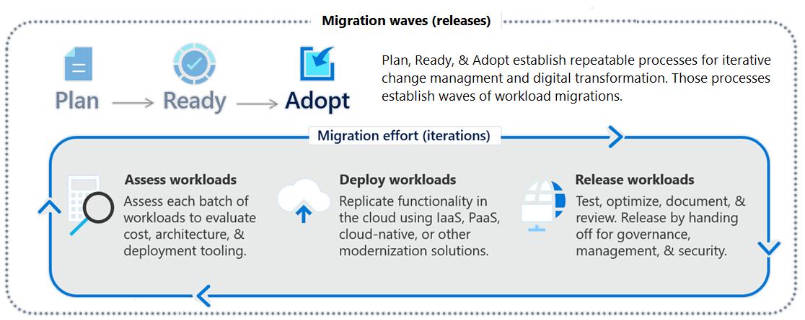
Focus on migration efforts
Notes:
Cloud Adoption Framework migration model - https://docs.microsoft.com/azure/cloud-adoption-framework/migrate/migration-considerations/
The One Migrate approach to migrating the IT portfolio - https://docs.microsoft.com/azure/cloud-adoption-framework/scenarios
Questions:
Why are we moving the solution to Azure?
What are the business objectives or quantifiable business goals?
What outcomes will you achieve?
Is there a timeline for building the solution Azure?
Is there a targeted event or date for an announcement about the solution's availability on Azure?

Slide 25
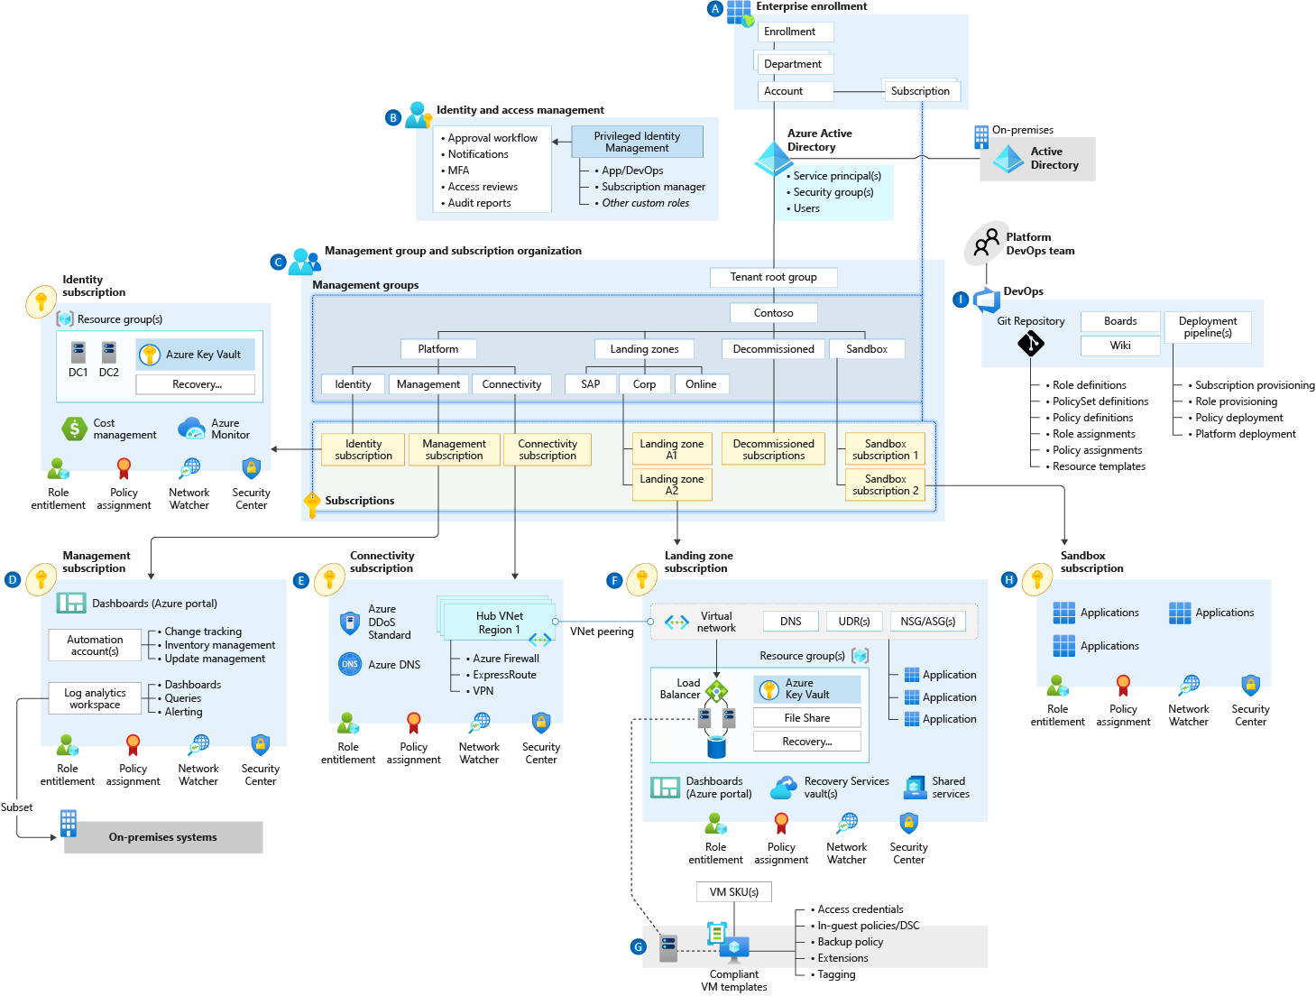
Azure Landing Zone (*)
Fast provision the Azure services
  Speed up
  Standardize
  Easy Config.
  Adapt to fast business change
5 Areas
  Workload
  Security
  Governance
  Networking
  Identity
Notes:
Azure landing zone
https://docs.microsoft.com/en-us/azure/cloud-adoption-framework/ready/landing-zone/
Example
https://docs.microsoft.com/en-us/azure/cloud-adoption-framework/ready/landing-zone/implementation-options
ALZ implementation option
https://docs.microsoft.com/en-us/azure/cloud-adoption-framework/ready/landing-zone/implementation-options

Slide 26
Cloud Migration Tools

Slide 27
Migration Stages
4 stages
  Assess your on-premises environment
    4 R’s approach
  Migrate your workloads
    Deploy cloud infrastructure targets
    Migrate workloads by tools/services
      Server
      Apps
      DB
      Data
    Decommission on-premises infrastructure
      Archive and Backup
  Optimize the migrated workloads
  Monitor your workloads

Slide 28




Determine your migration strategy
Select a strategy that meets your goals – you may need several strategies
Pattern | When to use
Rehost | Move workloads quickly to the cloud Don't need immediate changes to app capabilities
Refactor | Apply Azure DevOps practices or using a container strategy for workloads. Consider the portability of your existing code base and available development skills.
Rearchitect | Use existing application investments, Apps need major revisions for new features and to work effectively on a cloud platform.
Rebuild (new) | Rapid development and existing apps have limited functionality and lifespan. Expedite business innovation by using Azure DevOps practices. Legacy apps as no code or low apps in the cloud.
Notes:
Overview of application migration examples for Azure - https://docs.microsoft.com/azure/cloud-adoption-framework/migrate/azure-best-practices/contoso-migration-overview
The options Replace and Retire would not be considered migration strategies for the purposes of our discussion.

Slide 29
Identify migration tools
Tool | Usage
Cloud Adoption Strategy Evaluator (*) URL | Assesses your strategy posture across distinct areas of the Strategy methodology Identifying motivations Evaluating financial considerations Technical considerations in creating a business case
Azure Migrate: Server Assessment | Physical servers and on-premises VMs running in Hyper-V and VMware environments as preparation for migrating to Azure.
Azure Migrate: Server Migration (Example) | Physical servers and on-premises VMs running in Hyper-V, VMware environments, and other public cloud VMs.
Azure Migrate: Database Assessment | Performs an assessment of on-premises Microsoft SQL Server databases as preparation for migration to Azure SQL Database, an Azure SQL Managed Instance, or Azure VMs running Microsoft SQL Server.
Azure Migrate: Database Migration | Migrates data from your existing on-premises databases to databases running in Azure.
Azure Migrate: Web App Assessment | Assessment of on-premises web apps and migrates them to Azure.
Azure Migrate: Data Box | Move of large amounts of offline data to Azure by using Azure Data Box.
Notes:
Plan your Azure migration - https://docs.microsoft.com/learn/modules/design-your-migration-to-azure/2-plan-your-azure-migration
There are also optimization tools like Azure Cost Management and Azure Advisor. And other tools like TCO calculator and Service Map.
And more Integration Tools - https://docs.microsoft.com/azure/migrate/migrate-services-overview#integrated-tools.

Slide 30
Discussion
HKJC adoption readiness & migration planning
Business motivation and outcome?
  Concern? SLA? Business Commitment?
  Digital Estate? Power-Of-N planning?
  Adoption and Skill Readiness?
Any use cases?

Slide 31
Multi-Cloud Strategy by Azure Arc

Slide 32
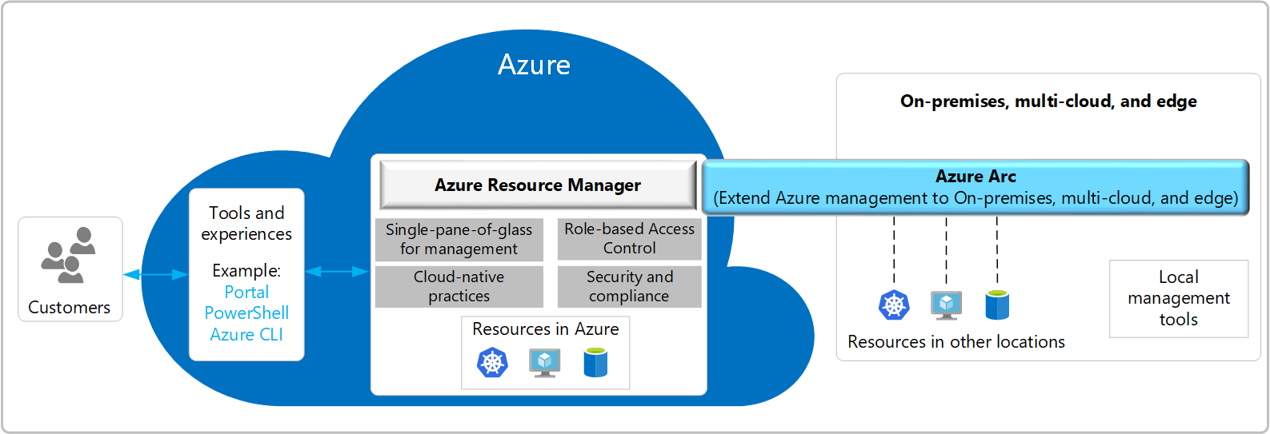
Azure Arc Overview
Notes:
Let us now have a bird's eye view of the Azure Arc service. Imagine we have resources…
Exta Info:
To support this momentum, Azure offers unique hybrid and multicloud capabilities that give customers the flexibility to innovate anywhere in their environment.
It’s starts with Azure Arc. Azure Arc enables you to standardize visibility, operations, and compliance across a wide range of resources and locations by extending the Azure control plane. Right from Azure, you can easily organize, govern, and secure Windows, Linux, SQL server, and Kubernetes clusters across data centers, edge, and multi-cloud.
Enabled by Azure Arc, you can bring Azure services to any existing infrastructure including other clouds you are using, so you can take advantage of cloud benefits everywhere, such as scalability, fast deployment, and always up-to-date cloud innovation.
You can build Azure-consistent new cloud infrastructure in your own datacenter with Azure Stack, so you can modernize your datacenter and run cloud native applications on-premises while taking advantage of existing investments and meeting regulatory compliances.
You can extend AI to edge devices with Azure IoT, so you can run machine learning and advanced analytics close to the users and the data. As a result, you can gain real-time insights and deliver immersive experiences at the edge of your network, opening up endless new business opportunities.
This is our portfolio of capabilities to support customer’s hybrid and multicloud strategy.
<CLICK>

Slide 33







Azure Arc – Enabled Infrastructure and Enabled Services
Microsoft Azure
Single control plane with Azure Arc
Azure Arc enabled infrastructure
Connect and operate hybrid resources
as native Azure resources
Azure Arc enabled services
Deploy and run Azure services outside of Azure while still operating it from Azure
Multi-cloud
Datacenter
Edge
Notes:
So, How does Azure Arc make all of this possible.
There are 2 key parts here:
The first part is, Azure Arc enabled infrastructure which enables us to connect our resources, which live outside of Azure today, and operate them as if they were native Azure resources, using the same management tools and services that Azure provides.
And the second is, Azure Arc enabled services, which gives us the flexibility to deploy fully managed Azure services anywhere – be it on-premises or in other public clouds so that we can take advantage of cloud benefits everywhere, such as scalability, faster deployment, and always up-to-date cloud innovation. The most awesome is that you can initiate and manage these deployments, right from the Azure Portal.
To summarize, Azure Arc is a set of technologies that unlocks new hybrid scenarios for our customers by extending Azure services and management to any infrastructure irrespective of where the infrastructure resides, so that customers can build, operate, and manage all of their resources in a consistent way across their entire IT estate.

Slide 34
The main components of Azure Arc
Azure
Custom locations
Azure Resource Manager
Azure Data Services
Azure Management
SQL
PostgreSQL
Resource specific tools
Azure Arc data agent
Azure Data Studio
Azure Portal
Identity
Azure Arc data RP
Azure Arc data controller
Azure CLI
Azure SDK
RBAC
Kubernetes
K8s Native Tools
Container registry
GitOps Manager
Azure PaaS Control
Cluster provisioning​
Cluster upgrade and patch management​
Cluster lifecycle management​
Cluster monitoring
Policy
Azure Arc K8s RP
Azure Arc K8s agent
K8s API
Groups
Etc.
Azure Arc server RP
Servers
Azure Arc server agent
Linux
Server Admin Tools
Azure Arc server agent
Windows Server
Azure Arc:
Notes:
Now, Let us understand about the key components of Azure Arc.
Just to summarize, it’s the Agents which do most of the heavy lifting here and make all the magic possible.
For more info:
We need a Kubernetes cluster as the orchestrating fabric in the environment to run Azure data services.
Azure SQL offers several different deployment and management options across IaaS and PaaS for the SQL Server engine hosted on Azure. While Azure Arc-enabled SQL Managed Instance provides the cloud Platform-as-a-Service benefits, SQL Server on Azure Arc-enabled servers provides capabilities similar to SQL Server in Azure Virtual Machines. To help your decision-making process.
https://azure.microsoft.com/en-in/services/azure-arc/hybrid-data-services/#faq

Slide 35
Azure Arc Key Benefits
Organize all resources using - Azure management groups, subscriptions, resource groups, and tags.​
Consolidated view via - Azure portal, CLI, PowerShell, and REST API.​
Policies​
Update Management​
Inventory​
Change Tracking​
Delegation of permissions using Role Based Access Control (RBAC).​
Extend Azure Monitor to on-premises and other clouds.​
Notes:
Let us now summarize the key benefits of Azure Arc.

Slide 36
back

Slide 37
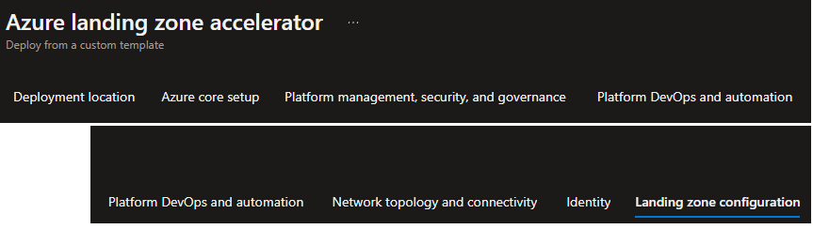
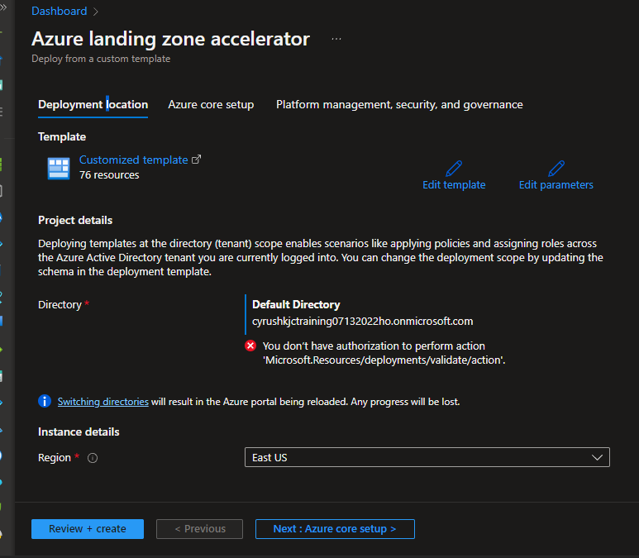
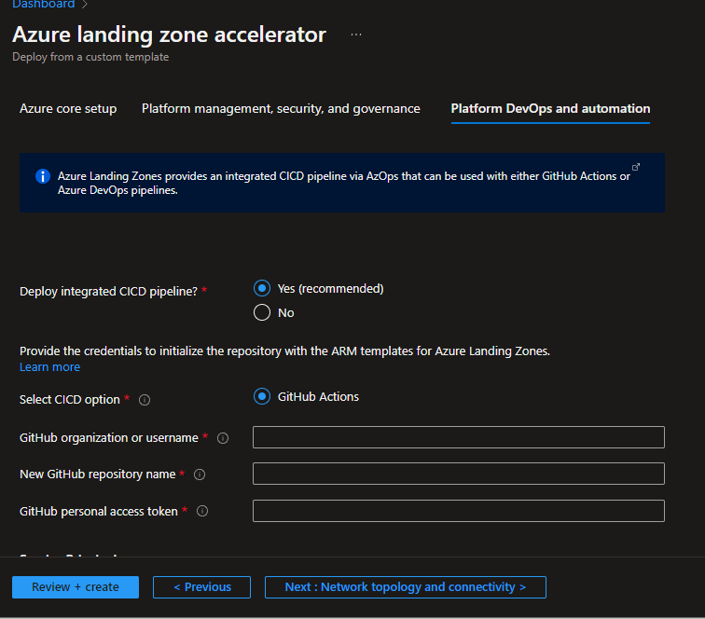
back

Slide 38
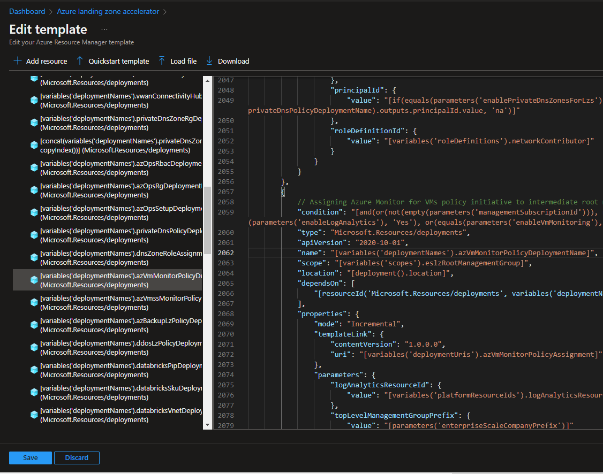
back

Slide 39
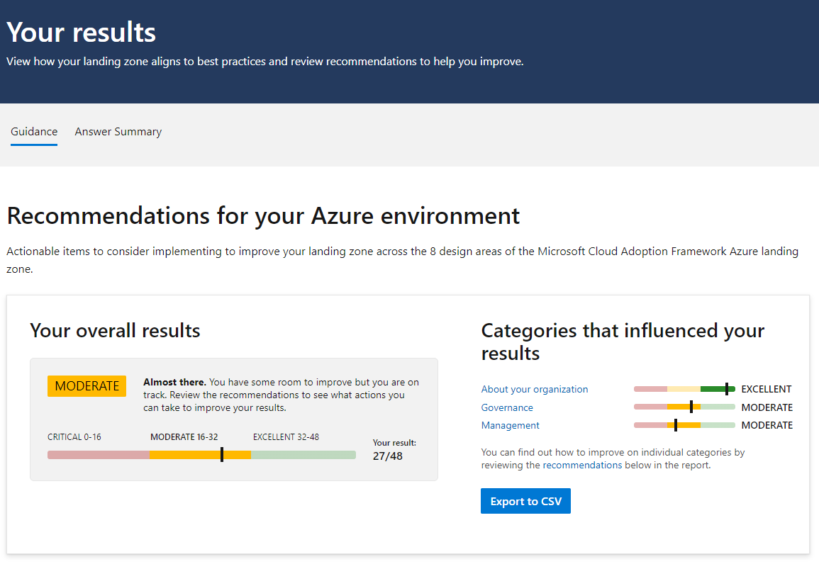
back

Slide 40
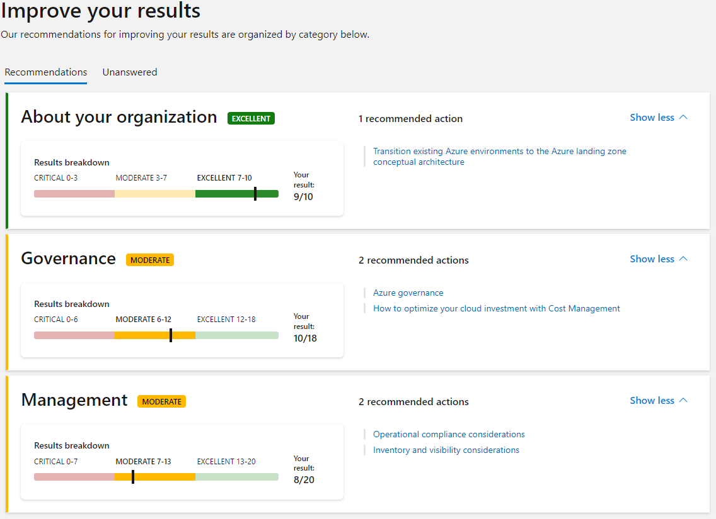
back

