Slide 1


Module 04:
Management And Goverance
Cyrus Cheng
ITSWS - FO Cashout Team

Slide 2

Module Outline

Slide 3

Module 03 – Outline
You will learn the following concepts:
Identity, Access, and Security
  Directory services
  Authentication methods
  Security models
Governance and compliance
  Blueprints, policies, and resource locks
  Service Trust portal
Resource deployment tools
  Portal, PowerShell, CLI, and others
  Azure Arc and Azure Resource Manager
Monitoring tools
  Azure Advisor, Azure Service Health, and Azure Monitor

Slide 4

Identity, Access, and Security
Notes:
https://docs.microsoft.com/learn/modules/describe-azure-identity-access-security

Slide 5

Azure Active Directory (AAD)
Azure Active Directory (AAD) is Microsoft Azure’s cloud-based identity and access management service.
  Authentication (employees sign-in to access resources).
  Single sign-on (SSO).
  Application management.
  Business to Business (B2B).
  Business to Customer (B2C) identity services.
  Device management.
Notes:
https://docs.microsoft.com/learn/modules/describe-azure-identity-access-security/2-directory-services
Azure AD - https://azure.microsoft.com/en-us/services/active-directory/
Azure tenant
A dedicated and trusted instance of Azure AD that's automatically created when your organization signs up for a Microsoft cloud service subscription, such as Microsoft Azure, Microsoft Intune, or Office 365. An Azure tenant represents a single organization.
Azure AD directory
Each Azure tenant has a dedicated and trusted Azure AD directory. The Azure AD directory includes the tenant's users, groups, and apps and is used to perform identity and access management functions for tenant resources.

Slide 6









Compare Authentication and Authorization
Authentication
Identifies the person or service seeking access to a resource.
Requests legitimate access credentials.
Basis for creating secure identity and access control principles.
Authorization
Determines an authenticated person’s or service’s level of access.
Defines which data they can access, and what they can do with it.
Notes:
https://docs.microsoft.com/learn/modules/describe-azure-identity-access-security/3-authentication-methods
✔️Authentication is sometimes shortened to AuthN, and authorization is sometimes shortened to AuthZ.
Authentication
Identifies the person or service seeking access to a resource.
Requests legitimate access credentials.
Basis for creating secure identity and access control principles.
Authorization
Determines an authenticated person’s or service’s level of access.
Defines which data they can access, and what they can do with it.
Learn and SkillPipe content order note:
https://docs.microsoft.com/en-us/learn/modules/secure-access-azure-identity-services/2-compare-authentication-authorization

Slide 7
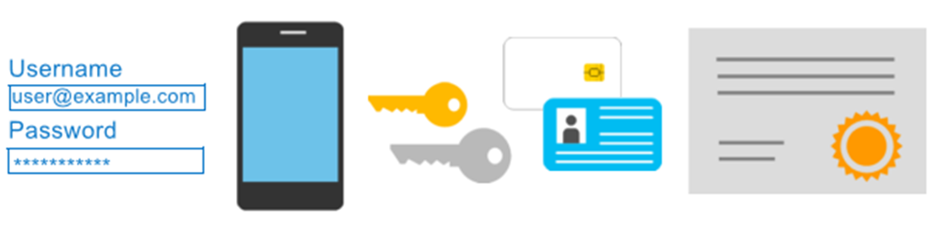
Azure Multi-Factor Authentication
Provides additional security for your identities by requiring two or more elements for full authentication.
  Something you know ←→ Something you possess ←→ Something you are
Notes:
https://docs.microsoft.com/learn/modules/describe-azure-identity-access-security/3-authentication-methods
Discuss what could qualify for each of the items listed
Something you know: This could be a password or the answer to a security question.
Something you possess: This might be a mobile app that receives a notification, or a token-generating device.
Something you are: This is typically some sort of biometric property, such as a fingerprint or face scan used on many mobile devices.
MFA - https://docs.microsoft.com/en-us/azure/active-directory/authentication/concept-mfa-howitworks
Learn and SkillPipe content order note:
Slides 7 & 9
https://docs.microsoft.com/en-us/learn/modules/secure-access-azure-identity-services/2-compare-authentication-authorization

Slide 8
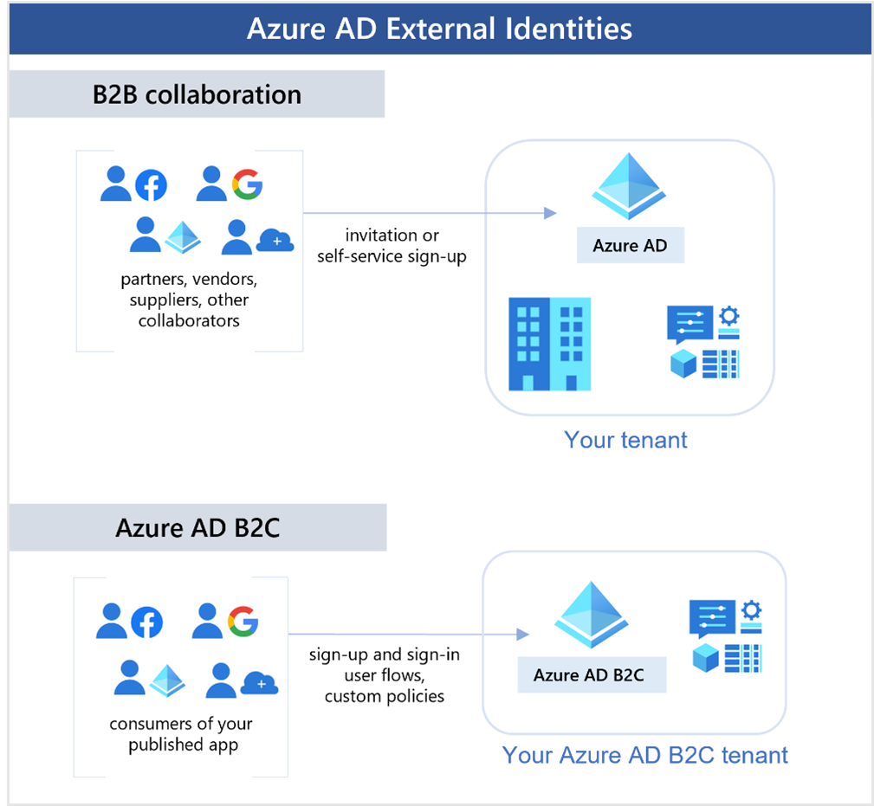
External Identities
Notes:
https://docs.microsoft.com/learn/modules/describe-azure-identity-access-security/4-external-identities

Slide 9
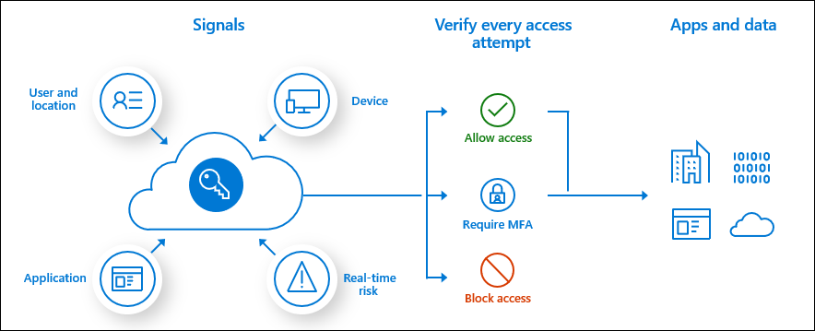
Conditional Access
Conditional Access is used by Azure Active Directory to bring signals together, to make decisions, and enforce organizational policies.
User or Group Membership
IP Location
Device
Application
Risk Detection
Notes:
https://docs.microsoft.com/learn/modules/describe-azure-identity-access-security/5-conditional-access
https://docs.microsoft.com/en-us/azure/active-directory/conditional-access/overview
The modern security perimeter now extends beyond an organization's network to include user and device identity. Organizations can utilize these identity signals as part of their access control decisions.
Conditional Access is the tool used by Azure Active Directory to bring signals together, to make decisions, and enforce organizational policies. Conditional Access is at the heart of the new identity driven control plane.
Conditional Access policies at their simplest are if-then statements, if a user wants to access a resource, then they must complete an action. Example: A payroll manager wants to access the payroll application and is required to perform multi-factor authentication to access it.
Administrators are faced with two primary goals:
Empower users to be productive wherever and whenever
Protect the organization's assets
By using Conditional Access policies, you can apply the right access controls when needed to keep your organization secure and stay out of your user's way when not needed.
Learn and SkillPipe content order note:
Slides 7 & 9
https://docs.microsoft.com/en-us/learn/modules/secure-access-azure-identity-services/2-compare-authentication-authorization

Slide 10






Explore Role-based access control (RBAC)
Fine-grained access management.
Segregate duties within the team and grant only the amount of access to users that they need to perform their jobs.
Enables access to the Azure portal and controlling access to resources.
Azure
Active Directory
Azure
subscription
User
Apps
User groups
Resource group
Resource group
Notes:
https://docs.microsoft.com/learn/modules/describe-azure-identity-access-security/6-role-based-access-control
Azure RBAC - https://docs.microsoft.com/en-us/azure/role-based-access-control/overview
Learn and SkillPipe content order note:
https://docs.microsoft.com/en-us/learn/modules/build-cloud-governance-strategy-azure/4-control-access-azure-rbac

Slide 11
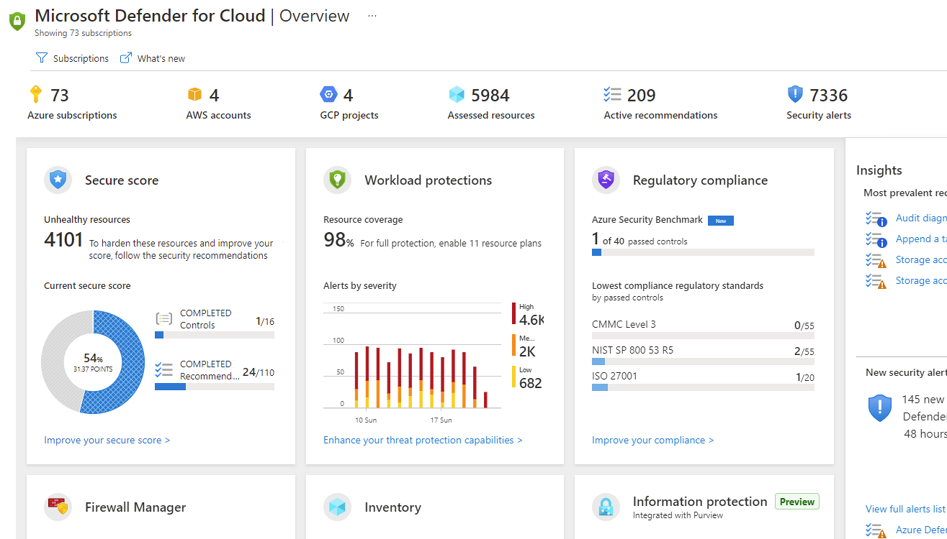
Microsoft Defender for Cloud
Microsoft Defender for Cloud is a monitoring service that provides threat protection across both Azure and on-premises datacenters.
Provides security recommendations
Detect and block malware
Analyze and identify potential attacks
Just-in-time access control for ports
Notes:
https://docs.microsoft.com/learn/modules/describe-azure-identity-access-security/9-describe-microsoft-defender-for-cloud
Microsoft Defender for Cloud is a unified infrastructure security management system that strengthens the security posture of your data centers and provides advanced threat protection across your hybrid workloads in the cloud - whether they're in Azure or not - as well as on premises.
Strengthen security posture: Defender for Cloud assesses your environment and enables you to understand the status of your resources, and whether they are secure.
Protect against threats: Defender for Cloud assesses your workloads and raises threat prevention recommendations and security alerts.
Get secure faster: In Defender for Cloud, everything is done in cloud speed. Because it is natively integrated, deployment is easy, providing you with auto-provisioning and protection with Azure services.
Policy compliance
Defender for Cloud is built on top of Azure Policy controls so you can set and monitor your policies to run on management groups, across subscriptions, and even for a whole tenant.
Security alerts
Defender for Cloud automatically collects, analyzes, and integrates log data from your Azure resources like firewall and endpoint protection to detect real threats. Then list of prioritized security alerts is shown in Microsoft Defender for Cloud along with the information you need to quickly investigate and remediate an attack.
Secure score
Defender for Cloud continually assesses your resources for security issues; then aggregates all the findings into a single score so that you can tell your current security situation.
Microsoft Defender for Cloud - https://azure.microsoft.com/en-us/services/defender-for-cloud/
Learn and SkillPipe content order note:
Slides 6 & 8-9
https://docs.microsoft.com/en-us/learn/modules/protect-against-security-threats-azure/2-protect-threats-security-center

Slide 12

Governance and compliance
Notes:
https://docs.microsoft.com/learn/modules/describe-features-tools-azure-for-governance-compliance

Slide 13

Azure Policy
Azure Policy helps to enforce organizational standards and to assess compliance at-scale. Provides governance and resource consistency with regulatory compliance, security, cost, and management.
  Evaluates and identifies Azure resources that do not comply with your policies.
  Provides built-in policy and initiative definitions, under categories such as Storage, Networking, Compute, Security Center, and Monitoring.
Notes:
https://docs.microsoft.com/learn/modules/describe-features-tools-azure-for-governance-compliance/3-describe-purpose-of-azure-policy
Azure Policy - https://azure.microsoft.com/en-us/services/azure-policy
Stay compliant with your corporate standards and service level agreements (SLAs) by using policy definitions to enforce rules and effects for your Azure resources.
Evaluates and identifies Azure resources that do not comply with your policies.
Provides built-in policy and initiative definitions, under categories such as Storage, Networking, Compute, Security Center, and Monitoring.

Slide 14

Azure Blueprints
Azure Blueprints makes it possible for development teams to rapidly build and stand up new environments. Development teams can quickly build trust through organizational compliance with a set of built-in components (such as networking) in order to speed up development and delivery.
Role Assignments
Policy Assignments
Azure Resource Manager Templates
Resource Groups
Notes:
https://docs.microsoft.com/learn/modules/describe-features-tools-azure-for-governance-compliance/2-describe-purpose-of-azure-blueprints
Azure Blueprints - https://azure.microsoft.com/en-us/services/blueprints/

Slide 15
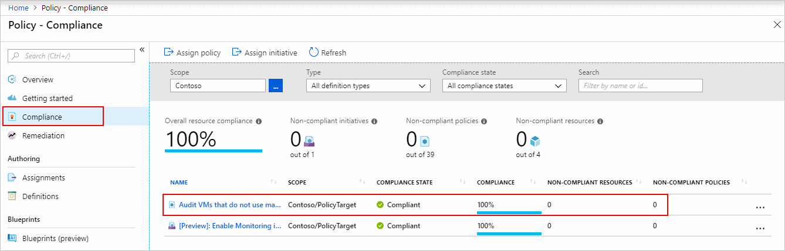

Identifying Non-Compliant Resources
Use the applied policy definition to identify resources that aren't compliant with the policy assignment using the Azure portal

Slide 16
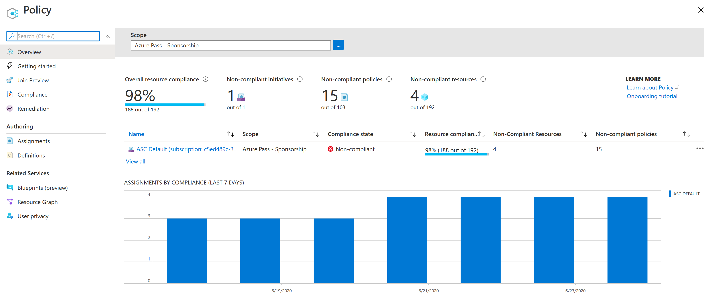
View Policy Evaluation Results
Lorem

Slide 17
Resource locks
Protect your Azure resources from accidental deletion or modification.
Manage locks at subscription, resource group, or individual resource levels within Azure Portal.
Lock Types | Read | Update | Delete
Delete | Yes | Yes | No
ReadOnly | Yes | No | No
Notes:
https://docs.microsoft.com/learn/modules/describe-features-tools-azure-for-governance-compliance/4-describe-purpose-of-resource-locks
Resource Locks - https://docs.microsoft.com/en-us/azure/azure-resource-manager/resource-group-lock-resources

Slide 18
Tags
Provides metadata for your Azure resources.
Logically organizes resources into a taxonomy.
Consists of a name-value pair.
Very useful for rolling up billing information.
OR
owner: joe
department: marketing
environment: production
cost-center: marketing
Notes:
https://docs.microsoft.com/learn/modules/describe-cost-management-azure/7-describe-purpose-of-tags
Tags - https://docs.microsoft.com/en-us/azure/azure-resource-manager/resource-group-using-tags

Slide 19
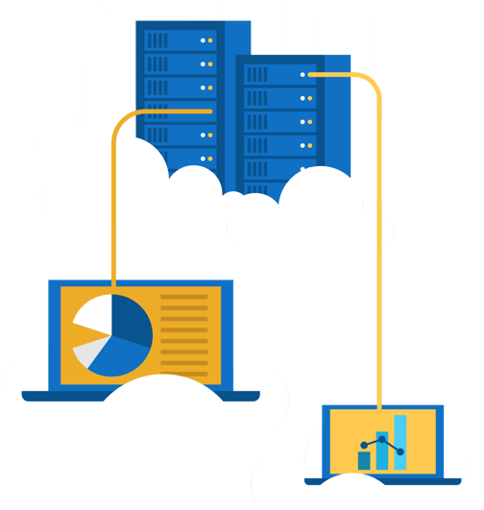
Walkthrough - Manage Resource Locks
  Create a resource add a lock and modification.
  Create a resource.
  Add a ReadOnly resource lock to prevent resource modification.
  Update lock and retest.
  Remove the resource lock.
  Delete the resource.
Notes:
https://docs.microsoft.com/learn/modules/describe-features-tools-azure-for-governance-compliance/5-exercise-configure-resource-lock
NOTE: This is a bring your own subscription exercise. This will fully work in the Azure free trial, but the learner will need an actual Azure subscription for this exercise. May be better to do as a demo.

Slide 20
Management and deployment tools
Notes:
https://docs.microsoft.com/learn/modules/describe-features-tools-for-managing-deploying-azure-resources

Slide 21





Tools for interacting with Azure
Azure Portal
Azure PowerShell
Command-Line Interface (CLI)
Azure Cloud Shell
Notes:
https://docs.microsoft.com/learn/modules/describe-features-tools-for-managing-deploying-azure-resources/2-describe-interacting-azure

Slide 22
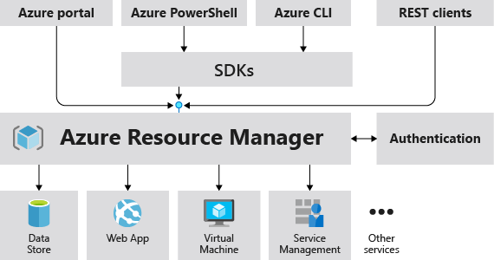
Azure Resource Manager
The Azure Resource Manager (ARM) provides a management layer that enables you to create, update, and delete resources in your Azure subscription.
© Copyright Microsoft Corporation. All rights reserved.
Notes:
https://docs.microsoft.com/learn/modules/describe-features-tools-for-managing-deploying-azure-resources/4-describe-azure-resource-manager-azure-arm-templates
Provides a management layer that enables you to create, update, and delete resources in your Azure subscription.
Create, configure, manage and delete resources and resource groups.
Organizes resources.
Controls access and resources.
Automates using different tools and SDKs.
Stores layouts in JSON files.
You can view more details about Azure Resource Manager at https://docs.microsoft.com/en-us/azure/azure-resource-manager

Slide 23
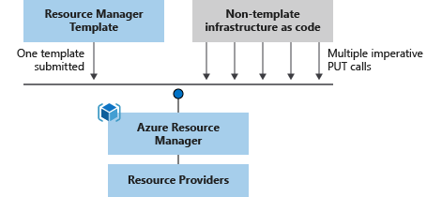
Azure Resource Manager (ARM) templates
Azure Resource Manager (ARM) templates are JavaScript Object Notation (JSON) files that can be used to create and deploy Azure infrastructure without having to write programing commands.
Declarative syntax
Repeatable results
Orchestration
Modular files
Built-in validation
Exportable code
Notes:
https://docs.microsoft.com/learn/modules/describe-features-tools-for-managing-deploying-azure-resources/4-describe-azure-resource-manager-azure-arm-templates
https://azure.microsoft.com/en-us/features/resource-manager/
https://docs.microsoft.com/en-us/azure/azure-resource-manager/management/overview
https://docs.microsoft.com/en-us/azure/azure-resource-manager/templates/overview
Deploy app resources Azure Resource Manager enables you to repeatedly deploy your app and have confidence your resources are deployed in a consistent state. You define the infrastructure and dependencies for your app in a single declarative template. This template is flexible enough to use for all of your environments such as test, staging or production. If you create a solution from the Azure Marketplace, the solution will automatically include a template that you can use for your app.
Organize resources
Azure Resource Manager makes it easy for you to manage and visualize resources in your app. You no longer have to deploy parts of your app separately and then manually stitch them together. You put resources with a common lifecycle into a resource group that can be deployed or deleted in a single action. You can see which resources are linked by a dependency. You can apply tags to resources to categorize them for management tasks, such as billing.
Control access to resources
With Azure Resource Manager, you can control who in your organization can perform actions on the resources. You manage permissions by defining roles and adding users or groups to the roles. For critical resources, you can apply an explicit lock that prevents users from deleting or modifying the resource. Azure Resource Manager logs all user actions so you can audit those actions. For each action, the audit log contains information about the user, time, events, and status.

Slide 24
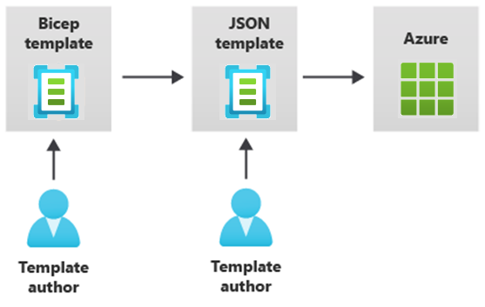

Provision resources with Infrastructure as Code
Azure supports IaC with Azure Resource Manager and third-party platforms.
  Azure Resource Manager templates – Bicep, JSON
  Azure Automation
  Azure DevOps services
  GitHub actions
  Terraform
  Jenkins
Notes:
Student content does not cover all the options shown on the slide.
Azure Resource Manager (ARM) templates - https://docs.microsoft.com/azure/azure-resource-manager/templates/overview
Bicep - https://docs.microsoft.com/azure/azure-resource-manager/bicep/overview
Automation deployment - https://docs.microsoft.com/azure/virtual-machines/infrastructure-automation
Azure DevOps documentation - https://docs.microsoft.com/azure/devops
GitHub Actions - https://docs.github.com/actions
Terraform by Hashicorp - https://www.terraform.io/
Jenkins - https://www.jenkins.io/
Could also mention:
Python with Pulumi - https://devblogs.microsoft.com/devops/infrastructure-as-code-azure-python-wpulumi/
Chef Automate - https://docs.chef.io/azure_marketplace/
Ansible - https://docs.microsoft.com/azure/developer/ansible/overview
And:
Azure Chaos Studio - https://azure.microsoft.com/services/chaos-studio/

Slide 25
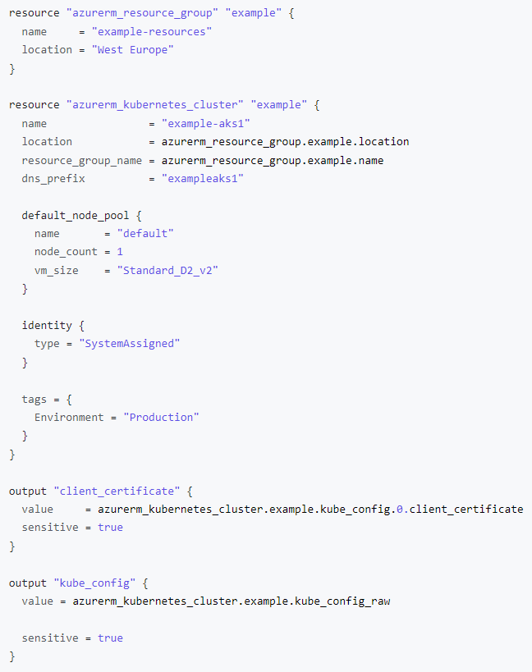
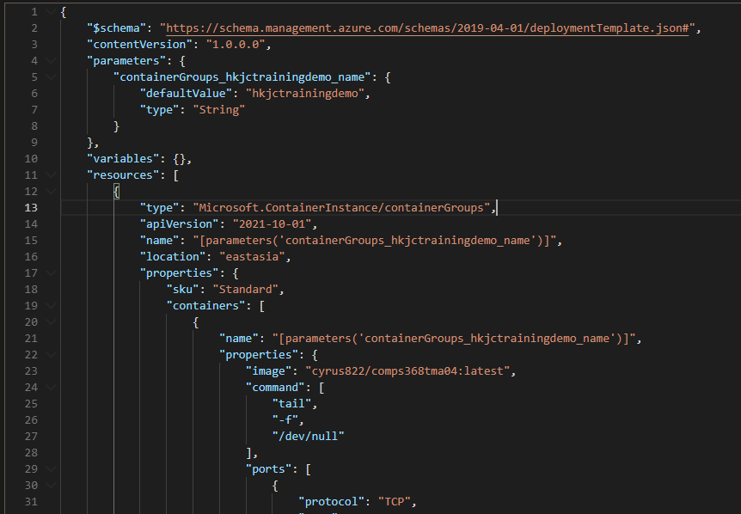

Slide 26

Azure monitoring tools
Notes:
https://docs.microsoft.com/learn/modules/describe-monitoring-tools-azure

Slide 27
Azure Management Tools - Objective Domain
Describe the functionality and usage of:
Describe the purpose of Azure Advisor.
Describe Azure Service Health.
Describe Azure Monitor, including Azure Log Analytics, Azure Monitor Alerts, and Application Insights.

Slide 28

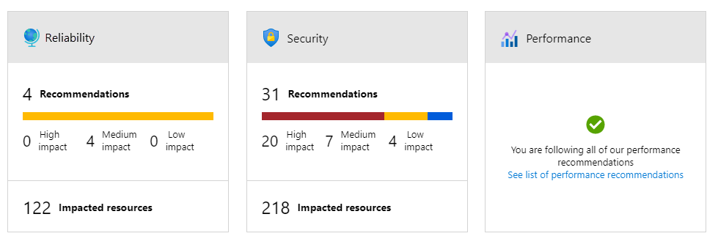
Azure Advisor
Azure Advisor analyzes deployed Azure resources and makes recommendations based on best practices to optimize Azure deployments.
Reliability
Security
Performance
Cost
Operational Excellence
© Copyright Microsoft Corporation. All rights reserved.
Notes:
https://docs.microsoft.com/learn/modules/describe-monitoring-tools-azure/2-describe-purpose-of-azure-advisor
Get proactive, actionable, and personalized best practice recommendations.
Improve the performance, security, and availability of your resources.
Identify opportunities to reduce your Azure costs.
Azure Advisor - https://docs.microsoft.com/en-us/azure/advisor/

Slide 29
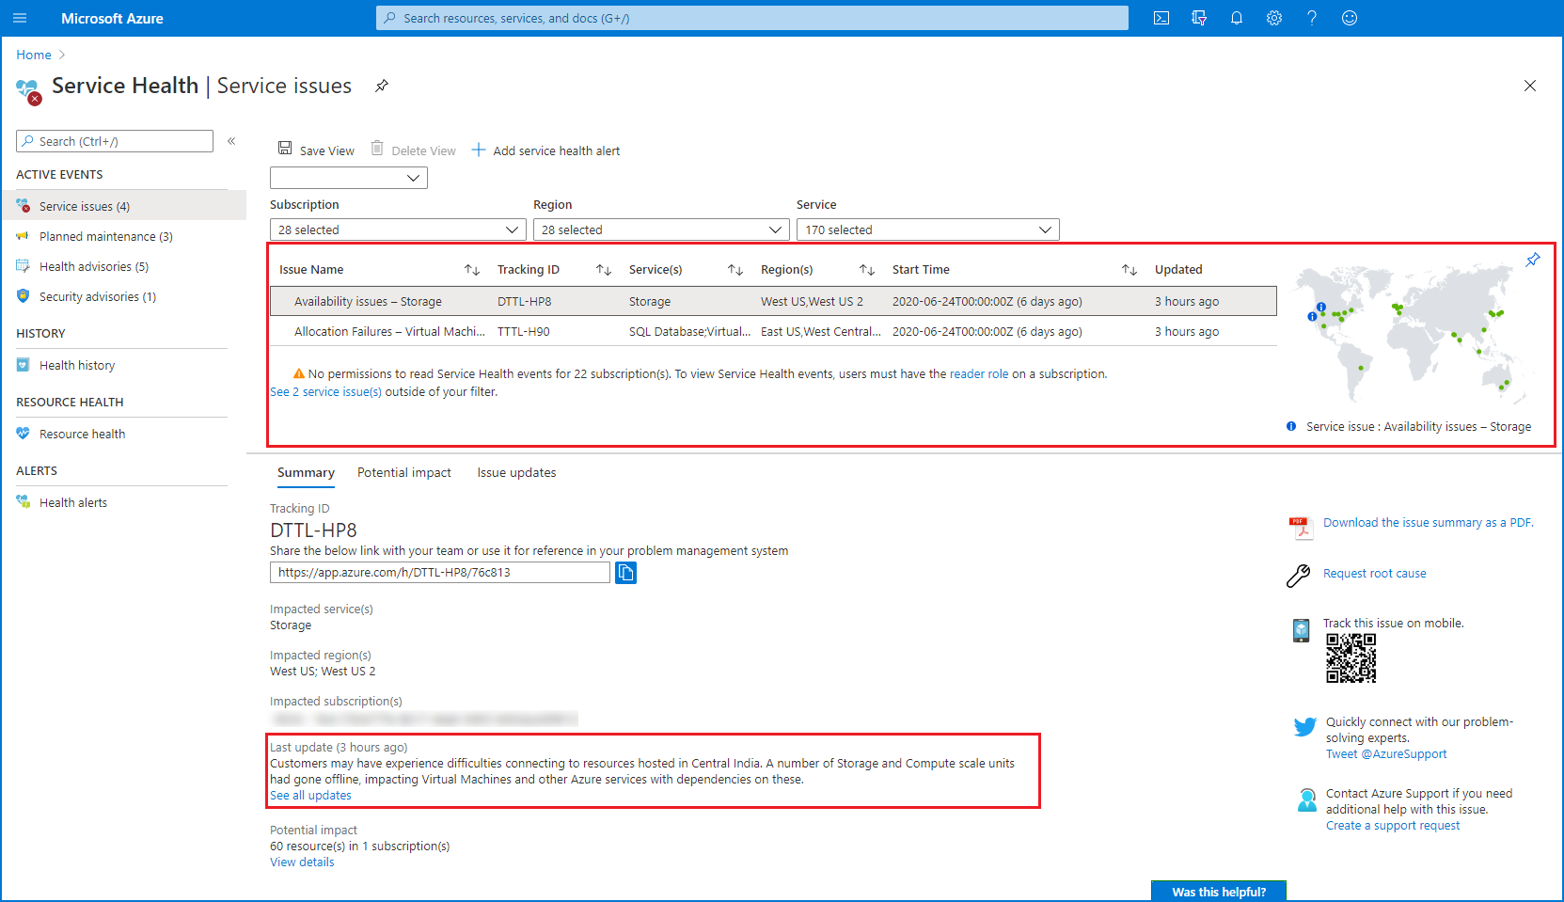

Azure Service Health
Evaluate the impact of Azure service issues with personalized guidance and support, notifications, and issue resolution updates.
Notes:
https://docs.microsoft.com/learn/modules/describe-monitoring-tools-azure/3-describe-azure-service-health

Slide 30
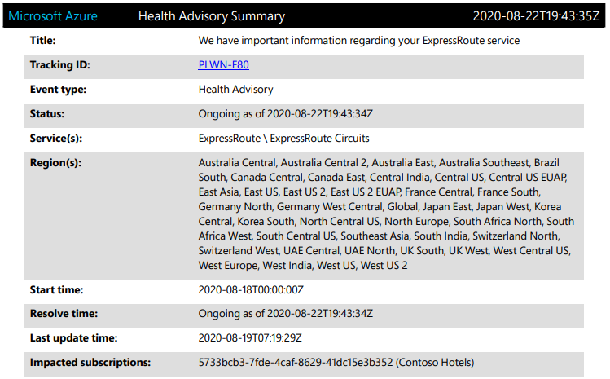
Azure Service Health (continued)
Azure Service Health provides a personalized view of the health of Azure services and the regions being used.
Communication regarding outages
Planned maintenance
Other health advisories
Notes:
https://docs.microsoft.com/learn/modules/describe-monitoring-tools-azure/3-describe-azure-service-health

Slide 31

Azure Monitor
Azure Monitor maximizes the availability and performance of applications and services by collecting, analyzing, and acting on telemetry from cloud and on-premises environments.
Application Insights
Log Analytics
Smart Alerts
Automation Actions
Customized Dashboards
Notes:
https://docs.microsoft.com/learn/modules/describe-monitoring-tools-azure/4-describe-azure-monitor

