Slide 1
BReast CAncer Genes
Compared Across Species
Cyrus Liang and Patrick Solis

Slide 2
Background

Slide 3
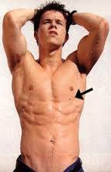
Problem
Breast and ovarian cancer susceptibility gene (BRCA1)
Humans vs. Other mammals
Feasibility test
Notes:
Cyrus

Slide 4


Importance
American women have a 1 in 8 chance of developing breast cancer
Between 1 in 400 and 1 in 800 people have a BRCA1/2 mutation
Learning more
Notes:
Cyrus

Slide 5
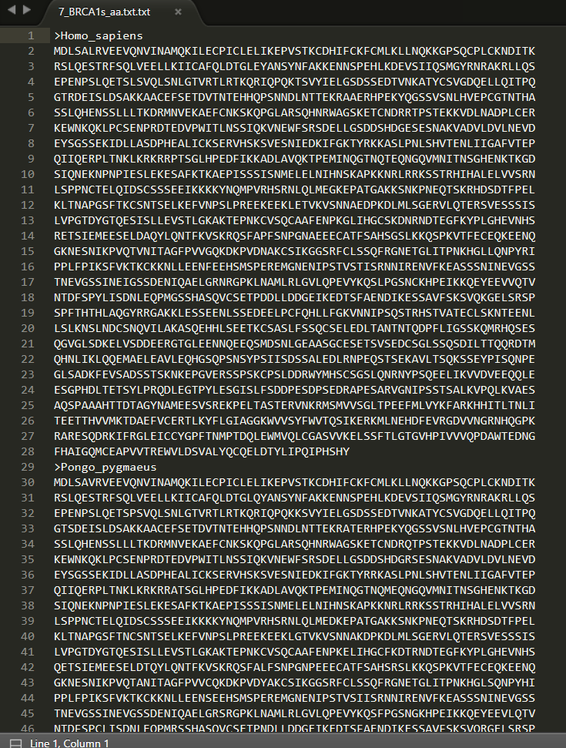
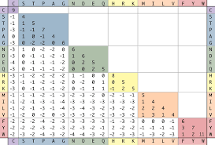
Data Type
Amino Acid Sequence
Difference Table
WPGMA guide tree
Notes:
Cyrus

Slide 6


Type of Analysis
Comparing our methods with professional methods
Notes:
Cyrus

Slide 7

Expected Results
Less than perfect
Learning by doing
Notes:
Cyrus

Slide 8
Method

Slide 9
Data
Amino Acid Strings from NCBI
Notes:
Cyrus

Slide 10

Procedure
Sequence comparing
Protein comparing to find biologically important patterns
Lab: “BRCA1: Good gene, bad name”
Notes:
Cyrus

Slide 11






Procedure
Multiple sequence alignment in Java
WPGMA guide tree in Java
Netbeans and Eclipse
GitHub and Google Drive
Slack and Text Messaging
Notes:
Cyrus

Slide 12
Sequence Alignment

Slide 13
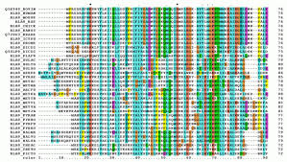
Sequence Alignment
Main 146, Global Alignment 153, Grid 383
BLOSUM62 Substitution Matrix
Notes:
Cyrus

Slide 14
Main
java.io.*
java.util.ArrayList
Input.txt
File paths
Pair scores
Output.txt
Notes:
Cyrus

Slide 15
Global Alignment
Sequence A
Sequence B
Get Best Score:
Nested for-loop search
Get Global Score
Notes:
Cyrus

Slide 16
Grid
2D Integer Array
Populate Grid using sequence A and B
Nested for-loop
BLOSUM62 Substitution Matrix:
Switch / Case: Switch / Case
Get Score
Notes:
Cyrus

Slide 17
WPGMA Tree

Slide 18
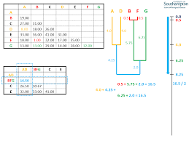
WPGMA Tree
Main, Tree, Node
Clustering pairs to create a guide tree

Slide 19
Scores to Grid
First two lines:
Number of amino acid sequences
Number of output scores
Nodes
2D array

Slide 20
Pairing Process
Minimum value
Levels
Node names
Clustering
Nodes stored in pairedSequences

Slide 21
Printing
Specific levels
Ultrametric

Slide 22
Results

Slide 23
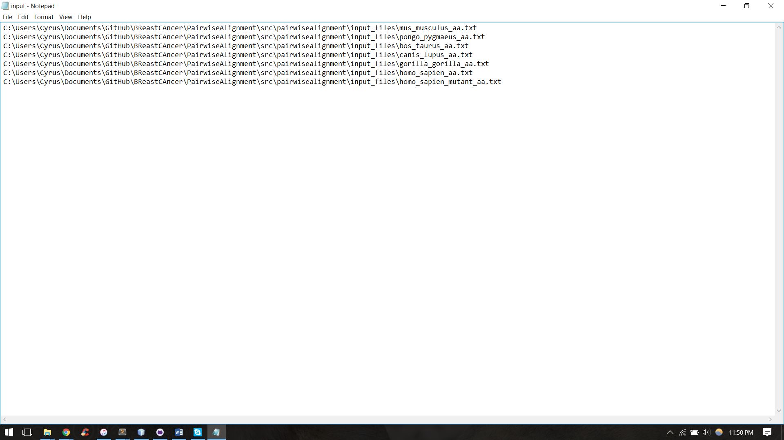
Figure 1: “input.txt” input file for Pairwise Alignment

Slide 24
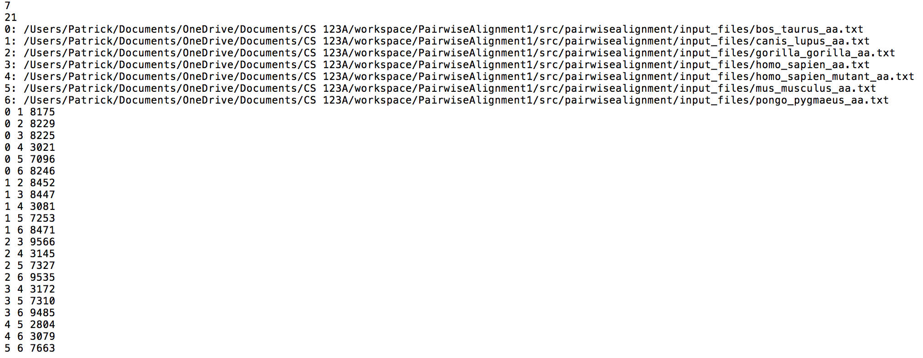
Figure 2: “output.txt” output file for Pairwise Alignment and input file for WPGMA Tree

Slide 25
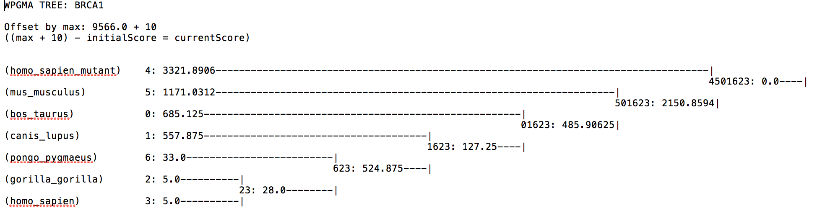
Figure 3: “tree.txt” output file for WPGMA tree

Slide 26
Discussion

Slide 27
Executive Summary
7 Amino acid sequences processed
BLOSUM62 used for scores
Difference table creates Grid
Grid to WPGMA Tree

Slide 28
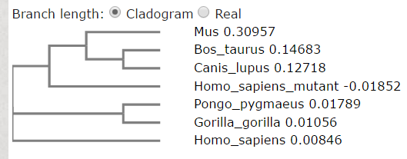
Executive Summary
WPGMA guide tree vs. Professional Phylogenetic Tree
EMBL-EBI’s Clustal Omega and Phylogeny

Slide 29
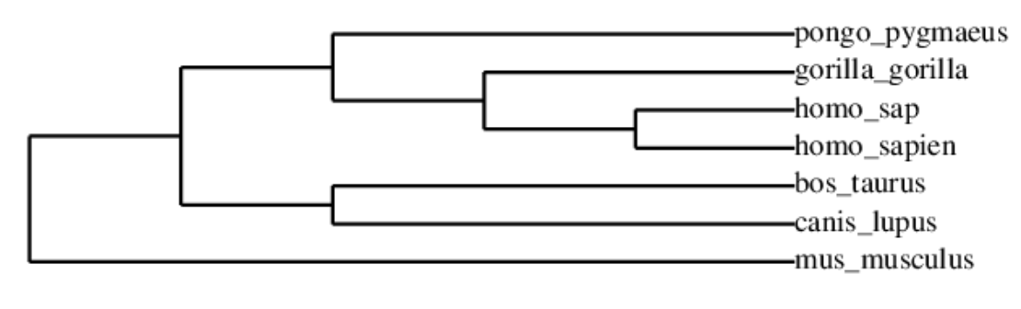
WPGMA Tree from WPGMA Program
Phylogenetic Tree generated by www.phylogency.fr

Slide 30
Executive Summary
Professional Software:
Free
Easy
Reliable
Creating our own: learning by doing

Slide 31
Data Interpretation
Modern Humans and Primates
Humans, Dogs, and Mice
Mice and Mutated Modern Humans

Slide 32
Improvements
Comparing our guide tree versus the professional phylogenetic tree
Contrasts
Algorithm for local alignment
Cluster grouping and resizing

Slide 33
Next Steps
Can mutation in BRCA1 Gene cause breast/ovarian cancer in other species
Likelihood of other species developing breast/ovarian cancer
Any other mutations in humans be similar to mutations in other species

Slide 34
References
Easton, D. F., Deffenbaugh, A. M., Pruss, D., Frye, C., Wenstrup, R. J., Allen-Brady, K., ... & Goldgar, D. E. (2007). A systematic genetic assessment of 1,433 sequence variants of unknown clinical significance in the BRCA1 and BRCA2 breast cancer–predisposition genes. The American Journal of Human Genetics, 81(5), 873-883.
Herschkowitz, J. I., Simin, K., Weigman, V. J., Mikaelian, I., Usary, J., Hu, Z., ... & Backlund, M. G. (2007). Identification of conserved gene expression features between murine mammary carcinoma models and human breast tumors. Genome biology, 8(5), 1.
Szabo, C. I., Wagner, L. A., Francisco, L. V., Roach, J. C., Argonza, R., King, M. C., & Ostrander, E. A. (1996). Human, canine and murine BRCA1 genes: sequence comparison among species. Human molecular genetics, 5(9), 1289-1298.
Welcsh, P. L., Owens, K. N., & King, M. C. (2000). Insights into the functions of BRCA1 and BRCA2. Trends in Genetics, 16(2), 69-74.

