Slide 1

Image Object Identification on AWS with YOLOv5
Serverless: Lambda container image, API Gateway, S3 and DynamoDB
Sirous Namjoo | Student 240344
ICT5205 Cloud Computing, Assessment 2
github.com/CyrusNamjoo/ict5205-yolov5-aws-serverless
Real output of my Lambda function

Slide 2




What I wanted to build and why it is not easy
Run a real deep learning model in Lambda
YOLOv5s with PyTorch. PyTorch alone is bigger than the 250 MB limit of a Lambda zip package.
Constraints I worked with
Personal account on the AWS Free plan
t3.large blocked, so EC2 is m7i-flex.large
Lambda concurrency limit: only 10
Lambda init limit: 10 seconds
API Gateway timeout: 29 seconds
No GPU: CPU-only PyTorch
Secure, separate layers
API key, usage plan and validation in front; raw images, results and summaries in separate storage.
Measure, then optimise
Cold starts, memory size and concurrency tested with my own test client, not guessed.
Reproducible
The whole stack can be created again with one CloudFormation command.

Slide 3
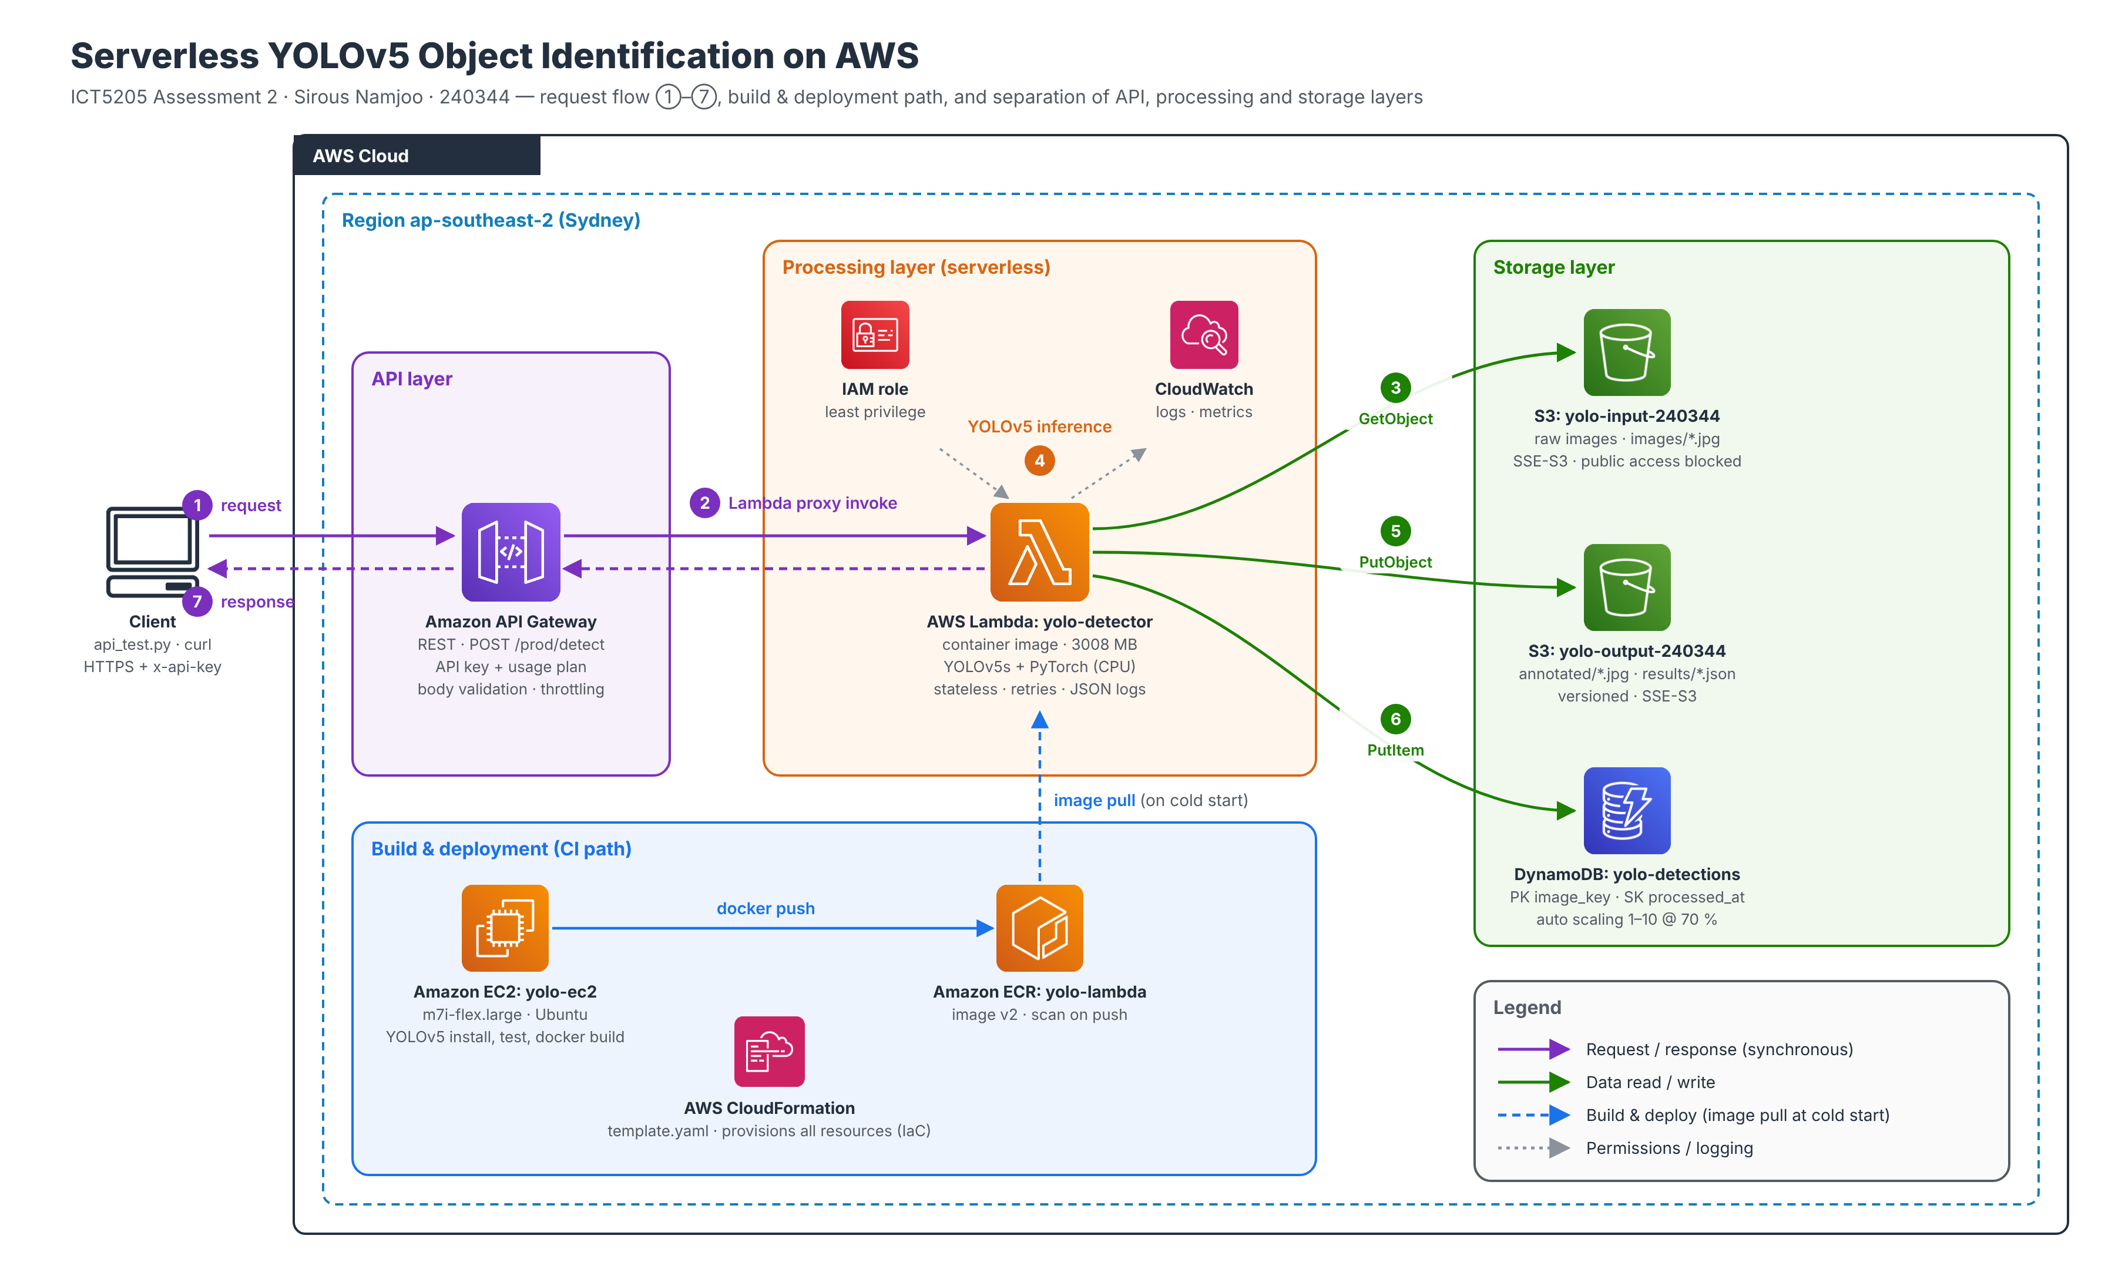
Architecture: three layers, one clear request path

Slide 4
How I built it, step by step
1
2
3
4
5
6
7
IAM + S3
EC2 + YOLOv5
Docker + ECR
Lambda
DynamoDB
API Gateway
CloudFormation
Admin user with MFA, budget alert, two private encrypted buckets, COCO128 images
m7i-flex.large, CPU PyTorch, tested on my S3 images (115 ms per image)
Lambda base image, YOLOv5 and weights inside, built on EC2, pushed to ECR
Container function, 3008 MB, validation, retries, JSON logs
image_key + processed_at keys, auto scaling 1 to 10 @ 70 %
REST POST /detect, API key, usage plan, body validation, throttling
template.yaml: 21 resources, one command, tested end to end

Slide 5
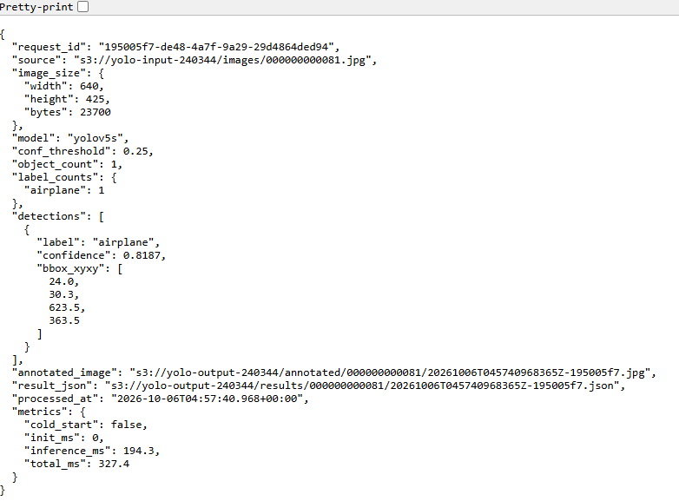
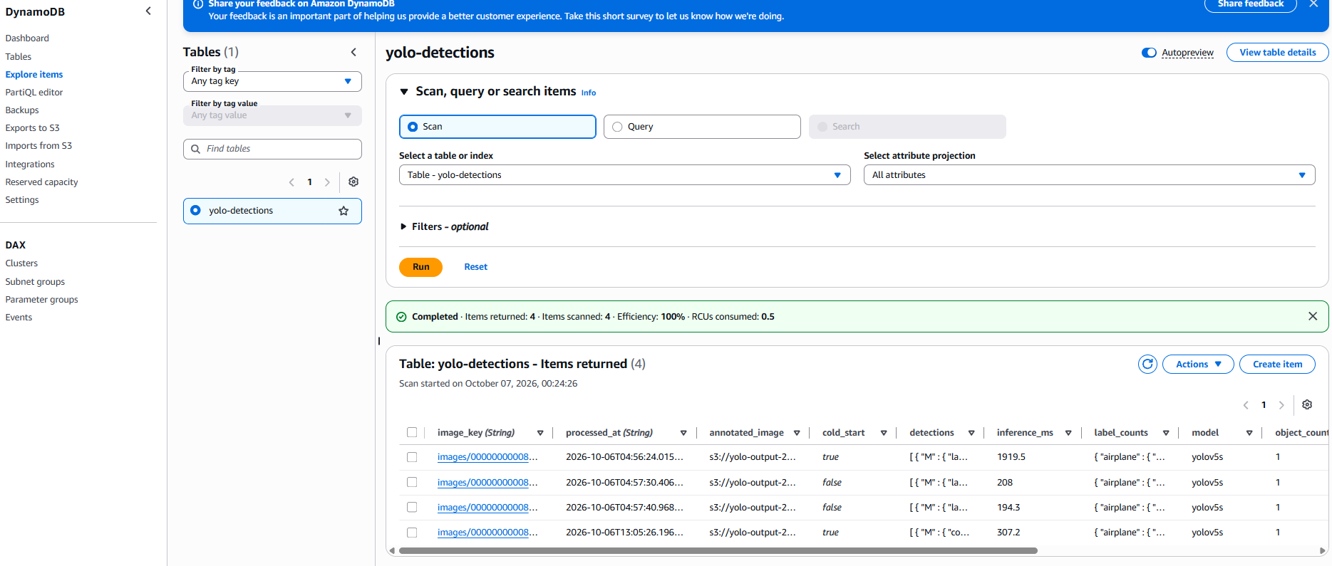
Output: the pipeline works end to end
0.4 s
warm request, end to end via the API
185 ms
YOLOv5s inference on Lambda (115 ms on EC2)
Annotated image saved in S3 by Lambda
Full JSON result in S3
80
COCO classes, e.g. 10 persons, 4 cups and 2 pizzas in one image
Summary items in DynamoDB (cold_start true / false)

Slide 6

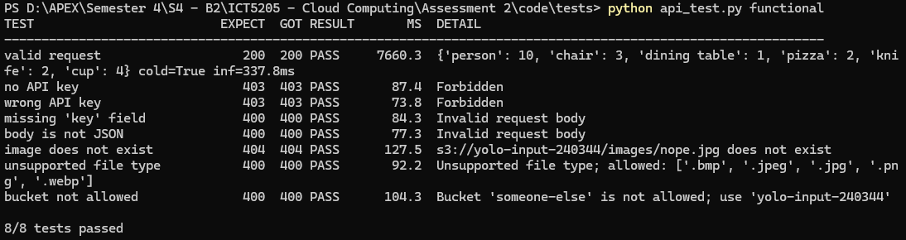


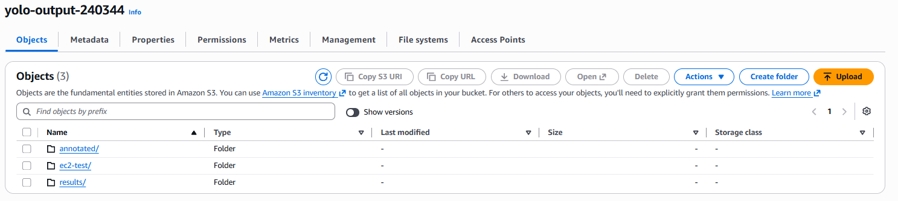

Security and functional tests: 8 out of 8 passed
API key + usage plan
No key or wrong key: 403 at API Gateway (about 80 ms). 5 requests/s, 1,000 per day.
Request validation
Missing field or invalid JSON: 400 from the gateway, Lambda is never called.
Validation in Lambda
Only my input bucket and image files; missing image gives 404, not a crash.
Least privilege + private data
Read-only on input, write-only on output, Block Public Access, SSE-S3.
Bad requests are rejected before any processing, so they cost almost nothing.

Slide 7
Cold starts: what I measured and what surprised me
7 s
0.4 s
cold start (image cached)
warm request
29 s
10 s
API Gateway limit: first call after a deploy gave 504
Lambda init limit: v1 sometimes timed out
Lesson: lazy loading removed the init timeouts but made cold starts 1.4 s slower. The real factor is whether Lambda has cached the 2 GB image. I kept eager loading and added a warm-up step after deploy.

Slide 8
Memory tuning: more memory was almost free
2.2x faster
3008 MB vs 1024 MB, whole request
+13 % cost
$0.0149 vs $0.0132 per 1000 requests
Lambda gives CPU in proportion to memory. My function uses only about 710 MB of RAM, so memory matters here only because it buys CPU. Each request finishes so much sooner that the bigger size almost pays for itself.

Slide 9
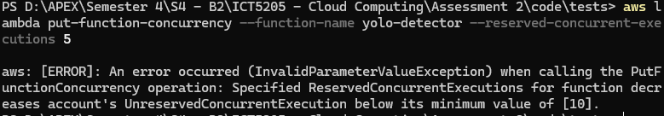
Scaling: the real bottleneck was an account limit
Load test
Burst test
Burst + client retries
20 requests, 5 at a time
40 requests, 20 at a time
same burst, exponential backoff
20 / 20
10 / 40
40 / 40
Lambda created 4 new environments automatically (4 cold starts)
Account concurrency limit is 10, so 30 were throttled and returned 500 in about 90 ms
21 requests needed a retry, slowest 3.8 s. Overload became delay, not error
Reserved and provisioned concurrency are blocked by the limit of 10. I requested an increase to 1,000 (pending). DynamoDB auto scaling (1 to 10 units at 70 %) was ready, but the busiest test used only 46 of 60 writes per minute.

Slide 10






Challenges and how I solved them
PyTorch too big for Lambda
EC2 role could not create the ECR repo
Container image from ECR, CPU-only PyTorch, headless OpenCV, all caches in /tmp.
I did not widen the role. Admin created the repo; EC2 kept push-only rights.
504 on the first call after deploy
API returned 500 instead of 429
Lambda needed 49.6 s to pull the new image. Fixed with a warm-up invoke in deploy.ps1.
Found the concurrency limit in the Lambda Throttles metric; added retries and a quota request.
Free plan blocked t3.large
DNS error when testing the API
Used m7i-flex.large: free-tier eligible with the same 8 GB RAM.
I had used the API key id in the URL. Read the real API id with the CLI.

Slide 11
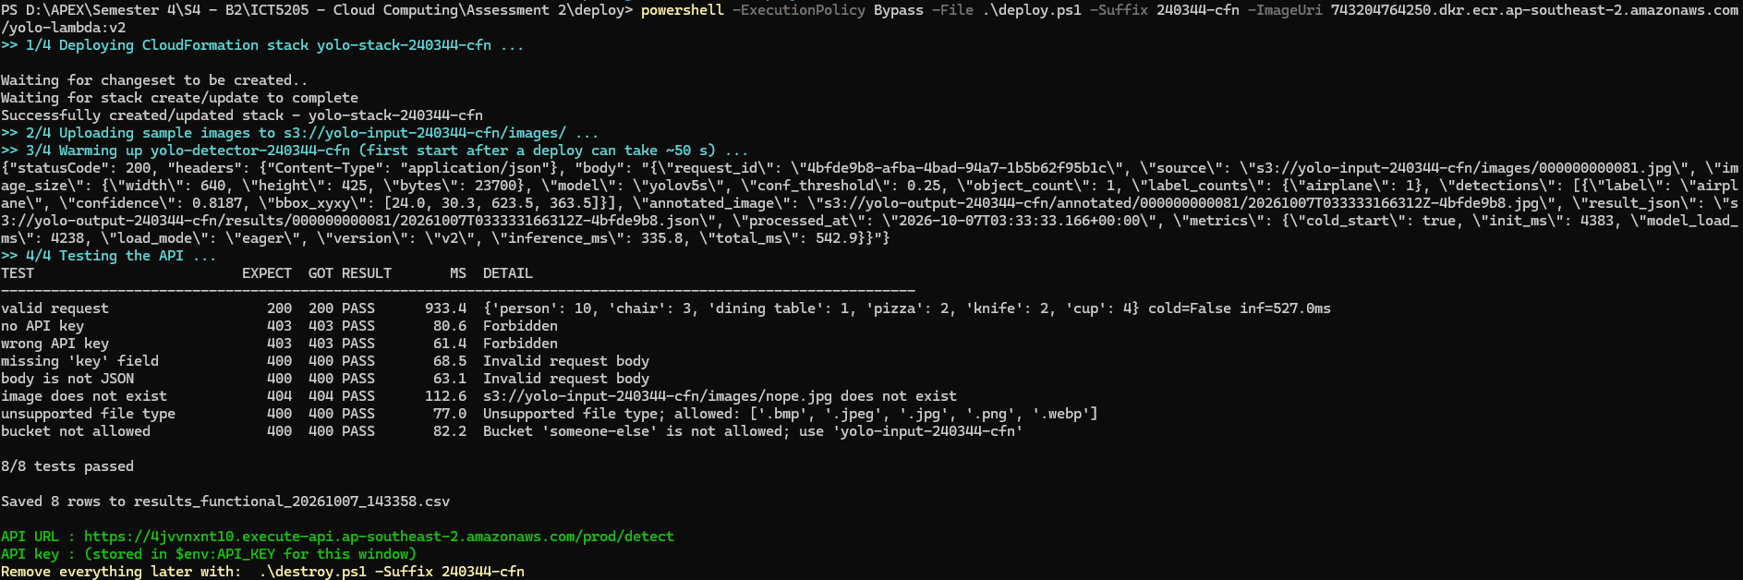
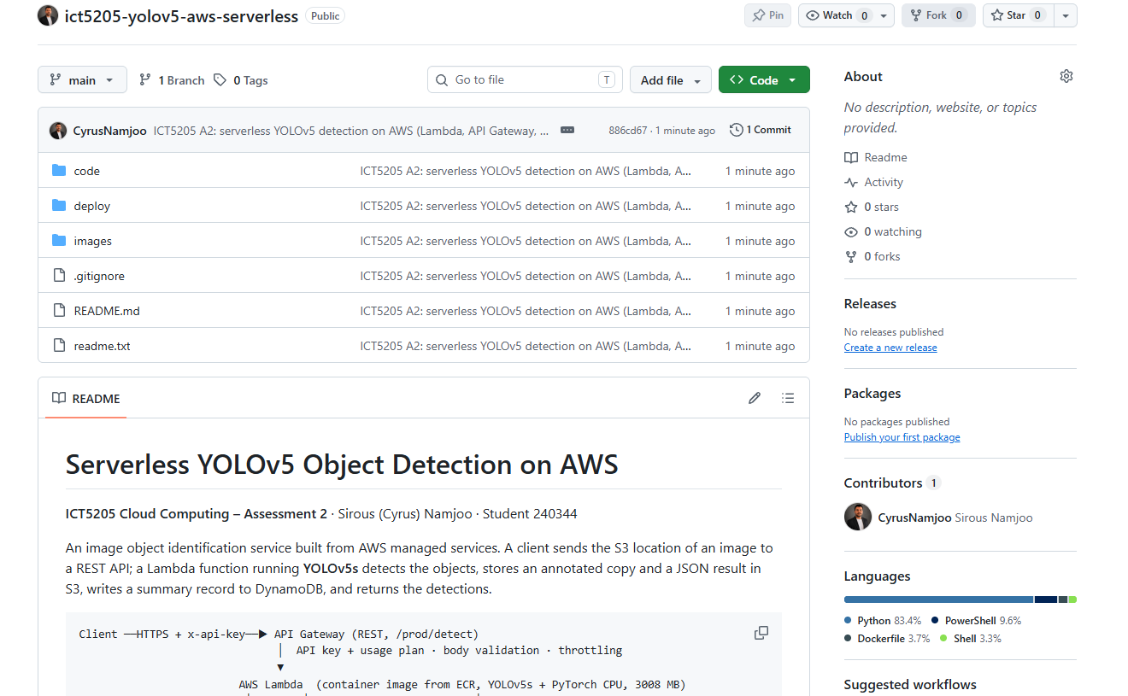
Reproducible: the whole stack from one template
21
AWS resources created by template.yaml
8 / 8
functional tests passed on the new copy
deploy.ps1: deploy, upload images, warm up, test
destroy.ps1: empty buckets and delete the stack
Template also fixes one broad IAM permission (PutObject only on results/ and annotated/)

Slide 12

Conclusion
Measure first, then optimise
Working system
What I learned
Next steps
YOLOv5 in Lambda behind a secured REST API, results in S3 and DynamoDB, 0.4 s warm
My optimisation idea was wrong, the data showed the real causes: image caching and an account limit
Scheduled warm-up, SQS queue for bursts, upload page with pre-signed URLs, higher concurrency
Thank you | github.com/CyrusNamjoo/ict5205-yolov5-aws-serverless

