Slide 1
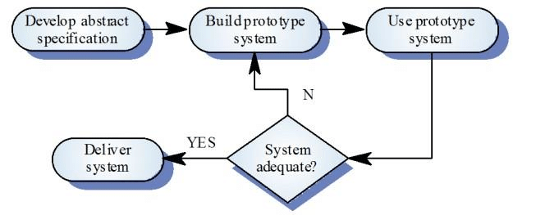

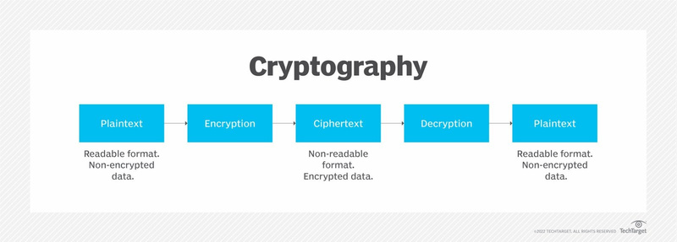
1)Background
AIM
To develop a chat application which employ end-to-end encryption and allows users to send and receive messages
Chat Application Features
To send text messages, we will create a Message model with for the sender, recipient, timestamp, and message content. Using the Message model, we will define the view that receives a POST request with the necessary message data and saves it to the database.
Chat conversation storage: The message model will be used to store conversation history.
Creation and modification of chat member data: We will create a ChatMember model with fields for the user, the conversation they are a member of and other data.
Conclusion
Users must register and log in to communicate with other users using the chat application. Users can select and delete their messages, send messages, and search for other registered users.
The chat application can encrypt user messages for security and privacy to address most current applications' issues.
In conclusion, integrating end-to-end encryption in chat applications is crucial for giving users a secure interaction system
Maintaining data security during transmission requires the use of cryptography. This involves encryption (ciphering) and decryption (deciphering). Encryption transforms the original message into a coded message. The inverse of encryption is decryption.
Some cryptography algorithms include:
RivestShamirAdleman
elliptic curve cryptography
advanced encryption standard
data encryption standard (DES)
RSA and ECC are the most common cryptography algorithms. ECC has been shown to have a smaller key size than RSA while offering a similar quality of security as RSA . With this advantage, ECC has been found suitable for devices, such as smartphones, that have limited resources.
The most common operating system platforms are Android and iOS. Consequently, Android messaging platforms are more susceptible to attacks from hackers and unauthenticated persons; hence the need for better security and encryption of messages and files. Essentially, to promote user privacy, communication systems must employ regulating frameworks such as end-to-end encryption (E2EE).
Methodology
Evolutionary prototyping methodology was used:

