Slide 1

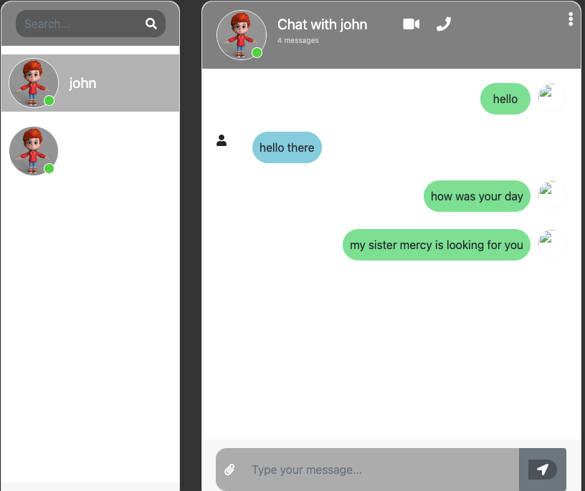
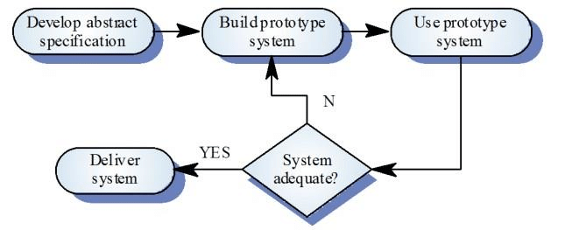
Please insert the title of your project here
Name, Programme, Department of Computer and Information Sciences
Project Aims
Research Questions
Since the research is centered on broken cryptography and end-point security, and the methodology of choice is a systematic review, the questions guide the solution development process. They include the following:
How do machines break cryptography and can service providers still manage to spy after the implementation of peer-to-peer encryption?
How can future developers of apps compensate for the loopholes?
What are the options for improving end-point security?
Project Aims
Conduct literature review for current E2EE landscape and end-point security
Create requirements specifications for the application
Facilitate end-to-end encryption of information
Test the applications developed against the requirement specification
Problem statement
Broken cryptography is a significant challenge facing chat applications. The main broken cryptography point of concern for this research is the need for peer-to-peer encryption in some systems in favor of server-to-peer encryption only. Findings show disparities in implementing security features, with some systems disregarding peer-to-peer encryption, leaving loopholes that service providers can use to eavesdrop on their networks. In any case, one can combine the different technologies used across the platforms to develop an efficient solution. The challenge of preventing third-party access at either endpoint remains even after fixing the broken cryptography issue. The research identifies preventing screenshots as a potential solution to third-party interference. The two points of concern are broken cryptography and third-party access at terminals.
Project Details
Project Results
Proposed Solution
To solve the problem, it was decided to develop a chat application that employs end-to-end encryption, which allows users to send and receive messages.
Software Development Methodology
Evolutionary prototyping methodology was used. The steps following in this methodology include:
Chat Application Main Features
The main chat application features include the following:
Send text messages: Allows user to send and receive messages.
Chat conversation storage: Store the conversation history.
Some of the application user interface:
Conclusions/Future Work
Users must register and log in to communicate with other users using the chat application. Users can select and delete their messages, send messages, and search for other registered users.
The chat application can encrypt user messages for security and privacy to address most current applications' issues.
Future Work
It is therefore recommend the use of Android technology for the development of the chat application.
Bibliography
Ali, A. & Sagheer, A. M. 2017. Design and implementation of secure chatting application with end to end encryption. Journal of Engineering and Applied Sciences, 12, 156-160.
Ermoshina, K., Musiani, F. & Halpin, H. 2016. End-to-end encrypted messaging protocols: An overview. Internet Science: Third International Conference, INSCI 2016, Florence, Italy, September 12-14, 2016, Proceedings 3, 2016. Springer, 244-254.
.
This presentation poster was designed by FPPT.
Notes:
You can add your presentation notes here. This presentation template for research posters is fully editable so text, graphics and content can be updated to fit your own research needs.
Download more poster presentation templates from FPPT.com

