Slide 1

University of Asia Pacific
Course code: CSE 316
Course title: Peripheral and Interfacing
Submitted by: Submitted to:
Name : Ashik E Elahi Abdullah Al Omar
ID:17201028 Lecturer, Dept of CSE
University of Asia Pacific
Name : Nime Molla
ID : 17201028
Section: A1

Slide 2

Project - Temperature Data Logger

Slide 3
Project Details
In this project , we will attempt to record temperature using Arduino micro computer system. We will use DS18B20 sensor to read temperature and DS3231 Real Time Clock chip to track time and data information. Time , date and temperature values will be displayed in 20x4 LCD screen and saved in a SD card .
And all these sensor and electronics will be controlled Arduino Uno.

Slide 4
Software Requirements
Proteus 8 Professional
Arduino
Winimage

Slide 5
Component Requirements
Arduino Uno
Micro SD card with FAT16 File system
Micro SD card module
20x4 LCD screen
DS18B20 temperature sensor
DS3231 Module
4.7k Ohm resistor

Slide 6
Component Requirements
10K Ohm variable resistor
330 Ohm resistor
Two Push Button
3v coin battery
Breadboard
Jumper wire

Slide 7
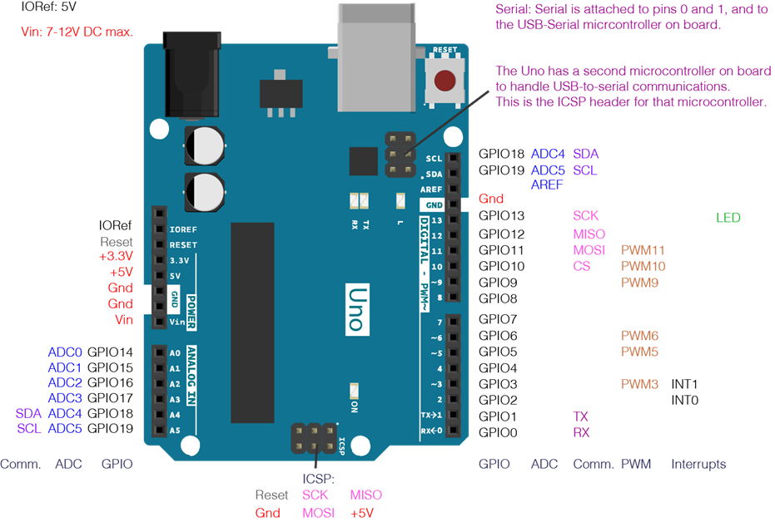
Arduino Uno
Arduino Uno is a microcontroller board based on the ATmega328P. It has 14 digital input/ output pins , 6 analog inputs , a 16 MHz crystal oscillator, a USB connection, a power jack, an ICSP header and a reset button.

Slide 8
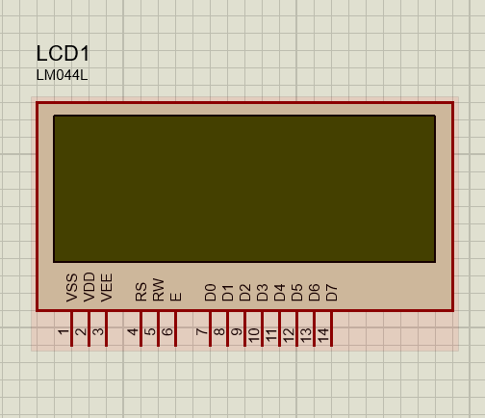
20x4 LCD Screen

Slide 9
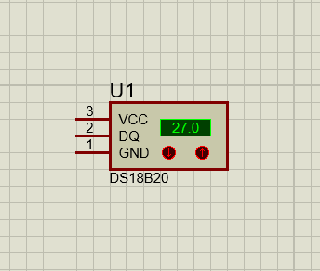
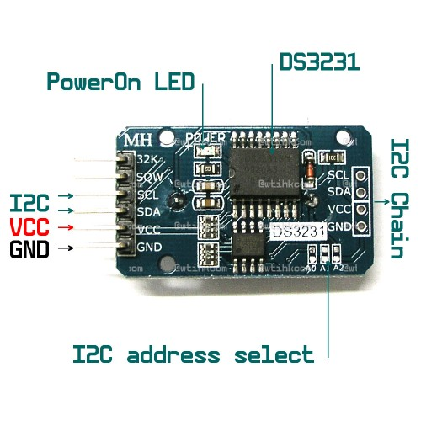
DS18B20 Sensor
DS3231 RTC

Slide 10
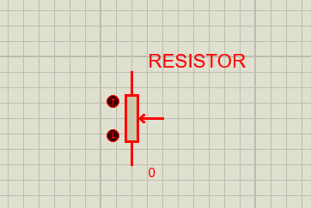
Resistor
330 Ohm
4.7K Ohm
10k Ohm

Slide 11
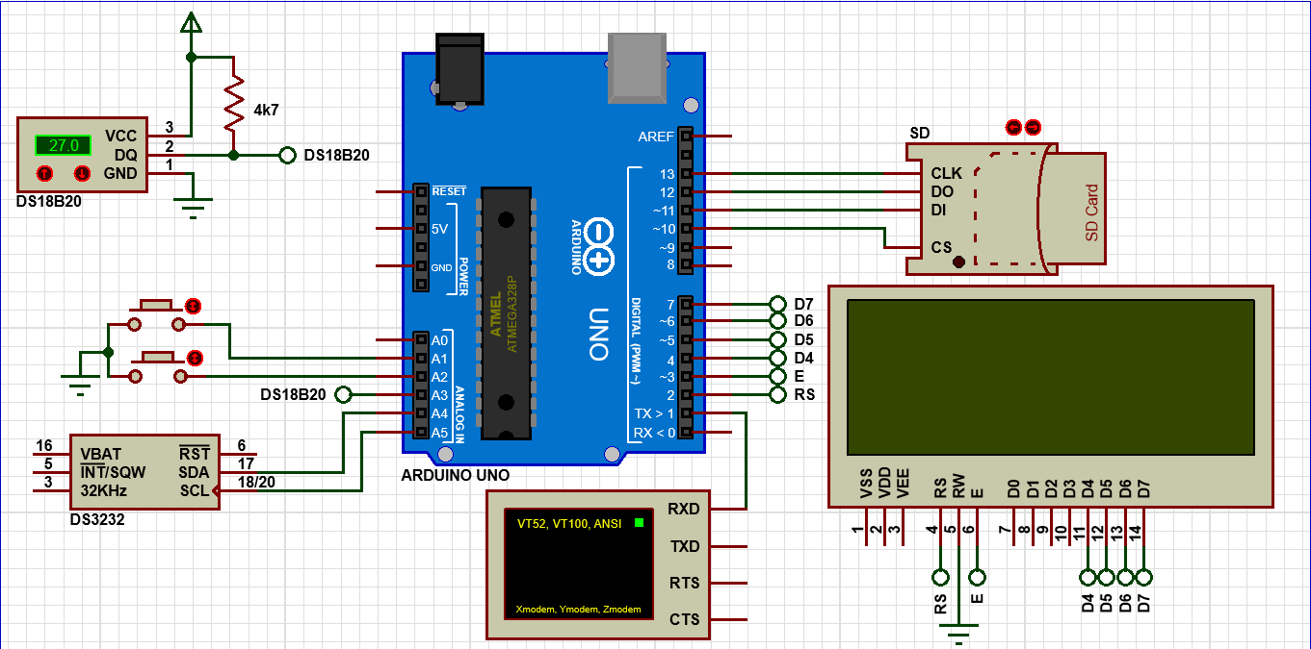
Circuit Diagram

Slide 12
Fin

