Slide 1
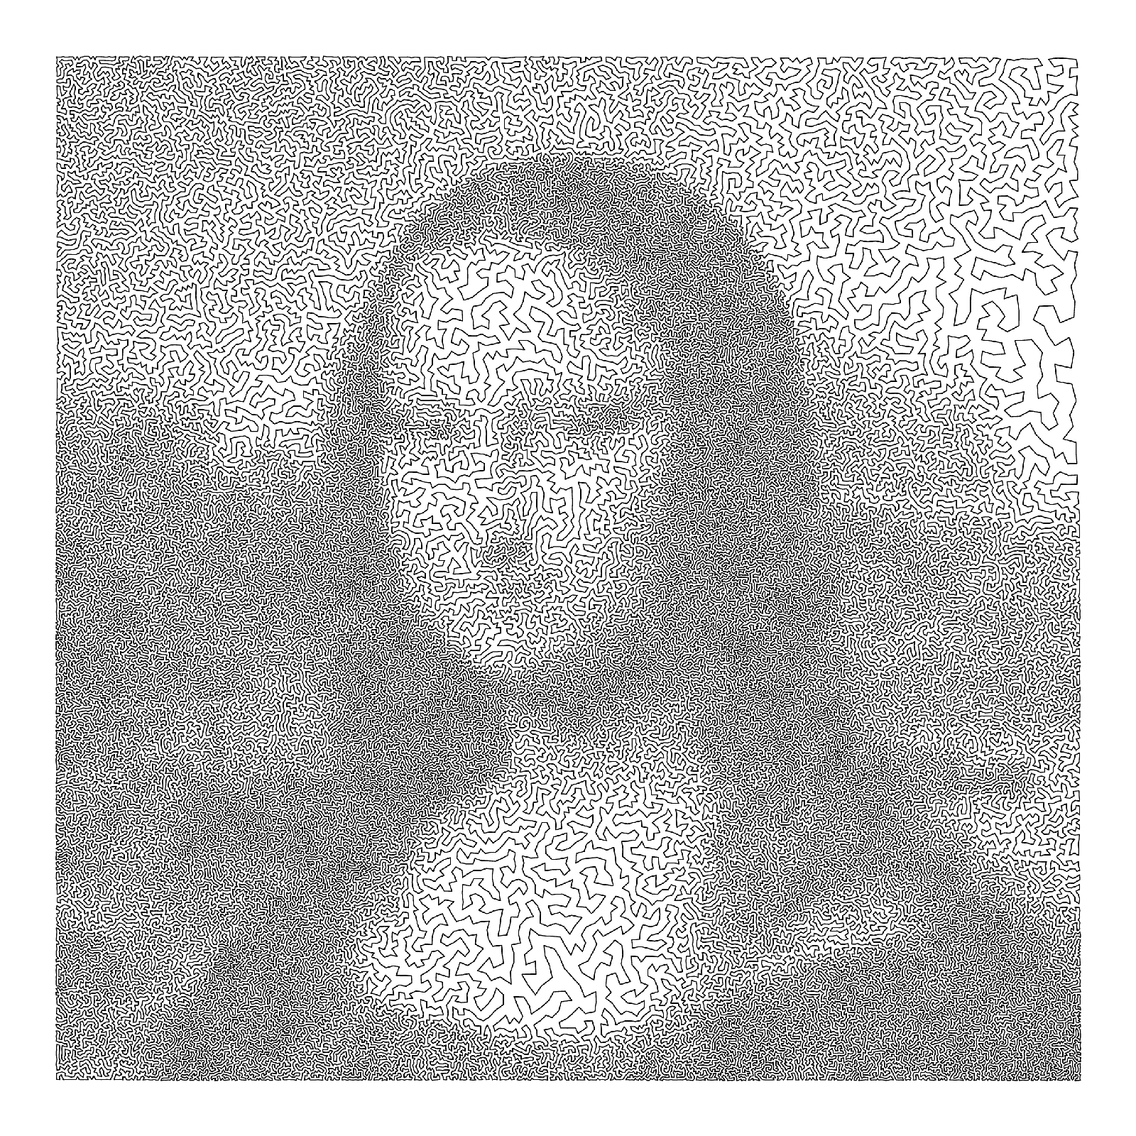
Traveling Salesman Problem
Parallel Approximate
Algorithm
Tong Xiao, Jiaxin Mao, Zhen Ru
Notes:
Hello everyone! It’s our pleasure to present our final project here. In the project, we focused on traveling salesman problem, which is well known and studied for a long time. We tried to solve it by using two kinds of parallel approximate algorithms. Now let’s begin.

Slide 2
Content
Introduction
TSP and its complexity
Goal
What did we want to do?
Works
What have we done?
Summary
Notes:
Our presentation is divide into 4 parts, first we’d like to introduce the TSP and the variant we tried to solve. And then we will b show the aims of our project. After that we’d like to show the works we did, including the implementation of algorithms and the experiment result of our program. Finally a brief summary will be given.

Slide 3
Navigator
Intro
Goal
Works
Summary

Slide 4
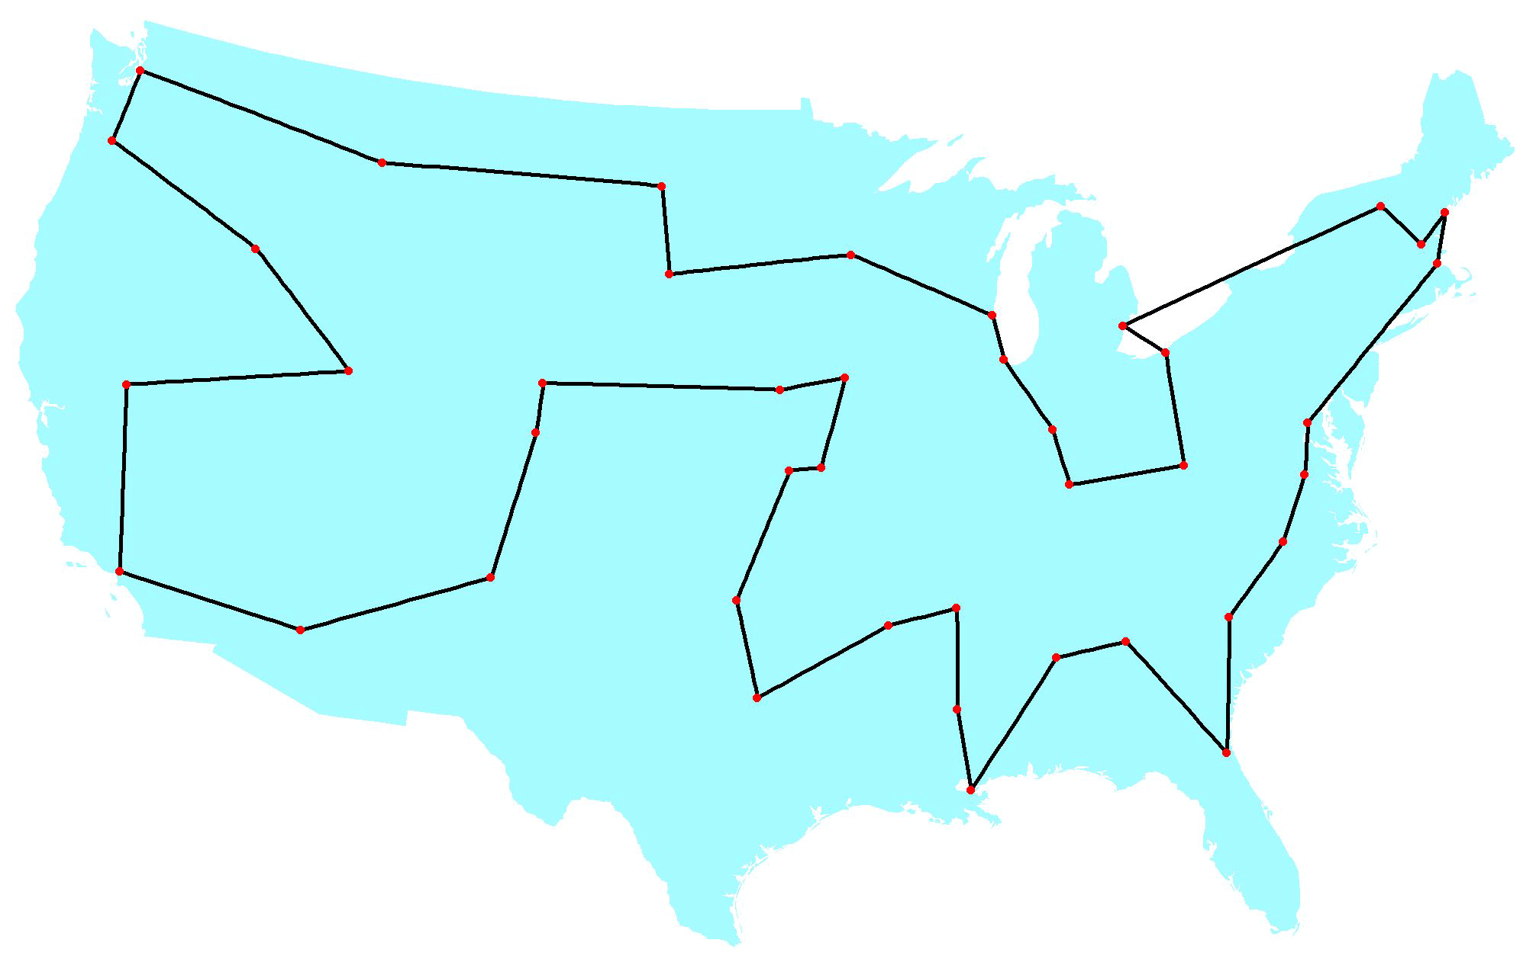
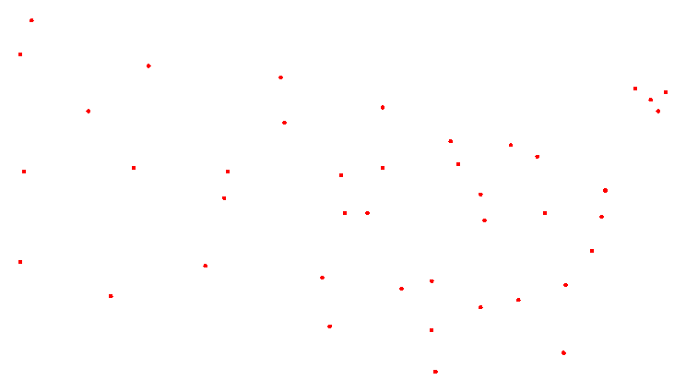
T S P
Description
Shortest circle
Notes:
I think we are all very familiar with the TSP, which is to find the shortest circle that passes every node of a weighted graph exactly once. And in this project we focused on a subset of the general TSP – the 2D Euclidean TSP, in this variant of TSP, the node is given by the coordinates (x,y) in a plane, there will be an edge between every two cities, and the length equals to the Euclidean distance of two cities.

Slide 5

TSP
Complexity
NP-Hard
Dynamic Programming: $O\left(n^{2}2^{n}\right)$
9,663,676,416 when n = 30
Notes:
We all know that the TSP is NP-hard. So the best found accurate algorithm is not polynomial. In fact the best upper bound of the worse case running time of the general TSP is O(n^2 * 2 ^ n) ,which is implemented by using dynamic programming skill. But this algorithm is still limited to solve practical instances. So we need to find some other ways.

Slide 6
Navigator
Intro
Goal
Works
Summary

Slide 7
Goal
Approximate solution
Genetic Algorithm
Lin-Kernighan Algorithm
Parallelize
Faster speed vs. Better solution
Expectation
n = 100~200
Notes:
There is a lot of approximate algorithms for TSP, we chose two kinds of them-GA and LKA. We’d like to parallelize these two algorithms, either to reduce the running time or improve the quality of the solutions. Our expectation is to solve a TSP with 100-200 cities on a computer with 4 cores, in an acceptable amount of time.

Slide 8
Navigator
Intro
Goal
Works
Summary

Slide 9

G A
Description
Mate
Mate
Mate
Mate
Group 1
Group 2
Group 3
Group 4
Send genes to each other
Notes:
Our program is based on the homework of AI course. To parallelize it, we use more than one group and assign each group to a thread. Then, we make each thread run the sequential part, including mating and mutation, independently. And exchange the better part to each other each iteration.

Slide 10
Lin-Kernighan
K-opt tour
Can’t be better by changing K edges.
Target: N-opt, but impossible.
3-opt
Local Search
Maintain a tour.
Delete a longer edge. Add a shorter edge.
If the tour is better, update.
Notes:
The other algorithm we used is the Lin-Kernighan algo. First we introduce the concept of k-opt tour. We say a tour is k-opt when it can’t be improved by changing k edges. The N-opt tour is the answer of TSP, which is hard to compute, so we try to find some k-opt tours with a small k, and hope they will be good approximate answers. The LK algorithm use local search method to find 3-opt tours, and base on that, try to exchange more edges to improve the final answer.

Slide 11

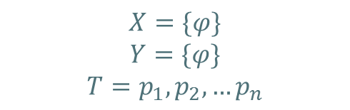



L K
Initialization
Generate a random tour $T$.
$X=\left\{φ\right\}, Y=\{φ\}.$
$$p_{1}$$
$$p_{2}$$
$$p_{n}$$
$$X=\{φ\}$$
$$Y=\{φ\}$$
$$T=p_{1},p_{2},{…p}_{n}$$
Notes:
In the implementation, we first generate a random tour T, and try to compute two set of edges X and Y that satisfy a number of conditions. And the edges in X will be replaced by the edges in Y to get a better tour. An example is shown.

Slide 12


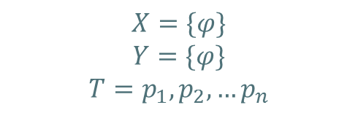


Lin-Kernighan
Search
Remove $\left(p_{1},p_{2}\right)$ from $T$, add to $X$, denotes $x_{1}$.
$$p_{1}$$
$$p_{n}$$
$$p_{2}$$
$$X=\{φ\}$$
$$Y=\{φ\}$$
$$T=p_{1},p_{2},{…p}_{n}$$

Slide 13
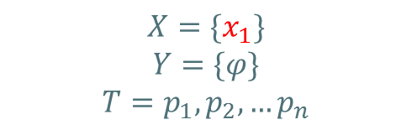
Lin-Kernighan
Search
Remove $\left(p_{1},p_{2}\right)$ from $T$, add to $X$, denotes $x_{1}$.
$$p_{1}$$
$$p_{n}$$
$$p_{2}$$
$$X=\{x_{1}\}$$
$$Y=\{φ\}$$
$$T=p_{1},p_{2},{…p}_{n}$$

Slide 14


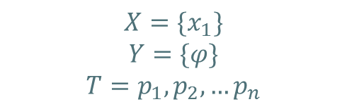
Lin-Kernighan
Search
Remove $\left(p_{1},p_{2}\right)$ from $T$, add to $X$, denotes $x_{1}$.
Choose $p_{i}$, let $y_{1}=(p_{2}$, $p_{i})$, s.t. $\left|y_{1}\right|<\left|x_{1}\right|$. Add $y_{1}$ to $Y$.
$$p_{1}$$
$$p_{n}$$
$$p_{2}$$
$$p_{i}$$
$$X=\{x_{1}\}$$
$$Y=\{φ\}$$
$$T=p_{1},p_{2},{…p}_{n}$$

Slide 15

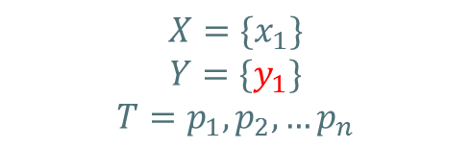
Lin-Kernighan
Search
Remove $\left(p_{1},p_{2}\right)$ from $T$, add to $X$, denotes $x_{1}$.
Choose $p_{i}$, let $y_{1}=(p_{2}$, $p_{i})$, s.t. $\left|y_{1}\right|<\left|x_{1}\right|$. Add $y_{1}$ to $Y$.
$$p_{1}$$
$$p_{n}$$
$$p_{2}$$
$$y_{1}$$
$$p_{i}$$
$$X=\{x_{1}\}$$
$$Y=\{y_{1}\}$$
$$T=p_{1},p_{2},{…p}_{n}$$

Slide 16
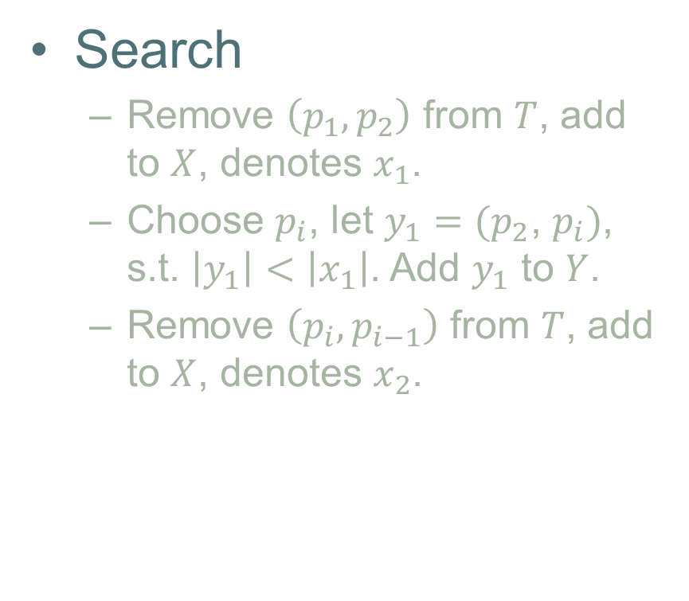
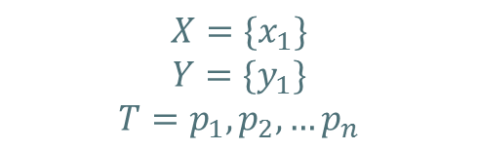

Lin-Kernighan
Search
Remove $\left(p_{1},p_{2}\right)$ from $T$, add to $X$, denotes $x_{1}$.
Choose $p_{i}$, let $y_{1}=(p_{2}$, $p_{i})$, s.t. $\left|y_{1}\right|<\left|x_{1}\right|$. Add $y_{1}$ to $Y$.
Remove $\left(p_{i},p_{i−1}\right)$ from $T$, add to $X$, denotes $x_{2}$.
$$p_{1}$$
$$p_{n}$$
$$p_{2}$$
$$y_{1}$$
$$p_{i−1}$$
$$p_{i}$$
$$X=\{x_{1}\}$$
$$Y=\{y_{1}\}$$
$$T=p_{1},p_{2},{…p}_{n}$$

Slide 17
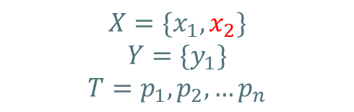
Lin-Kernighan
Search
Remove $\left(p_{1},p_{2}\right)$ from $T$, add to $X$, denotes $x_{1}$.
Choose $p_{i}$, let $y_{1}=(p_{2}$, $p_{i})$, s.t. $\left|y_{1}\right|<\left|x_{1}\right|$. Add $y_{1}$ to $Y$.
Remove $\left(p_{i},p_{i−1}\right)$ from $T$, add to $X$, denotes $x_{2}$.
$$p_{1}$$
$$p_{n}$$
$$p_{2}$$
$$y_{1}$$
$$p_{i−1}$$
$$p_{i}$$
$$X=\{x_{1},x_{2}\}$$
$$Y=\{y_{1}\}$$
$$T=p_{1},p_{2},{…p}_{n}$$

Slide 18
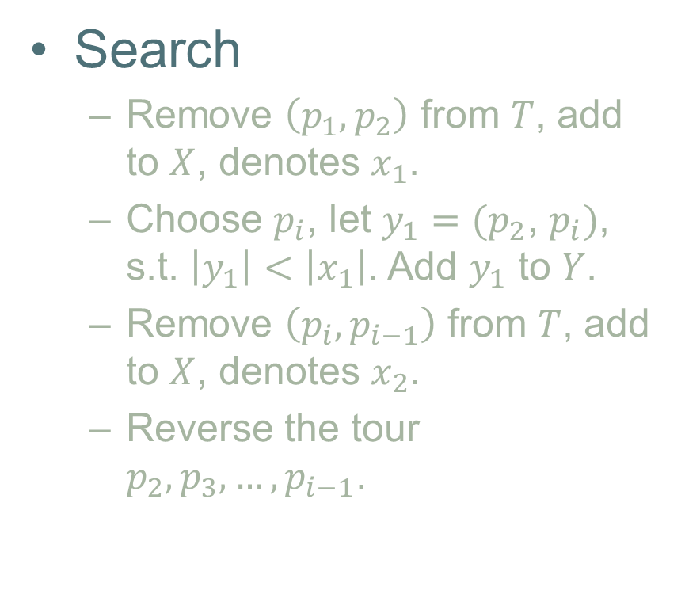
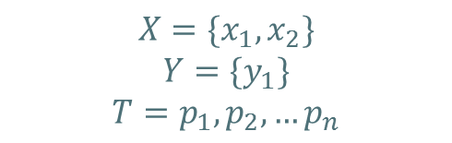
Lin-Kernighan
Search
Remove $\left(p_{1},p_{2}\right)$ from $T$, add to $X$, denotes $x_{1}$.
Choose $p_{i}$, let $y_{1}=(p_{2}$, $p_{i})$, s.t. $\left|y_{1}\right|<\left|x_{1}\right|$. Add $y_{1}$ to $Y$.
Remove $\left(p_{i},p_{i−1}\right)$ from $T$, add to $X$, denotes $x_{2}$.
Reverse the tour $p_{2},p_{3},…,p_{i−1}$.
$$p_{1}$$
$$p_{n}$$
$$p_{2}$$
$$y_{1}$$
$$p_{i−1}$$
$$p_{i}$$
$$X=\{x_{1},x_{2}\}$$
$$Y=\{y_{1}\}$$
$$T=p_{1},p_{2},{…p}_{n}$$

Slide 19

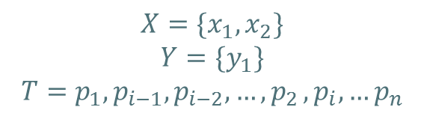

Lin-Kernighan
Search
Remove $\left(p_{1},p_{2}\right)$ from $T$, add to $X$, denotes $x_{1}$.
Choose $p_{i}$, let $y_{1}=(p_{2}$, $p_{i})$, s.t. $\left|y_{1}\right|<\left|x_{1}\right|$. Add $y_{1}$ to $Y$.
Remove $\left(p_{i},p_{i−1}\right)$ from $T$, add to $X$, denotes $x_{2}$.
Reverse the tour $p_{2},p_{3},…,p_{i−1}$.
$$p_{1}$$
$$p_{n}$$
$$p_{i−1}$$
$$p_{2}$$
$$p_{i}$$
$$X=\{x_{1},x_{2}\}$$
$$Y=\{y_{1}\}$$
$$T=p_{1},p_{i−1},p_{i−2},…{,p}_{2},{p_{i},…p}_{n}$$

Slide 20

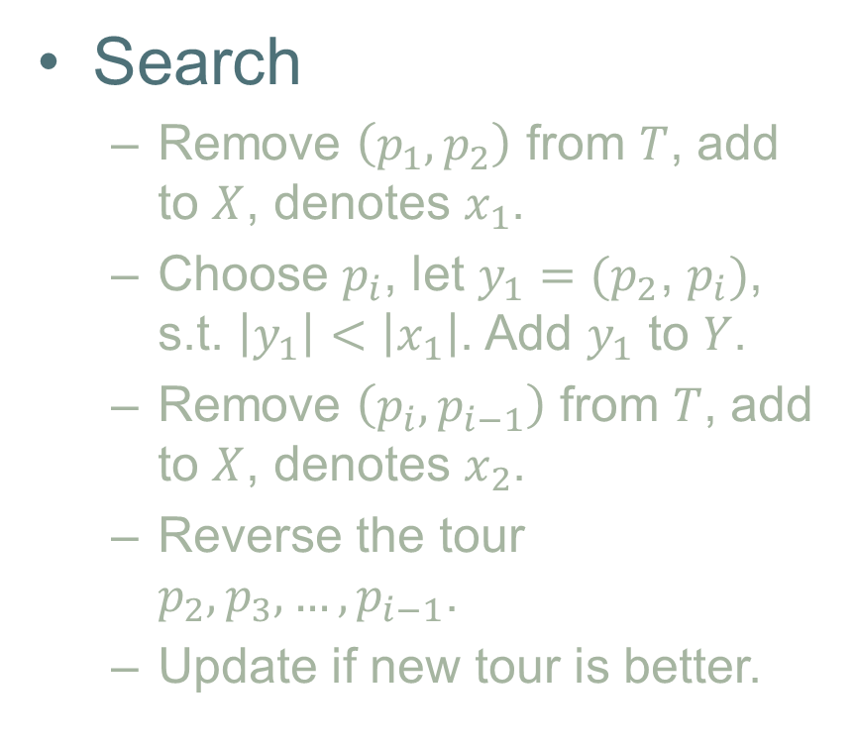

Lin-Kernighan
Search
Remove $\left(p_{1},p_{2}\right)$ from $T$, add to $X$, denotes $x_{1}$.
Choose $p_{i}$, let $y_{1}=(p_{2}$, $p_{i})$, s.t. $\left|y_{1}\right|<\left|x_{1}\right|$. Add $y_{1}$ to $Y$.
Remove $\left(p_{i},p_{i−1}\right)$ from $T$, add to $X$, denotes $x_{2}$.
Reverse the tour $p_{2},p_{3},…,p_{i−1}$.
Update if new tour is better.
$$p_{1}$$
$$p_{n}$$
$$p_{i−1}$$
$$p_{2}$$
$$p_{i}$$
$$X=\{x_{1},x_{2}\}$$
$$Y=\{y_{1}\}$$
$$T=p_{1},p_{i−1},p_{i−2},…{,p}_{2},{p_{i},…p}_{n}$$

Slide 21










L K
Notes
$x_{i}$ can’t be in $Y$ when selecting.
$y_{i}$ can’t be in $X$ when selecting.
Enumerate $x_{1},y_{1},y_{2}$, others are chosen uniquely.
Select the nearest valid $y_{i}$ .
$$p_{1}$$
$$p_{2}$$
$$p_{n}$$
$$y_{1}$$
$$y_{2}$$
$$p_{i−1}$$
$$p_{j}$$
$$p_{j−1}$$
$$p_{i}$$

Slide 22
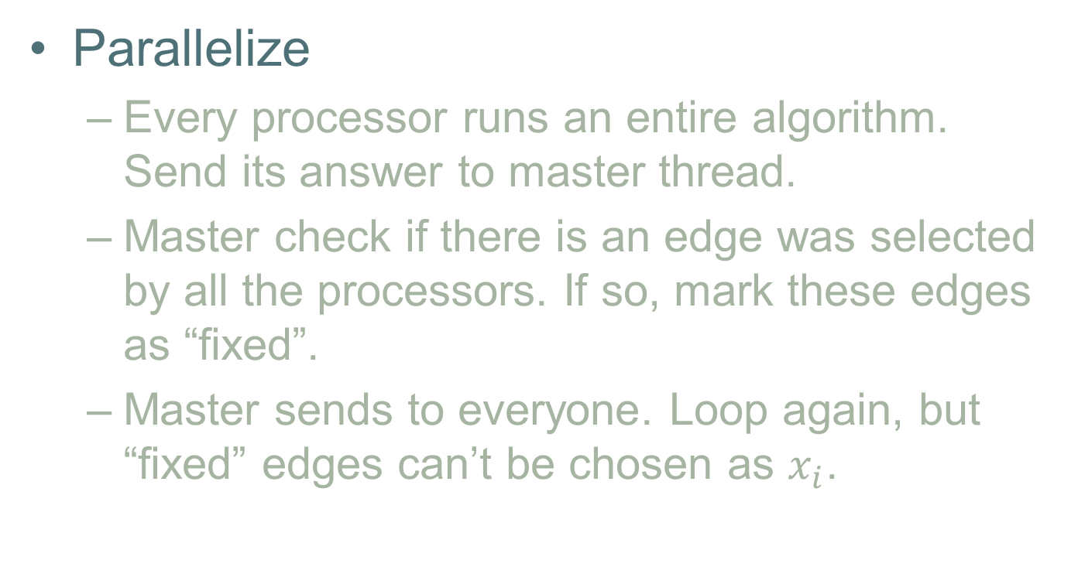
Lin-Kernighan
Parallelize
Every processor runs an entire algorithm. Send its answer to master thread.
Master check if there is an edge was selected by all the processors. If so, mark these edges as “fixed”.
Master sends to everyone. Loop again, but “fixed” edges can’t be chosen as $x_{i}$.

Slide 23
L K
Performance
More processors, more better answer.
“Fixed” edges let the program run faster.
Threads
Notes:
The performance of the parallelization is shown in this graph. When the number of threads is increasing, the length of the tour is getting smaller, but due to the overhead cost of communication, the running time also increases. And because the machine we use has only four processors, when the number of thread is more than 4, the running time doubles.

Slide 24
Lin-Kernighan
Performance
Cities | Opt Len | LK / GA | Difference | Time(s)
52 | 7544 | 7544 / 7567 | 0% / 0.3% | 2.44
130 | 6110 | 6110 / 7806 | 0% / 27.7% | 7.33
150 | 6531 | 6531 / 8012 | 0% / 22.7% | 9.61
225 | 3859 | 3888 / | 0.75% | 54.83
Test data from TSPLIB
Notes:
Then opt tour we computed and the running time of the program is in this chart. Notice that the for a instance that has about 100 cities, our program may be able to find the best tour in a short time.

Slide 25
Navigator
Intro
Goal
Works
Summary

Slide 26
Summary
TSP
Approximate Algorithm
Parallelize
NP-hard
Answer is not good
Better answer
GA
LK
“Fixed” speed up
Notes:
We focused on the TSP, and try to solve some practical instances, but although we can use more threads we still can’t catch up with the expontentionly increasing time complexity. So we try some approximate algorithms, but the quality of the answer is dependent on RP and the number of iterations, so we parallelize these algorithms and use some refinement to improve the performance.

Slide 27
Navigator
Intro
Goal
Works
Summary

Slide 28
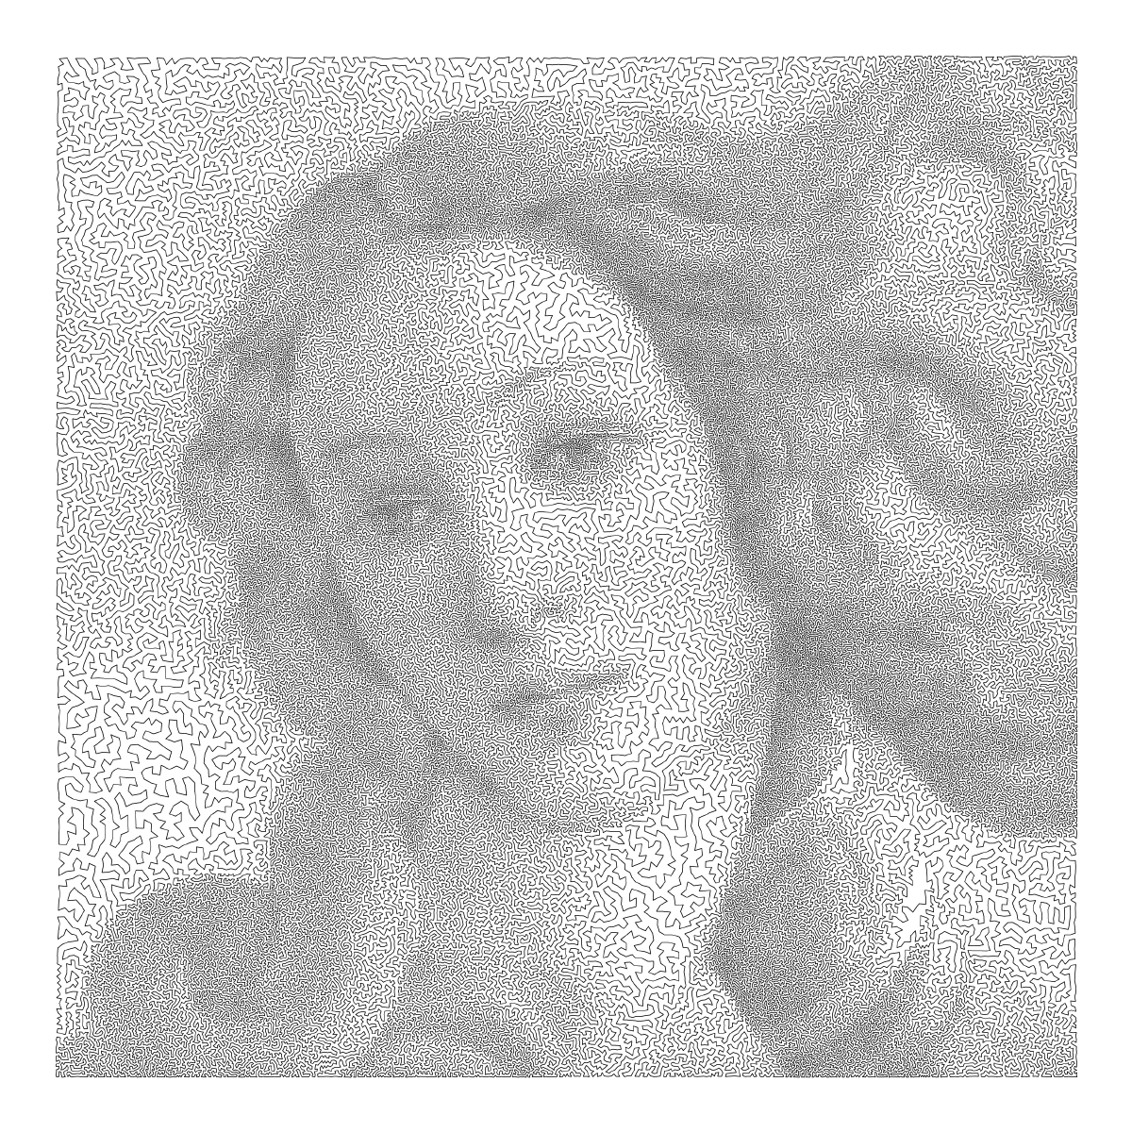
Traveling Salesman Problem
Thanks!
Tong Xiao, Jiaxin Mao, Zhen Ru

